Slide 1
Strategies: Using Photos as Thinking Prompts
AP Human Geography
Kristi Neuroth

Slide 2
Why use photos as thinking prompts?
Generate curiosity.
Build observational skills.
Practice GSI (“Geography Scene Investigation”) skills.
Help students learn how to effectively and thoroughly analyze visual stimuli.
Accompanying Documents:
“Photo Fridays” Student Questions Document

Slide 3
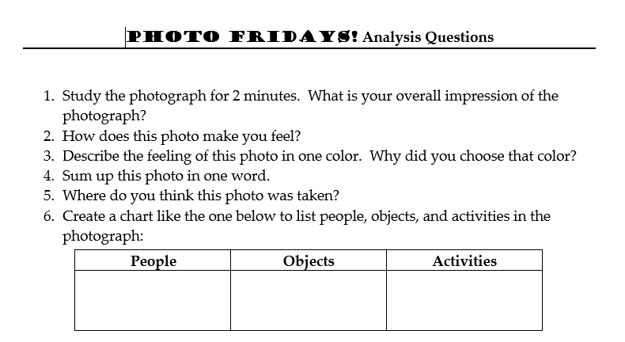

Slide 4
Strategy #1: Photo Fridays

Slide 5
PHOTO FRIDAY! Questions # 1, 5, 8, 11, 12

Slide 6
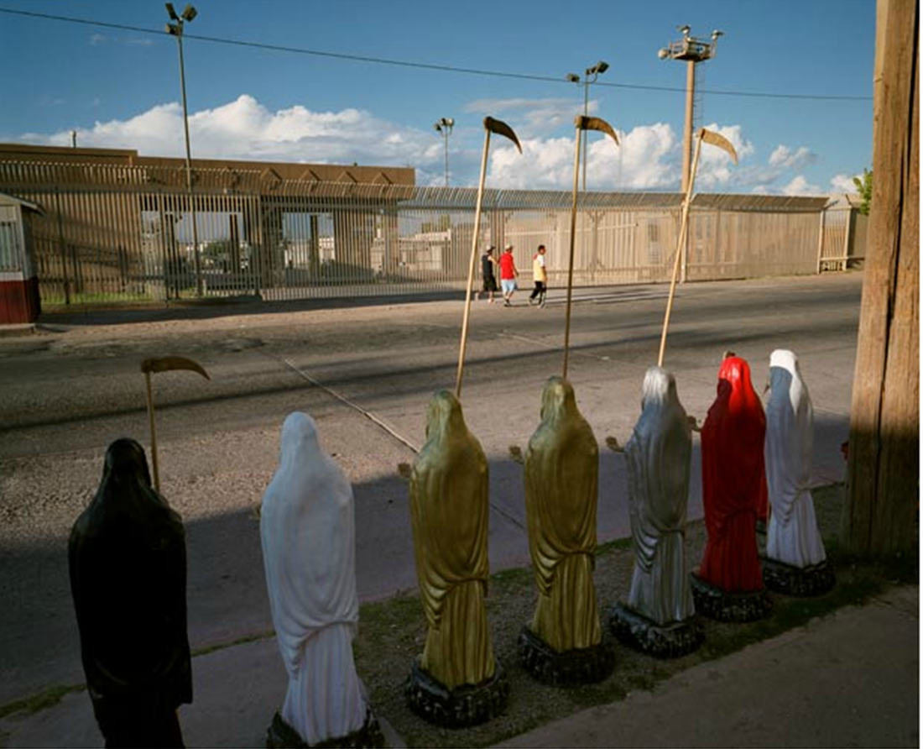

Slide 8
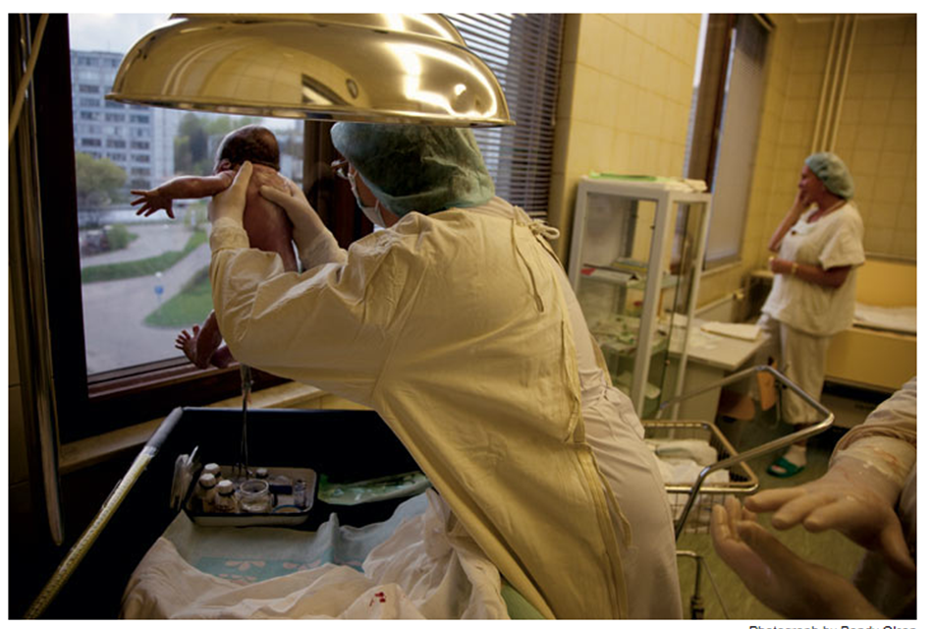
Questions 1,3,5,10

Slide 9
Strategy #2: Multiple Photos

Slide 10
Questions 1,11,16

Slide 12
Strategy #3: Photo Reveal

