Slide 1
The Continent of Africa

Slide 2
An overview

Slide 3
Comparative Information
The continent of Africa covers nearly 12 million square miles (31 million sq. km).
How big is that, you wonder? It's BIG! Africa could hold the land occupied by China, India, Europe, Argentina, New Zealand and the continental United States, with room to spare!
It’s Big

Slide 4
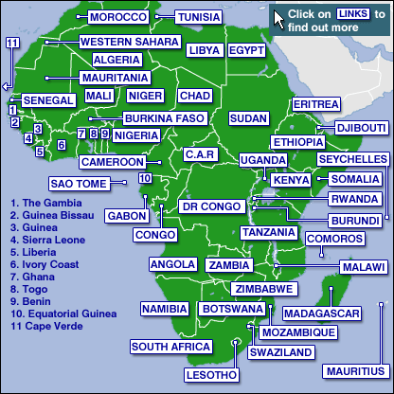
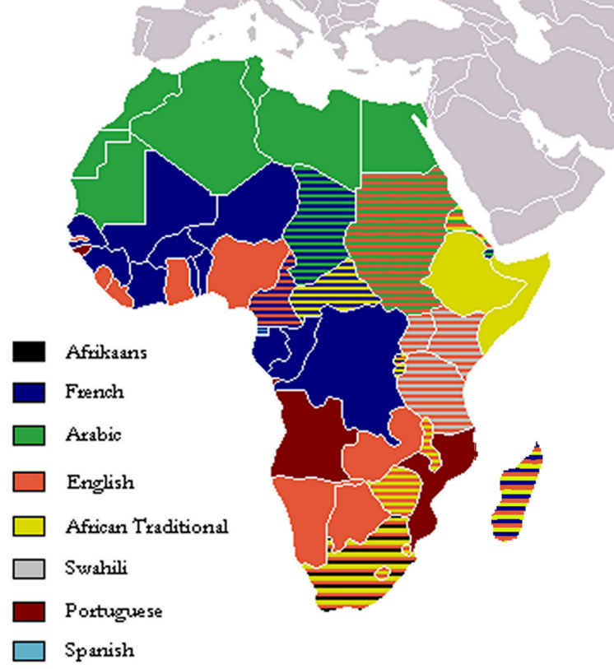
Comparative Information
53 Including islands
Over 2,000
Many Countries
Many Languages

Slide 5
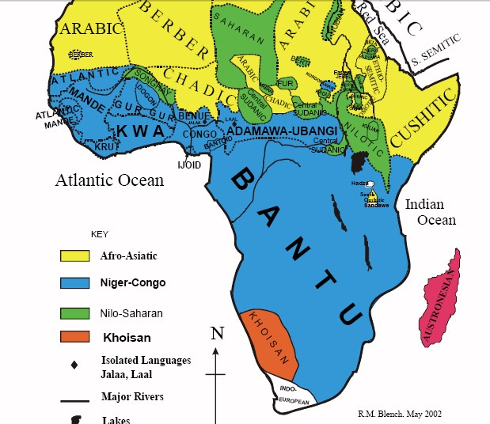
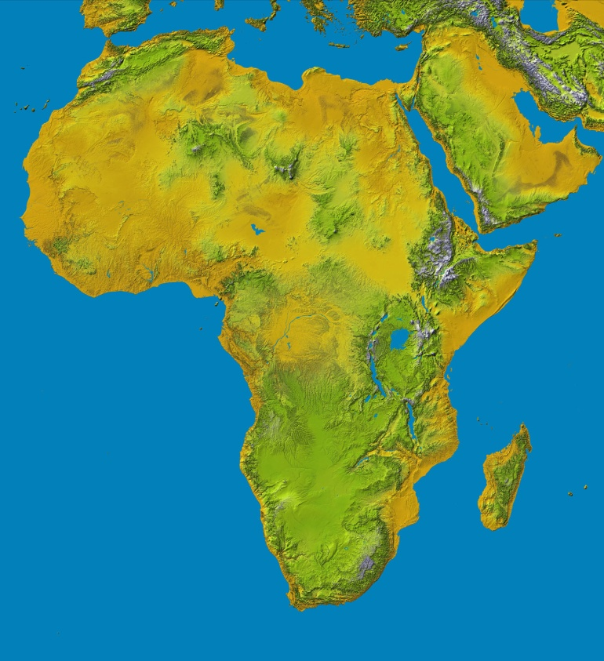
Comparative Information
Many people
Different topography

Slide 6
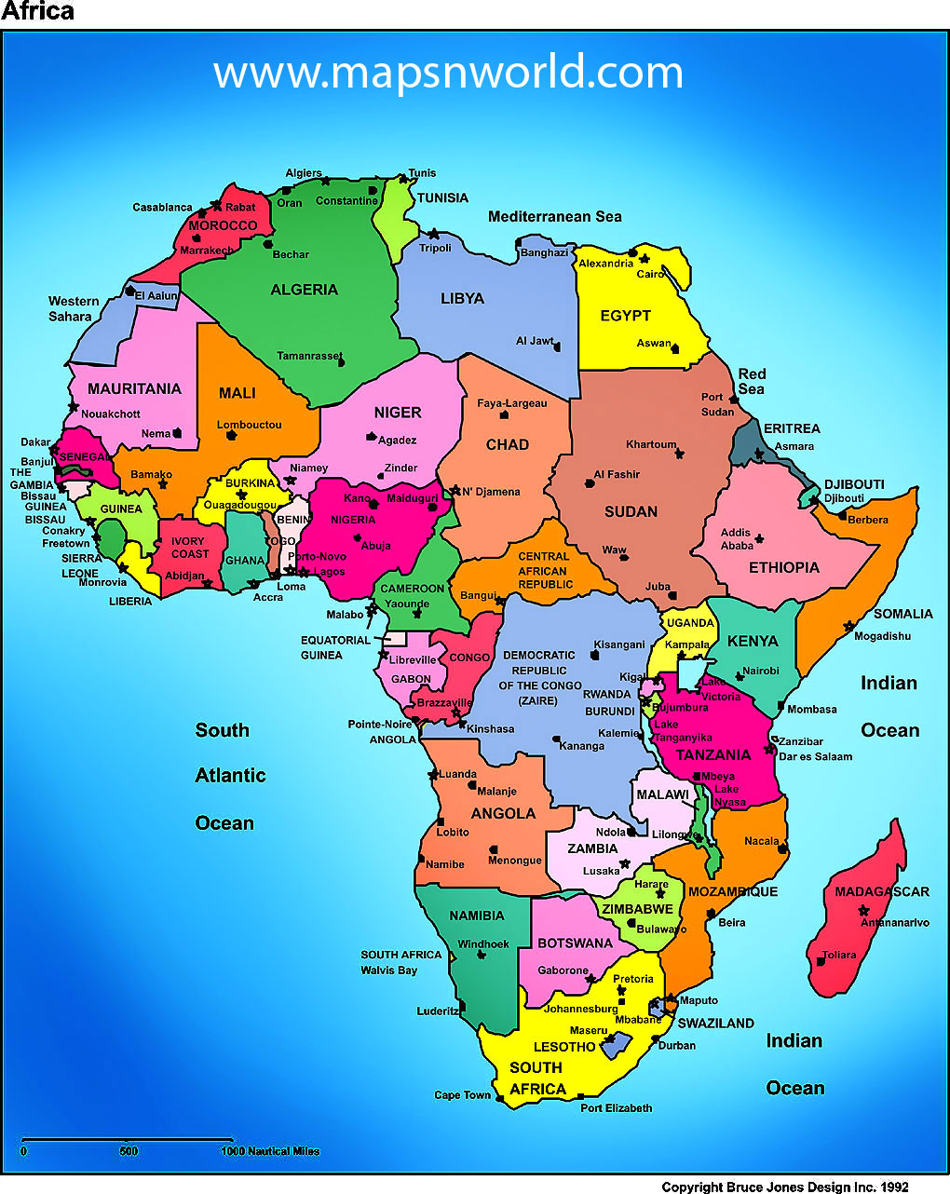

Slide 7
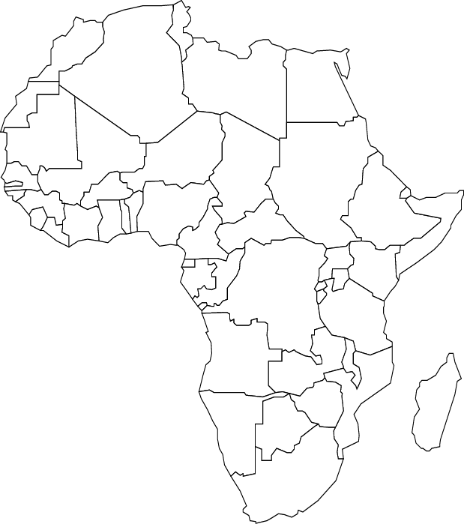

Slide 8
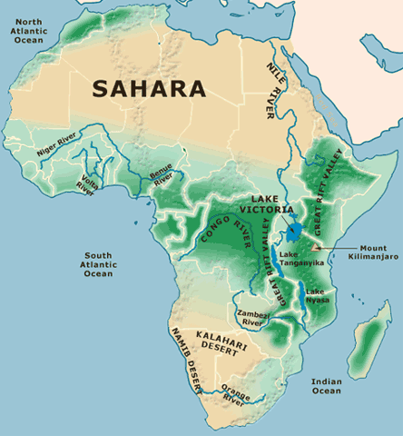

Slide 9
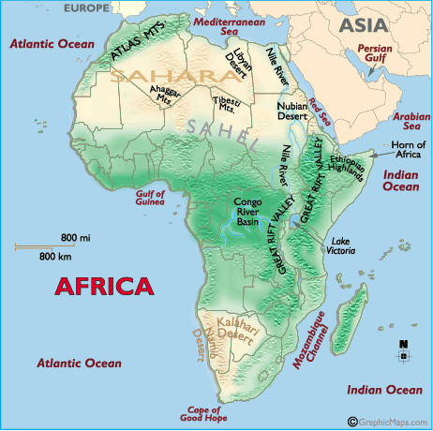
Scenery – Major Landforms
Congo River Basin
1.4m square miles
20% of world rain forests
Atlas Mountains
North western Africa
Great Rift Valley
4,000 miles long – Red Sea to Mozambique
Series of geological faults formed by volcanoes
Includes Mt Kilimanjaro – highest mountain in Africa
Nile River System
World’s longest river (4,160 miles)
Sahel
Transition zone between desert and fertile land
Sahara Desert
1/3 of the continent – 3.5M sq. miles
Elevation -100ft to 11,000 ft

Slide 10
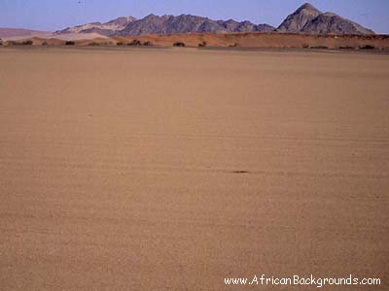
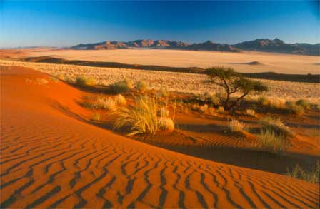
Scenery - Deserts
Deserts of the World

Slide 11
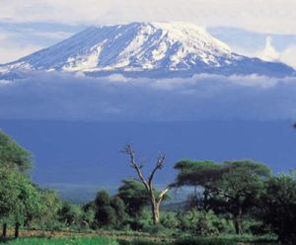
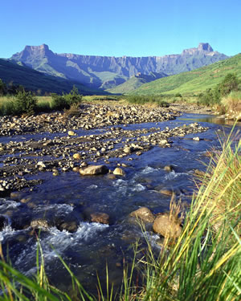
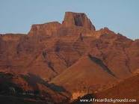
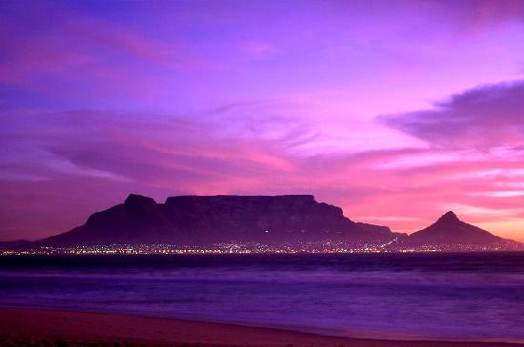
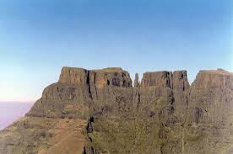
Scenery - Mountains

Slide 12
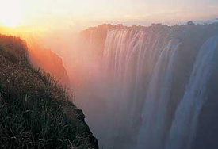
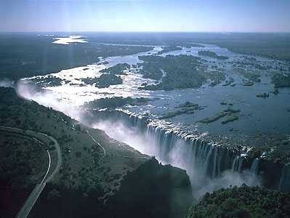
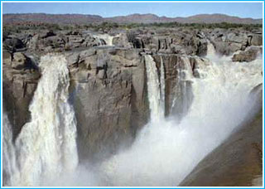
Scenery - Waterfalls

Slide 13
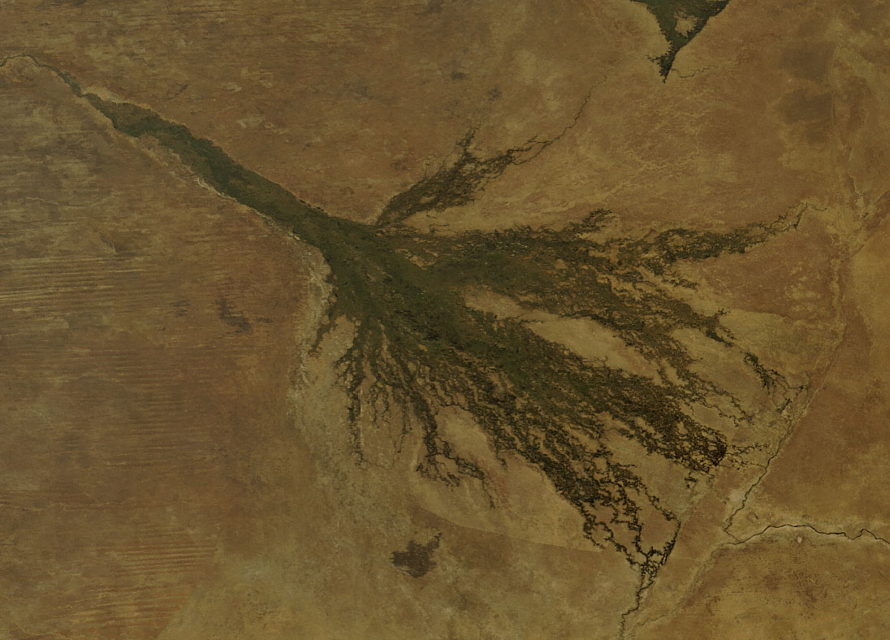
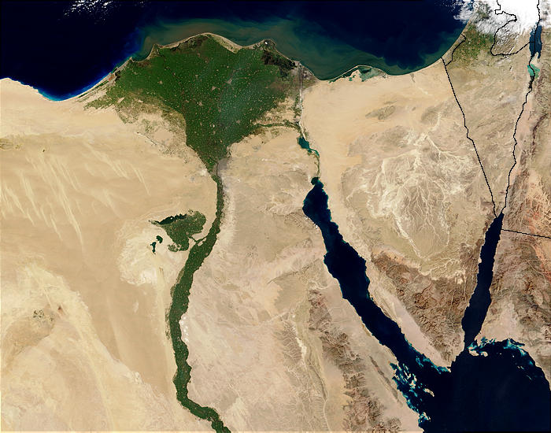
Major Deltas

Slide 14
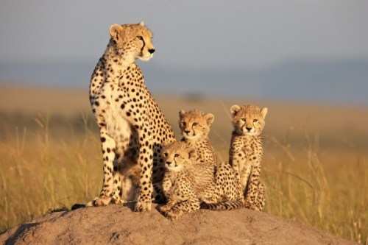
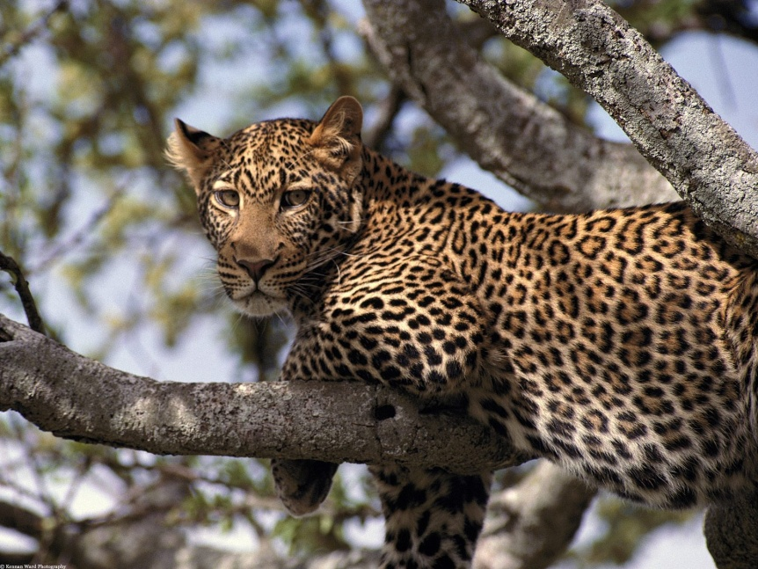
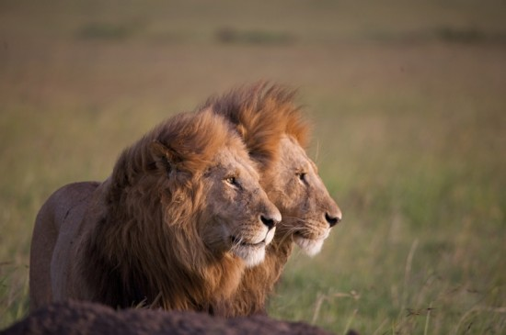
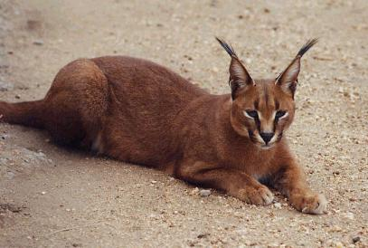
African Animals

Slide 15
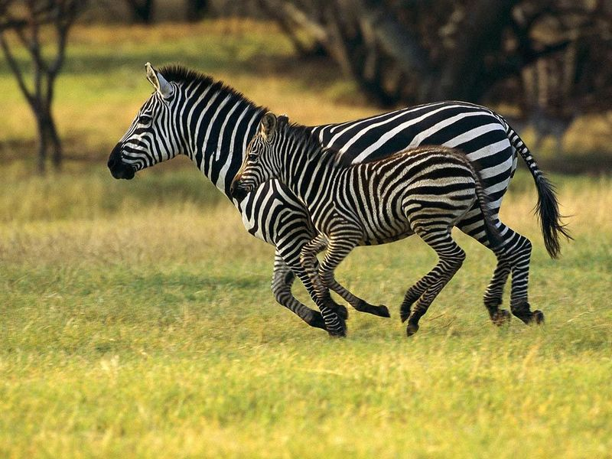
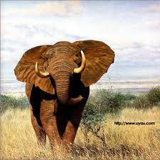
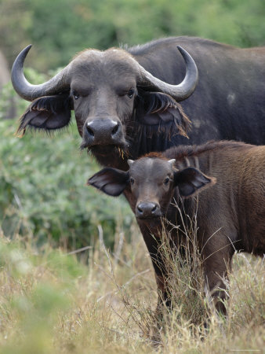
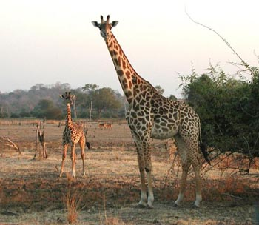
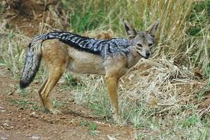
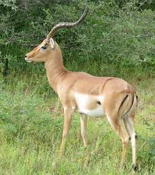
African Animals

Slide 16
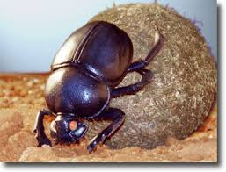
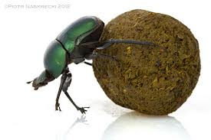
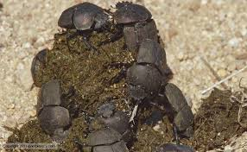
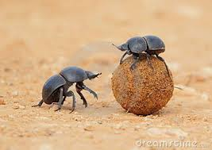
Dung Beetles

Slide 17
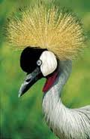
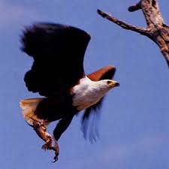
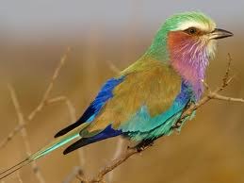
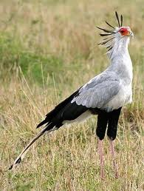
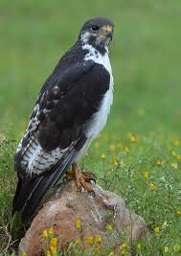
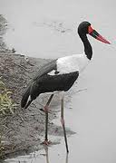
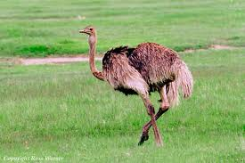
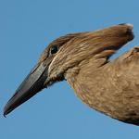
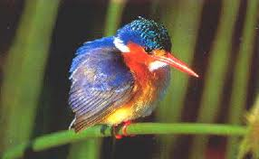
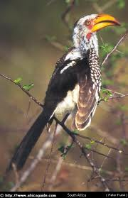
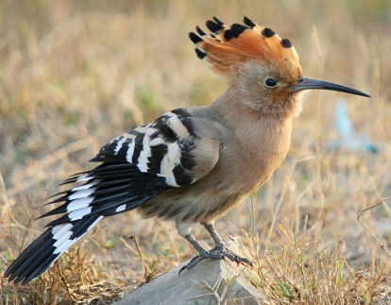
African Birds

Slide 18
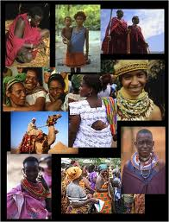
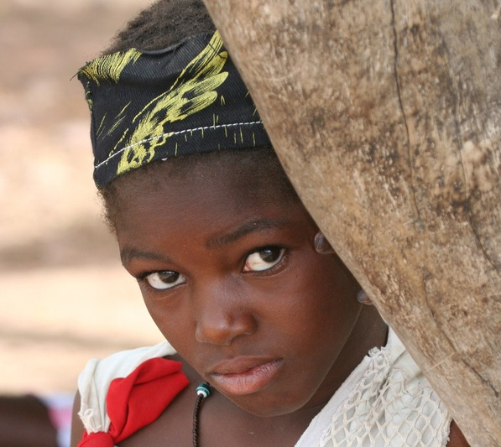
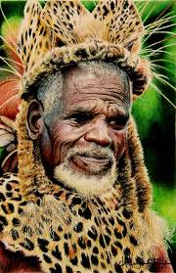
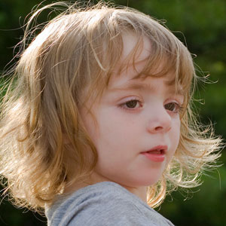
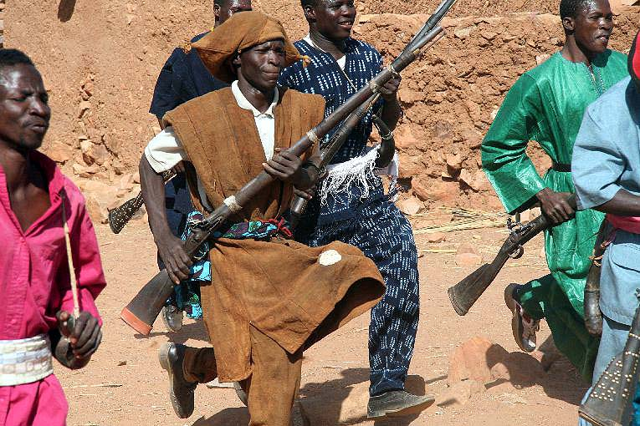
People

Slide 19
How many languages are spoken?

Slide 20
All-Africa Games

Slide 21
What is the All-Africa Games?
continental multi-sport event held every four years
All of the competing nations are from the African continent
The first Games were held in 1965 in Brazzaville, Congo
Brazzaville will host the 2015 edition in honor of the Games' 50th anniversary

Slide 22
Where is Brazzaville?
Brazzaville is the capital and largest city of the Republic of the Congo and is located on the Congo River

Slide 23
Plan a Class Trip to the Congo

Slide 24
Assignment
Choose a sport from the All-Africa Games
What do you know about it?
Compare and contrast it with another sport

