Slide 1
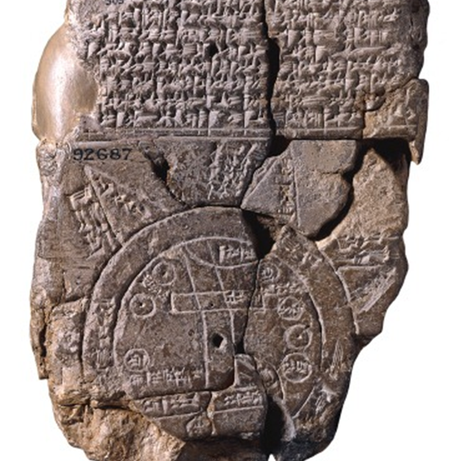
Developing a geographic awareness at the middle level using Ancient, Medieval, and Renaissance era maps.
Brian Smith
geo4tn@gmail.com
Notes:
Social studies practices are specific skills that students should apply when learning social studies. Like the social studies standards, the social studies practices increase in rigor as students get older. Students should apply these skills to create and address questions that will guide inquiry and critical thinking. These practices should be regularly applied throughout the year and are not written as stand-alone standards. Students will progress through the inquiry cycle by analyzing primary and secondary sources to construct and communicate their conceptual understanding of the content standards (SSP.1-SSP.4) and to develop historical and geographic awareness (SSP.5- SSP.6).

Slide 2
Art and geography have long been intertwined. In Babylonian times, people marked clay tablets that appear to be both art and cartography. Cartography took a giant leap forward during the Renaissance and Scientific Revolution. Renaissance maps are known for their artwork as well as representing the Earth’s landforms more accurately than their medieval counterparts. Maps were hung on the walls of merchants and power brokers to signal knowledge, influence, and the literal ownership of land during the Age of Exploration.

Slide 3
Social Studies Practices (SSP)
Using
geographic perspective to determine relationships, patterns, and diffusion across space at multiple scales
Determining
the use of diverse types of maps based on their origin, structure, context, and validity
Analyzing
locations, conditions, and connections of places and use maps to investigate spatial relationships
Analyzing
interaction between humans and the physical environment
Examining
how geographic regions and perceptions of regions are fluid across time and space.
Notes:
EACH PLACE ON EARTH has a unique set of local conditions and connections to other places. Some activities are appropriate in a given place and other activities are not. Events in one place influence events in other places. Geographic knowledge helps people to make decisions about “Where can I be safe, successful, and happy in my daily activities?” and “How can my community create and sustain a healthy environment?” Such knowledge is critically important to understanding what activities might be harmful to a place or what hazards might be encountered there.
Geographic inquiry helps people understand and appreciate their own place in the world, and fosters curiosity about Earth’s wide diversity of environments and cultures. Geographic reasoning rests on deep knowledge of Earth’s physical and human features, including the locations of places and regions, the distribution of landforms and water bodies, and historic changes in political boundaries, economic activities, and cultures. Geographic reasoning requires using spatial and environmental perspectives, skills in asking and answering questions, and being able to apply geographic representations including maps, imagery, and geospatial technologies.
A spatial perspective is about a-where-ness. Where are people and things located? Why there? What are the consequences? An environmental perspective views people as living in interdependent relationships within diverse environments. Thinking geographically requires knowing that the world is a set of complex ecosystems interacting at multiple scales that structure the spatial patterns and processes that influence our daily lives. Geographic reasoning brings societies and nature under the lens of spatial analysis, and aids in personal and societal decision making and problem solving.

Slide 4
Martin Waldseemüller on his 1507 world map
“This one request we have to make, that those who may not be acquainted with geography shall not condemn all that they see before them until they have learned what will surely be apparent to them later on, when they have come to understand what they see.”

Slide 5
Tools of the trade
Make a compass
Make an astrolabe
Build a sextant
Make a globe
Harrison’s Chronometer
Explore the Mariner’s Museum

Slide 6
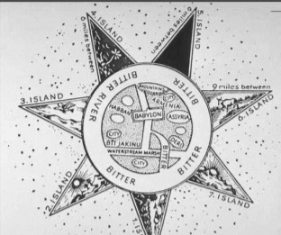
TITLE: Babylonian World Map DATE: 600-500 B.C. AUTHOR: unknown

Slide 7
TITLE: Turin Papyrus DATE: 1150 B.C. AUTHOR: unknown

Slide 8
Greek Views of the World Dates: Various Authors: Various

Slide 9
How we know the Earth is round

Slide 10
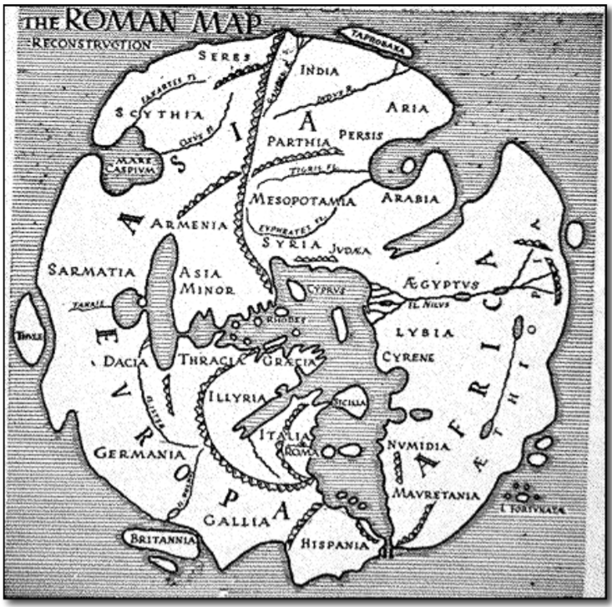
Marcus Vipsanius Agrippa Orbis Terrarum 20 A.D.

Slide 11
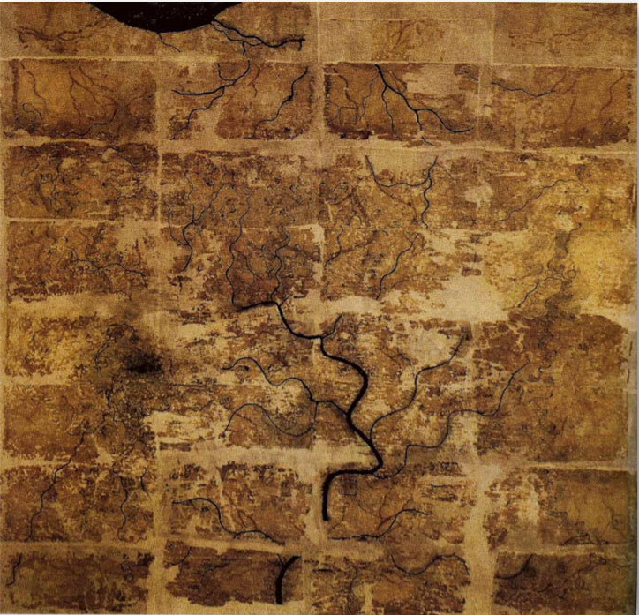
Title: The Han Mawangdui Maps Date: pre-168 B.C. Author: unknown

Slide 12
China in 1000 CE ‘The Most Advanced Society in the World’
A magnificent picture scroll painted by a Chinese artist in the 12th century provides us with a look at society and urban life in China during this time.
Interactive Map of the Song Scroll
EXPLORING THE QINGMING SCROLL What does an idealized image of society tell us? What does it hide?

Slide 13
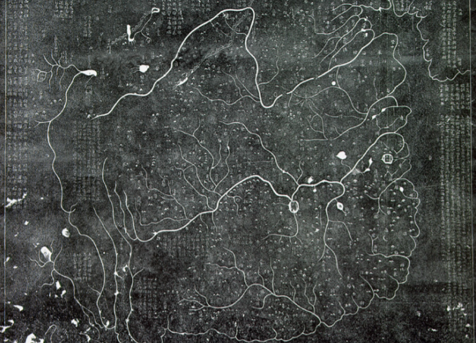
Early World Maps in China
A rubbing from the Hua I T’u [Map of China and the Barbarian Countries], ca.1137 A.D. actual size is about three feet square

Slide 14
TITLE: World Maps of al-Idrisi DATE: 1154-1192 AUTHOR: Abu Abdullah Mohammed Ibn al-Sharif al-Idrisi [Edrisi] TABULA ROGERIANA, @1138

Slide 15
TITLE: The Catalan Atlas DATE: 1375 AUTHOR: Abraham Cresques

Slide 16
The Mystery of Extraordinarily Accurate Medieval Maps

Slide 17
TITLE: Fra Mauro’s Mappamundi DATE: 1457 -1459 AUTHOR: Fra Mauro

Slide 18
On Scale and Distance:
Islamic scholars felt the Earth was @ 20,000 miles in circumference. An Arabic mile of that day was between 1.9 and 2 km, this measurement was about right.
Columbus himself used Italian miles but did not realize the difference between the two scales; an Italian mile was only 1.24 km; Columbus was underestimating the size of the earth by 37%.
This underestimate directly contributed to his belief that reaching the east coast of Asia was doable from western Europe with the ships of his time.

Slide 19
TITLE: Toscanelli’s World Map DATE: 1474 AUTHOR: Paolo Toscanelli

Slide 20
WHAT WAS FINALLY PROVEN? WHO WAS RESPONSIBLE FOR PROVING IT?
TITLE: Martellus’ World Maps
DATE: 1489-1490
AUTHOR: Henricus Martellus

Slide 21
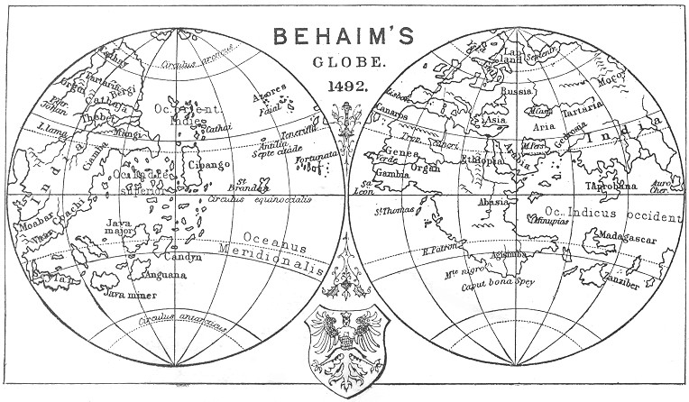
Erdapfel TITLE: Behaim Globe DATE: 1492 AUTHOR: Martin Behaim

Slide 22
How Leonardo da Vinci made a “satellite” map in 1502

Slide 23
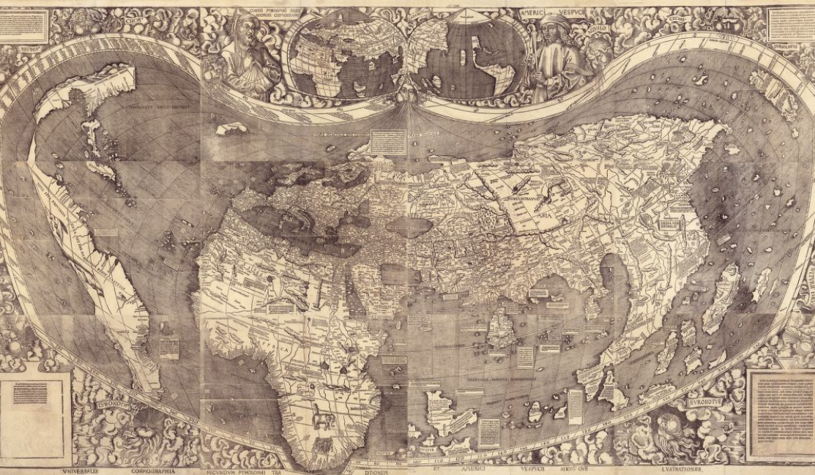
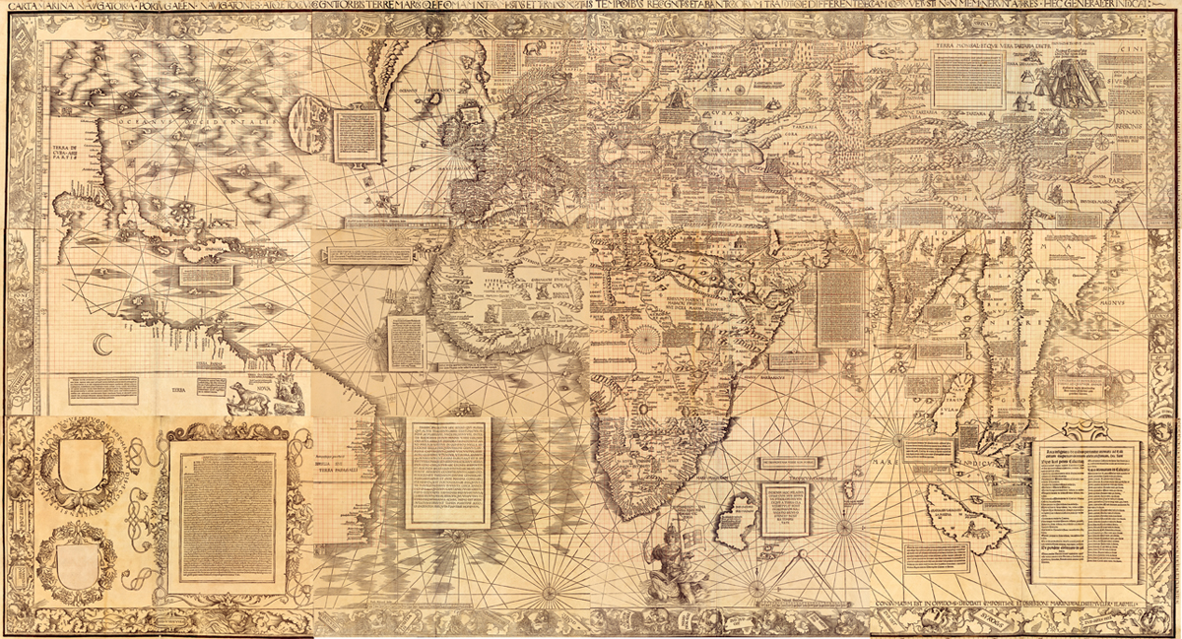
Exploring the Early Americas Waldseemüller Maps Compare and contrast his 1507 and 1516 maps with the Library of Congress Lesson

Slide 24
When North America was part of Asia

Slide 25
Author:Monte, Urbano Composite:Tavola 1-60 Date:1587

Slide 26
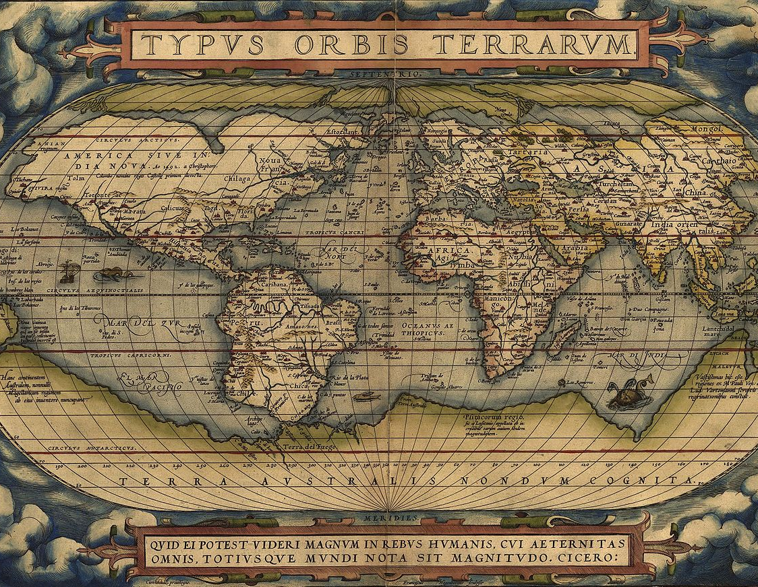
Any thoughts on Antarctica?
Author: Abraham Ortelius
Title: THEATRUM ORBIS TERRARUM
Date: 1570

Slide 27
JOAN BLEAU LATE 1600
Why would a Dutchman create such a realistic map?
What continent is missing?
How is the world map becoming more realistic?
Where is there
distortion? Why?

Slide 28
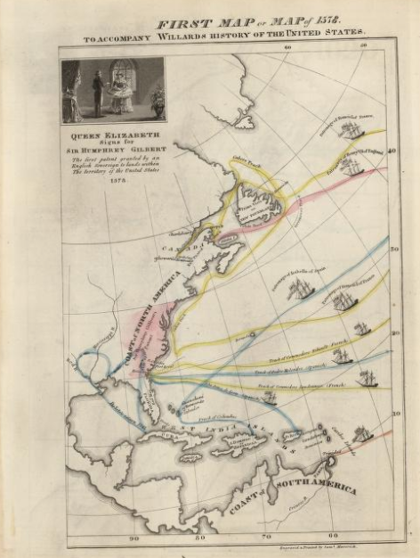
Emma Willard
Willard is one of the first, perhaps the very first, female mapmaker in America. A teacher, pioneer of education for women, and founder of her own school, Willard was fascinated with the power of geography and the potential for maps to tell stories.
David Rumsey Maps

Slide 29
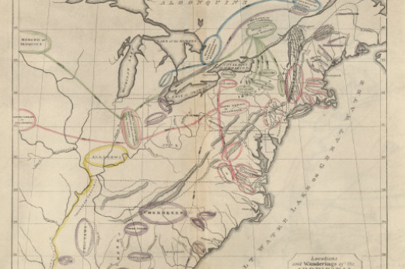
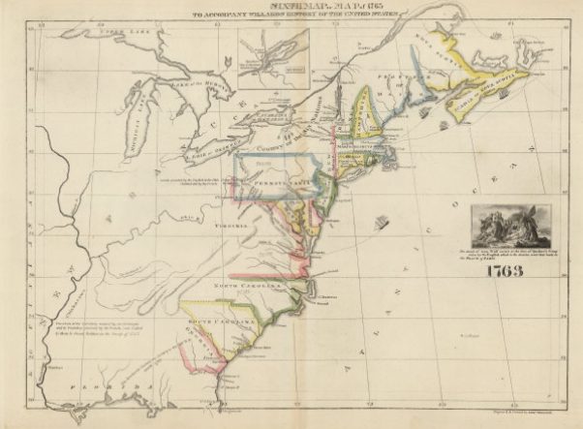
Emma Willard
In 1828, she published a series of maps as part of her History of the United States, or Republic of America, which showed graphically how the country, as she understood it, had come to be. It was the first book of its kind—the first atlas to present the evolution of America
David Rumsey Maps

Slide 30
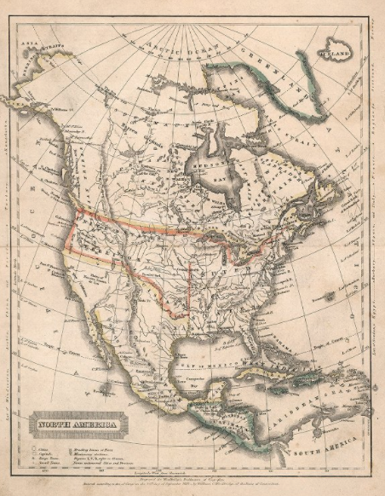
Emma Willard
In 1828, Emma Willard was 41 years old—only slightly older than the United States of America itself, if you start counting from 1789, when the U.S. Constitution came into force.
David Rumsey Maps

Slide 31
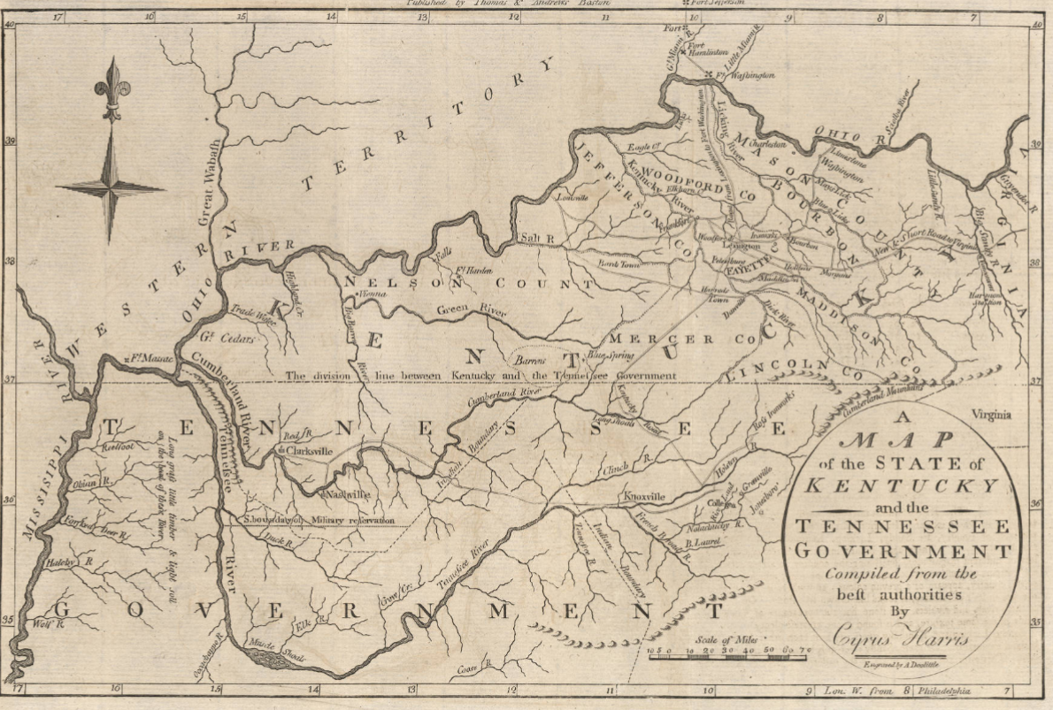
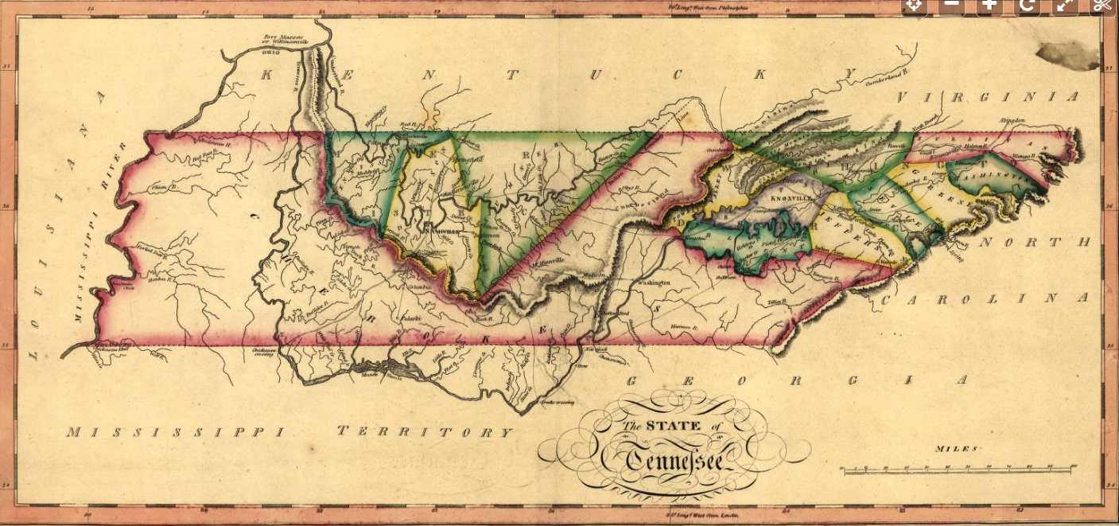
Historic Maps of Tennessee

Slide 32
GIOVANNI MARIA CASSINI: LA NUOVA OLANDA E LA NUOVA GUINEA DELINEATE SULLE ULTIME OSSERAZIONE . . . 1798

Slide 33
DÉTAILS SUR CARTE GEOGRAPHIE MAPPEMONDE PHYSIQUE ET POLITIQUE L. DUSSIEUX 1821
HOW REALISTIC DOES THE MAP LOOK?
WHAT CONTINENTS ARE FULLY MAPPED?
WHICH IS
MISSING?
WHEN WAS THAT CONTINENT DISCOVERED?

