Slide 1
State of the States
GALLUP 2013
http://www.gallup.com/poll/125066/State-States.aspx

Slide 2
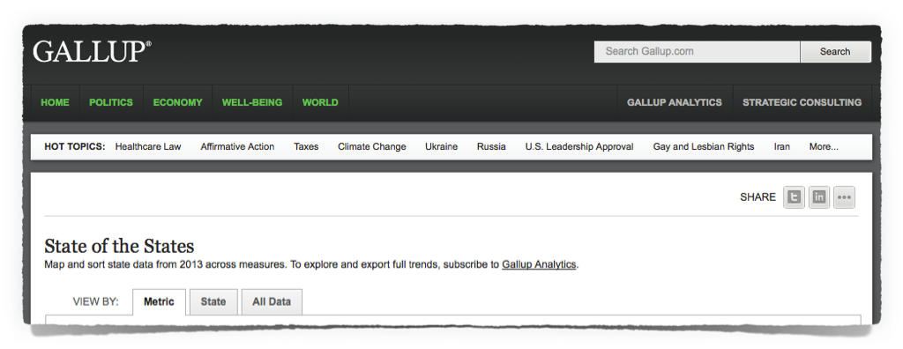
State of the States
GALLUP 2013
Map and sort state data from 2013 across measures.
http://www.gallup.com/poll/125066/State-States.aspx

Slide 3
The Questions

Slide 4
% Very religious
The percentage of state residents who say religion is important in their lives and say they attend church weekly or nearly weekly…
Which states are the most religious? least?
1
The Gallup Survey Topic

Slide 5
Place the following U.S. states in order from most to least RELIGIOUS:
TENNESSEE
UTAH
MAINE
HAWAII
OHIO

Slide 6
% Republican/Lean
The percentage of state residents who identify as Republicans or who identify as independents but say they lean Republican…
Which states are the most Republican? least?
2
The Gallup Survey Topic

Slide 7
Place the following U.S. states in order from most to least REPUBLICAN:
RHODE ISLAND
FLORIDA
ALABAMA
UTAH
CALIFORNIA

Slide 8
% Liberal
The percentage of state residents who describe their political views as liberal…
Which states are the most liberal? least?
3
The Gallup Survey Topic

Slide 9
Place the following U.S. states in order from most to least LIBERAL:
MASSACHUSETTS
IDAHO
WASHINGTON
MINNESOTA
MONTANA

Slide 10
% Protestant
The percentage of state residents who report they are Protestant…
Which states are the most Protestant? least?
4
The Gallup Survey Topic

Slide 11
Place the following U.S. states in order from most to least PROTESTANT:
NORTH CAROLINA
CONNECTICUT
ALABAMA
LOUISIANA
WISCONSISN

Slide 12
% Catholic
The percentage of state residents who report they are Catholic…
Which states are the most Catholic? least?
5
The Gallup Survey Topic

Slide 13
Place the following U.S. states in order from most to least CATHOLIC:
NEW JERSEY
TEXAS
SOUTH CAROLINA
COLORADO
NEW MEXICO

Slide 14
% Underemployed
The percentage of state residents who are employed part time but want to work full time, or are unemployed…
Which states are the most underemployed? least?
6
The Gallup Survey Topic

Slide 15
Place the following U.S. states in order from most to least UNDEREMPLOYED:
MICHIGAN
NEVADA
SOUTH DAKOTA
ALASKA
INDIANA

Slide 16
% Government workers
The percentage of state residents who are employed by federal, state, or local government
Which states have the highest percentage of government workers? lowest?
7
The Gallup Survey Topic

Slide 17
Place the following U.S. states in order from highest to lowest percentage of GOVERNMENT workers:
MICHIGAN
OREGON
ALASKA
GEORGIA
TENNESSEE

Slide 18
% Obese
The percentage of state residents whose Body Mass Index score, based on self-reported height and weight, is 30 or higher…
Which states are the most obese? least?
8
The Gallup Survey Topic

Slide 19
Place the following U.S. states in order from most to least OBESE:
ARKANSAS
WEST VIRGINIA
COLORADO
FLORIDA
TEXAS

Slide 20
% Uninsured
The percentage of state residents who say they do not have health insurance coverage…
Which states are the most uninsured? least?
9
The Gallup Survey Topic

Slide 21
Place the following U.S. states in order from most to least UNINSURED:
ARKANSAS
KENTUCKY
OHIO
CONNECTICUT
HAWAII

Slide 22
% No religious preference
The percentage of state residents who report they have no religious identity
Which states have the highest percentage of people who have no religious preference? lowest?
10
The Gallup Survey Topic

Slide 23
Place the following U.S. states in order from the highest to the lowest of people who have NO RELIGIOUS preference:
OKLAHOMA
ILLINOIS
LOUISIANA
NEVADA
VERMONT

Slide 24
The Answers

Slide 25
% Very religious
The percentage of state residents who say religion is important in their lives and say they attend church weekly or nearly weekly…
Which states are the most religious?
1
The Gallup Survey Topic

Slide 26
Place the following U.S. states in order from most to least RELIGIOUS:
TENNESSEE
2
UTAH
1
MAINE
5
HAWAII
4
OHIO
3

Slide 27
What is the most RELIGIOUS state in the United States?
MISSISSIPPI (61.1%)

Slide 28
What is the least RELIGIOUS state in the United States?
VERMONT (22.4%)

Slide 29
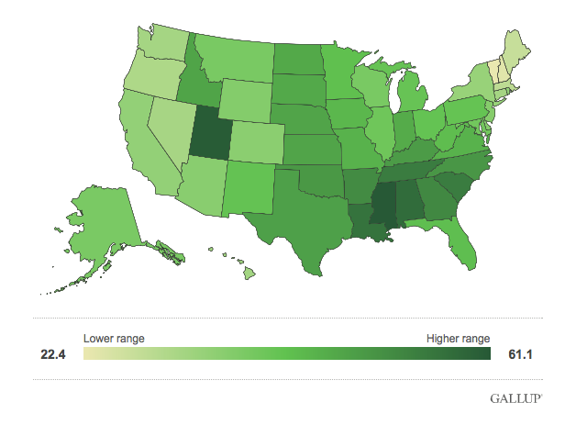
% Very religious
http://www.gallup.com/poll/125066/State-States.aspx

Slide 30
% Republican/Lean
The percentage of state residents who identify as Republicans or who identify as independents but say they lean Republican…
Which states are the most Republican?
2
The Gallup Survey Topic

Slide 31
Place the following U.S. states in order from most to least REPUBLICAN:
RHODE ISLAND
5
FLORIDA
3
ALABAMA
2
UTAH
1
CALIFORNIA
4

Slide 32
What is the most REPUBLICAN state in the United States?
WYOMING (60.1%)

Slide 33
What is the least REPUBLICAN state in the United States?
NEW YORK (28.6%)
DISTRICT OF COLUMBIA (14.3%)

Slide 34
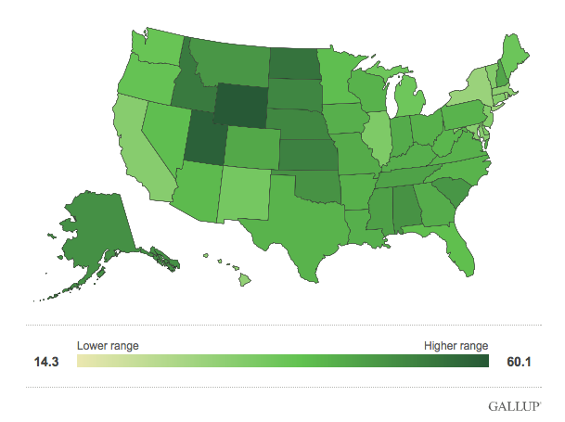
% Republican/Lean
http://www.gallup.com/poll/125066/State-States.aspx

Slide 35
% Liberal
The percentage of state residents who describe their political views as liberal…
Which states are the most liberal?
3
The Gallup Survey Topic

Slide 36
Place the following U.S. states in order from most to least LIBERAL:
MASSACHUSETTS
1
IDAHO
5
WASHINGTON
2
MINNESOTA
3
MONTANA
4

Slide 37
What is the most LIBERAL state in the United States?
VERMONT (32.4%)
DISTRICT OF COLUMBIA (38.1%)

Slide 38
What is the least LIBERAL state in the United States?
WYOMING (10.9%)

Slide 39
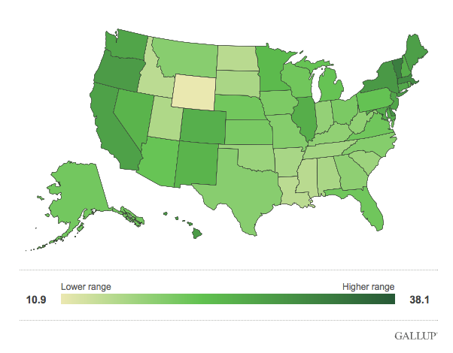
% Liberal
http://www.gallup.com/poll/125066/State-States.aspx

Slide 40
% Protestant
The percentage of state residents who report they are Protestant…
Which states are the most Protestant?
4
The Gallup Survey Topic

Slide 41
Place the following U.S. states in order from most RELIGIOUS to least religious:
NORTH CAROLINA
2
CONNECTICUT
5
ALABAMA
1
LOUISIANA
3
WISCONSIN
4

Slide 42
What is the most PROTESTANT state in the United States?
MISSISSIPPI (76.9%)

Slide 43
What is the least PROTESTANT state in the United States?
UTAH (10.9%)

Slide 44
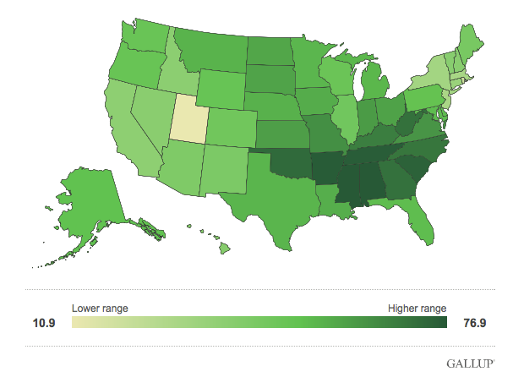
% Protestant
http://www.gallup.com/poll/125066/State-States.aspx

Slide 45
% Catholic
The percentage of state residents who report they are Catholic…
Which states are the most Catholic?
5
The Gallup Survey Topic

Slide 46
Place the following U.S. states in order from most to least CATHOLIC:
NEW JERSEY
1
TEXAS
3
SOUTH CAROLINA
5
COLORADO
4
NEW MEXICO
2

Slide 47
What is the most CATHOLIC state in the United States?
RHODE ISLAND (54.2%)

Slide 48
What is the least CATHOLIC state in the United States?
MISSISSIPPI (7.5%)

Slide 49
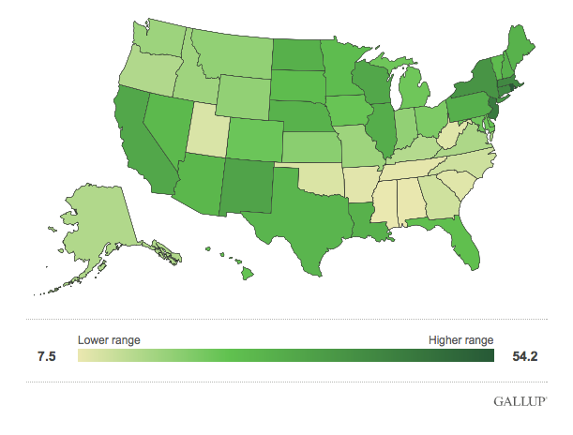
% Catholic
http://www.gallup.com/poll/125066/State-States.aspx

Slide 50
% Underemployed
The percentage of state residents who are employed part time but want to work full time, or are unemployed…
Which states are the most underemployed?
6
The Gallup Survey Topic

Slide 51
Place the following U.S. states in order from most to least UNDEREMPLOYED:
MICHIGAN
2
NEVADA
1
SOUTH DAKOTA
5
ALASKA
4
INDIANA
3

Slide 52
What is the most UNDEREMPLOYED state in the United States?
CALIFORNIA (22.0%)

Slide 53
What is the least UNDEREMPLOYED state in the United States?
NORTH DAKOTA (10.1%)

Slide 54
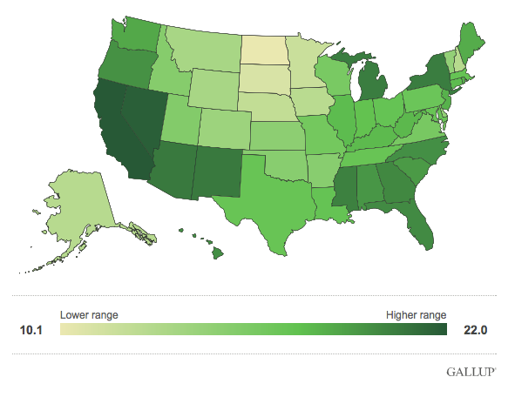
% Underemployed
http://www.gallup.com/poll/125066/State-States.aspx

Slide 55
% Government workers
The percentage of state residents who are employed by federal, state, or local government
Which states have the highest percentage of government workers?
7
The Gallup Survey Topic

Slide 56
Place the following U.S. states in order from highest to lowest percentage of government workers:
MICHIGAN
5
OREGON
4
ALASKA
1
GEORGIA
2
TENNESSEE
3

Slide 57
What U.S. state has the highest percentage of government workers?
MARYLAND (23.7%)
DISTRICT OF COLUMBIA (25.4%)

Slide 58
What U.S. state has the lowest percentage of government workers?
INDIANA (10.9%)

Slide 59
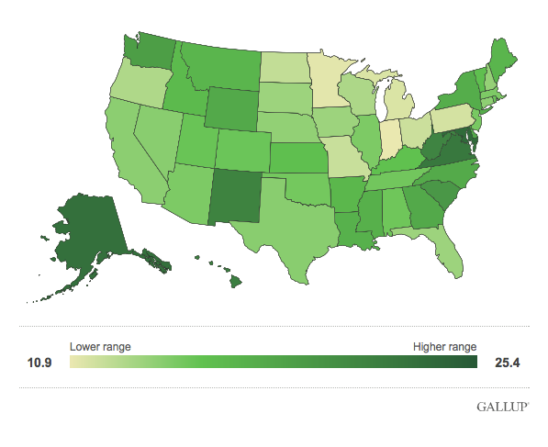
% Government Workers
http://www.gallup.com/poll/125066/State-States.aspx

Slide 60
% Obese
The percentage of state residents whose Body Mass Index score, based on self-reported height and weight, is 30 or higher…
Which states are the most obese?
8
The Gallup Survey Topic

Slide 61
Place the following U.S. states in order from most OBESE to least religious:
ARKANSAS
2
WEST VIRGINIA
1
COLORADO
5
FLORIDA
4
TEXAS
3

Slide 62
What is the most OBESE state in the United States?
MISSISSIPPI (35.4%)

Slide 63
What is the least OBESE state in the United States?
MONTANA (19.6%)

Slide 64
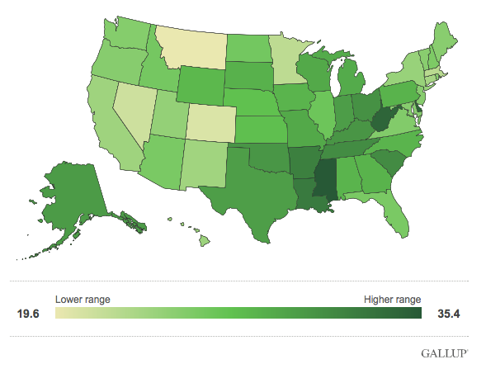
% Obese
http://www.gallup.com/poll/125066/State-States.aspx

Slide 65
% Uninsured
The percentage of state residents who say they do not have health insurance coverage…
Which states are the most uninsured?
9
The Gallup Survey Topic

Slide 66
Place the following U.S. states in order from most to least uninsured:
ARKANSAS
1
KENTUCKY
2
OHIO
3
CONNECTICUT
4
HAWAII
5

Slide 67
What is the most UNINSURED state in the United States?
TEXAS (27%)

Slide 68
What is the least UNINSURED state in the United States?
MASSACHUSETTS (4.9%)

Slide 69
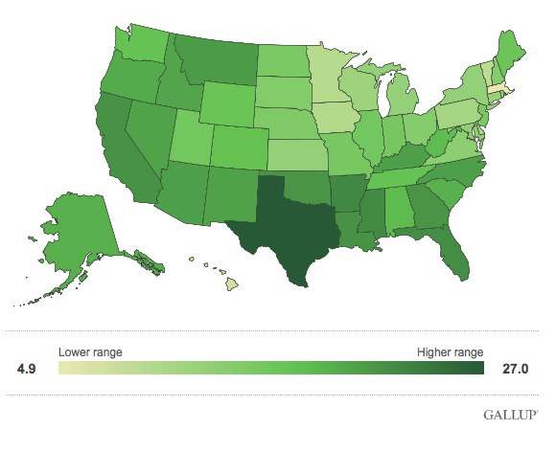
% Uninsured
http://www.gallup.com/poll/125066/State-States.aspx

Slide 70
% No religious preference
The percentage of state residents who report they have no religious identity
Which states have the highest percentage of people who have no religious preference?
10
The Gallup Survey Topic

Slide 71
Place the following U.S. states in order from the highest to the lowest of people who have no religious preference:
OKLAHOMA
4
ILLINOIS
3
LOUISIANA
5
NEVADA
2
VERMONT
1

Slide 72
What is the U.S. state with the highest percentage of people who have no religious preference?
OREGON (27.3%)

Slide 73
What is the U.S. state with the lowest percentage of people who have no religious preference?
MISSISSIPPI (7.2%)

Slide 74
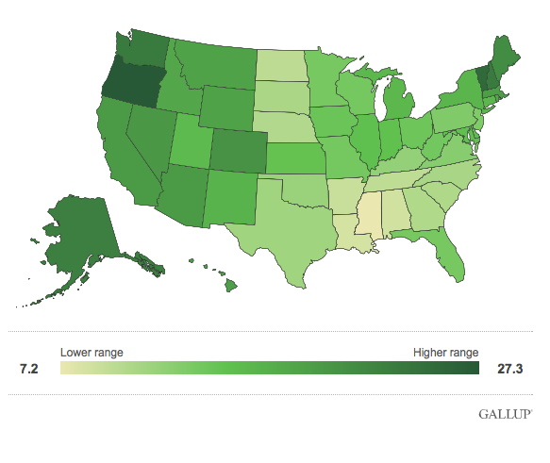
% No religious preference
http://www.gallup.com/poll/125066/State-States.aspx

