Slide 1
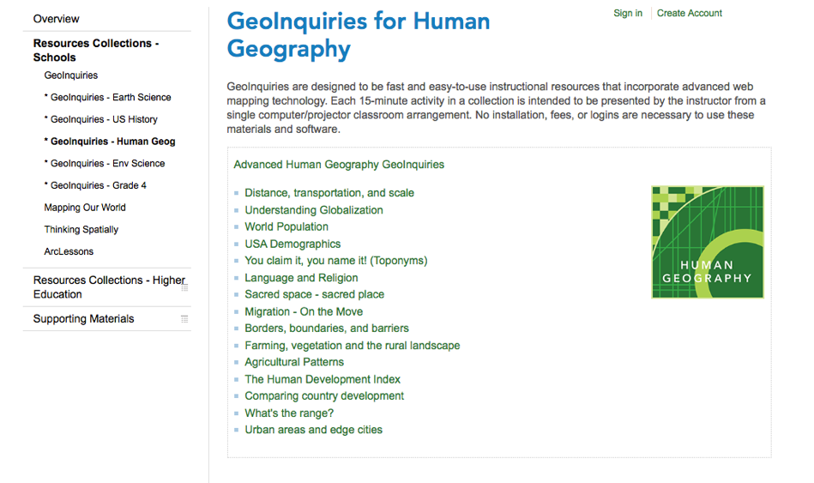
WEBSITE RESOURCE
http://edcommunity.esri.com/Resources/Collections/human_geoinquiries

Slide 2
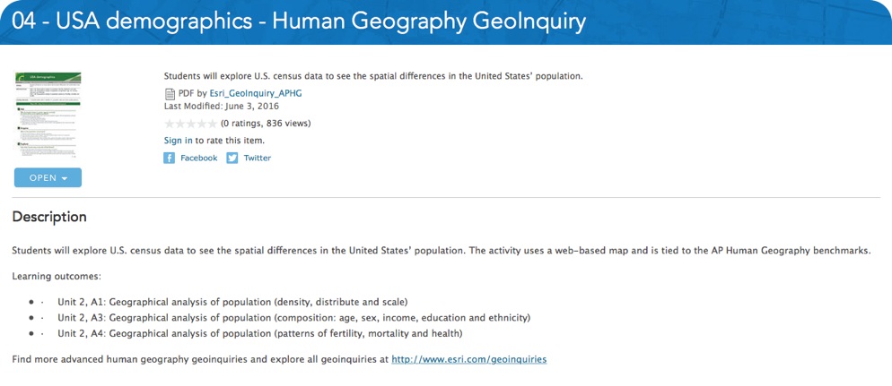
WEBSITE RESOURCE
http://edcommunity.esri.com/Resources/Collections/human_geoinquiries

Slide 3
WEBSITE RESOURCE
http://edcommunity.esri.com/Resources/Collections/human_geoinquiries

Slide 4
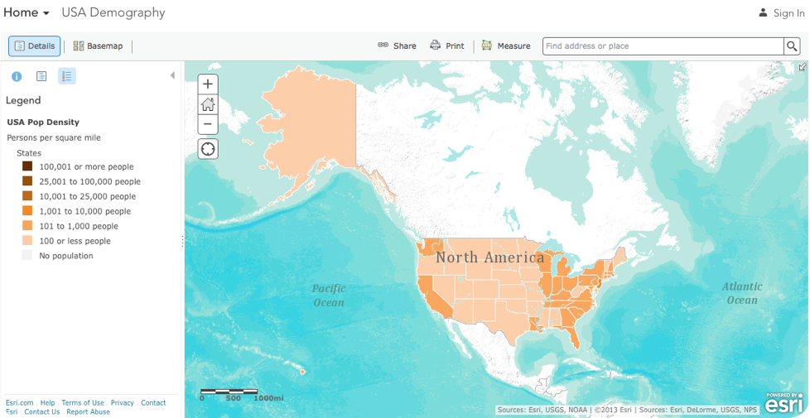
WEBSITE RESOURCE
http://edcommunity.esri.com/Resources/Collections/human_geoinquiries

Slide 5
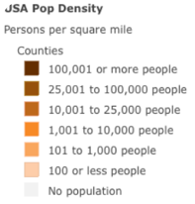

Slide 6
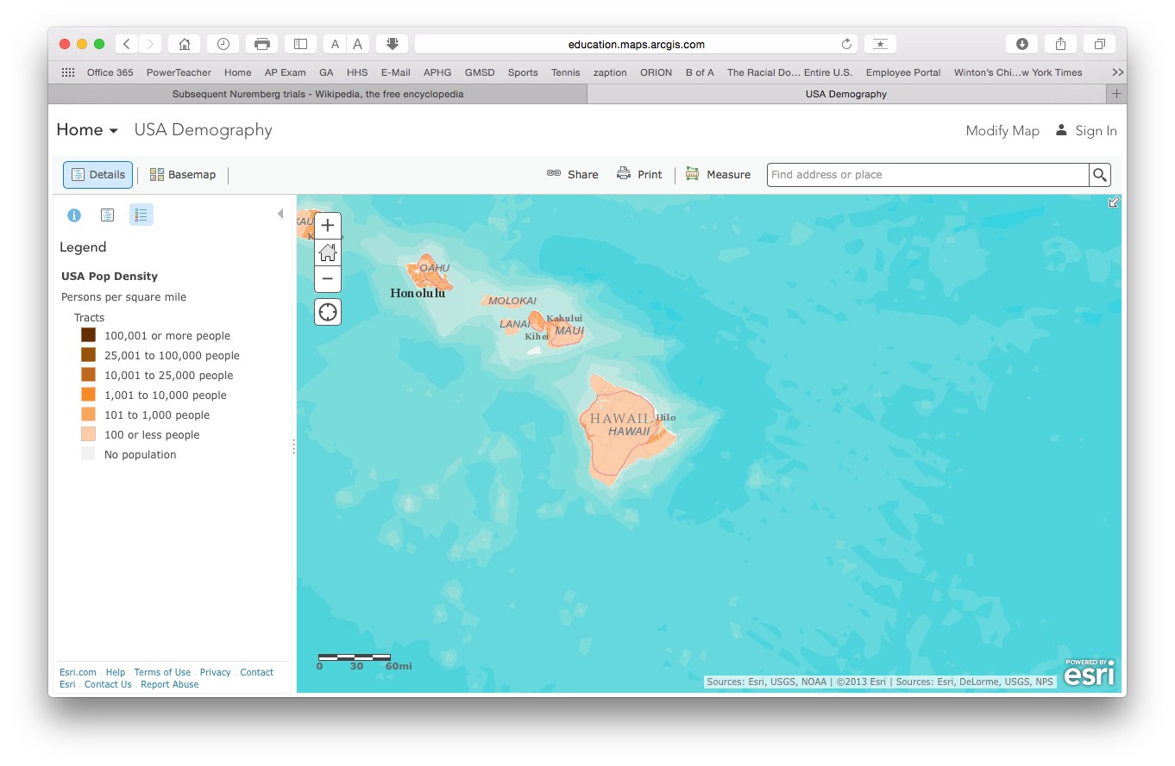

Slide 7
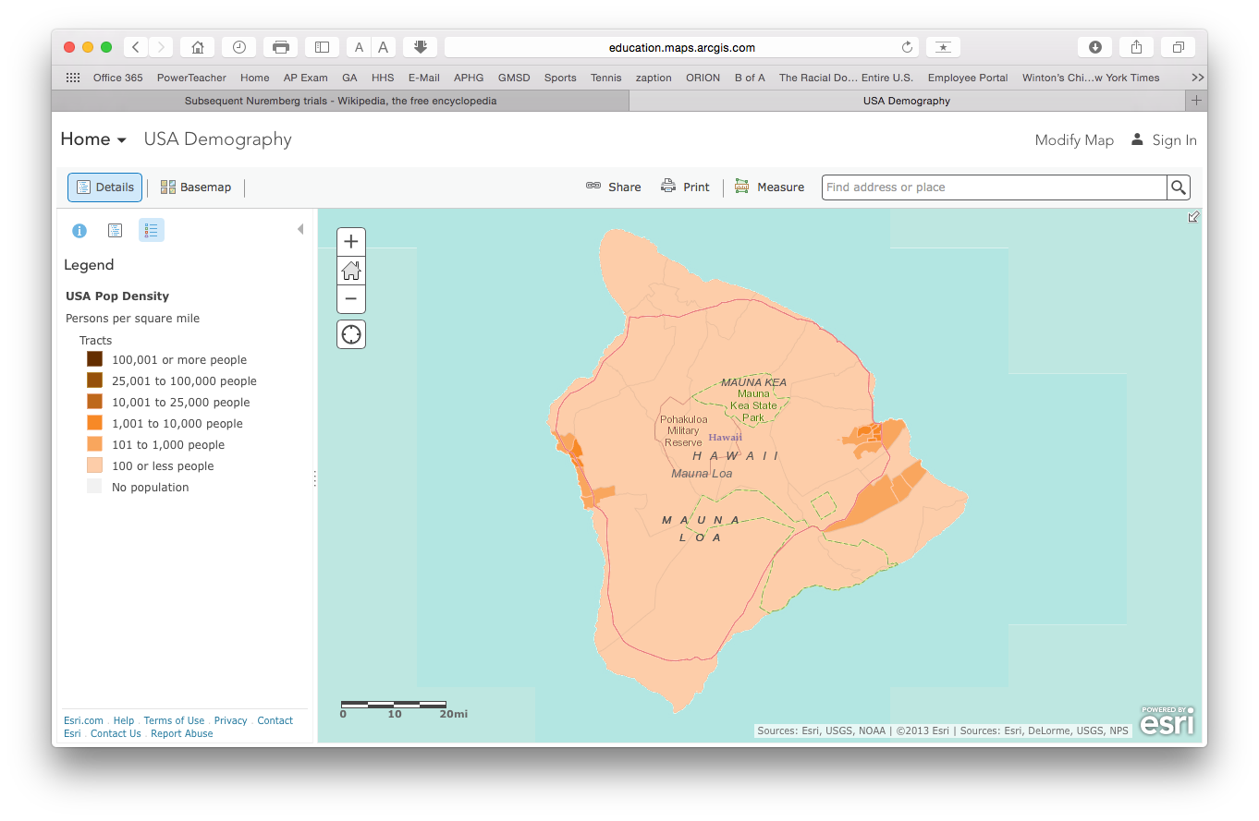

Slide 8
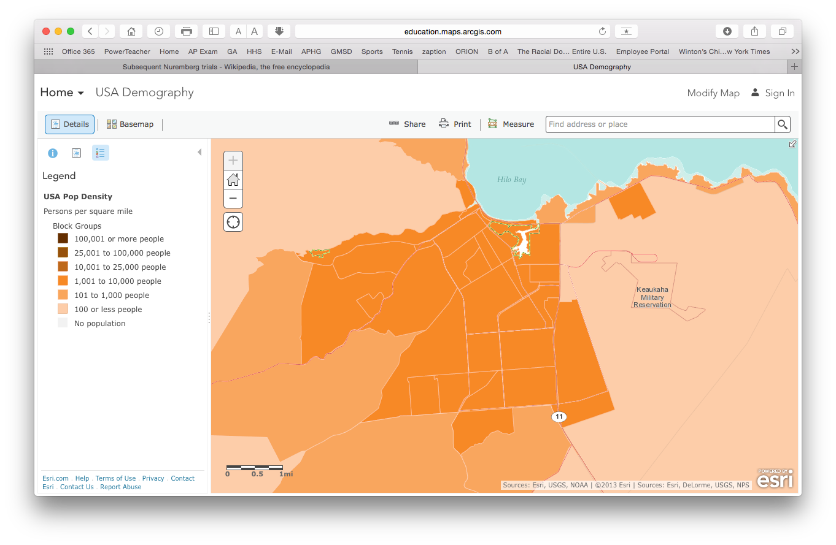

Slide 9
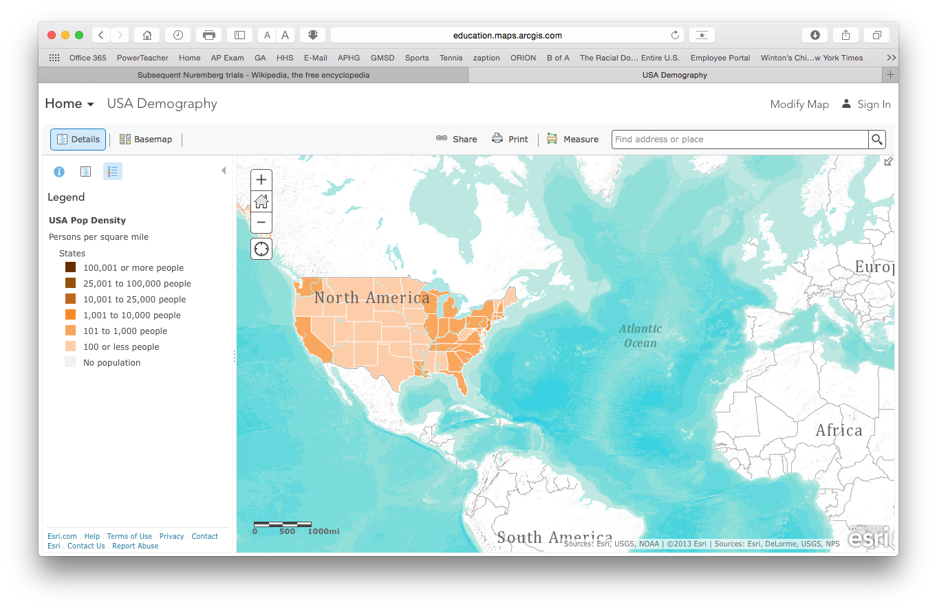

Slide 10
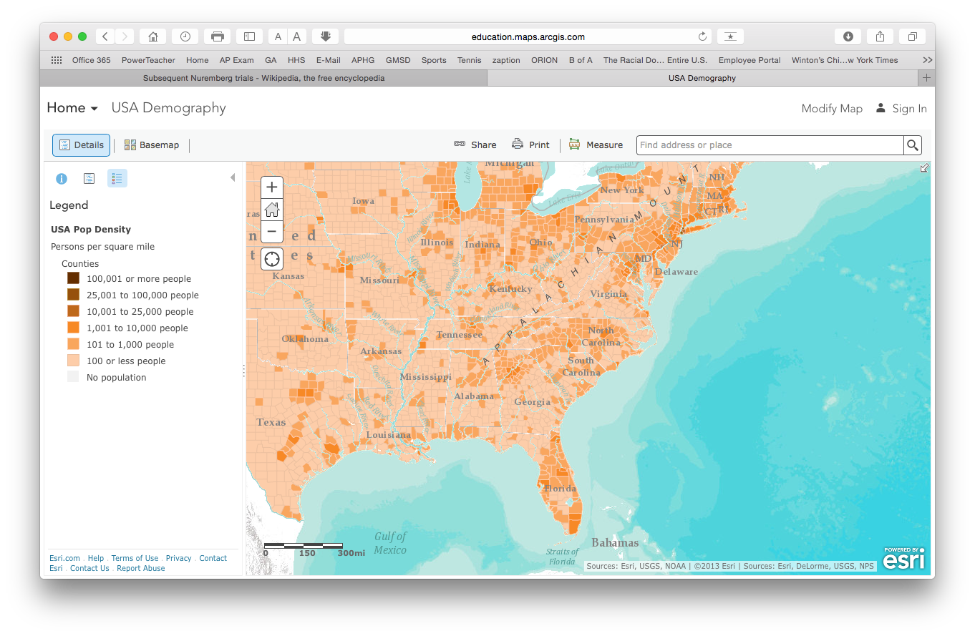

Slide 11
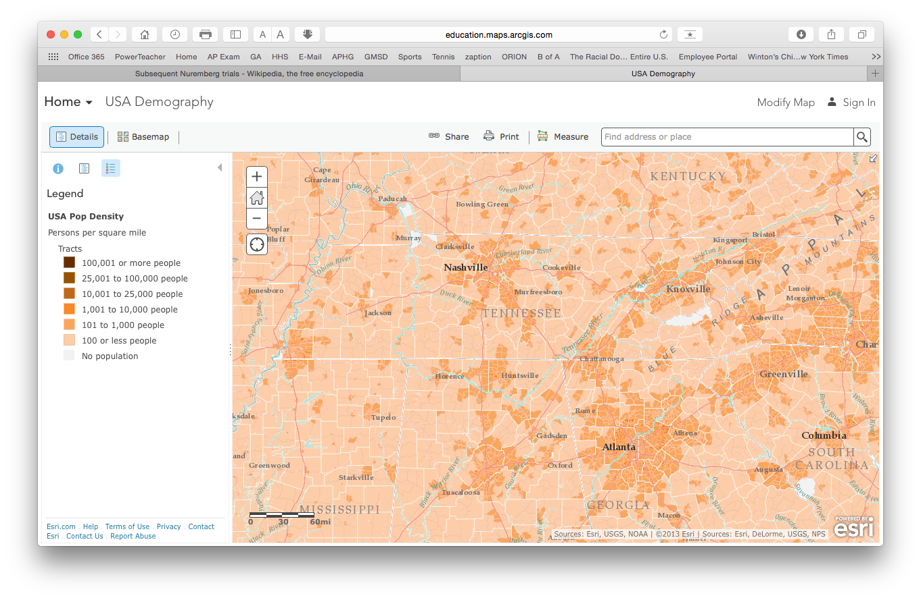

Slide 12
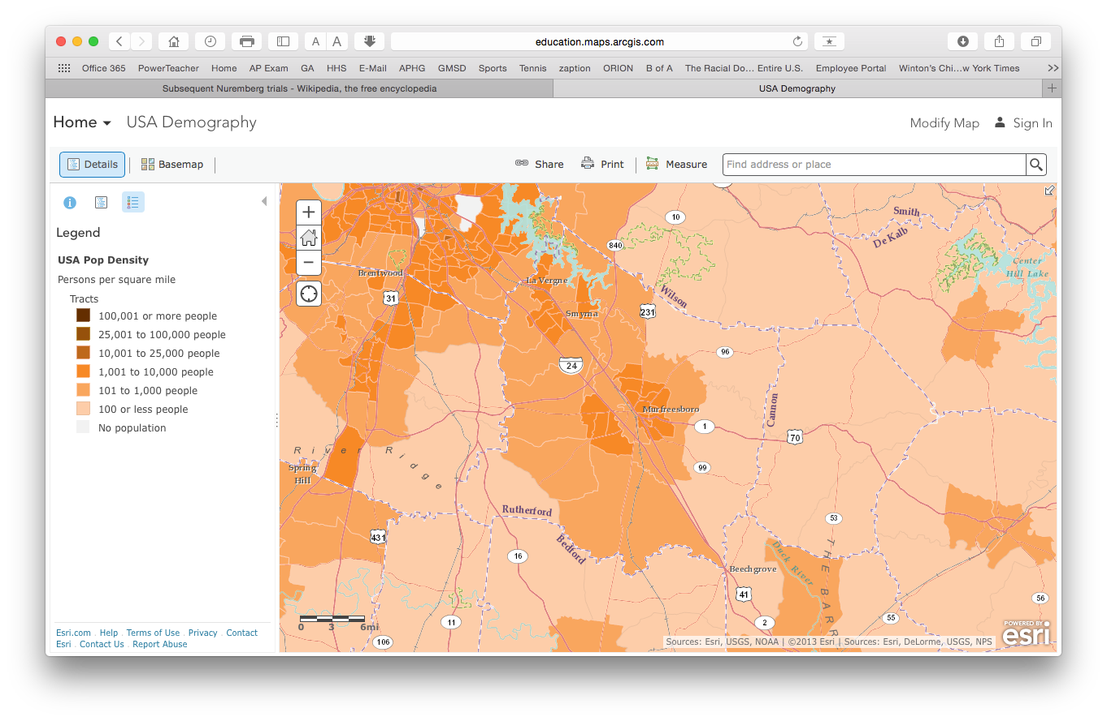

Slide 13
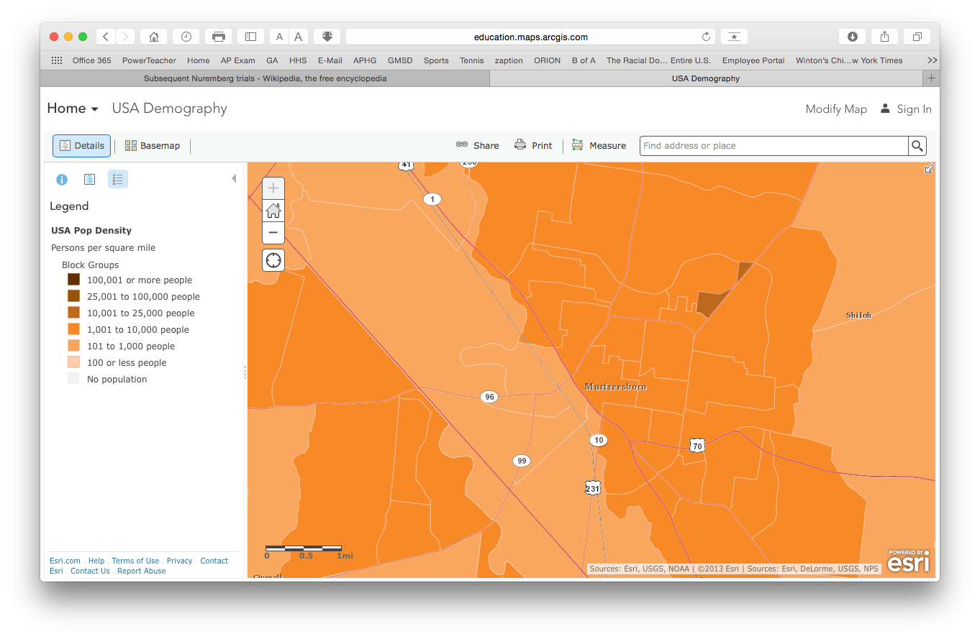

Slide 14
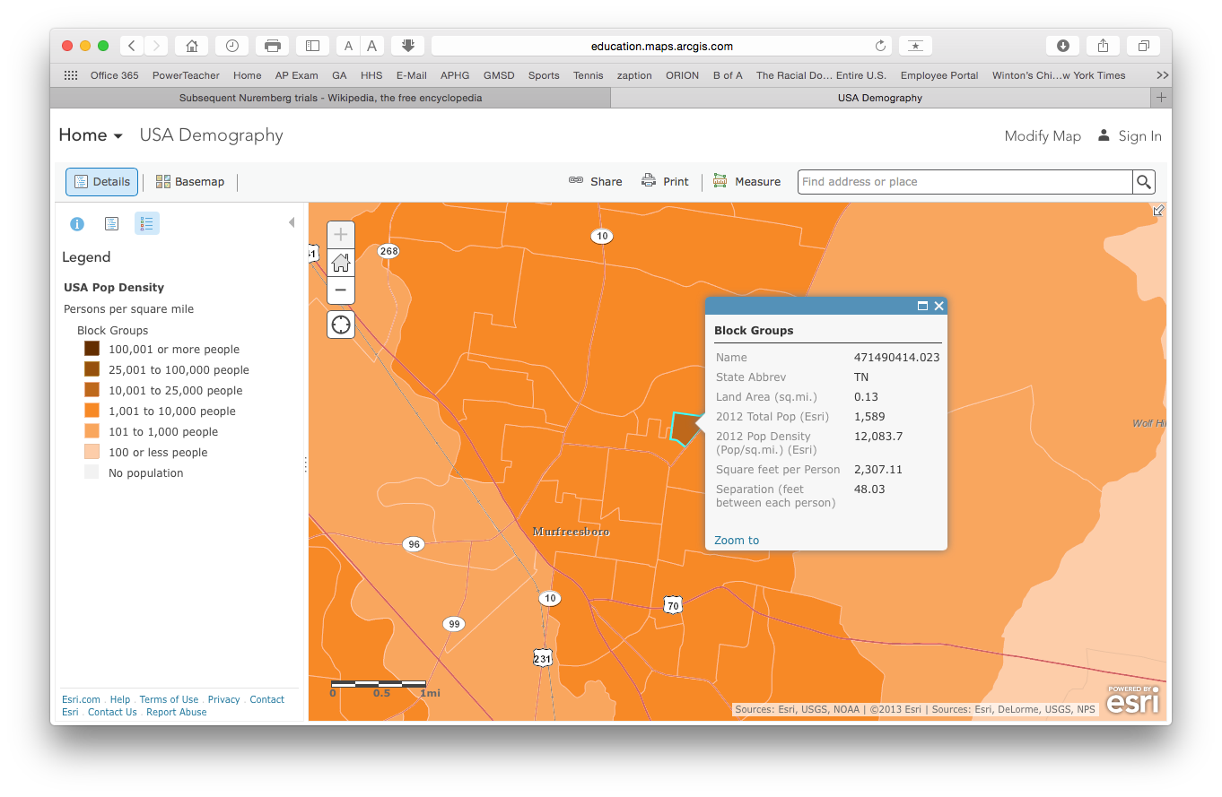

Slide 15
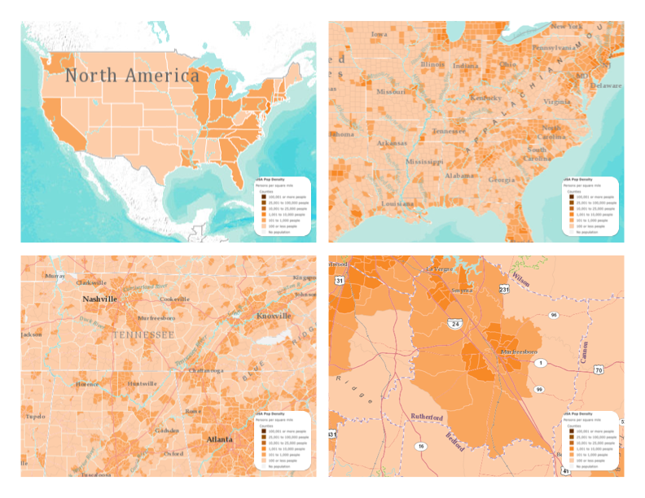

Slide 17
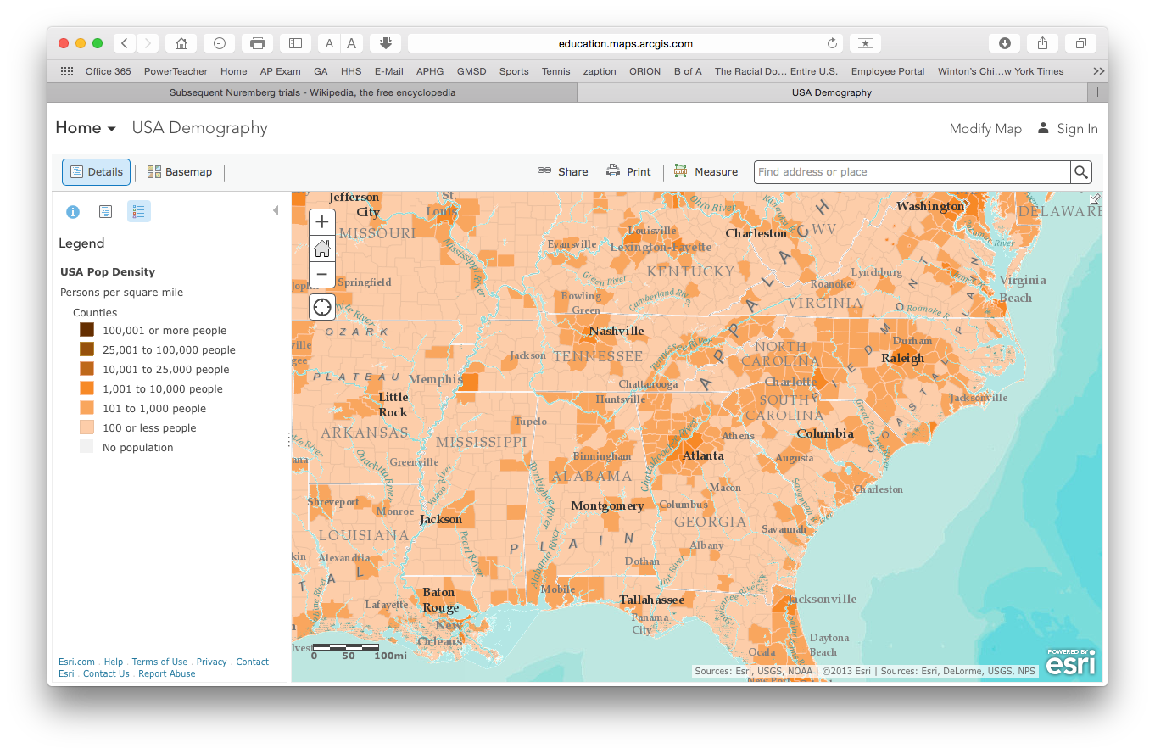

Slide 18
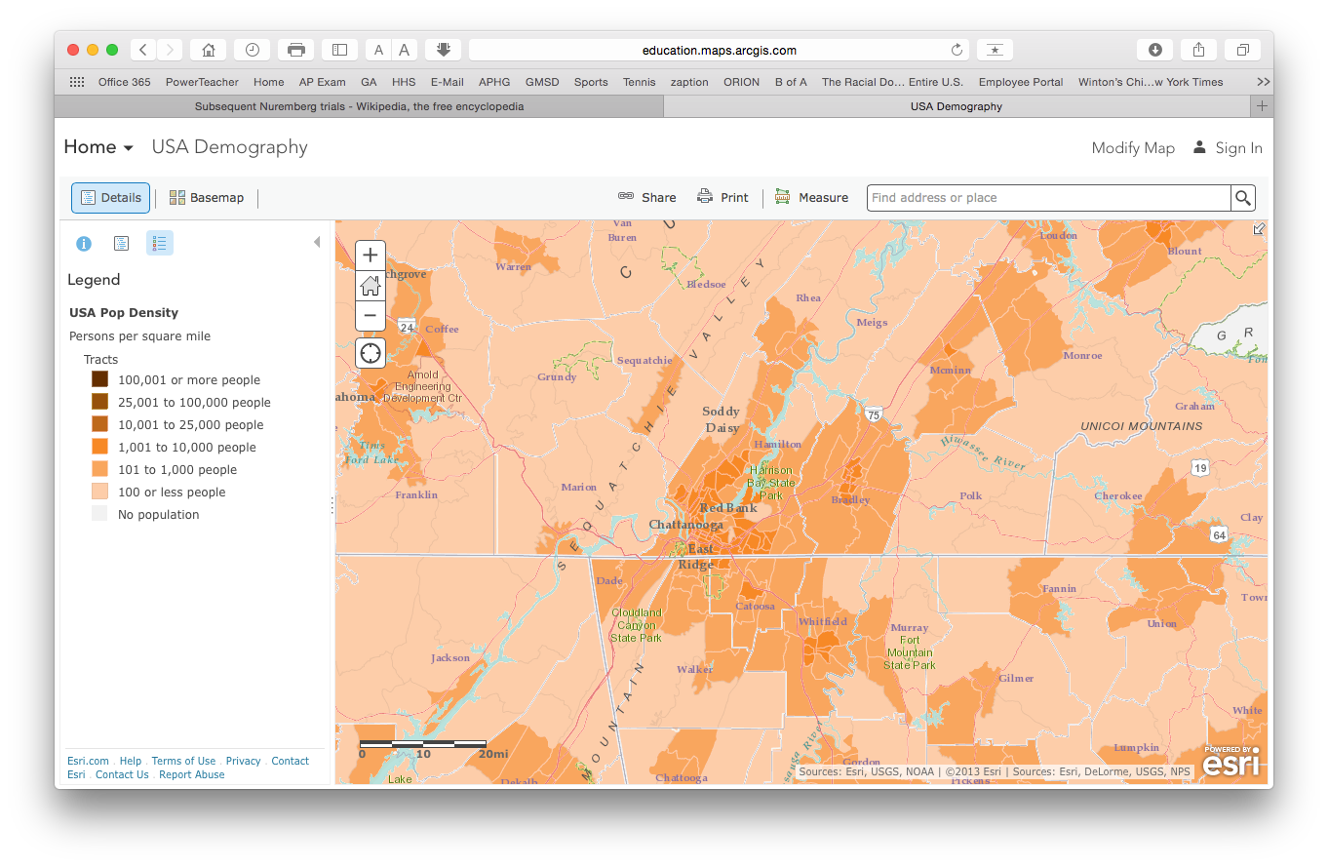

Slide 19
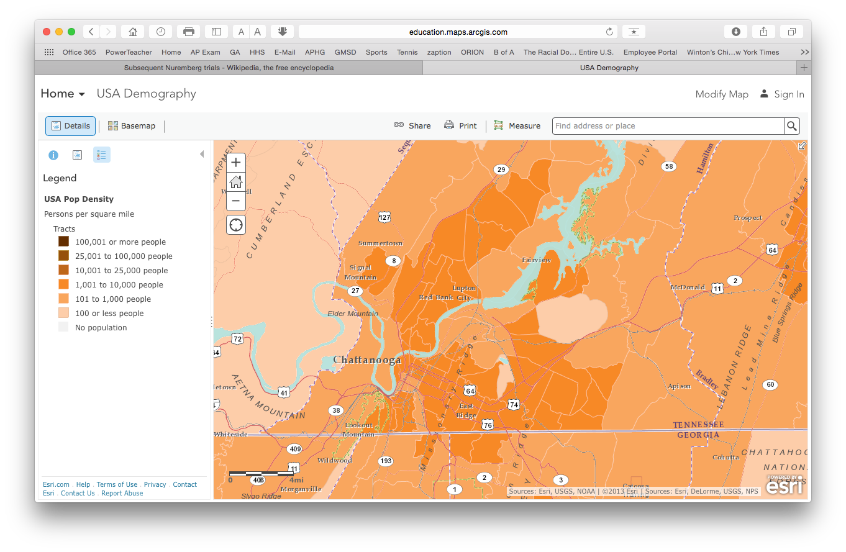

Slide 20
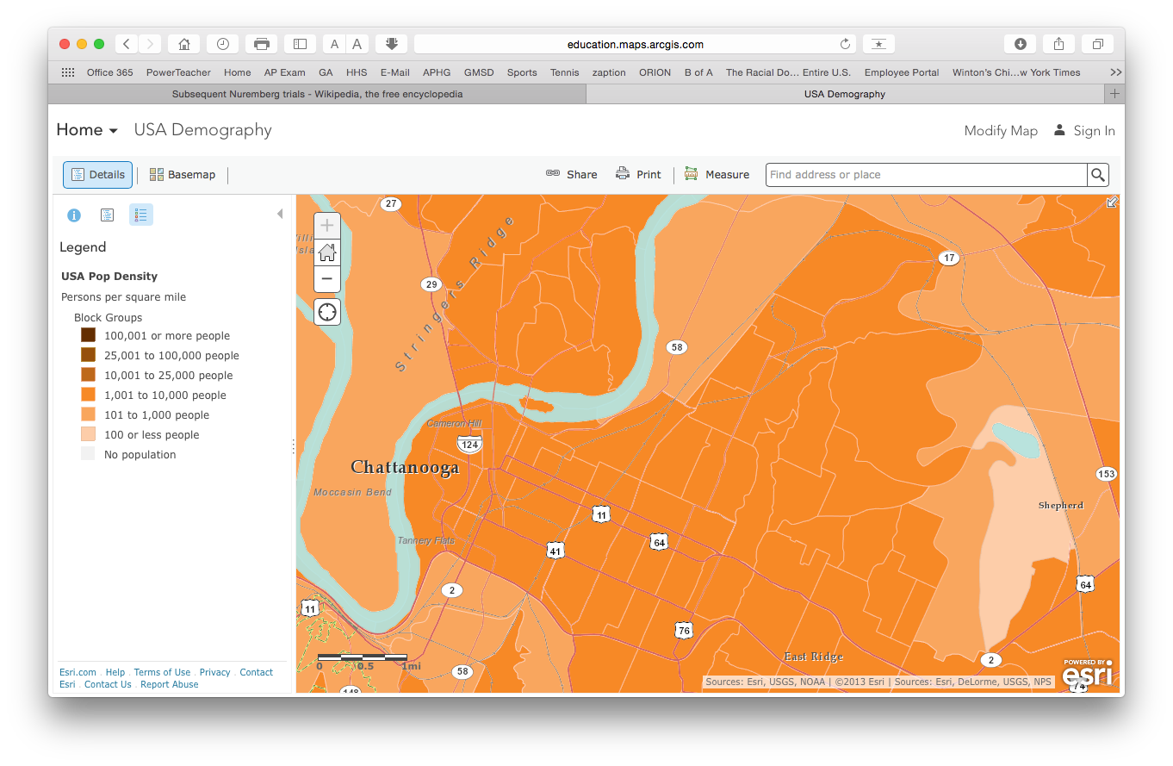

Slide 21
