Slide 1
Photo Analysis
What can be stated about physical geography as it relates to the photograph?
What can be stated about cultural geography as it relates to the photograph?
What would be a caption (4-7 words) for the photograph?

Slide 2
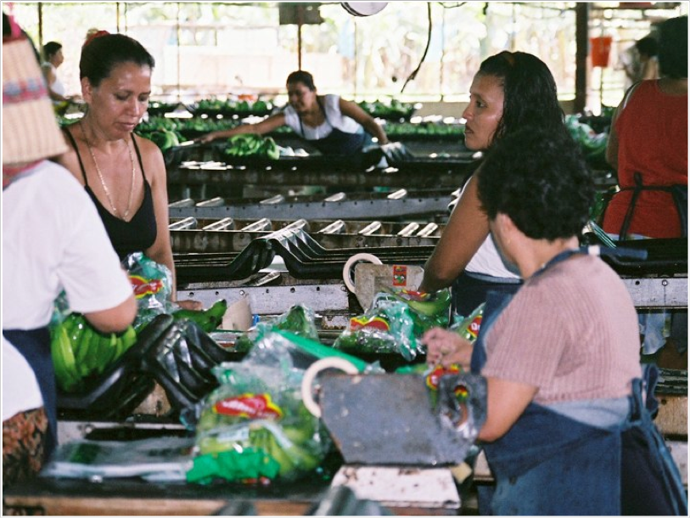
Physical
Cultural
Caption…
Guatamela

Slide 3
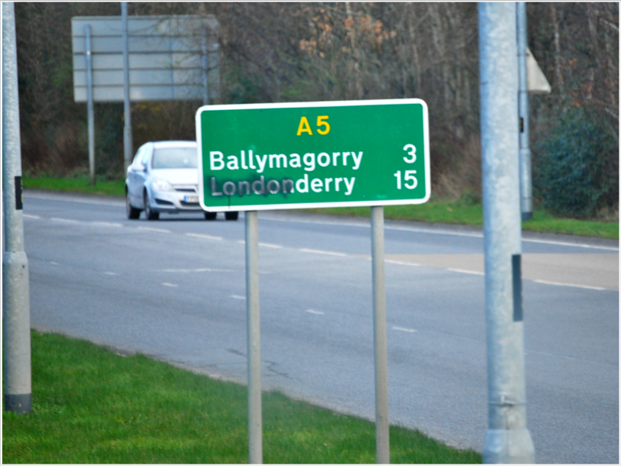
Physical
Cultural
Caption…
Northern Ireland

Slide 4
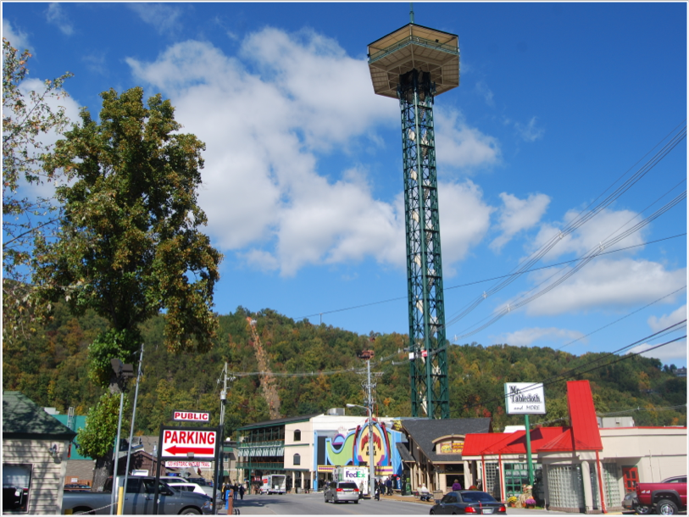
Physical
Cultural
Caption…
Gatlinburg, TN

Slide 5
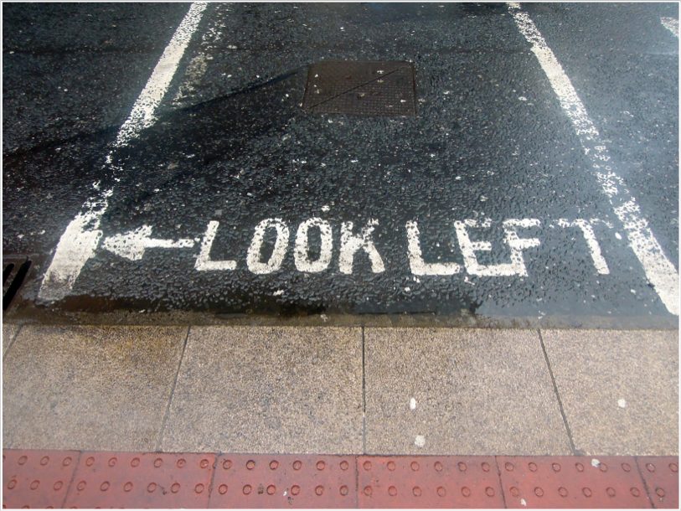
Physical
Cultural
Caption…
Ireland

Slide 6
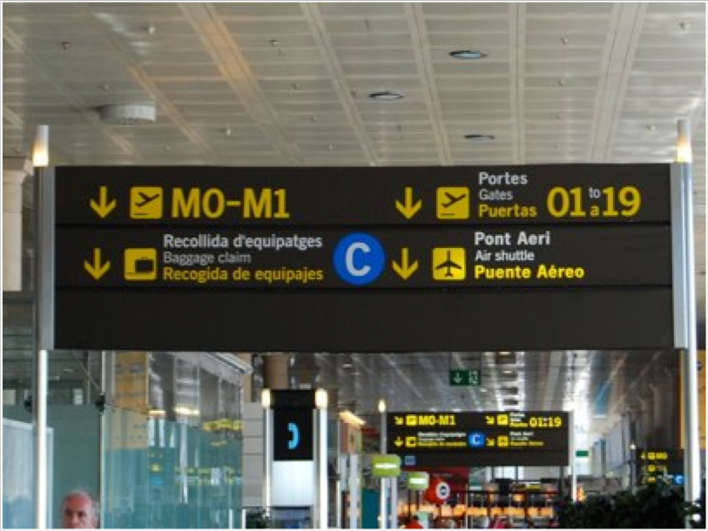
Physical
Cultural
Caption…
Barcelona, Spain

Slide 7
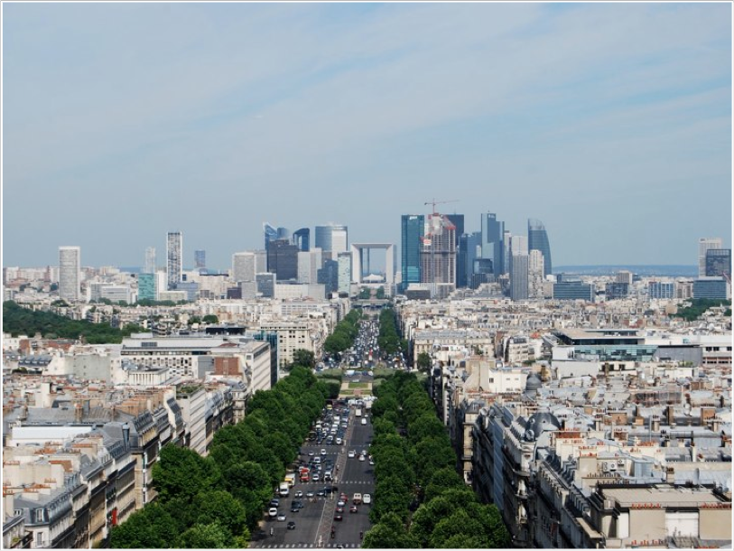
Physical
Cultural
Caption…
Paris, France

Slide 8
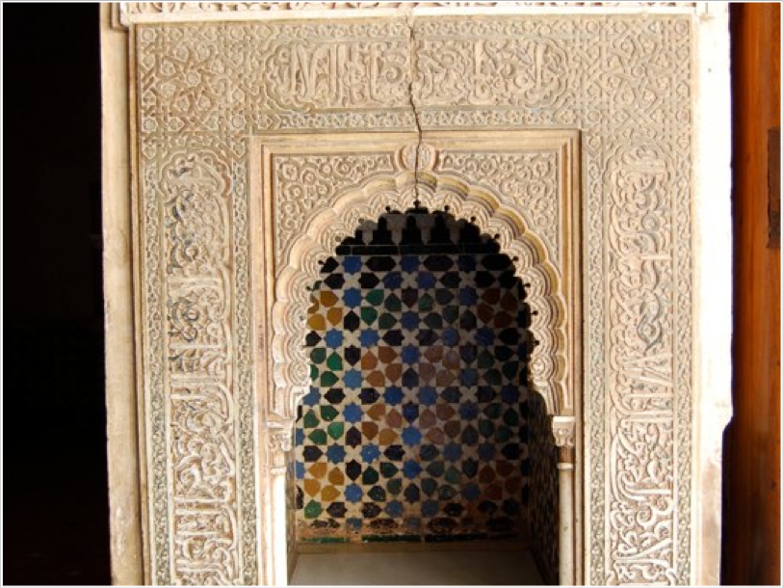
Physical
Cultural
Caption…
Spain

Slide 9
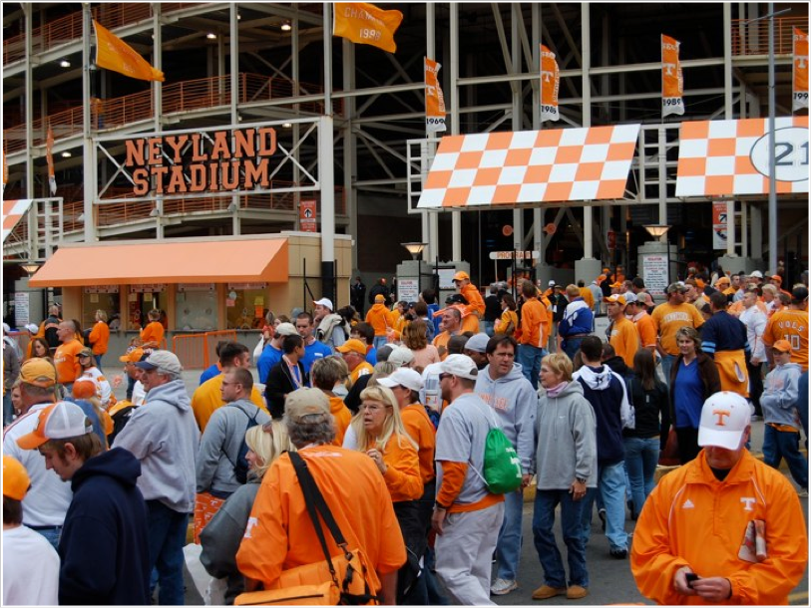
Physical
Cultural
Caption…
Knoxville, TN

Slide 10
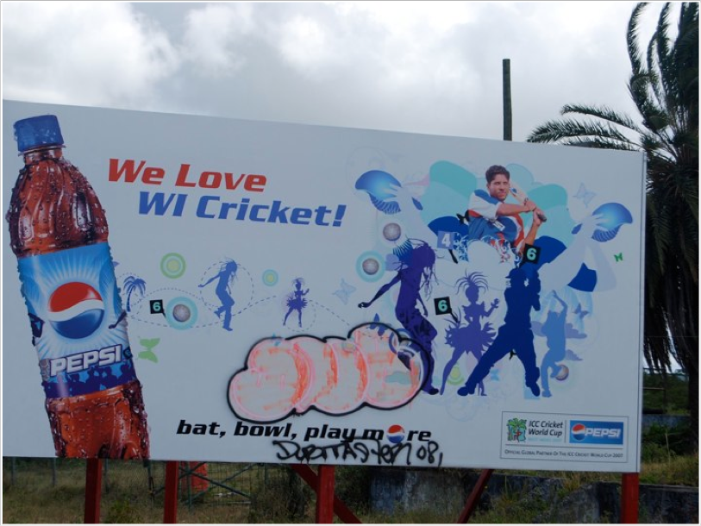
Physical
Cultural
Caption…
WI - West Indies
Antigua

Slide 11
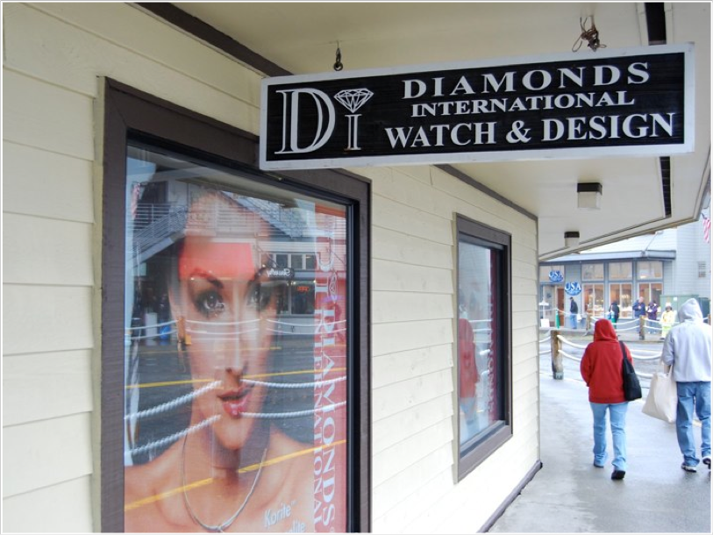
Physical
Cultural
Caption…
Ketchikan, Alaska

Slide 12
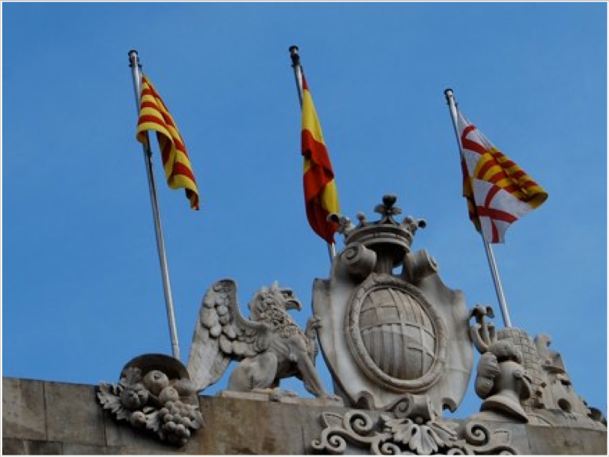
Physical
Cultural
Caption…
Barcelona, Spain

Slide 13
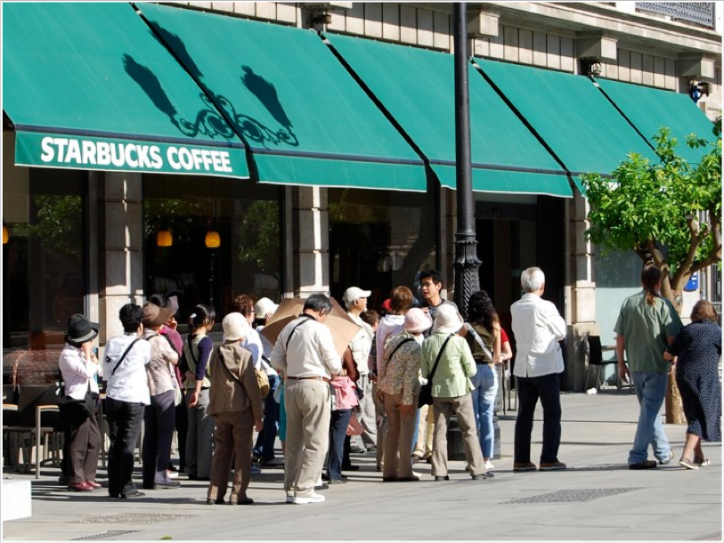
Physical
Cultural
Caption…
Spain

Slide 14
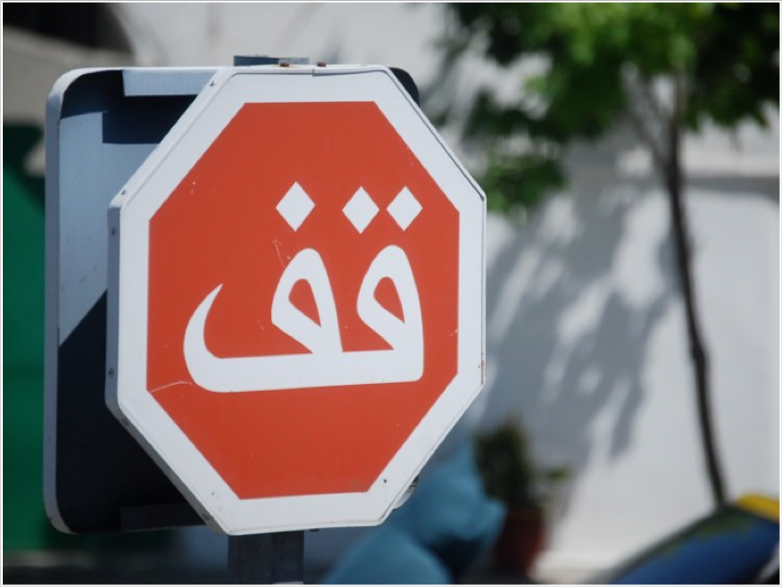
Physical
Cultural
Caption…
Morocco

Slide 15
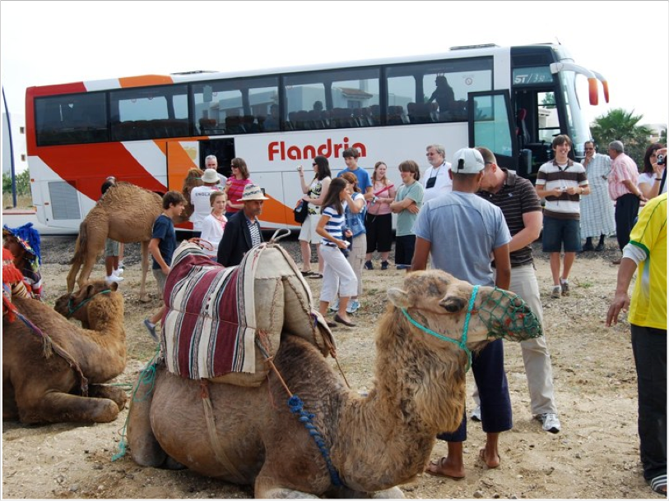
Physical
Cultural
Caption…
Morocco

Slide 16
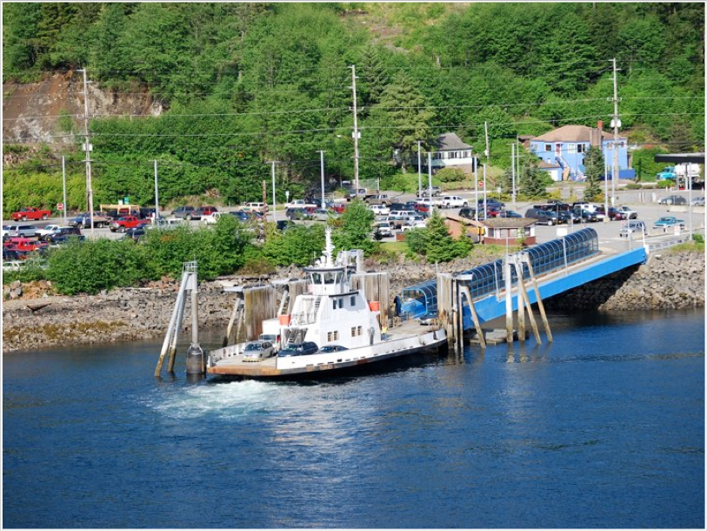
Physical
Cultural
Caption…
Alaska

Slide 17
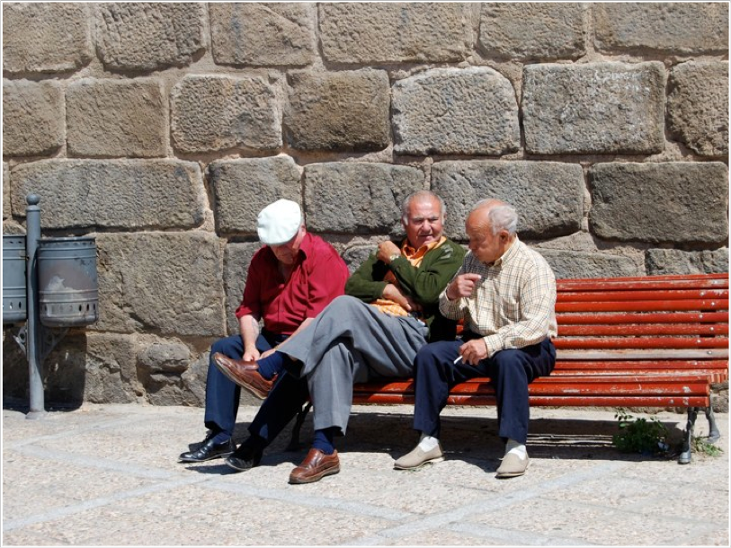
Physical
Cultural
Caption…
Spain

Slide 18
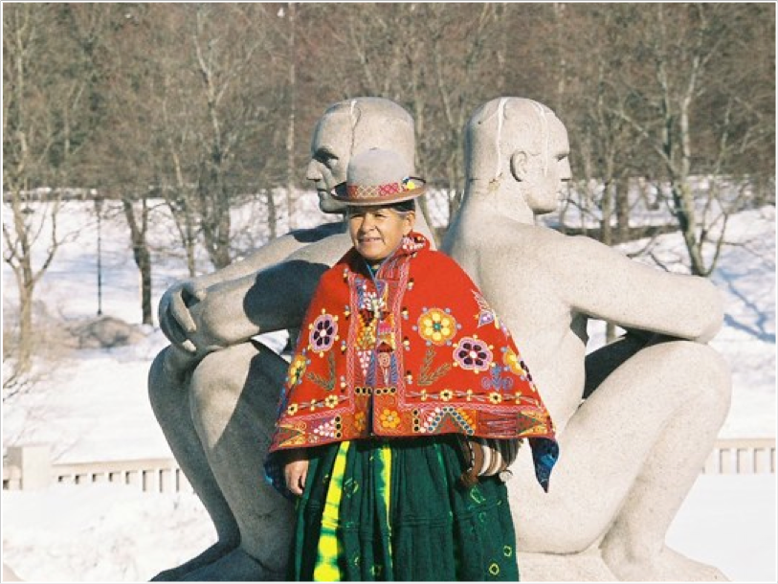
Physical
Cultural
Caption…
Oslo, Norway

Slide 19
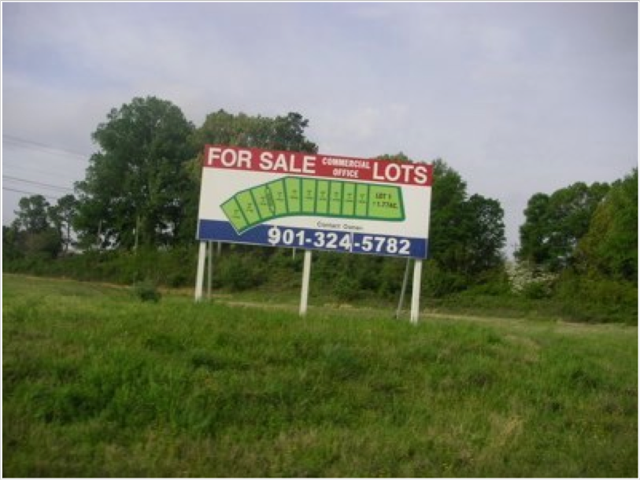
Physical
Cultural
Caption…
Tennessee

Slide 20
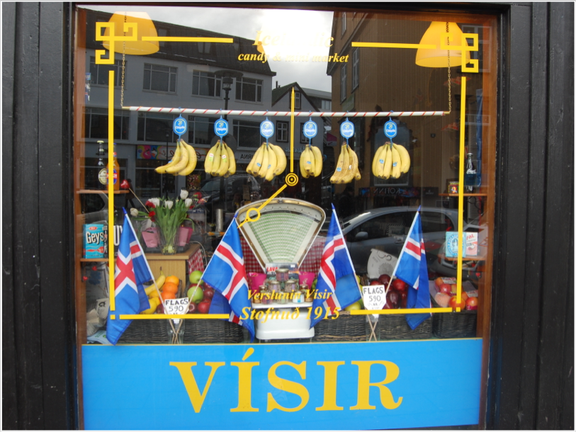
Physical
Cultural
Caption…
Iceland

Slide 21
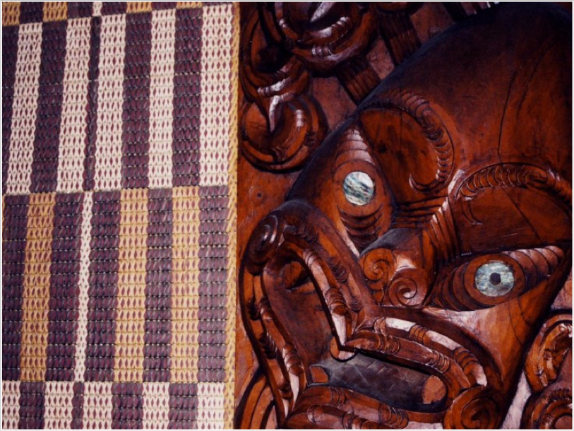
Physical
Cultural
Caption…
New Zealand

Slide 22
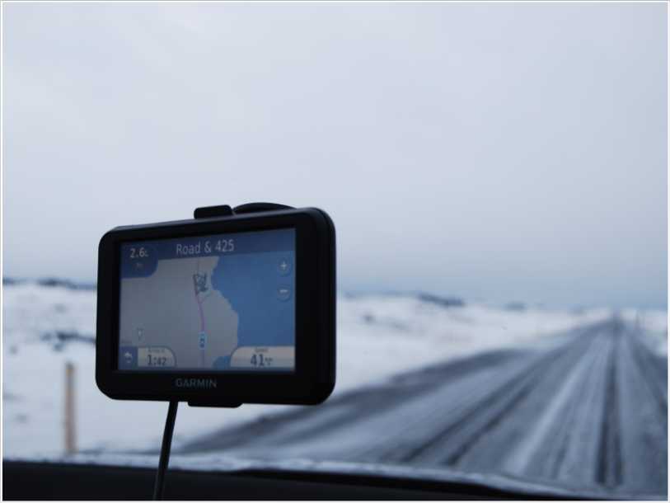
Physical
Cultural
Caption…
Iceland

Slide 23
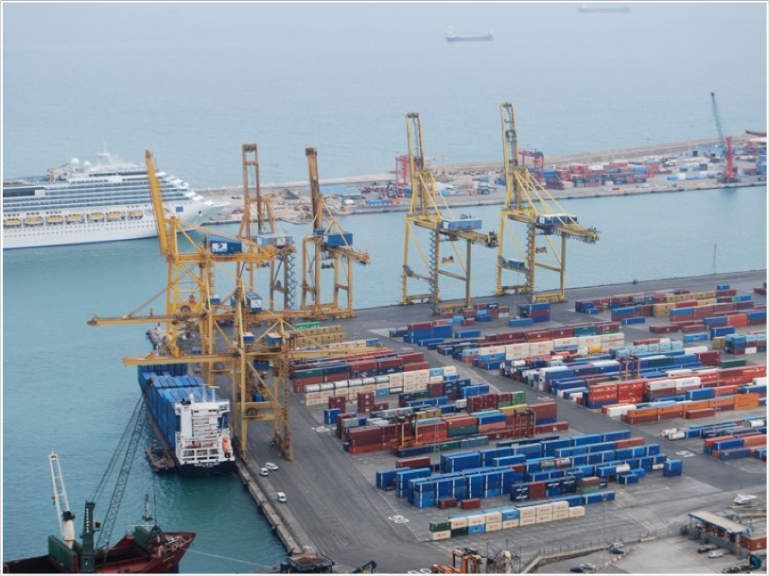
Physical
Cultural
Caption…
Seattle, WA

Slide 24
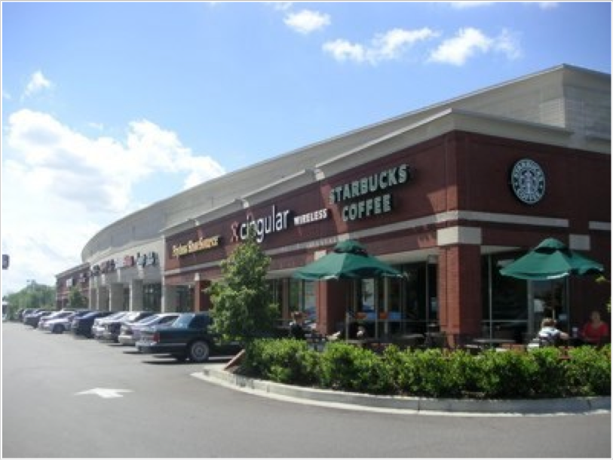
Physical
Cultural
Caption…
Tennessee

Slide 25
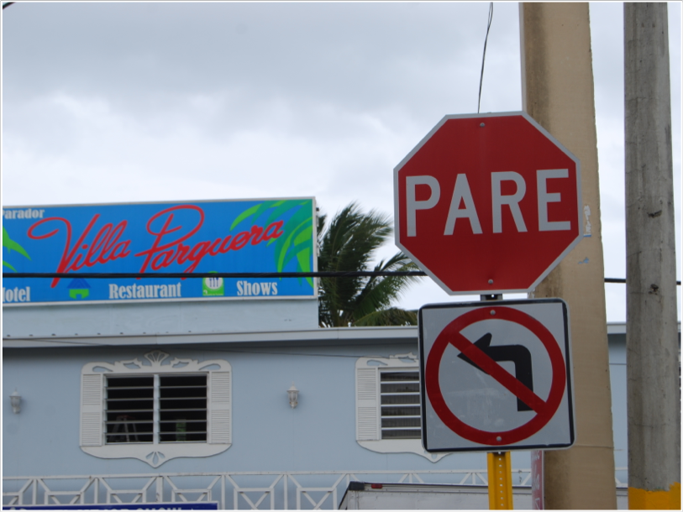
Physical
Cultural
Caption…
Puerto Rico

Slide 26
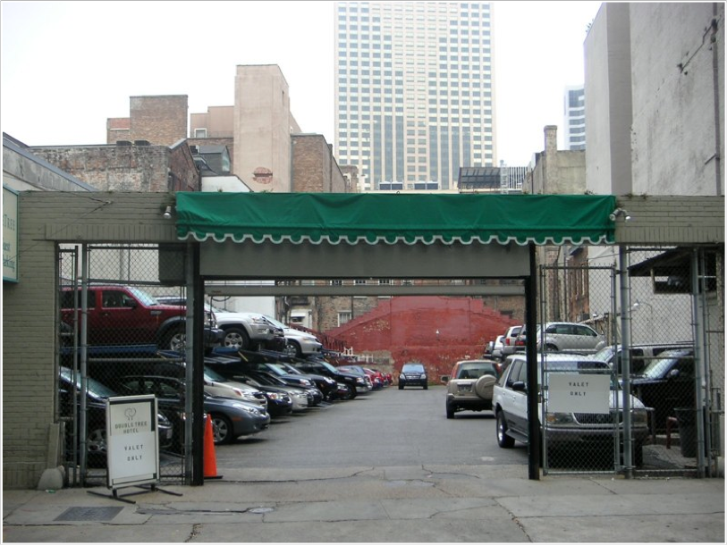
Physical
Cultural
Caption…
New Orleans, LA

Slide 27
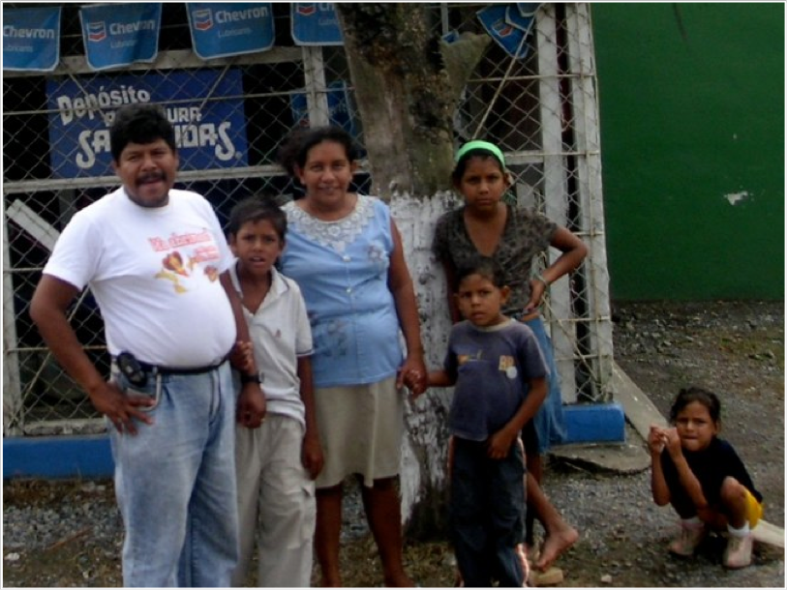
Physical
Cultural
Caption…
Guatemala

Slide 28
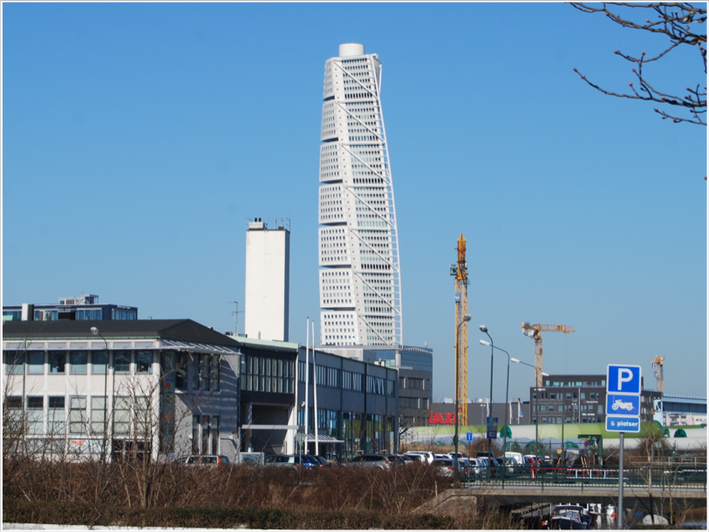
Physical
Cultural
Caption…
Sweden

Slide 29
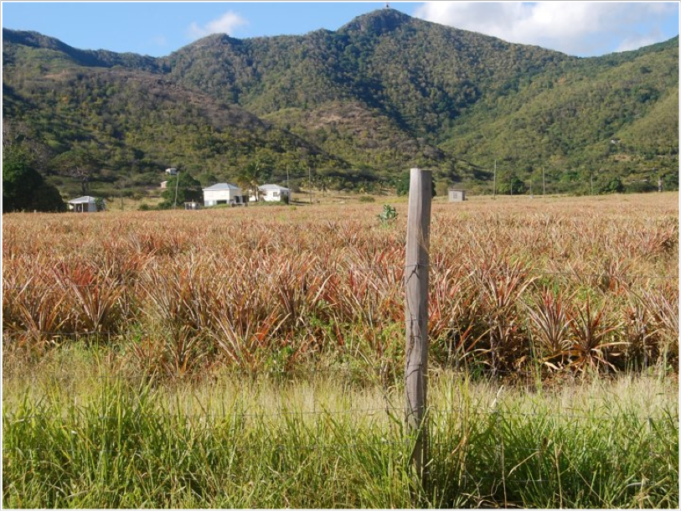
Pineapples
Physical
Cultural
Caption…
Antigua

Slide 30
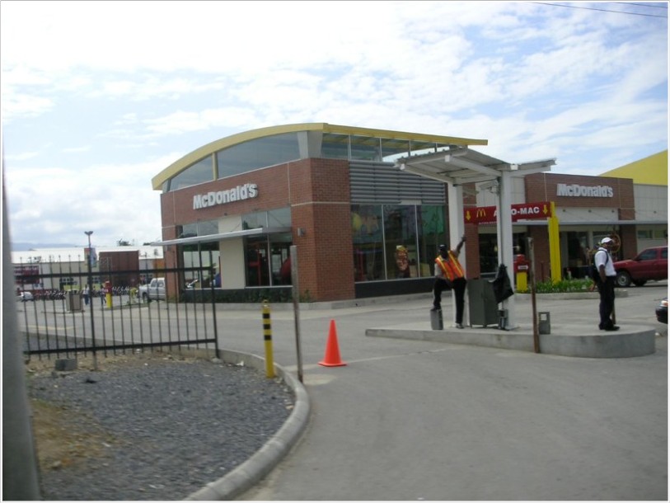
Physical
Cultural
Caption…
Guatemala

Slide 31
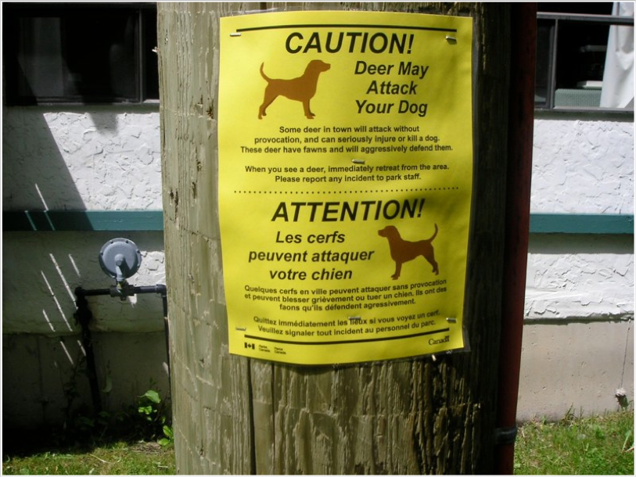
Physical
Cultural
Caption…
Canada

Slide 32
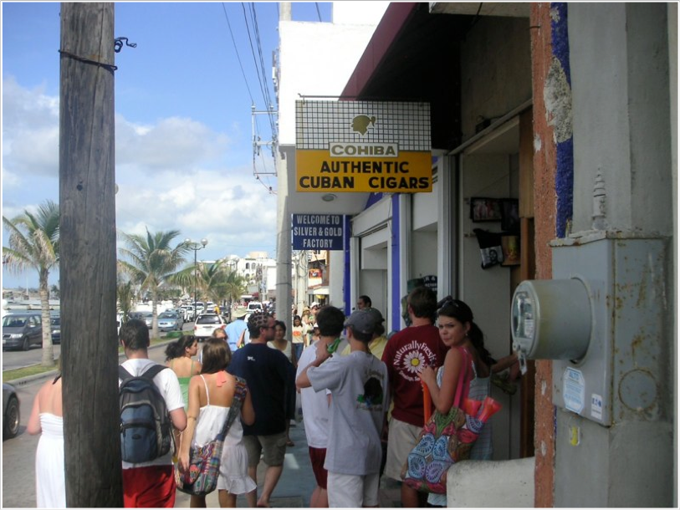
Physical
Cultural
Caption…
Cancun, Mexico

Slide 33
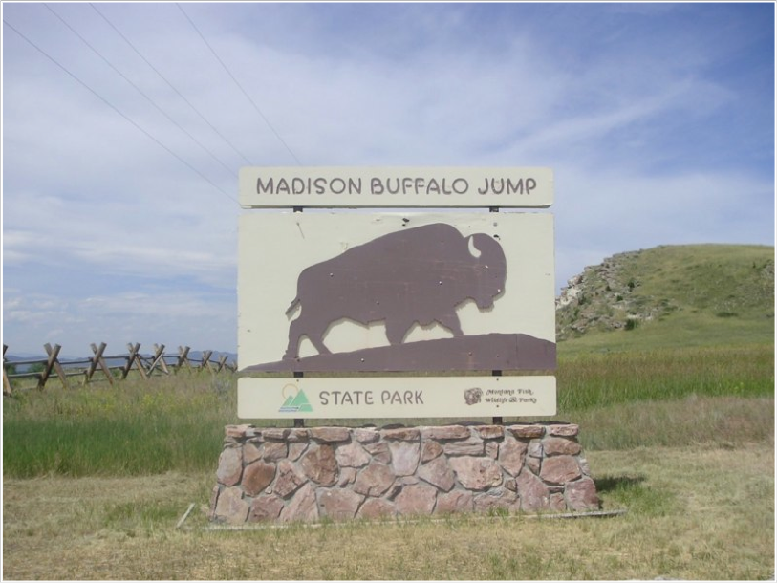
Physical
Cultural
Caption…
Montana

Slide 34
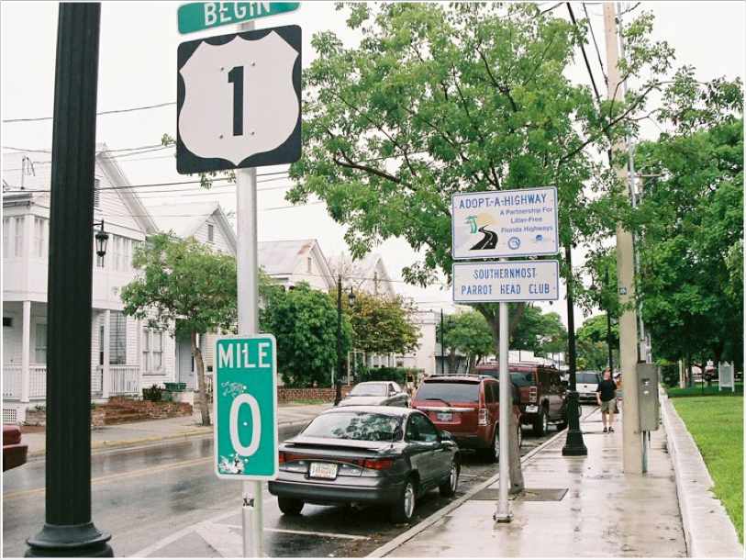
Physical
Cultural
Caption…
Key West, FL

Slide 35
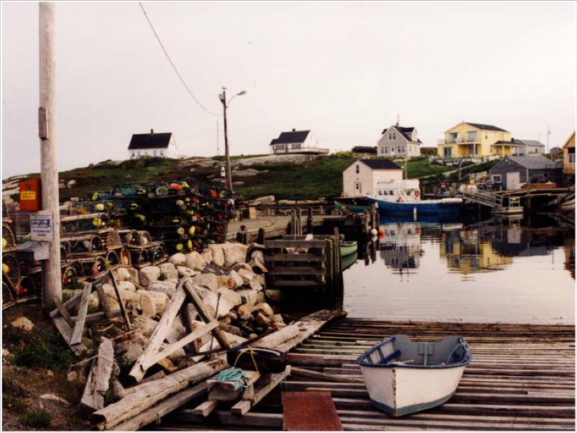
Physical
Cultural
Caption…
Nova Scotia, Canada

Slide 36
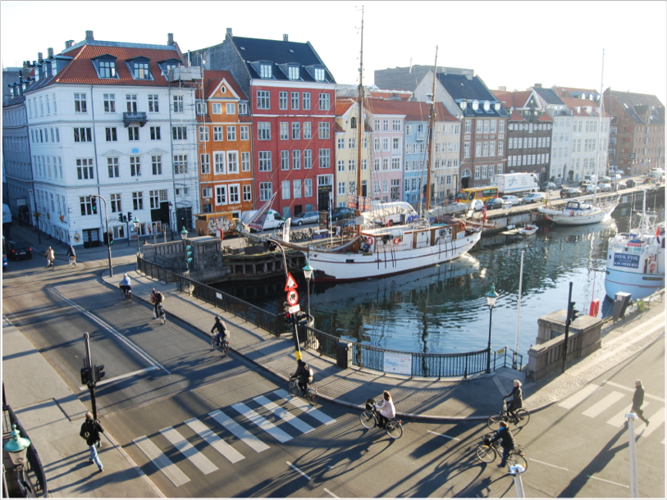
Physical
Cultural
Caption…
Denmark

Slide 37
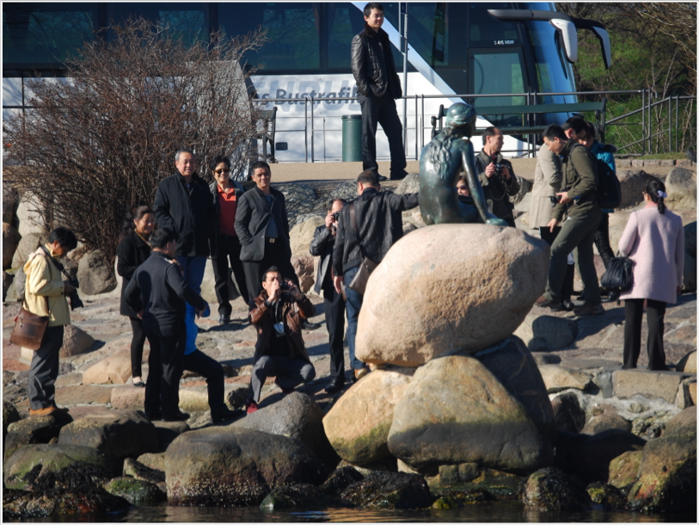
The Little Mermaid
Physical
Cultural
Caption…
Denmark

Slide 38
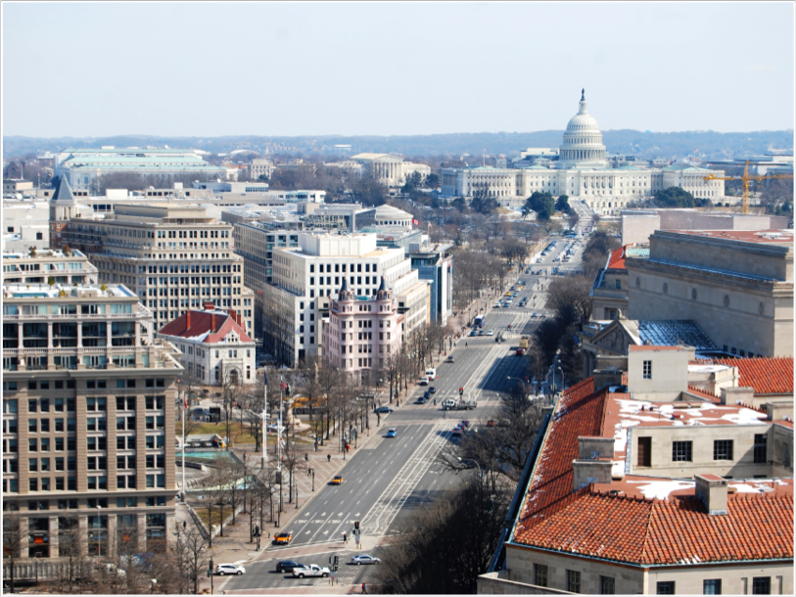
Physical
Cultural
Caption…
Washington, DC

Slide 39
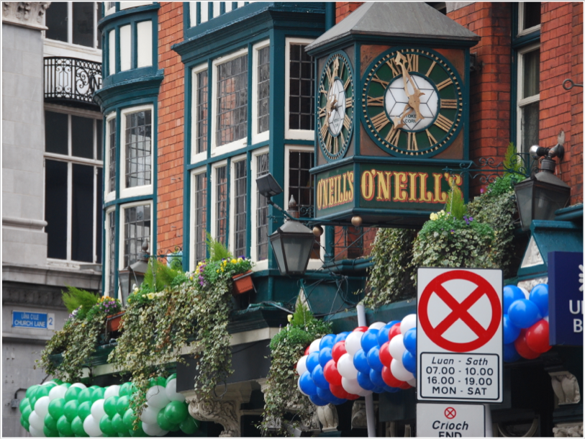
Physical
Cultural
Caption…
Dublin, Ireland

Slide 40
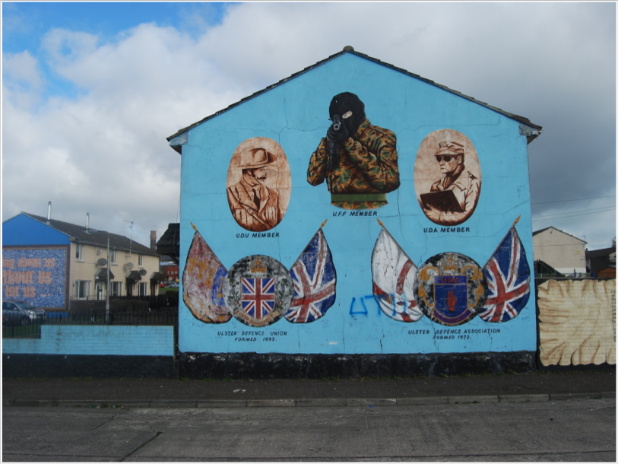
Physical
Cultural
Caption…
Northern Ireland

Slide 41
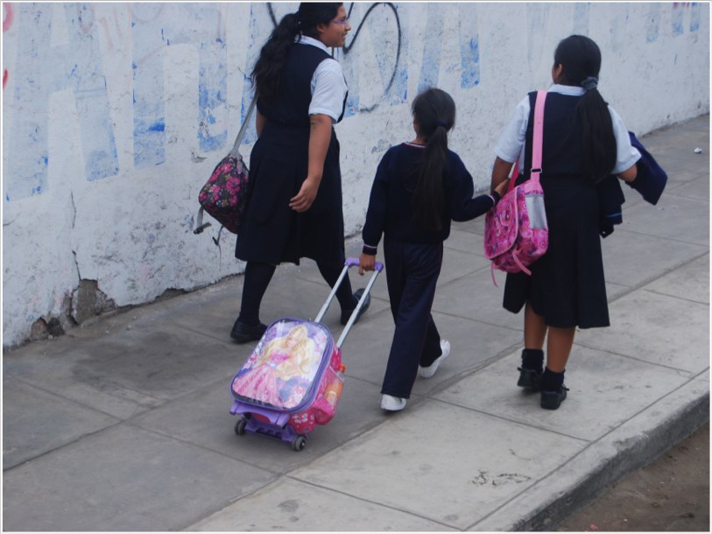
Physical
Cultural
Caption…
Peru

Slide 42
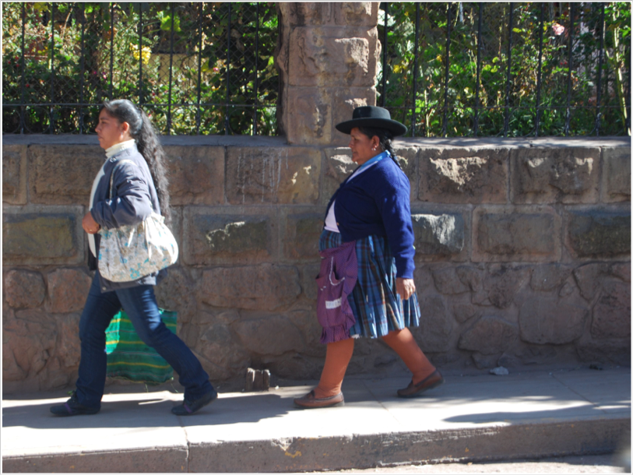
Physical
Cultural
Caption…
Peru

Slide 43
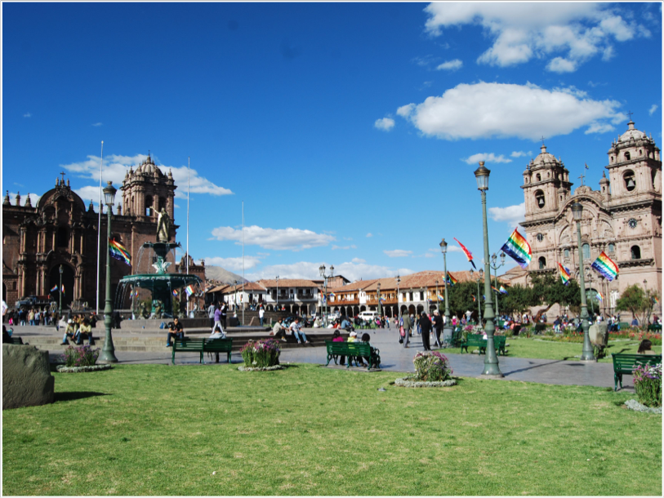
Physical
Cultural
Caption…
Peru

Slide 44
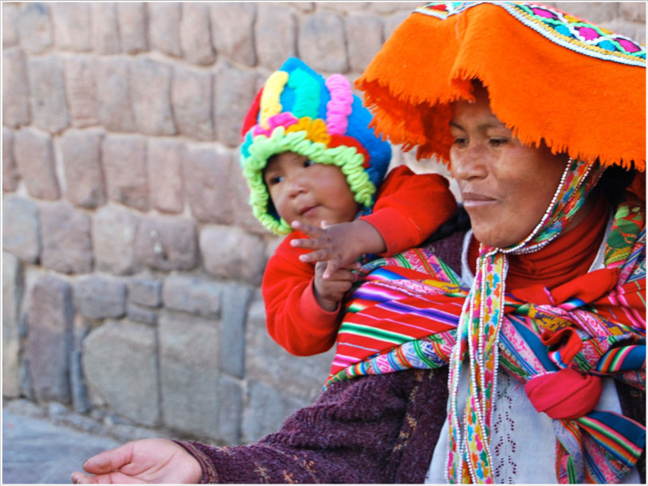
Physical
Cultural
Caption…
Peru

Slide 45
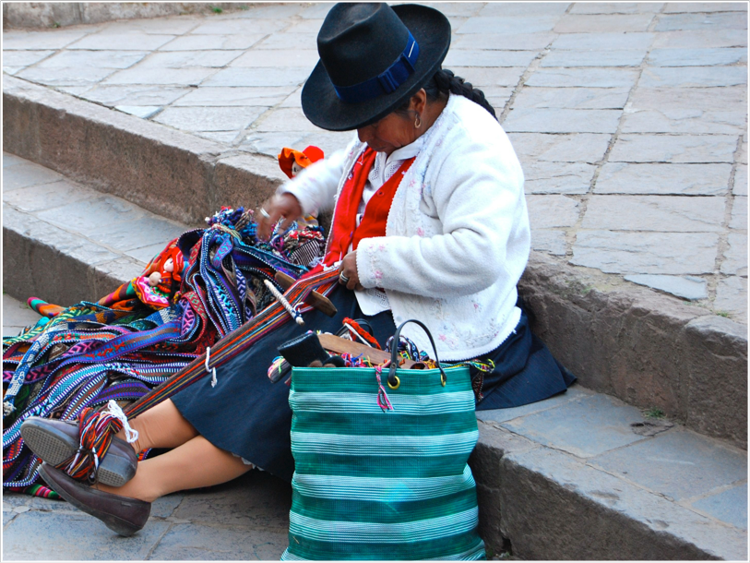
Physical
Cultural
Caption…
Peru

Slide 46
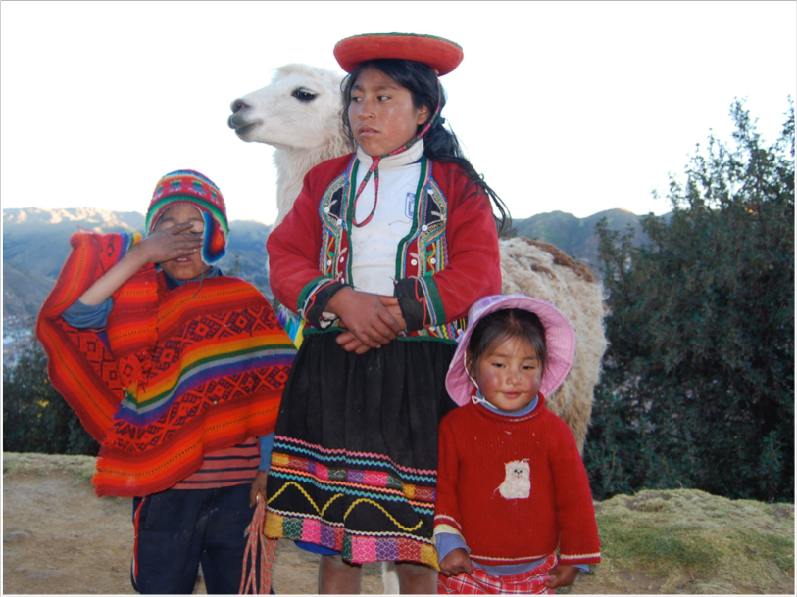
Physical
Cultural
Caption…
Peru

Slide 47
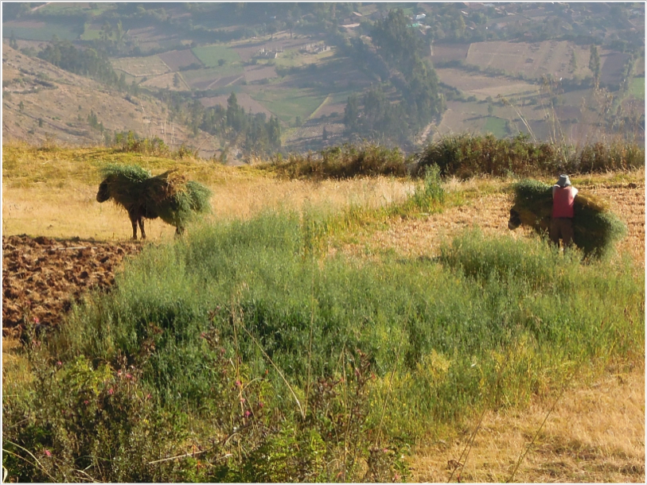
Physical
Cultural
Caption…
Peru

Slide 48
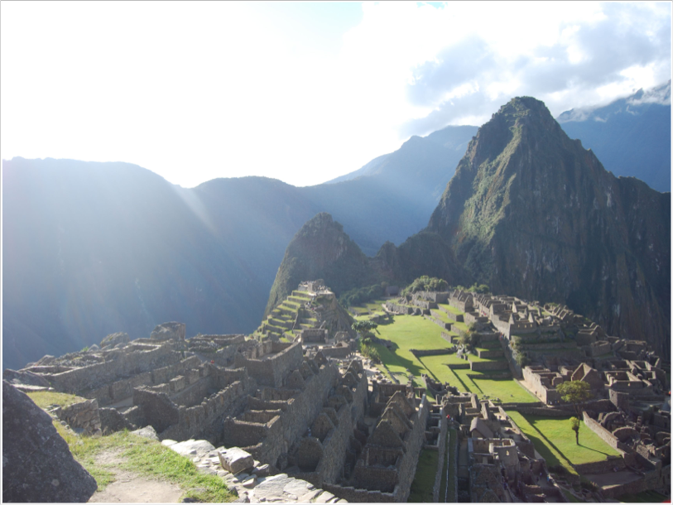
Physical
Cultural
Caption…
Peru

Slide 49
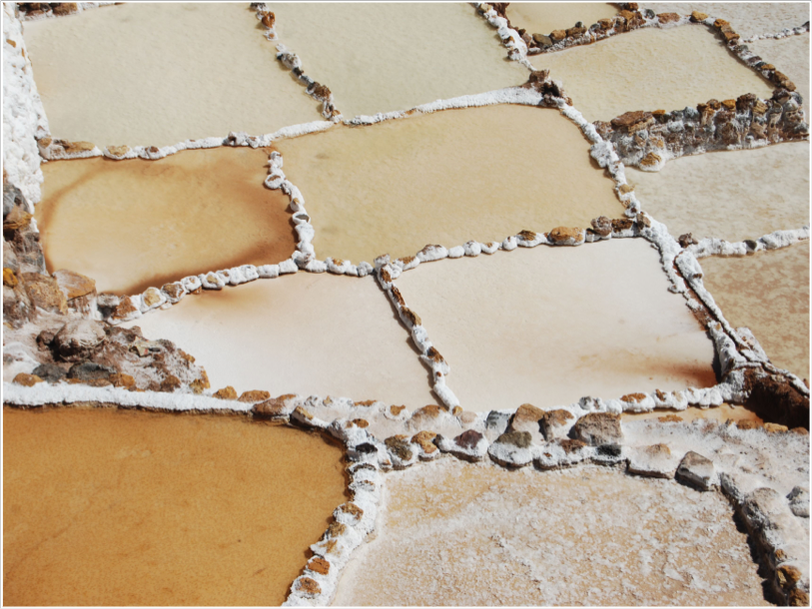
Salt
Physical
Cultural
Caption…
Peru

