Slide 1
Social Studies Standards
Third Grade

Slide 2
Northern Africa
and Middle East
Third Grade Social Studies Standards

Slide 3
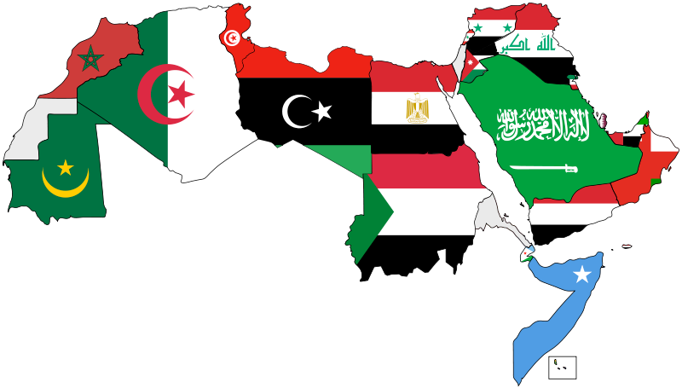
MIDDLE EAST
NORTHERN AFRICA

Slide 4
The Middle East- Climate
Dry Realm
Sahara and Arabian Deserts
climates: Arid, Semiarid, and Mediterranean
Hot Days and Cooler Nights (High Pressure)
poor/thin soils

Slide 5
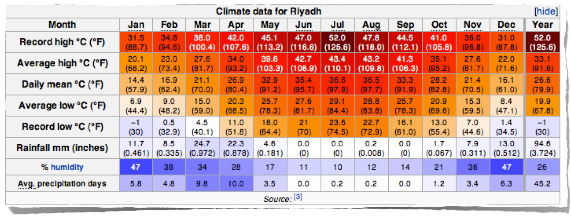
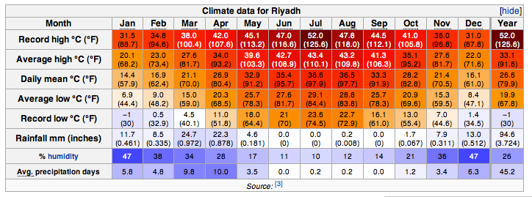

Slide 6
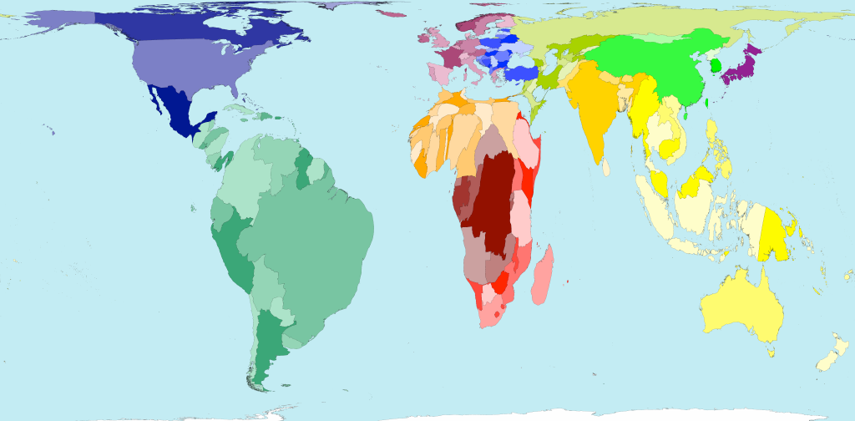
Rainfall

Slide 7
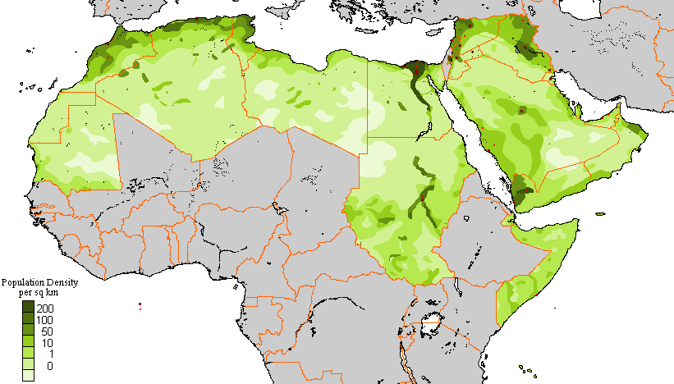
Where do most people live?

Slide 8
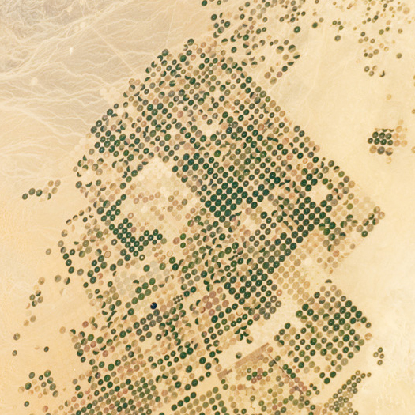

Slide 9
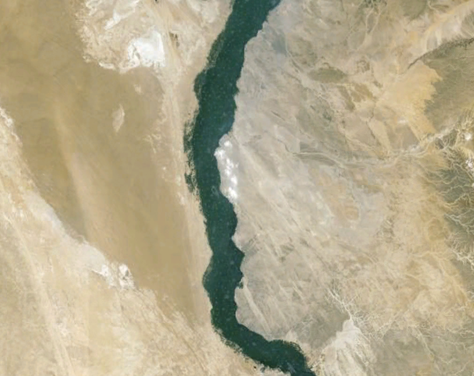

Slide 10
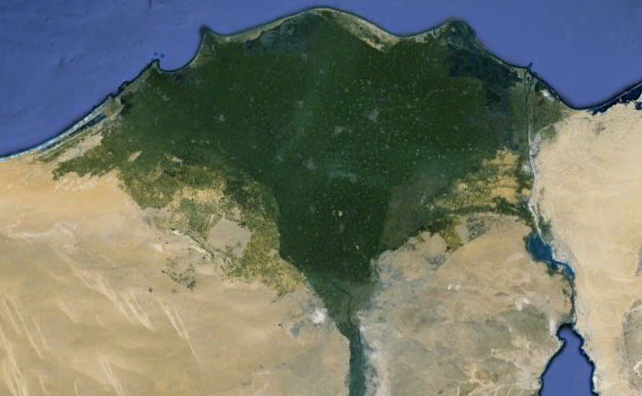

Slide 11
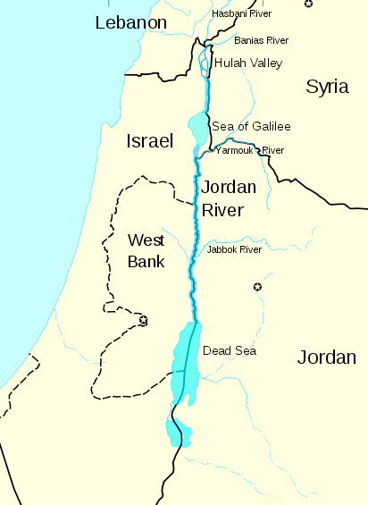
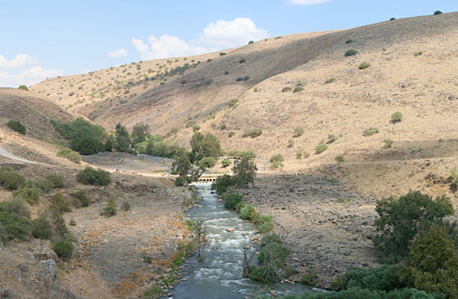
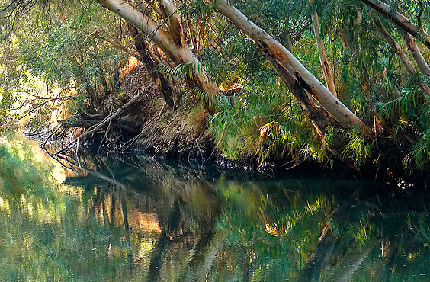
Jordan River

Slide 12
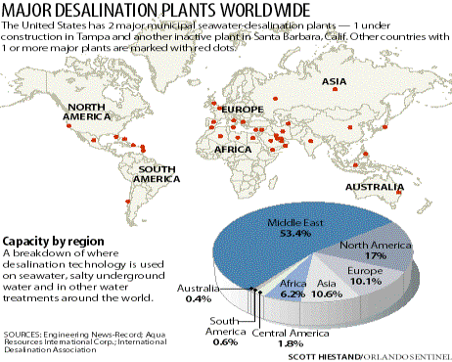

Slide 13
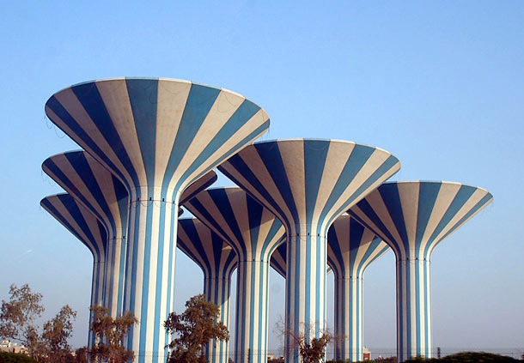

Slide 14
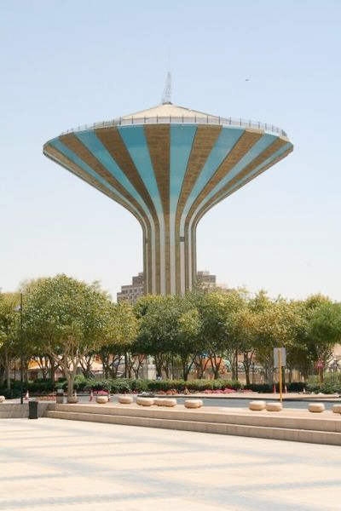
Water in Riyadh
About 50% of drinking water comes from desalination, 40% from the mining of non-renewable groundwater and 10% from surface water, especially in the mountainous South-West of the country.
The capital Riyadh, located in the heart of the country, is supplied with desalinated water pumped from the Persian Gulf over a distance of 467 km. Given the substantial oil wealth, water is provided almost for free.

Slide 15
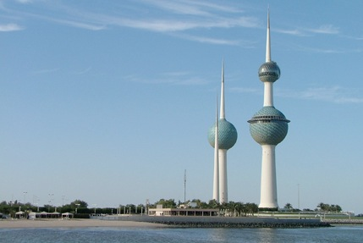

Slide 16
World's Largest Desalination Plant
in Saudi Arabia

Slide 17
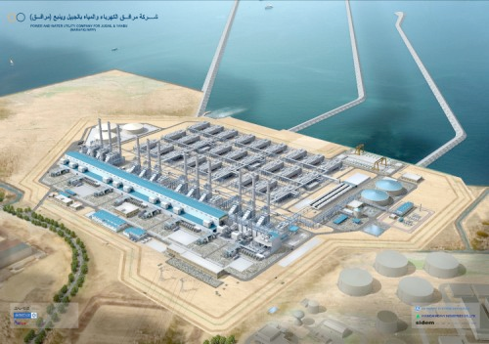
Saudi Arabia Opens World's Largest Desalination Plant

Slide 18
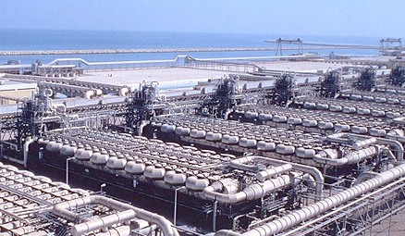
Desalination Plant
Saudi Arabia

Slide 19
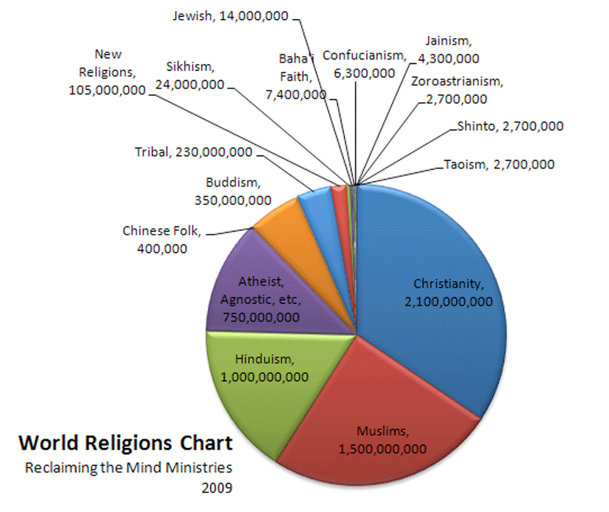

Slide 20
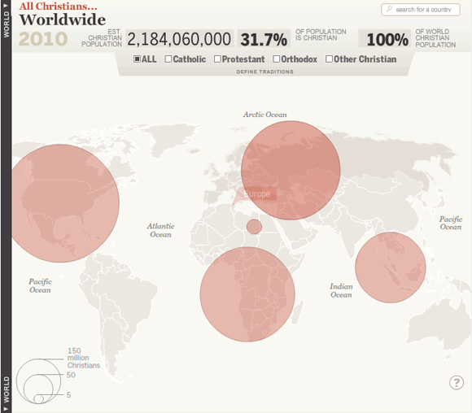

Slide 21
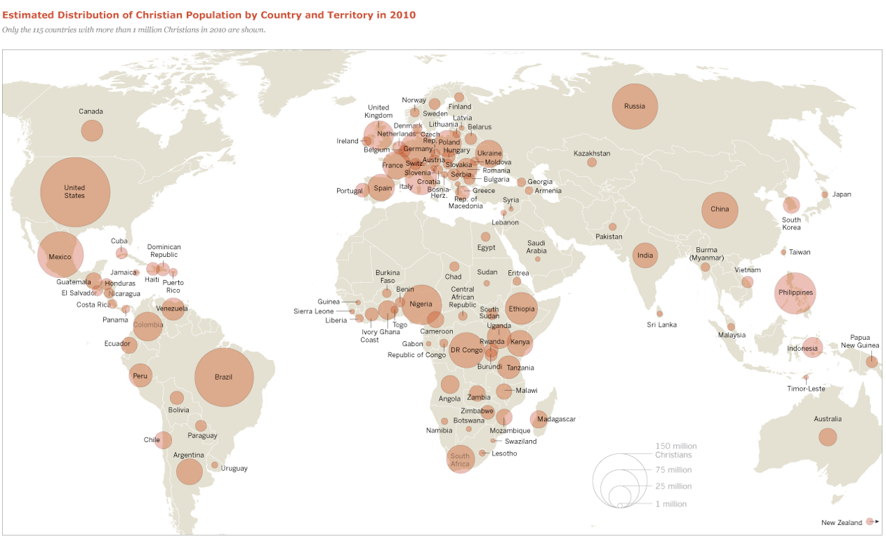

Slide 22
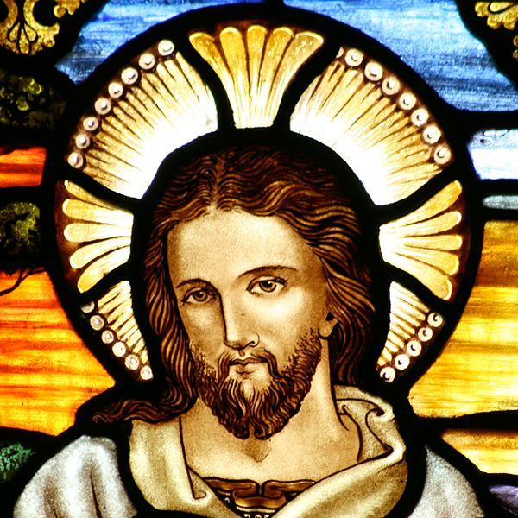

Slide 23
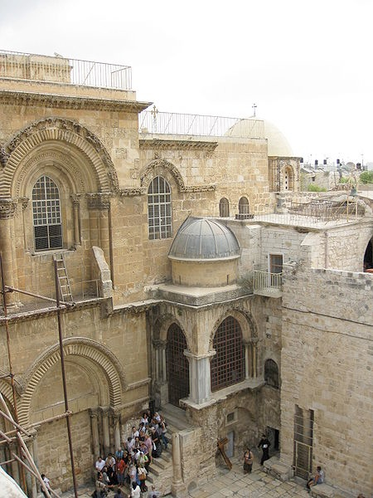
Holy Church of the Sepulchre

Slide 24
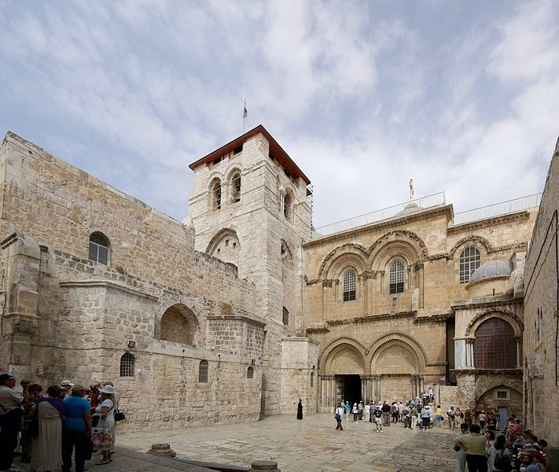
Holy Church of the Sepulchre

Slide 25
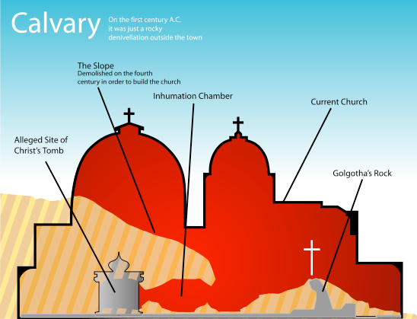

Slide 26
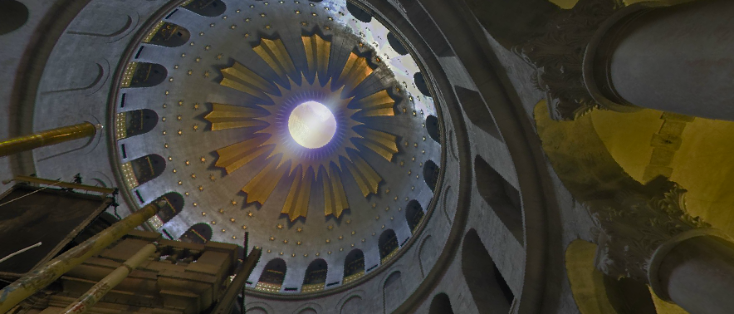

Slide 27
Christianity
2.1-2.2 Billion Followers (largest in the world).
Follows the teachings of the Holy Bible and Jesus Christ’s teachings (some use parables).
Jesus is the Messiah (Son of God) sent to the earth for the salvation of mankind.
Main Divisions: Roman Catholics (1.2 billion), Protestants (600-800 million), Eastern Orthodoxy (230 million)
Major Holidays: Christmas and Easter
Holy / Important Cities: Jerusalem, Rome (The Vatican), Bethlehem

Slide 28
The Middle East- Religion
Islamic Realm
Major religion of most people in Northern Africa and Middle East
Spread outside the region into Africa, Europe, and eastern Asia--largest Islamic countries: Pakistan, India, Indonesia, Bangladesh
Not everyone is a Muslim (follower of Islam)...
Jews in Israel and Christians in Lebanon

Slide 29
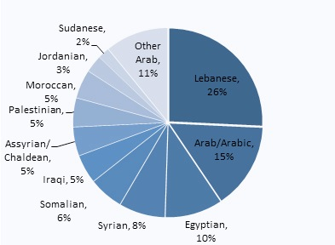

Slide 30
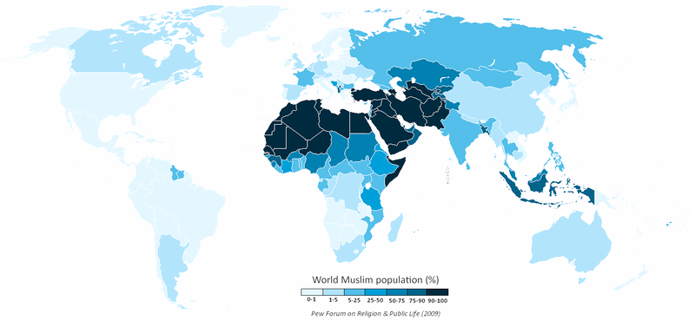
Muslims in Middle East and Northern Africa
321 million Muslims
91% of the overall population

Slide 31
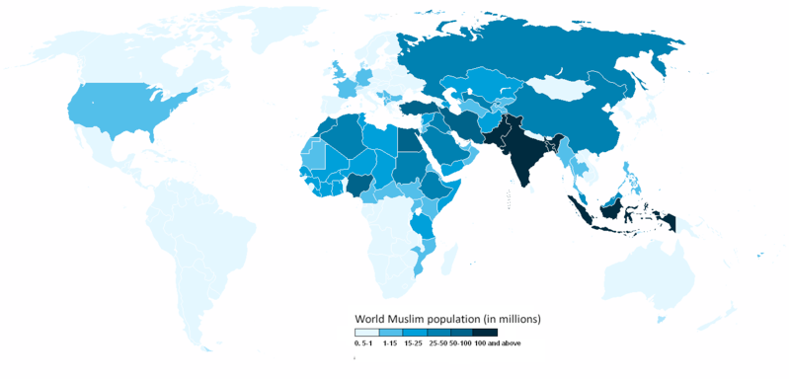
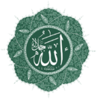
Islam by Country

Slide 32
Muslims Around the World
Complete the following:
1. Most of the world’s Muslims are not _______________________________________.
2. Most of the world’s Muslims live in _______________________________________.
3. Those who live in the Middle East are more likely to be ______________________.
Arabic or living in the Middle East
in South and Southeast Asia
Arabic and Muslim

Slide 33
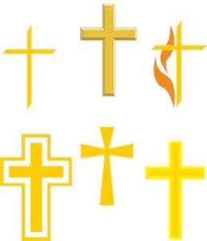
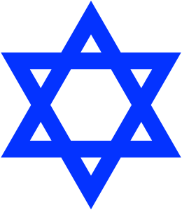
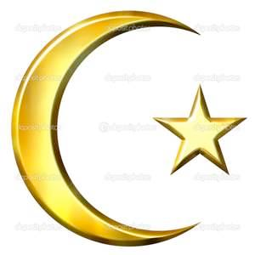

Slide 34
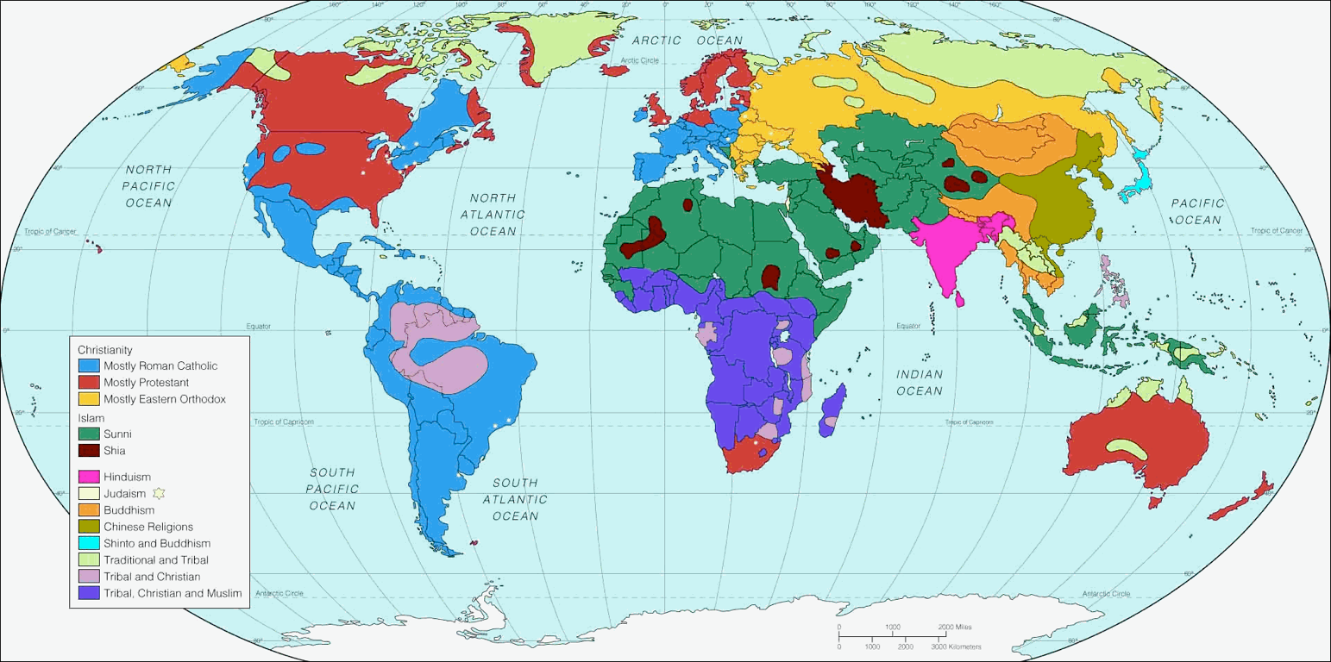
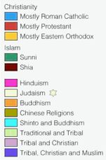

Slide 35
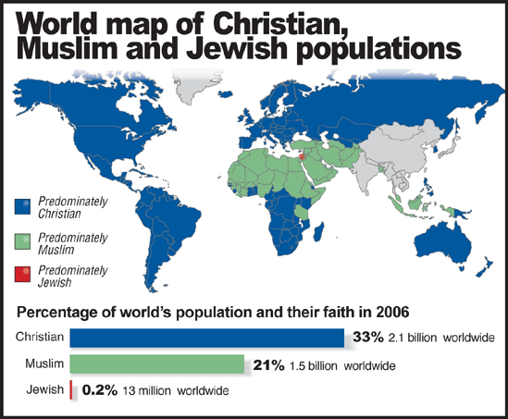

Slide 36
Judaism
Anyone born of Jewish stock and anyone who professes the Jewish religion.
They believe they are the chosen people of God, born to carry out the mission of bringing the whole world to his service.
Converts have been few and the majority of Jews are born Jews...ethnic religion.
Three main types of Judaism: Orthodox, Conservative, and Reform.

Slide 37
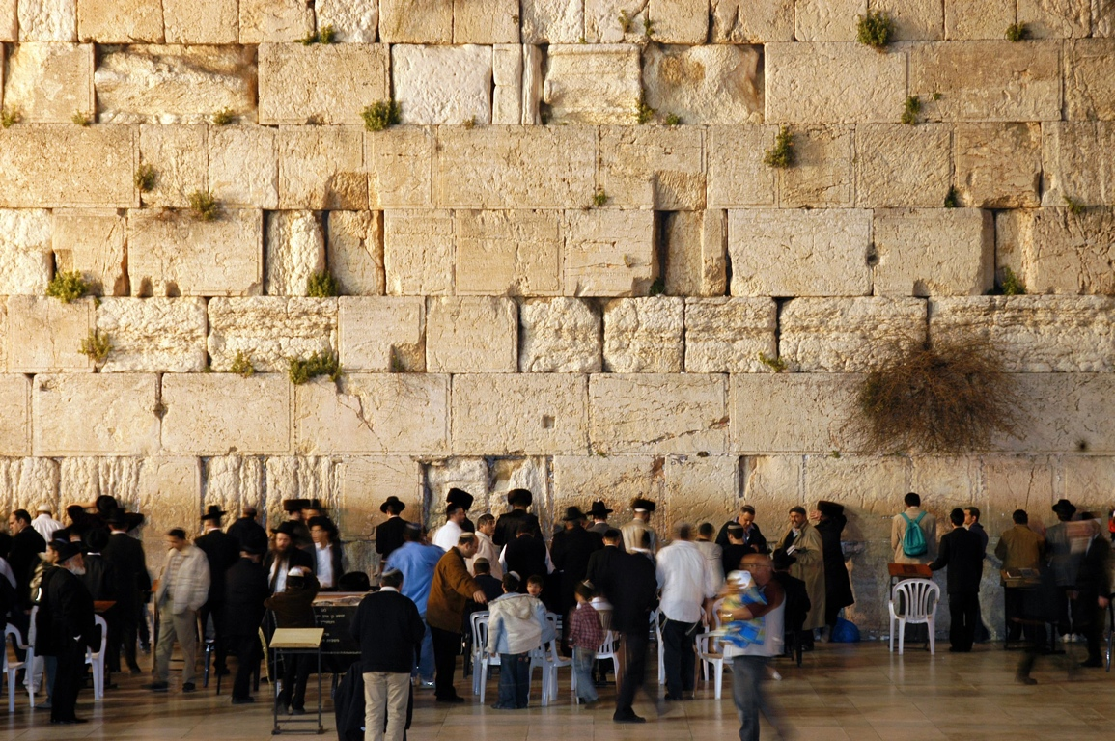

Slide 39
Bar Mitzah
Boy turns 13 (adult status)

Slide 40
Bat Mitzah
Boy turns 13 (adult status)

Slide 41
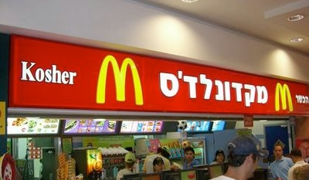
Kosher McDonald’s
2012

Slide 42
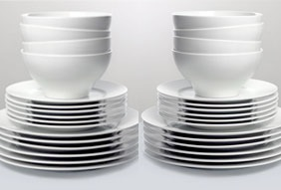
Keeping Kosher

Slide 43
Islam
means “submissive” to God (Allah).
religion based on the teachings of Muhammad.
youngest of the world’s major religions.
1.6 Billion followers around the world.
a revision and expansion of Jewish and Christian religions.
Muslim is a follower of the Islamic religion.

Slide 44
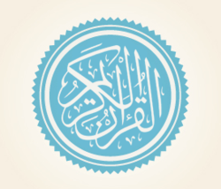
Quran

Slide 45
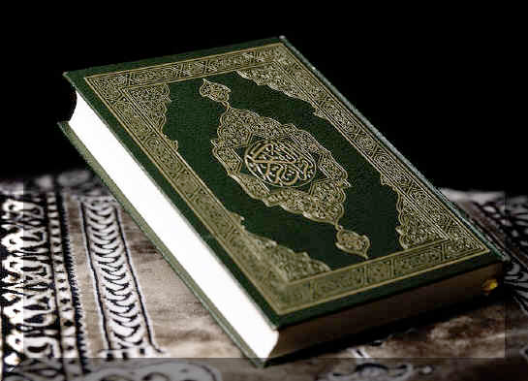
What is different about this book?

Slide 46
The Five Pillars
1- Shahada
Prayer which says:
“There is no God but Allah, and Muhammad is the messenger of Allah.”

Slide 47
The Five Pillars
2- Salat
This is the Muslim requirement to pray 5 times each day toward Mecca (Makkah): dawn, noon, afternoon, sunset, evening.

Slide 48
The Five Pillars
3- Zakat
Zakat means almsgivng (giving to the poor and sick). The Quran (Koran)

Slide 49
The Five Pillars
4- Sawm
Requirement that Muslims fast during the month of Ramadan (9th month in the Islamic calendar).

Slide 50
The Five Pillars
4- Sawm
NO food or drink is allowed from sun up to sun down for the entire month.
Exceptions: elderly, children, sick, pregnant women.

Slide 51
The Five Pillars
5- Hajj
The Hajj is the pilgrimage to Mecca which every Muslim is expected to make at least once in his/her lifetime.

Slide 52
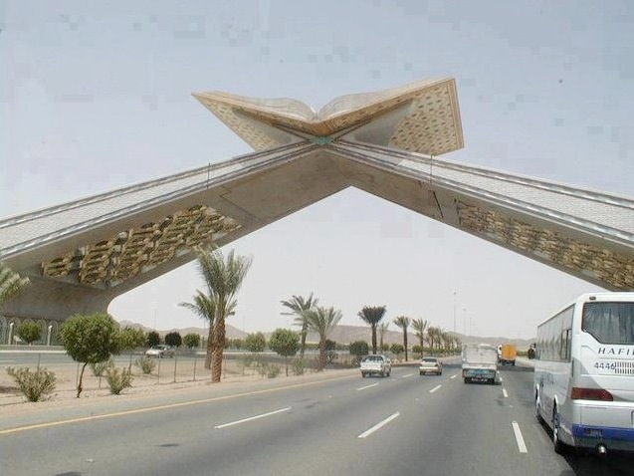

Slide 53
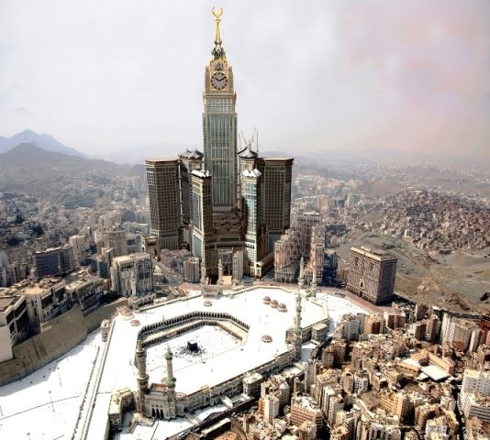

Slide 54
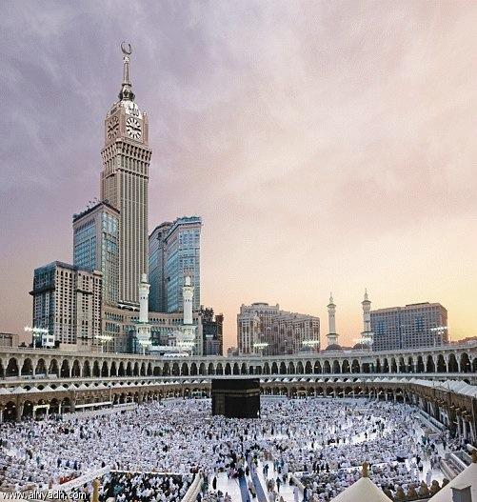

Slide 56
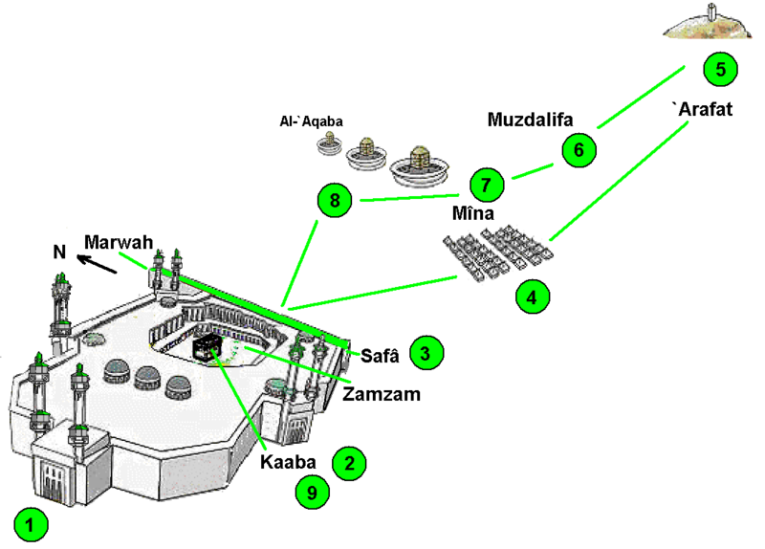

Slide 57
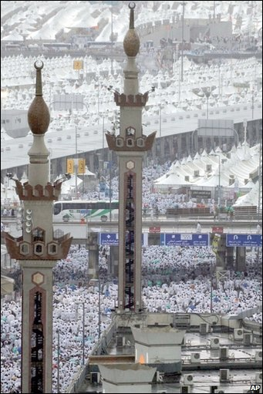

Slide 58
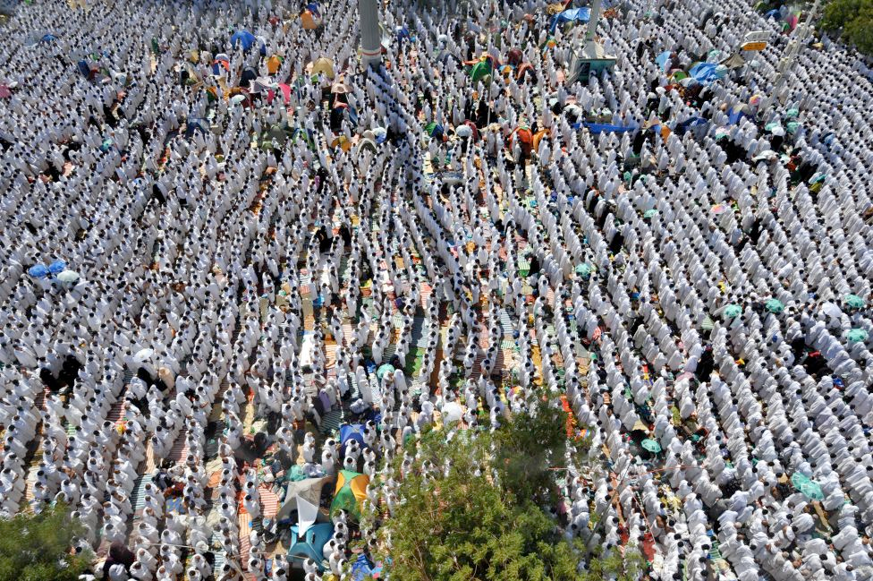

Slide 59
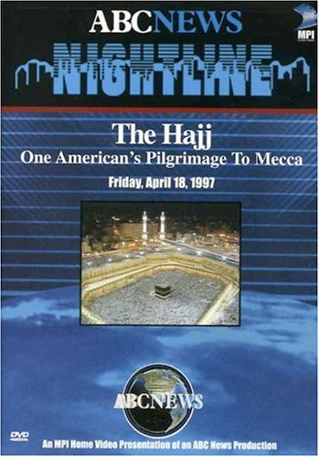
The Hajj Video Facts
Write out one fact for each minute of the video.
The video will be stopped at 11 minutes to discuss the first half.
21 Total Facts
and
Additional Facts from the class discussion.

Slide 60
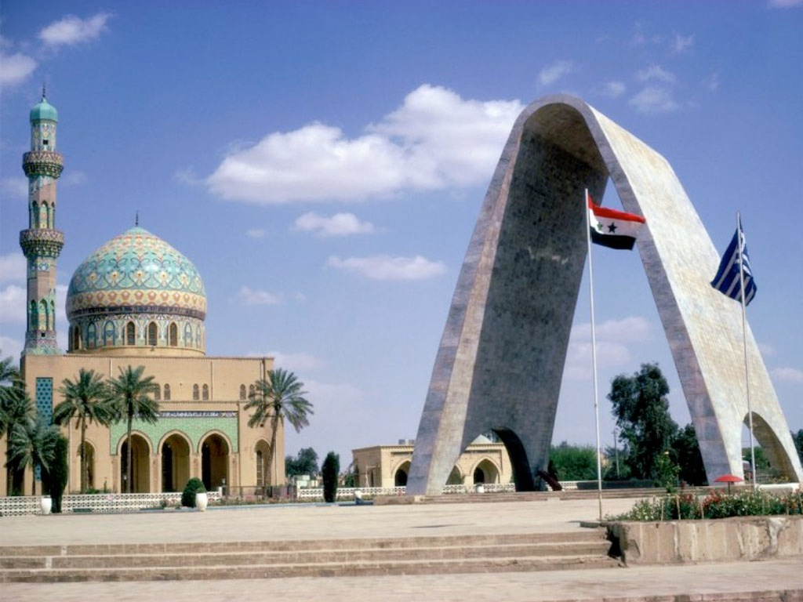

Slide 61
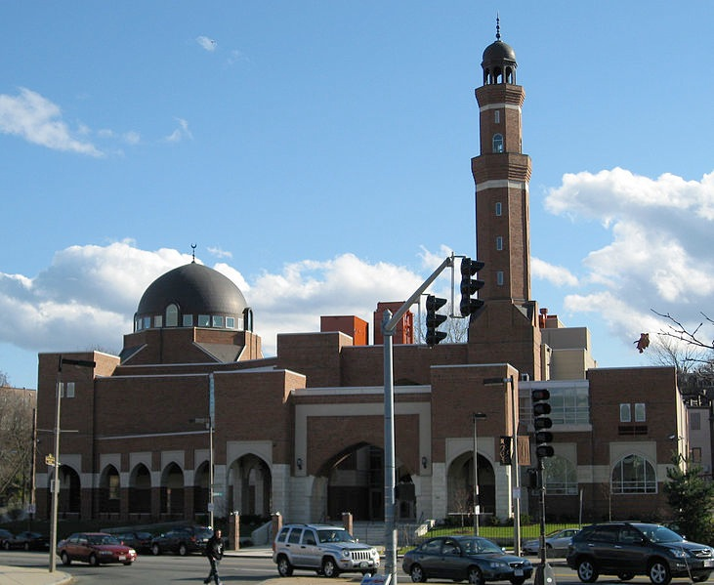
Mosque in Boston, USA

Slide 62
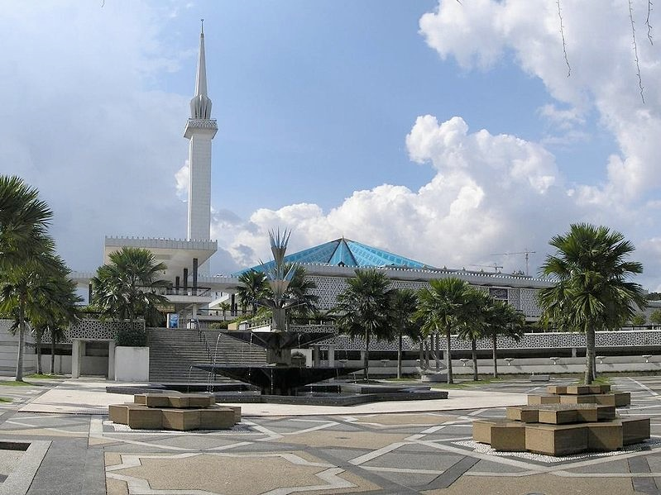
Mosque in Malaysia

Slide 63
Mosque in Russia

Slide 64
Mosque in Nigeria (Africa)

Slide 65
Istanbul, Turkey

Slide 66
Five Facts
about Middle East and Northern Africa

Slide 67
1. Majority of the population are Muslims, followers of Islam.
2. Birthplace of three major religions: Judaism, Christianity, and Islam.
3. Most people are Arab, with exceptions: Israelis, Turks, and Persians (Iran).
4. Main landscape is desert with most people living near water.
5. Oil has made many countries wealthy: Saudi Arabia, U.A.E., Qatar, etc.

