Slide 1
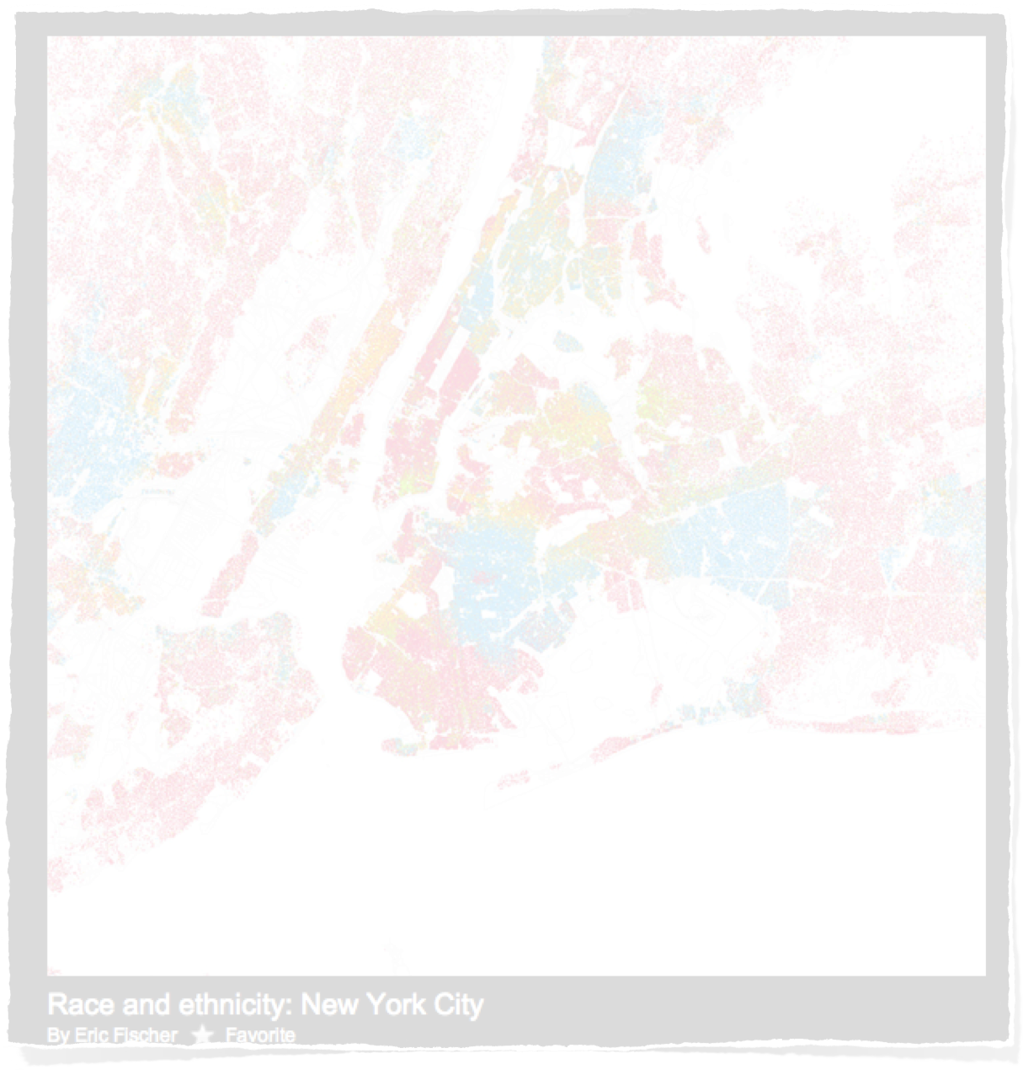
Race & Ethnicity Maps of U.S.A. Cities

Slide 2
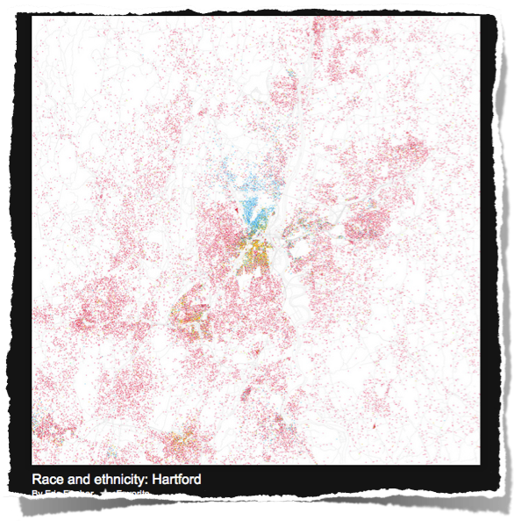
Understanding the Colors on the Maps
African- American
Asian
Hispanic
White

Slide 3
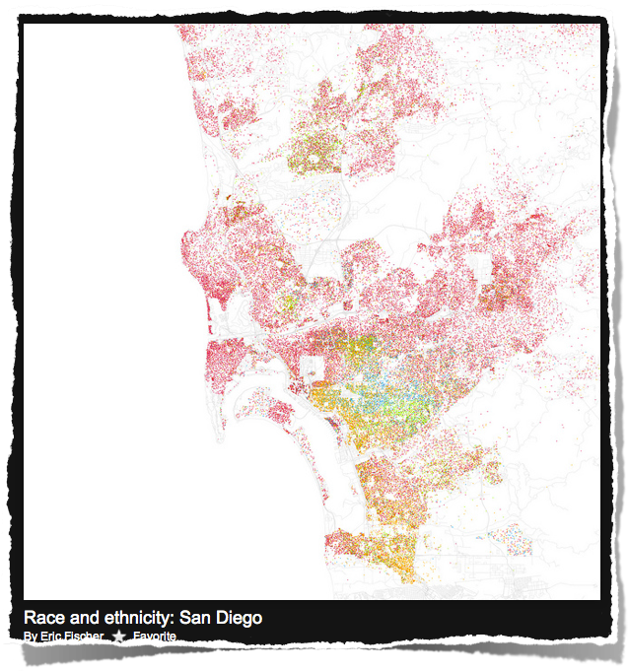
Columbus
Denver
Laredo
Las Vegas
San Diego
San Diego

Slide 4
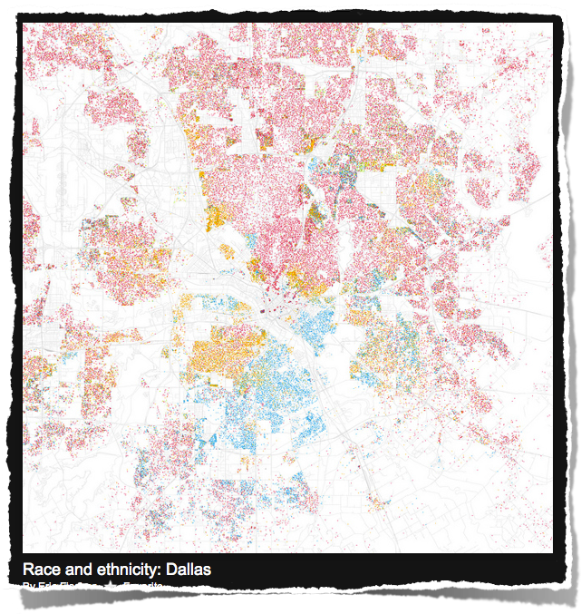
Baltimore
Dallas
Indianapolis
Jacksonville
Sacramento
Dallas

Slide 5
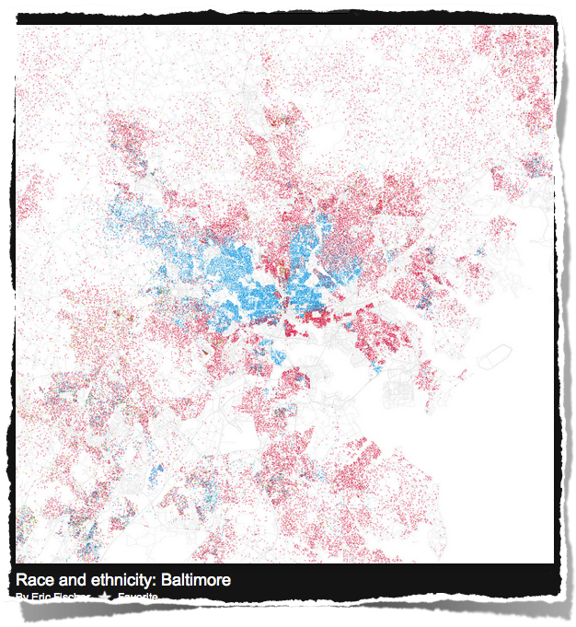
Baltimore
Baltimore
Denver
Las Vegas
Providence
Reno

Slide 6
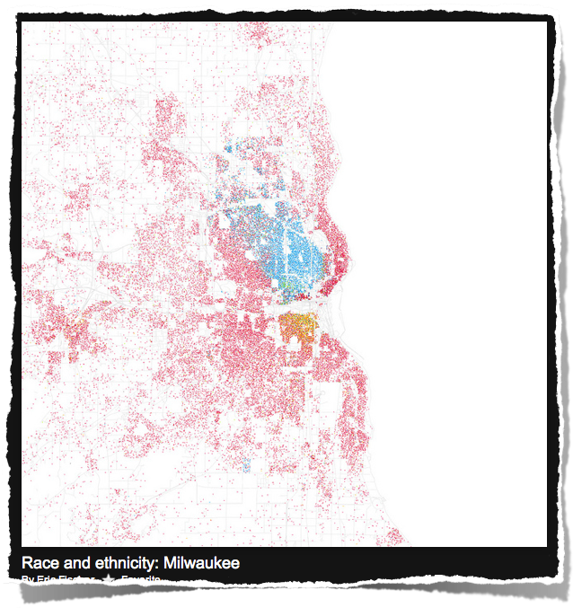
Huntsville, AL
Las Vegas
Milwaukee
Palm Beach
Wichita
Milwaukee

Slide 7
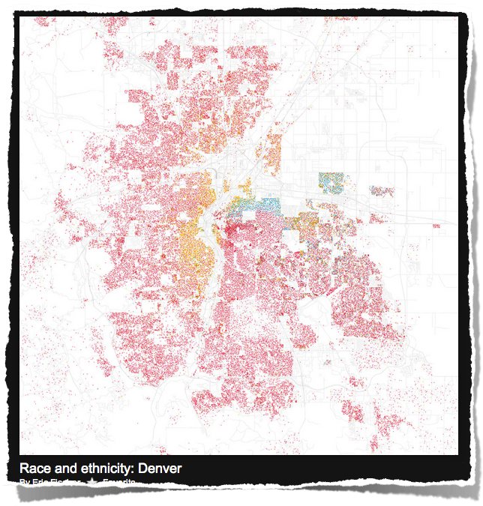
Denver
Milwaukee
Palm Beach
Tucson
Wichita
Denver

Slide 8
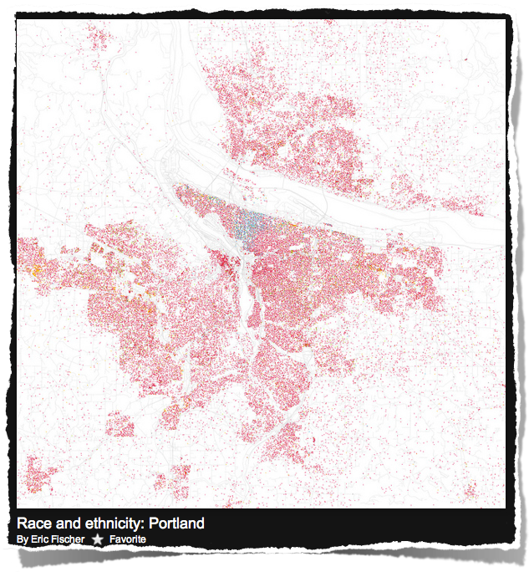
Kansas City
Pittsburgh
Portland
Savannah
Tucson
Portland

Slide 9
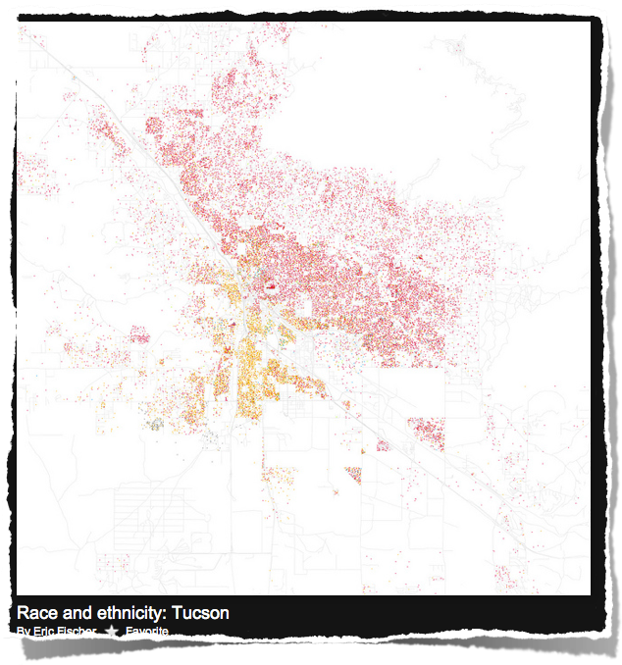
Nashville
Miami
Providence
Reno
Tucson
Tucson

Slide 10
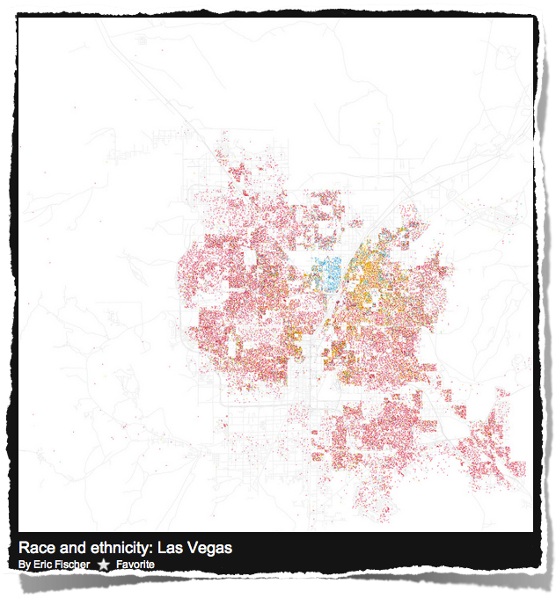
Las Vegas
Little Rock
Miami
Reno
Sacramento
Las Vegas

Slide 11
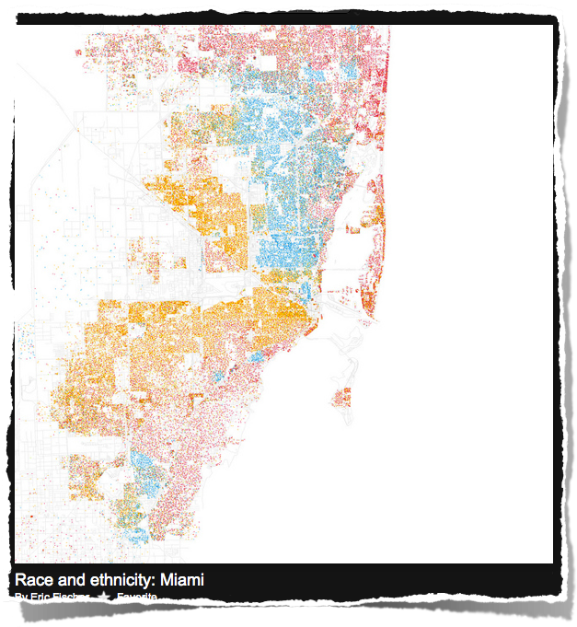
Buffalo
Cincinnati
Miami
Providence
Savannah
Miami

Slide 12
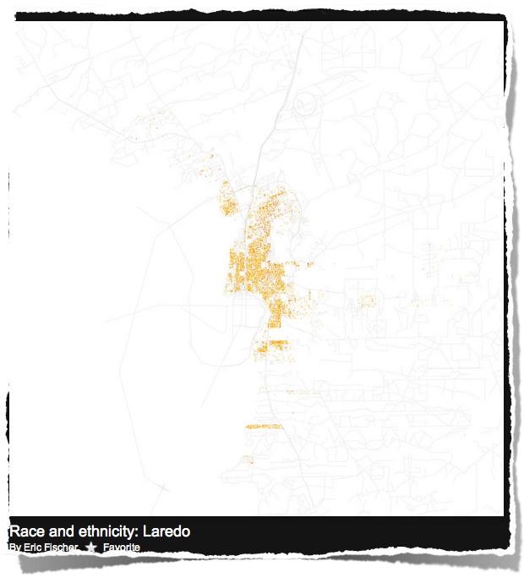
Huntsville, AL
Knoxville
Laredo, TX
Palm Beach
Providence
Laredo, TX

Slide 13
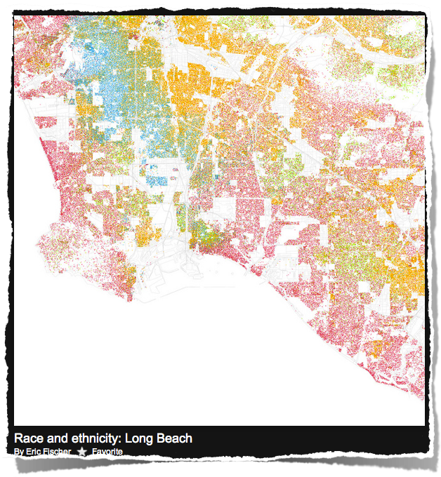
Laredo
Little Rock
Long Beach
Tampa
Wichita
Long Beach

Slide 14
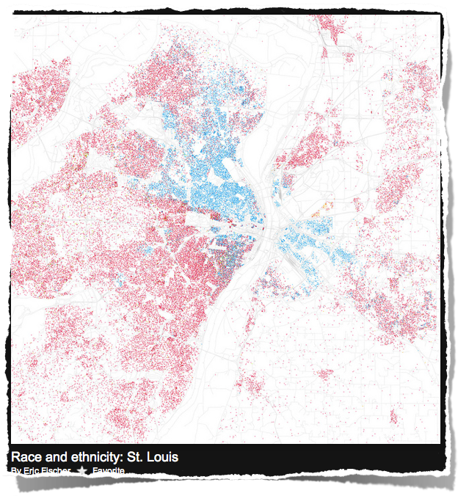
Buffalo
Cincinnati
Huntsville, AL
Savannah
St. Louis
St. Louis

Slide 15
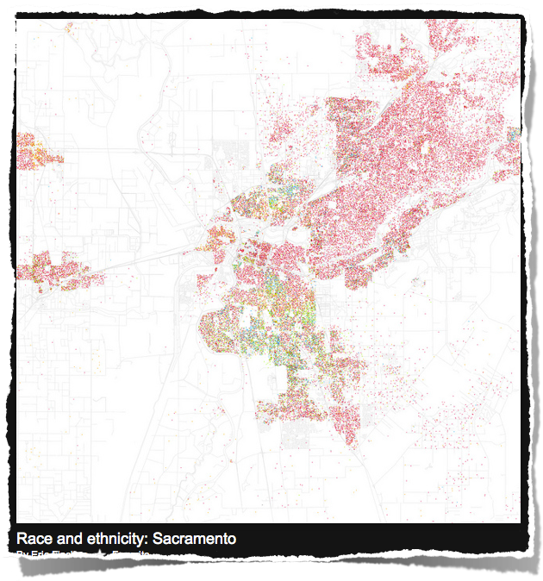
Cincinnati
Little Rock
Reno
Sacramento
Wichita
Sacramento

