Slide 1
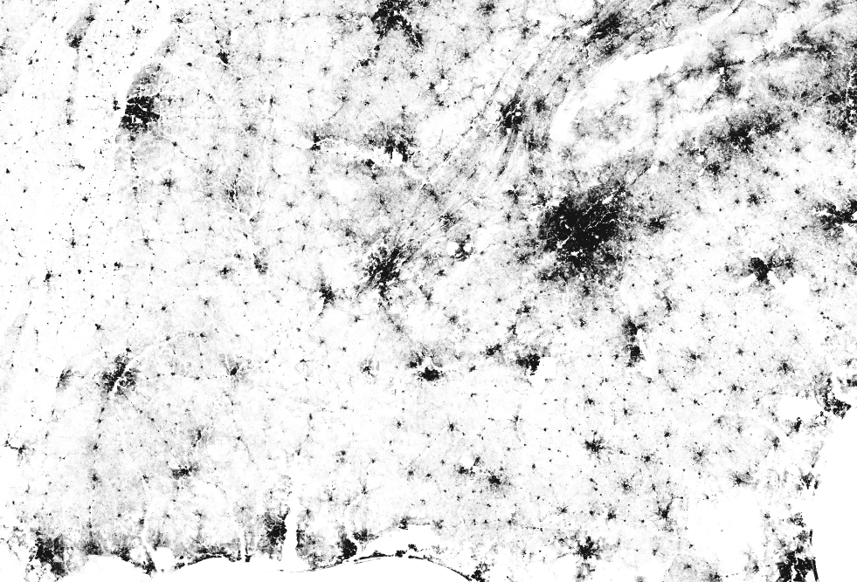
How many
MAJOR US CITIES
can you name?

Slide 2
How many US Cities can you name?
Nashville
Knoxville
Murfreesboro
Memphis
Chattanooga
Atlanta

Slide 3
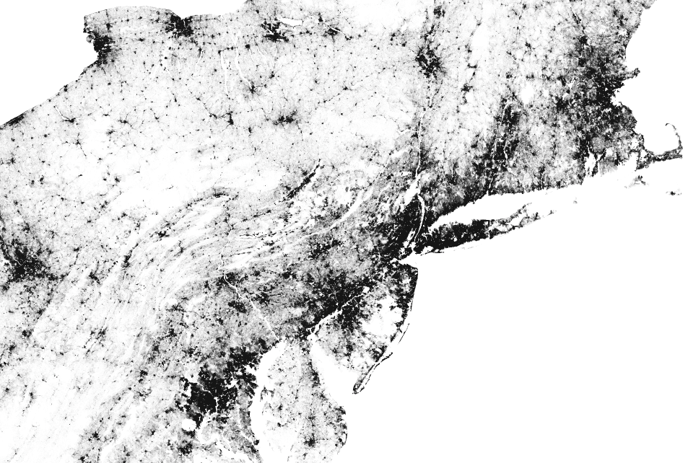
How many US Cities can you name?
Boston
New York City
DC

Slide 4
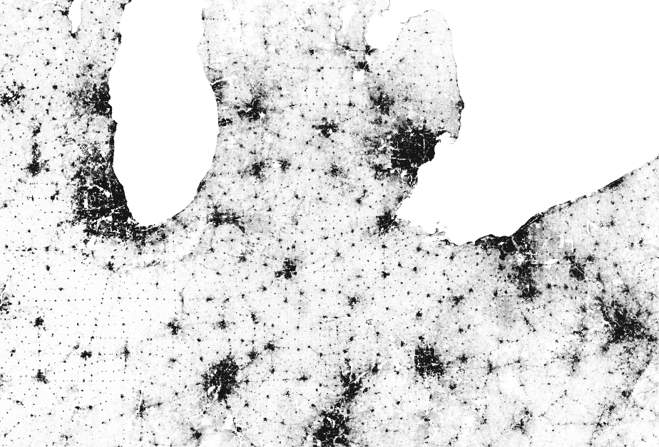
How many US Cities can you name?
Detroit
Chicago
Cleveland

Slide 5
How many US Cities can you name?
Denver

Slide 6
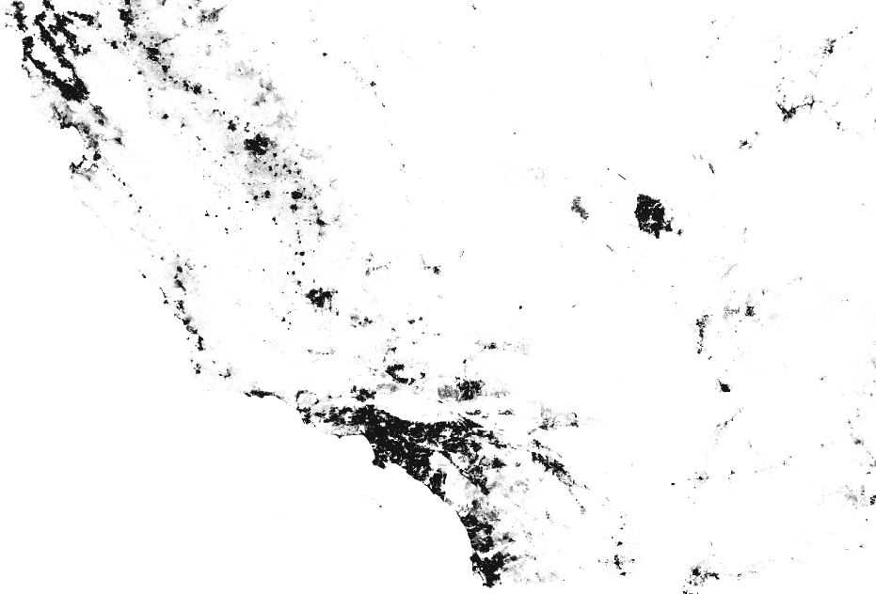
How many US Cities can you name?
Los Angeles

