Slide 1
The Exam: Review Reviewing for the AP exam by creating a “band”
AP Human Geography
Kristi Neuroth

Slide 2
Basics of the Band Project Review
Students will be in teams of 3-4
They will create a “band” as a way of reviewing for the AP Test focusing on one unit of the course.
Note: with the earlier test date this year this project could be used as an activity after the AP Test.
Please see the student instructions on the following slides. ☺
Accompanying materials:
Hit Song Template
Album Cover Template
Album Back Cover Template
Concert T-Shirt Design Template
Band Project Rubric

Slide 3
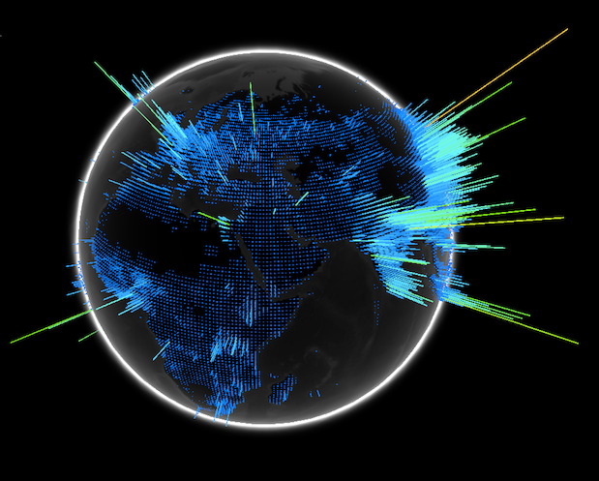
APHG REVIEW
Rock Band Style!

Slide 4
Your Assignment:
Your group is going to become a “band”. Your band is all about one unit in APHG, so everything you will do as a band will revolve around your unit.
Task #1: Choose a unit
Task #2: Decide what kind of musical style you will be.
Task #3: Name your band!
Task #4: Work on your debut Album (hit song, song titles, album cover, t-shirt).
Task #5: ALBUM RELEASE PARTY!!!

Slide 5
Possible Unit Choices (1 group per unit)
1. Geography: Nature and Perspectives
2. Population and Migration
3. Cultural Patterns and Processes
4. Political Geography
5. Agriculture and Rural Geography
6. Cities and Urban Land Use
7. Industrialization and Economic Development

Slide 6
JOBS
1.) Lyricist (ALL): Create one song that illustrates the important features of your unit.
2.) Album Cover (1 Person): Design an album cover that would represent the important features of the unit.
3.)Back Jacket (2 People – 2 different albums): Come up with 10 songs (including hit single) that would explain important elements of your unit.
4). T-Shirt (1 Person): Design a T-shirt that your band members will sell at your concert that would explain important features of the unit.

Slide 7
JOBS – EVERYONE “Concert Schedule”
The most important part of the project is to create a “concert schedule” AKA – the most important things people need to remember about your Unit. This will need to be submitted 2 days before your performance so I can upload your items to google classroom. This is essentially a 4-page review guide to share with the class (1 page per person in your group).
(Note: This is based on the AP Course Articulation)

Slide 8
Other Things To Know…
WEDNESDAY, MAY 11: Album RELEASE PARTY!!! Group will present their album cover, Song Titles, T-Shirt design.
KEEP THIS IN MIND: Your songs, song titles, t-shirt designs, and album cover MUST incorporate specific information about your unit.
EXAMPLE:
BAD: “Sweet Home Indonesia”
GOOD: “Slash and Burn on the Dance Floor”
(Don’t have to sing) If you sing=Candy ☺

Slide 9
Behavior Expectations
The only people who should be able to hear you are your own band members.
You are working the whole time on your project when given the opportunity in class.

Slide 10
Just so we are clear…
ALL of the information on your CD jacket, songs, hit single, etc… MUST relate to your unit. The more information you can incorporate, the better!

Slide 11
How you will be graded
Project Component | Points
Hit song (group grade) | 10
Individual band portion (One of the following: album cover, back cover (song titles), or t-shirt) | 10
Presentation of project on Wednesday (Do you speak clearly so everyone can hear? Are you well prepared?) | 10
Participation (Do you use your time in class wisely? Are you an outstanding audience member?) | 10
One Page Outline (submitted digitally) One group member will submit the outline for your group. Make sure each person’s name is at the top of the page they are responsible for. Clearly label your email with: Class period, unit covered. | 10

