Slide 1
Assessments: Including Stimuli Writing questions with photos, maps, graphs, and charts
AP Human Geography
Kristi Neuroth

Slide 2
Why should I include more stimuli in my FRQs and multiple choice assessment questions?
In the new design of the AP Test (beginning during the 2019-2020 school year) approximately 30 to 40% of the multiple choice questions will reference stimulus material, including maps, tables, charts, graphs, images, infographic, and/or landscapes, roughly evenly divided between qualitative and quantitative sources. 2 of the 3 FRQs will contain stimuli (one will have one stimulus and one will have two stimuli).

Slide 3
What makes a good stimulus question?
(Group Discussion)

Slide 4
What makes a good stimulus question?
Requires students to actively engage with the stimulus.
Is not trivial but rather requires critical thinking.
All answer options require careful consideration.
Bonus: is part of a set (several questions on the AP exam will have one stimulus with 2-3 questions connected to that stimulus).

Slide 5
Task Verbs
Compare: Provide a description of explanation of similarities and/or differences.
Define: Provide a specific meaning for a word or concept.
Describe: Provide the relevant characteristics of a specified topic.
Explain: Provide information about how or why a relationship, process, pattern, position, or outcome occurs, using evidence and/or reasoning.
Identify: Indicate or provide information about a specified topic, without elaboration or explanation.

Slide 6
Activity
Use the following stimulus material to craft multiple choice or FRQ test questions.

Slide 7
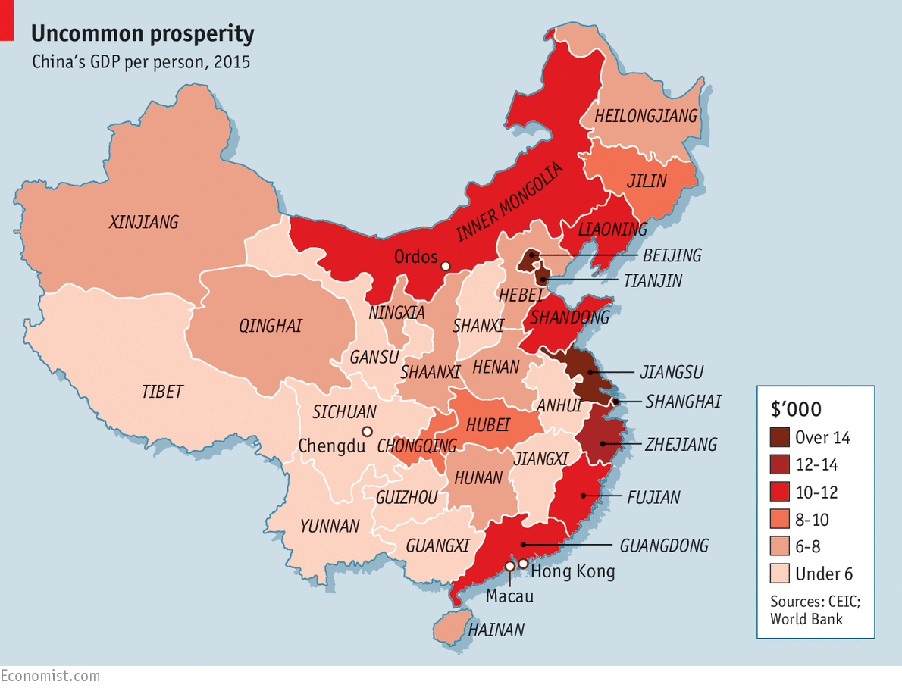
Notes:
Source: The Economist

Slide 8
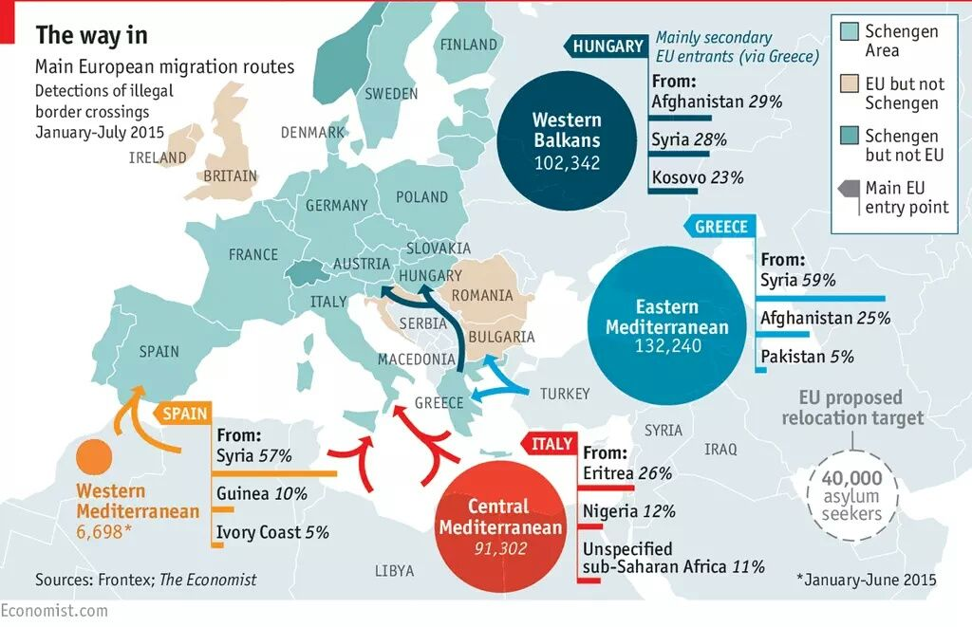

Slide 9
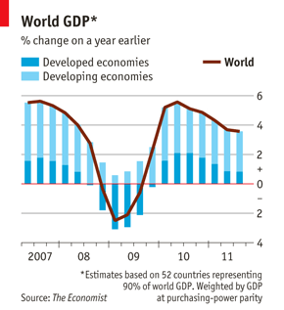

Slide 10
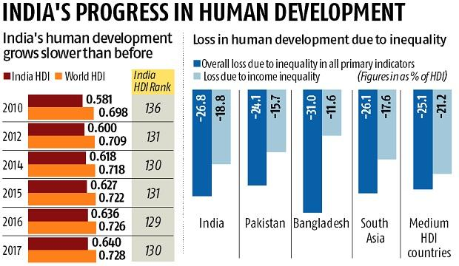
Notes:
Source: Business Standard

Slide 11
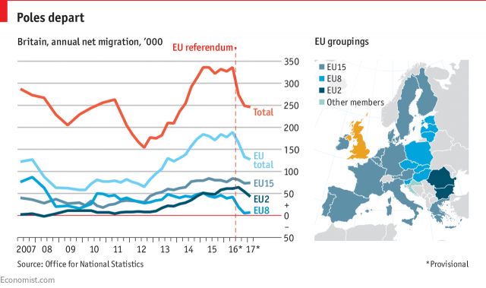
2 Stimuli

Slide 12
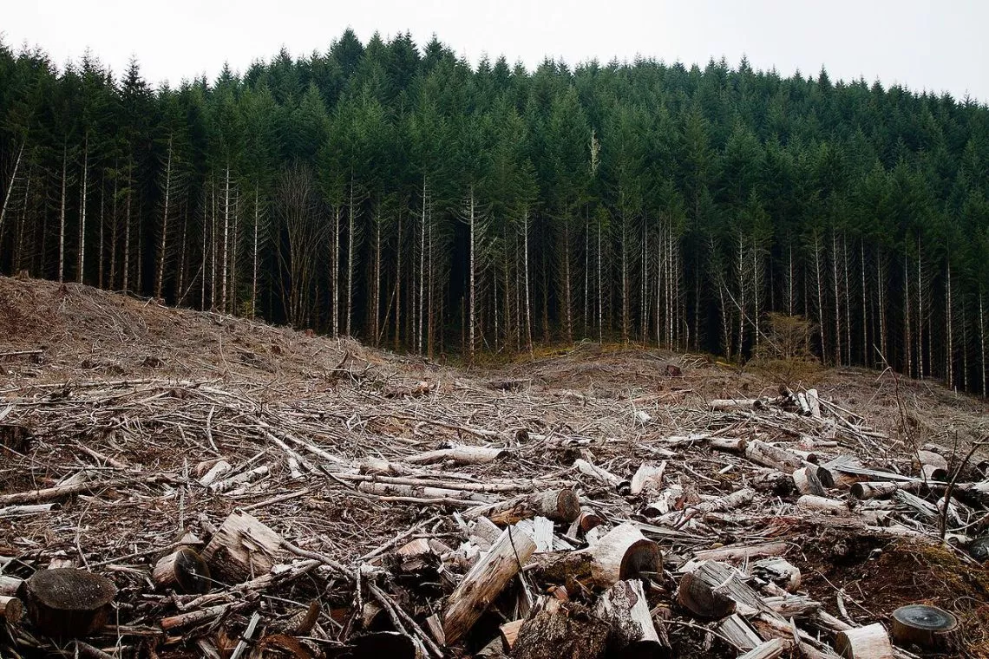
Notes:
Source: Landscape News

Slide 13
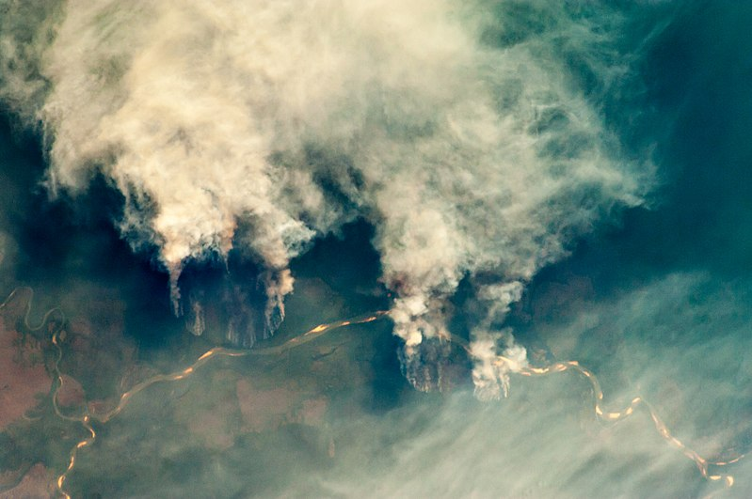
Notes:
Wikipedia

Slide 14
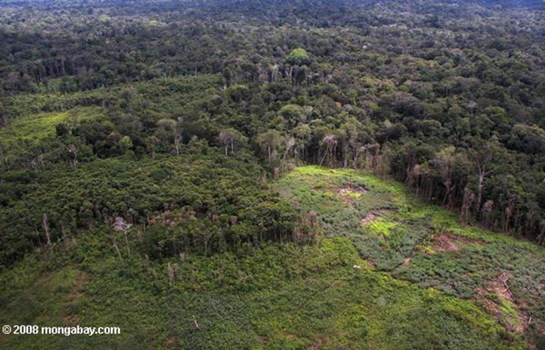

Slide 16
