Slide 1
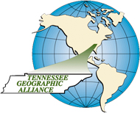
The American City
U.S. History and Geography High School
Tennessee Geographic Alliance
Instructor
Michael Robinson
Houston High School
Germantown, TN

Slide 2
Overview of Lesson
Where is the United States is there a majority of: African-Americans, Asians, Hispanics, and Whites?
Describe three different ethnic neighborhoods in Los Angeles.
Describe the diversity in selected US cities.
Explain what literally divides ethnic groups in the United States (e.g. roads, bodies of water, etc.).
Complete Student City Activity.
Describe Shelby County, Tennessee.

Slide 3
Tennessee Standard
US.9 US.9 Describe the difference between “old” and “new” immigrants and analyze the assimilation process…impact on American society, including ethnic clusters (C, E, G).

Slide 4
Connections to
Common Core Standards
Recognize and analyze how place and region influence the social, cultural, and economic characteristics of civilizations.

Slide 5
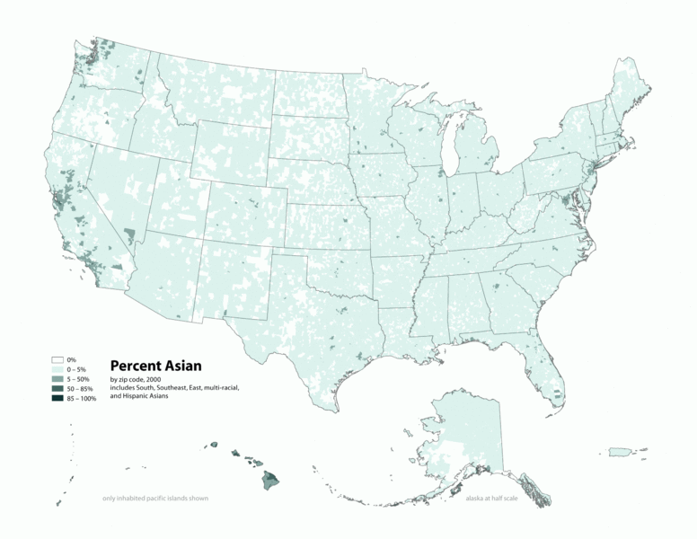
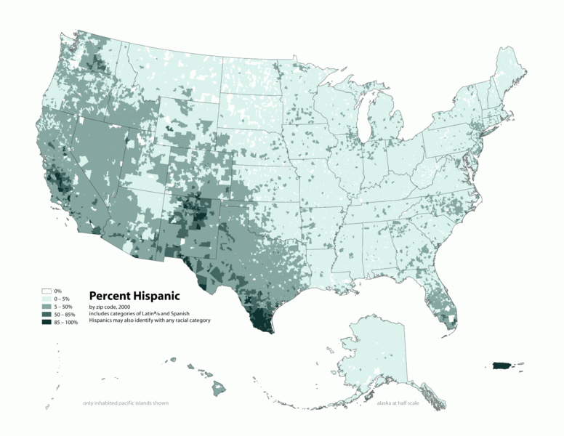
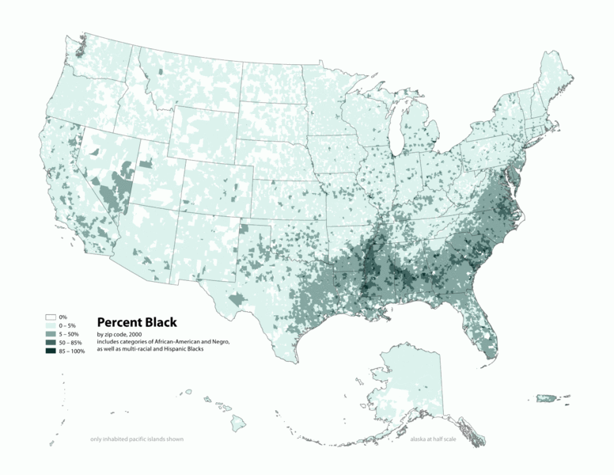
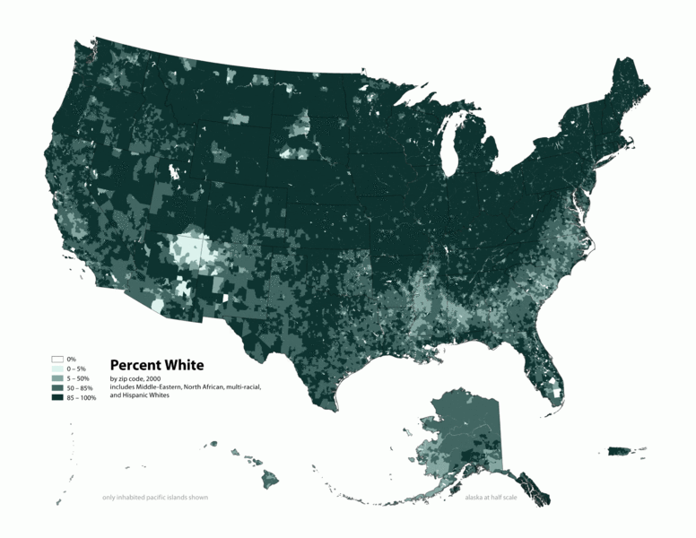
A
B
Which map is: African-American, Asian, Hispanic, and White?
C
D

Slide 6
A

Slide 7
B

Slide 8
C

Slide 9
D

Slide 10
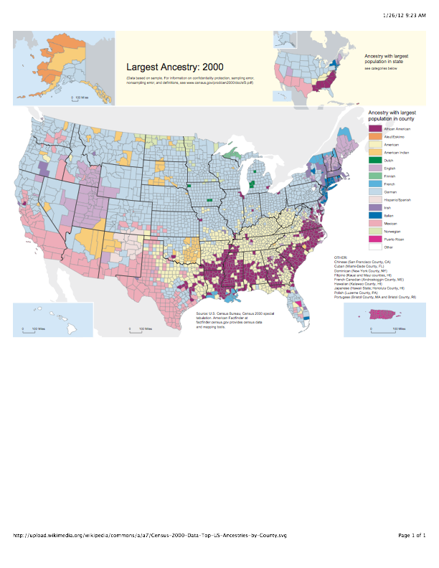
ANCESTRY
African-American
English
French
German
Irish
Italian
Mexican
Norwegian
D
H
G
F
A
C
B
E

Slide 11
Match up the letter with the correct ancestry...
ANCESTRY
African-American
English
French
German
Irish
Italian
Mexican
Norwegian
D
H
Norwegian
French
G
F
Irish
A
C
Italian
English
German
American
American
Indian
B
E
Mexican
African-American

Slide 12
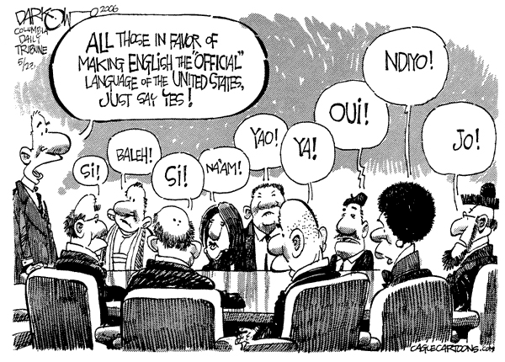
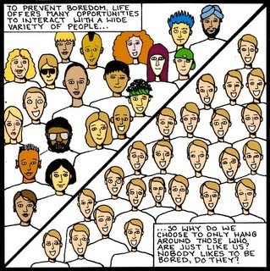
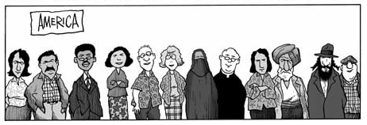
1.
2.
3.
4.

Slide 13
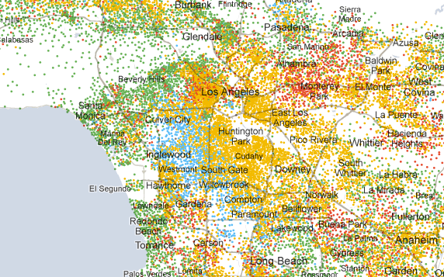
Three Neighborhoods in Los Angeles
What is the impact of wealth on ethnic / urban neighborhoods? (Los Angeles)...spatially
The following maps shows the familiar places for the people who live in that particular neighborhood. (mental maps)
What does each mental map tell about the people who live in that neighborhood?

Slide 14
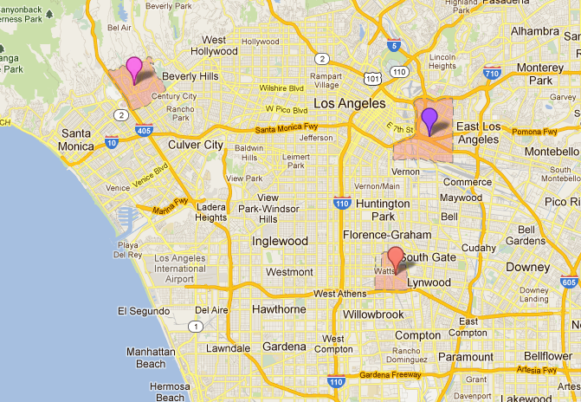
Westwood
Boyle Heights
Which neighborhood is:
Middle Class Hispanic
Poor New Immigrants
Wealthy
Avalon

Slide 15
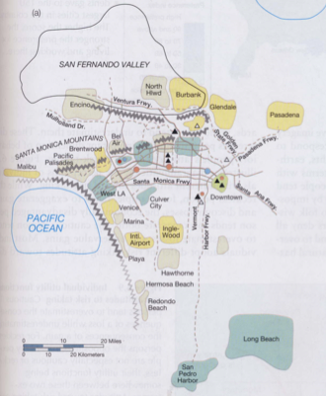
What do we know about the person who lives in this neighborhood?
Westwood
Source: ISBN 0131497057 Places and Regions in Global Context: Human Geography 4th 2007

Slide 16
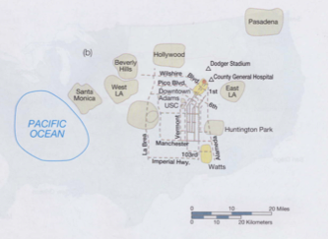
What do we know about the person who lives in this neighborhood?
Avalon
Source: ISBN 0131497057 Places and Regions in Global Context: Human Geography 4th 2007

Slide 17
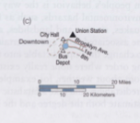
What do we know about the person who lives in this neighborhood?
Boyle Heights
Source: ISBN 0131497057 Places and Regions in Global Context: Human Geography 4th 2007

Slide 18
Los Angeles Neighborhoods Drawn to Scale
Avalon
Westwood
Boyle Heights
Source: ISBN 0131497057 Places and Regions in Global Context: Human Geography 4th 2007

Slide 19
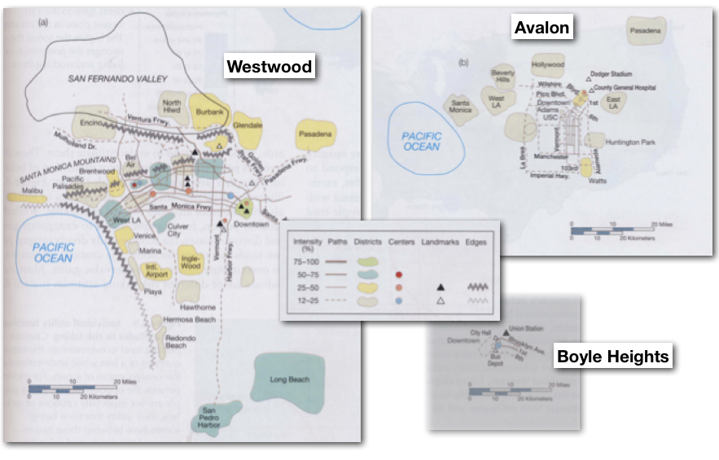
Westwood
wealthy
Which neighborhood is:
Middle Class Hispanic
Poor New Immigrants
Wealthy
Explain each answer.
Boyle Heights
poor immigrant
Avalon
middle class
Source: ISBN 0131497057 Places and Regions in Global Context: Human Geography 4th 2007

Slide 20
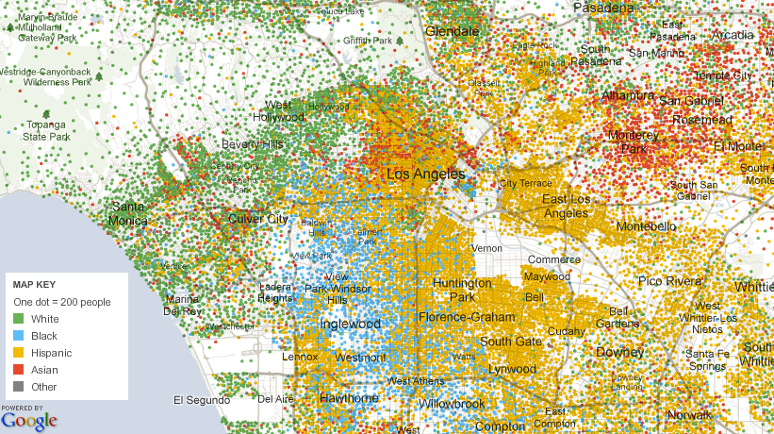
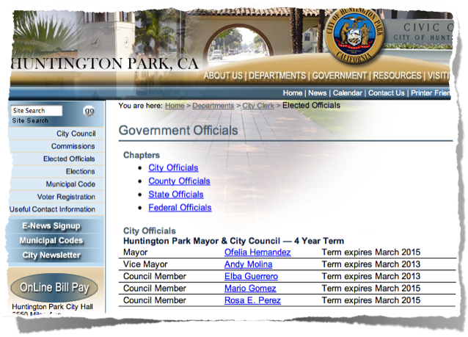
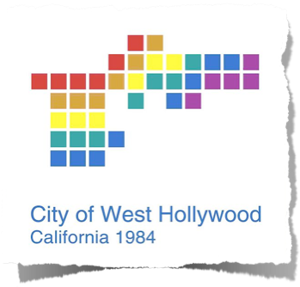
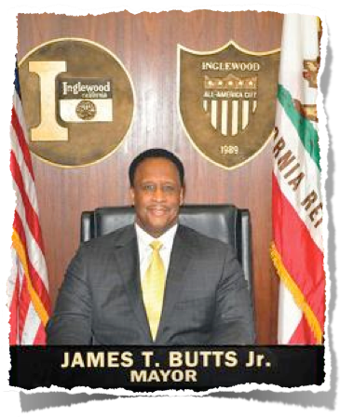
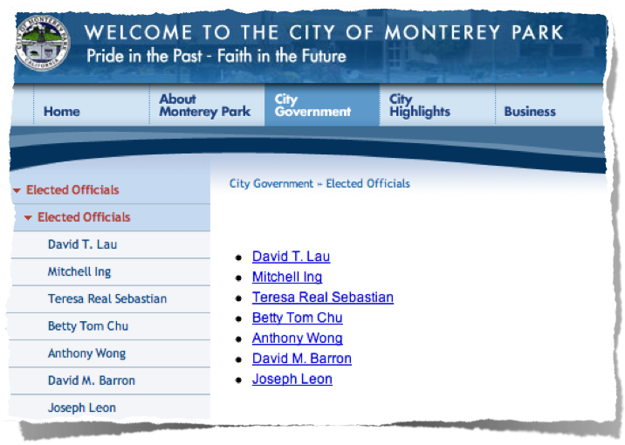
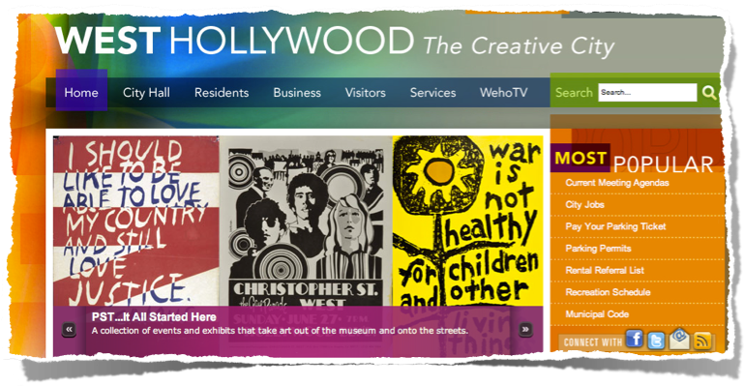
?

Slide 21
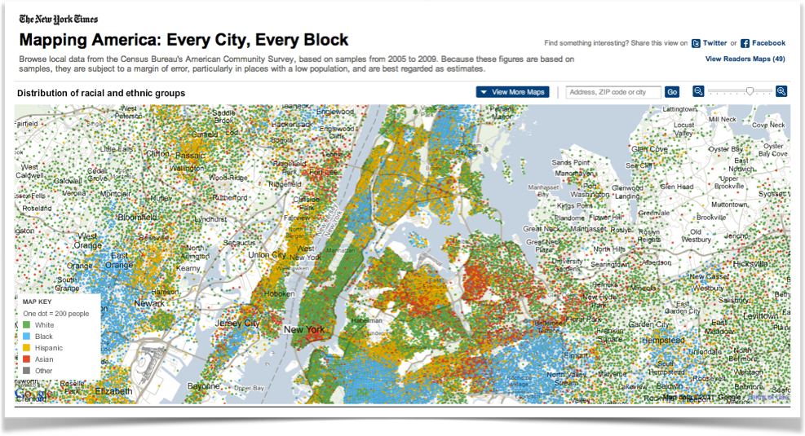
What do you notice about the diversity in our largest four cities?
http://projects.nytimes.com/census

Slide 22
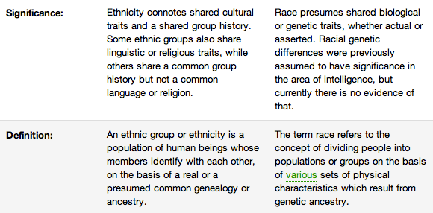
Race refers to a person's physical appearance, such as skin color, eye color, hair color, bone/jaw structure etc. Ethnicity, on the other hand, relates to cultural factors such as nationality, culture, ancestry, language and beliefs.
http://www.diffen.com/difference/Ethnicity_vs_Race

Slide 23
Race
What is Race?
The data on race were derived from answers to the question on race that was asked of individuals in the United States. The Census Bureau collects racial data in accordance with guidelines provided by the U.S. Office of Management and Budget (OMB), and these data are based on self-identification.
The racial categories included in the census questionnaire generally reflect a social definition of race recognized in this country and not an attempt to define race biologically, anthropologically, or genetically. In addition, it is recognized that the categories of the race item include racial and national origin or sociocultural groups. People may choose to report more than one race to indicate their racial mixture, such as “American Indian” and “White.” People who identify their origin as Hispanic, Latino, or Spanish may be of any race.
OMB requires five minimum categories: White, Black or African American, American Indian or Alaska Native, Asian, and Native Hawaiian or Other Pacific Islander.
http://www.census.gov/population/race

Slide 24
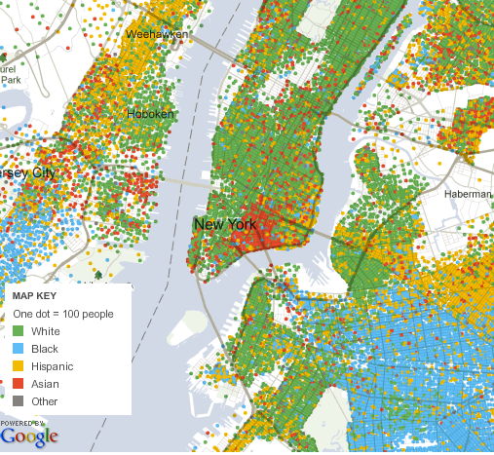
What do you notice about the diversity in our largest four cities?

Slide 25
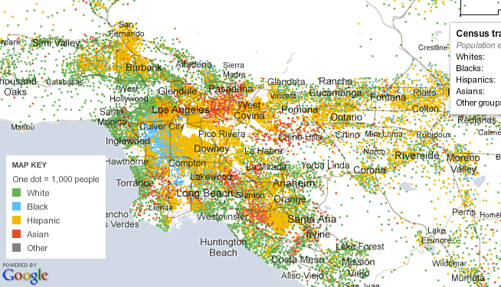
What do you notice about the diversity in our largest four cities?

Slide 26
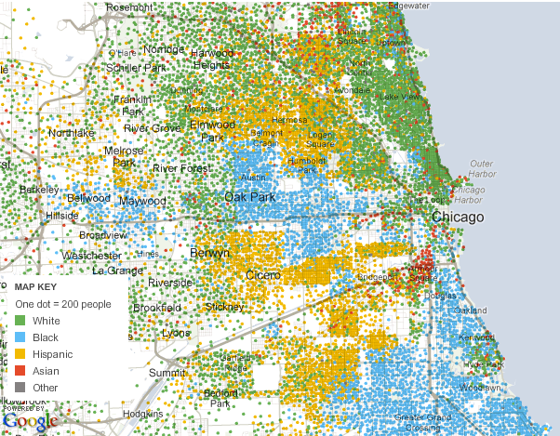
What do you notice about the diversity in our largest four cities?

Slide 27
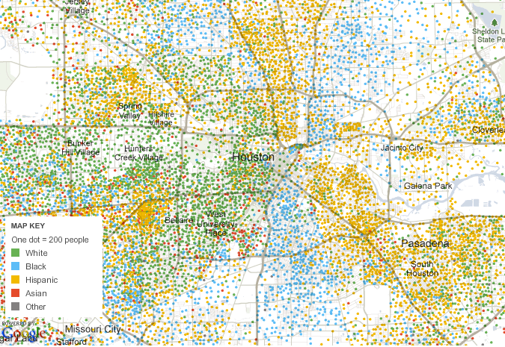
What do you notice about the diversity in our largest four cities?

Slide 28
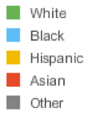
What do you notice about the diversity in our largest four cities?

Slide 29
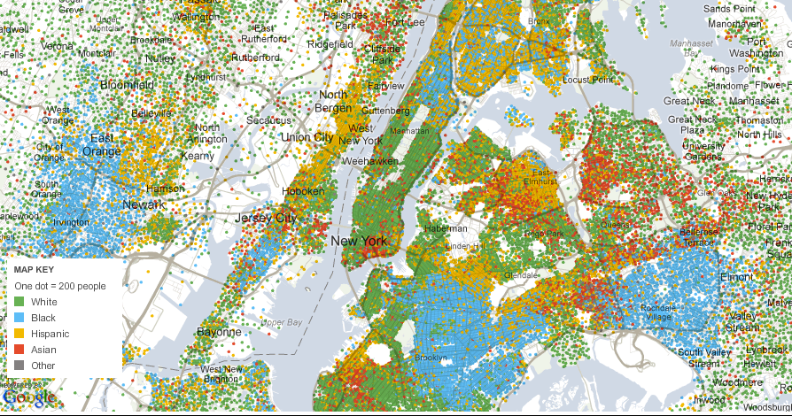

Slide 30
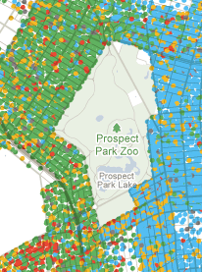
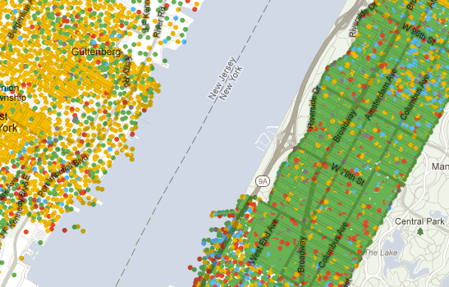
What is another example of a boundary or barrier between ethnic groups?
Boundaries in New York City

Slide 31
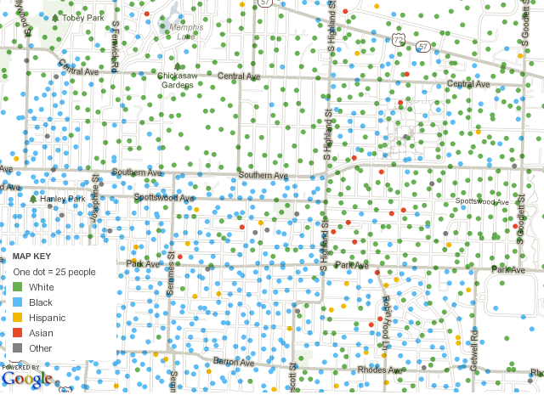

Slide 32
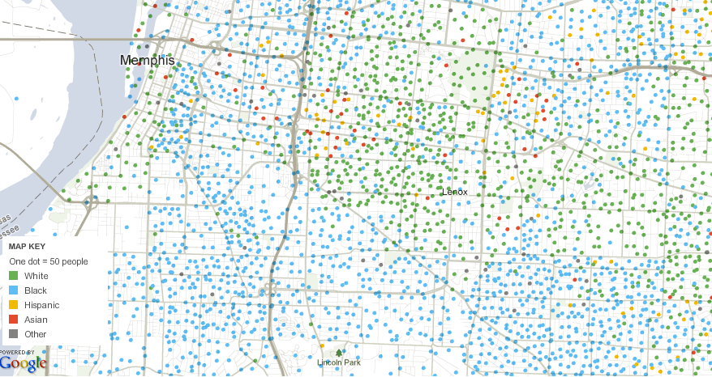

Slide 33
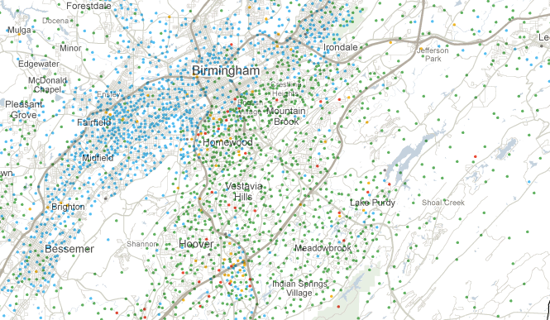
Suburban Cites
Birmingham, Alabama

Slide 34
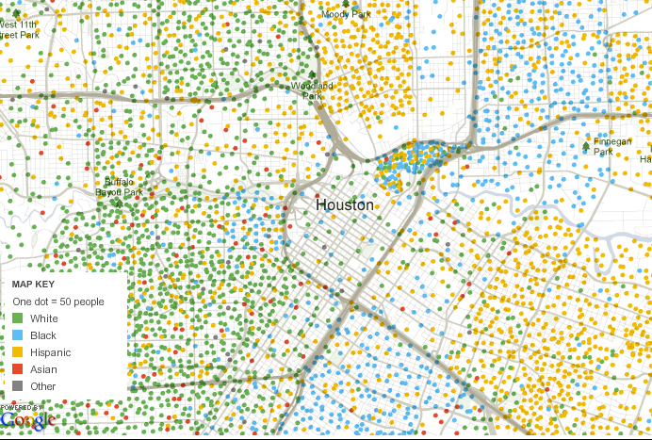
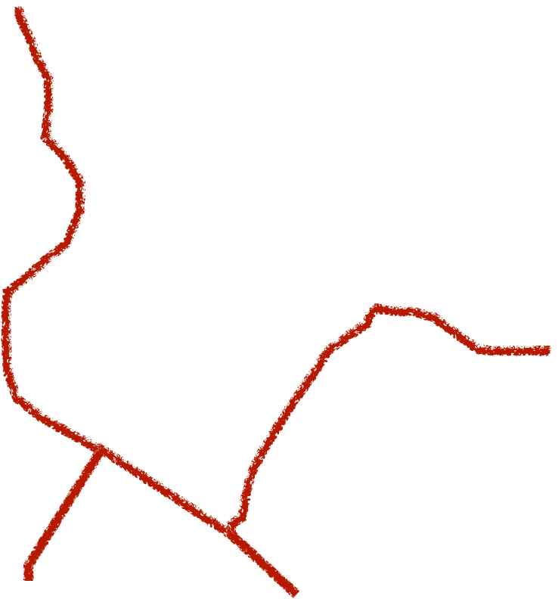

Slide 35
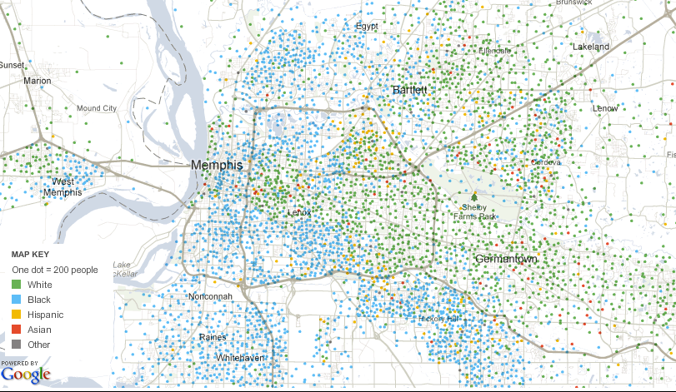

Slide 36
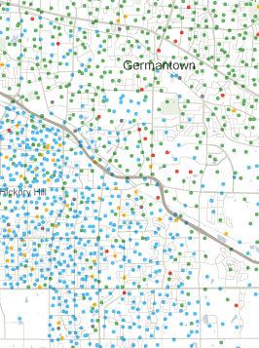
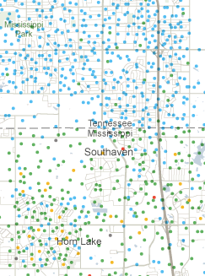
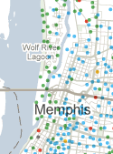
roads
state lines
water
Boundaries Between Ethnic Groups

Slide 37
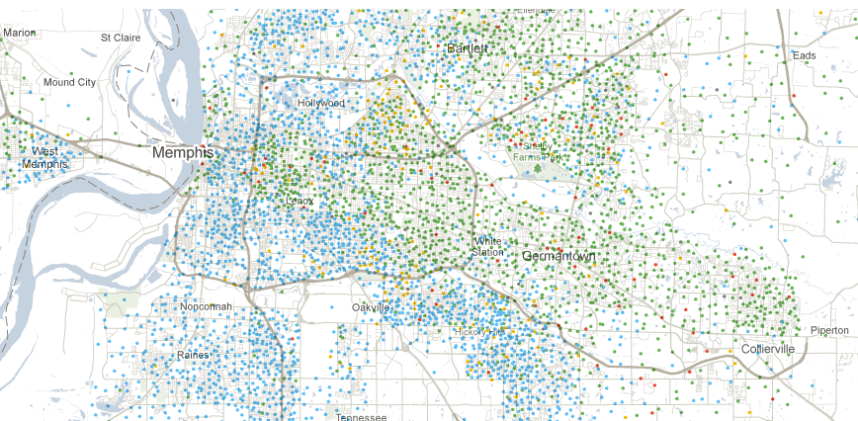
white
black
Hwy. 385
HHS

Slide 38
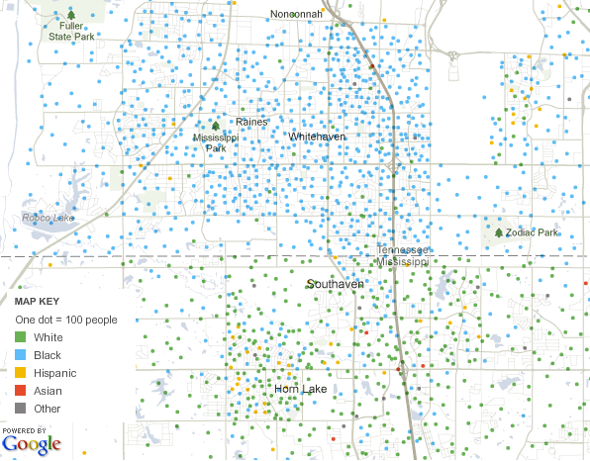
Tennessee
Mississippi

Slide 40
Blacks, whites in US shunning diverse areas: study
May 31, 2012
"We pay a lot of attention to this proliferation of multiethnic neighborhoods, but they are still only a small part of the overall inter-neighborhood mobility picture for blacks and whites," said lead author Kyle Crowder, a sociology professor at the University of Washington.
"The truth is, when it comes to eliminating residential segregation, we still have a long way to go," she added.

Slide 41
Blacks, whites in US shunning diverse areas: study
May 31, 2012
"When people say, 'Segregation is going away' and 'We don't need to worry about it anymore,' those are messages that people will latch onto quickly," she said. "Unfortunately, those types of statements are just untrue."

Slide 42
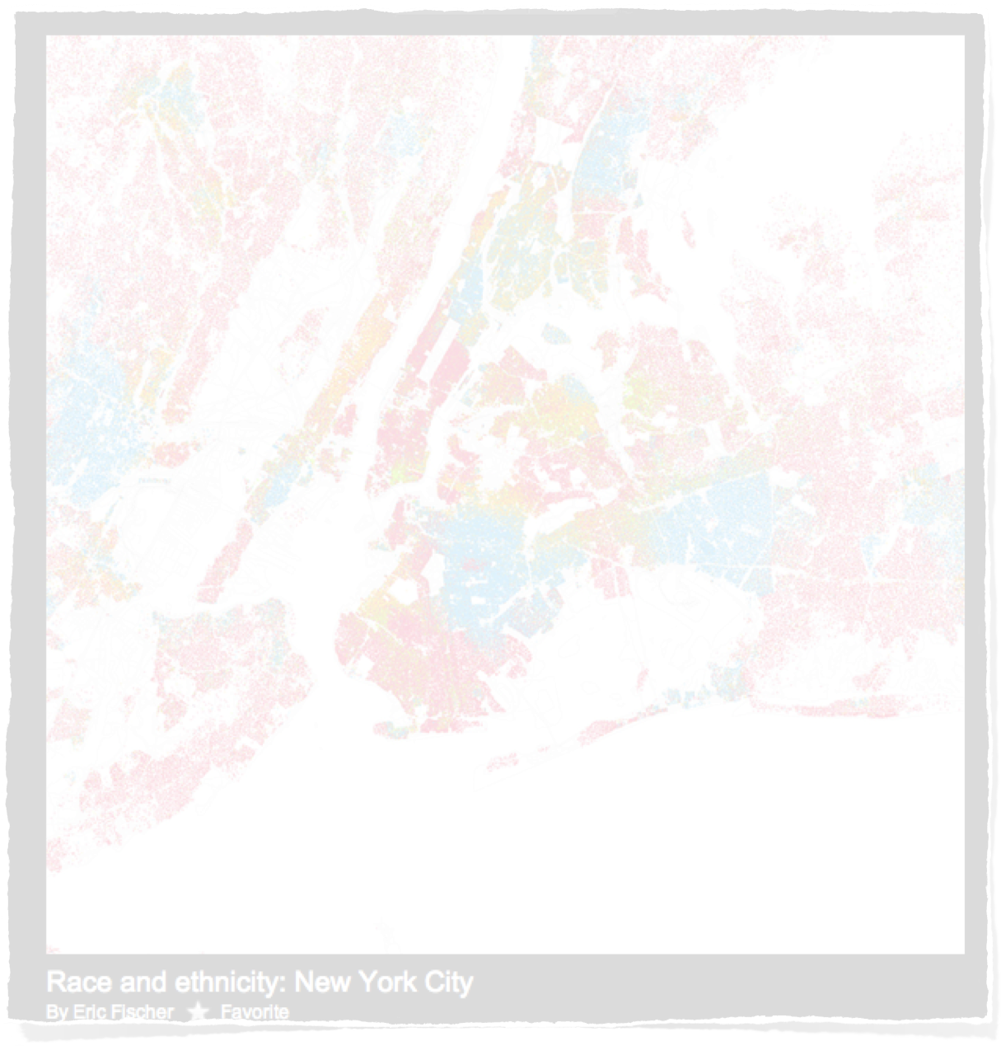
Race & Ethnicity Maps of U.S.A. Cities
SOURCE: http://www.flickr.com/photos/walkingsf/sets/72157624812674967/detail

Slide 43
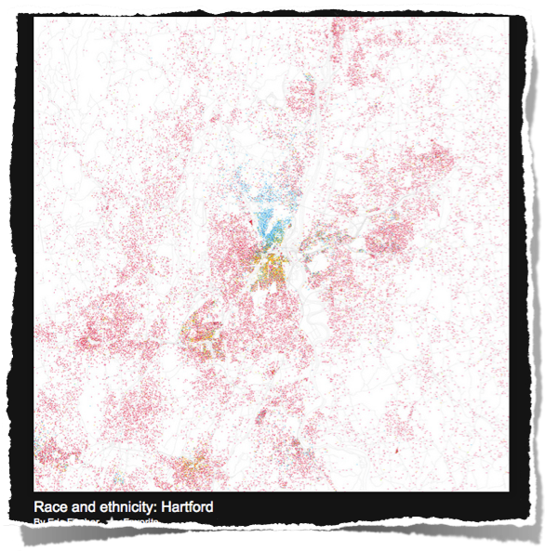
Understanding the Colors on the Maps
African- American
Asian
Hispanic
White

Slide 44
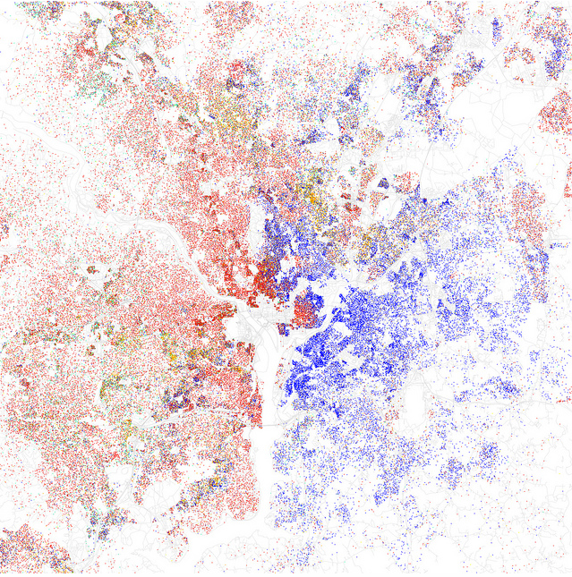
park
Washington, D.C.
golf
course
airport
AFB
Maryland
Virginia

Slide 45
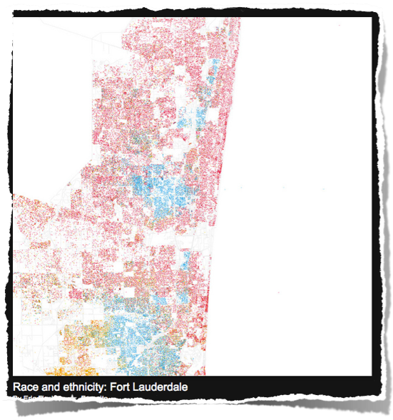
Reading & Interpreting the Ethnic Maps
African- American
Atlantic Ocean
Asian
No Population
Everglades National Park
Hispanic
Airport
Sparse Population
White
Dense Population
Ethnic Population

Slide 46
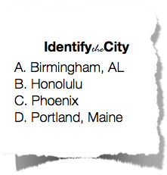
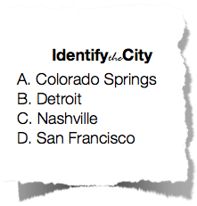
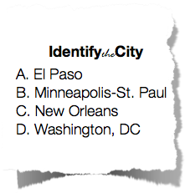
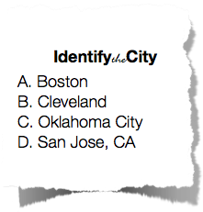
Race & Ethnicity Maps of U.S.A. Cities ANSWERS
Name:_____________________________________________
#1
Answers
1-
2-
3-
4-
#4
Answers
1-
2-
3-
4-
#2
Answers
1-
2-
3-
4-
Multiple Choice Answers
1-
2-
3-
4-
5-
6-
7-
8-
9-
10
#3
Answers
1-
2-
3-
4-
StudentHandout

Slide 47
1.
African- American
2.
Asian
3.
4.
Hispanic
White

Slide 48
1.

Slide 49
2.

Slide 50
3.

Slide 51
4.

Slide 52
1.
African- American
2.
New York
Asian
Los Angeles
3.
4.
Chicago
Hispanic
Houston
White

Slide 53
Race & Ethnicity Maps of U.S.A. Cities ANSWERS
Name:_____________________________________________
#1
Answers
1-
2-
3-
4-
#4
Answers
1-
2-
3-
4-
#2
Answers
1-
2-
3-
4-
Multiple Choice Answers
1-
2-
3-
4-
5-
6-
7-
8-
9-
10
#3
Answers
1-
2-
3-
4-
StudentHandout

Slide 54
1.
African- American
2.
Asian
#1
3.
4.
Hispanic
White

Slide 55
1.

Slide 56
2.

Slide 57
3.

Slide 58
4.

Slide 59
1.
African- American
2.
Asian
#1
3.
4.
Hispanic
White

Slide 60
1.
African- American
2.
Asian
#2
3.
4.
Hispanic
White

Slide 61
1.

Slide 62
2.

Slide 63
3.

Slide 64
4.

Slide 65
1.
African- American
2.
Asian
#2
3.
4.
Hispanic
White

Slide 66
1.
African- American
2.
Asian
#3
3.
4.
Hispanic
White

Slide 67
1.

Slide 68
2.

Slide 69
3.

Slide 70
4.

Slide 71
1.
African- American
2.
Asian
#3
3.
4.
Hispanic
White

Slide 72
1.
African- American
2.
Asian
#4
3.
4.
Hispanic
White

Slide 73
1.

Slide 74
2.

Slide 75
3.

Slide 76
4.

Slide 77
1.
African- American
2.
Asian
#4
3.
4.
Hispanic
White

Slide 78
Multiple Choice
Race & Ethnicity Maps of U.S.A. Cities

Slide 79
1
Columbus
Denver
Laredo
Las Vegas
San Diego

Slide 80
2
Baltimore
Dallas
Indianapolis
Jacksonville
Sacramento

Slide 81
3
Baltimore
Denver
Las Vegas
Providence
Reno

Slide 82
4
Huntsville, AL
Las Vegas
Milwaukee
Palm Beach
Wichita

Slide 83
5
Denver
Milwaukee
Palm Beach
Tucson
Wichita

Slide 84
6
Kansas City
Pittsburgh
Portland
Savannah
Tucson

Slide 85
7
Nashville
Miami
Providence
Reno
Tucson

Slide 86
8
Las Vegas
Little Rock
Miami
Reno
Sacramento

Slide 87
9
Buffalo
Cincinnati
Miami
Providence
Savannah

Slide 88
10
Huntsville, AL
Knoxville
Laredo
Palm Beach
Providence

Slide 89
Race & Ethnicity Maps of U.S.A. Cities
ANSWERS
SOURCE: http://www.flickr.com/photos/walkingsf/sets/72157624812674967/detail

Slide 90
1.
African- American
2.
C.
Phoenix
A.
Birmingham
Asian
#1
3.
4.
B.
Honolulu
Hispanic
D.
Portland, ME
White

Slide 91
1.
African- American
2.
D.
Washington,
DC
C.
New Orleans
Asian
#2
3.
4.
B.
Minneapolis-
St. Paul
A.
El Paso
Hispanic
White

Slide 92
1.
African- American
2.
D.
San Jose, CA
A.
Boston
Asian
#3
3.
4.
C.
Oklahoma
City
Hispanic
B.
Cleveland
White

Slide 93
1.
African- American
2.
D.
San
Francisco
B.
Detroit
Asian
#4
3.
4.
A.
Colorado
Springs
C.
Nashville
Hispanic
White

Slide 94
1
Columbus
Denver
Laredo
Las Vegas
San Diego
San Diego

Slide 95
2
Baltimore
Dallas
Indianapolis
Jacksonville
Sacramento
Dallas

Slide 96
3
Baltimore
Baltimore
Denver
Las Vegas
Providence
Reno

Slide 97
4
Huntsville, AL
Las Vegas
Milwaukee
Palm Beach
Wichita
Milwaukee

Slide 98
5
Denver
Milwaukee
Palm Beach
Tucson
Wichita
Denver

Slide 99
6
Kansas City
Pittsburgh
Portland
Savannah
Tucson
Portland

Slide 100
7
Nashville
Miami
Providence
Reno
Tucson
Tucson

Slide 101
8
Las Vegas
Little Rock
Miami
Reno
Sacramento
Las Vegas

Slide 102
9
Buffalo
Cincinnati
Miami
Providence
Savannah
Miami

Slide 103
10
Huntsville, AL
Knoxville
Laredo, TX
Palm Beach
Providence
Laredo, TX

Slide 104
Race & Ethnicity Maps of U.S.A. Cities ANSWERS
Name:_____________________________________________
#1
Answers
1-
2-
3-
4-
#4
Answers
1-
2-
3-
4-
C
B
A
D
B
C
D
A
#2
Answers
1-
2-
3-
4-
D
Multiple Choice Answers
1-
2-
3-
4-
5-
6-
7-
8-
9-
10
SAN DIEGO
C
DALLAS
A
BALTIMORE
B
MILWAUKEE
DENVER
#3
Answers
1-
2-
3-
4-
PORTLAND
D
TUCSON
A
LAS VEGAS
C
MIAMI
StudentHandout
B
LAREDO, TX

Slide 105
Tiebreaker
1
Laredo
Little Rock
Long Beach
Tampa
Wichita
Long Beach

Slide 106
Tiebreaker
2
Buffalo
Cincinnati
Huntsville, AL
Savannah
St. Louis
St. Louis

Slide 107
Tiebreaker
3
Cincinnati
Little Rock
Reno
Sacramento
Wichita
Sacramento

Slide 108
Shelby County Tennessee
Label the following on the map:
Airport
Arlington
Downtown
Bartlett
Collierville
Cordova
Frayser / Raleigh
Germantown
Houston High School
Interstate 40 / 240
Midtown Memphis
Mississippi River
Olive Branch
Shelby Farms Park
Southaven
State Lines
Warehouses
West Memphis
Whitehaven
Wolf River
Wolfchase Galleria

Slide 109
Shelby County Tennessee
Mississippi River
Arlington
Arkansas
Tennessee
I-40
Frayser / Raleigh
Bartlett
Wolf River
Wolfchase
I-40
Downtown
Cordova
West Memphis
Shelby
Farms
Midtown
Label the following on the map:
Airport
Arlington
Downtown
Bartlett
Collierville
Cordova
Frayser / Raleigh
Germantown
Houston High School
Interstate 40 / 240
Midtown Memphis
Mississippi River
Olive Branch
Shelby Farms Park
Southaven
State Lines
Warehouses
West Memphis
Whitehaven
Wolf River
Wolfchase Galleria
I-240
Some census tracts
are 90%+ White
I-55
Germantown
HHS
Collierville
Some census tracts
are 100% Black
Airport
Whitehaven
Warehouses
HWY 385
Tennessee
Mississippi
Olive Branch
Southaven
I-55 / 69

Slide 110
PHOENIX

