Slide 1
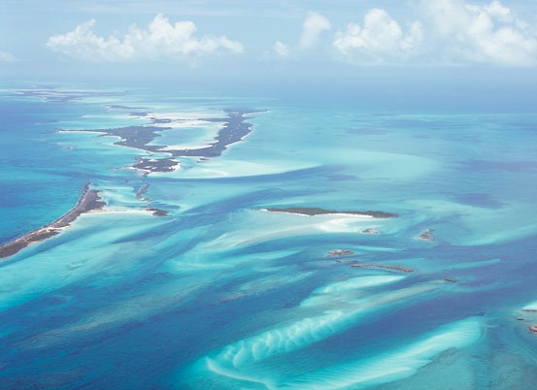
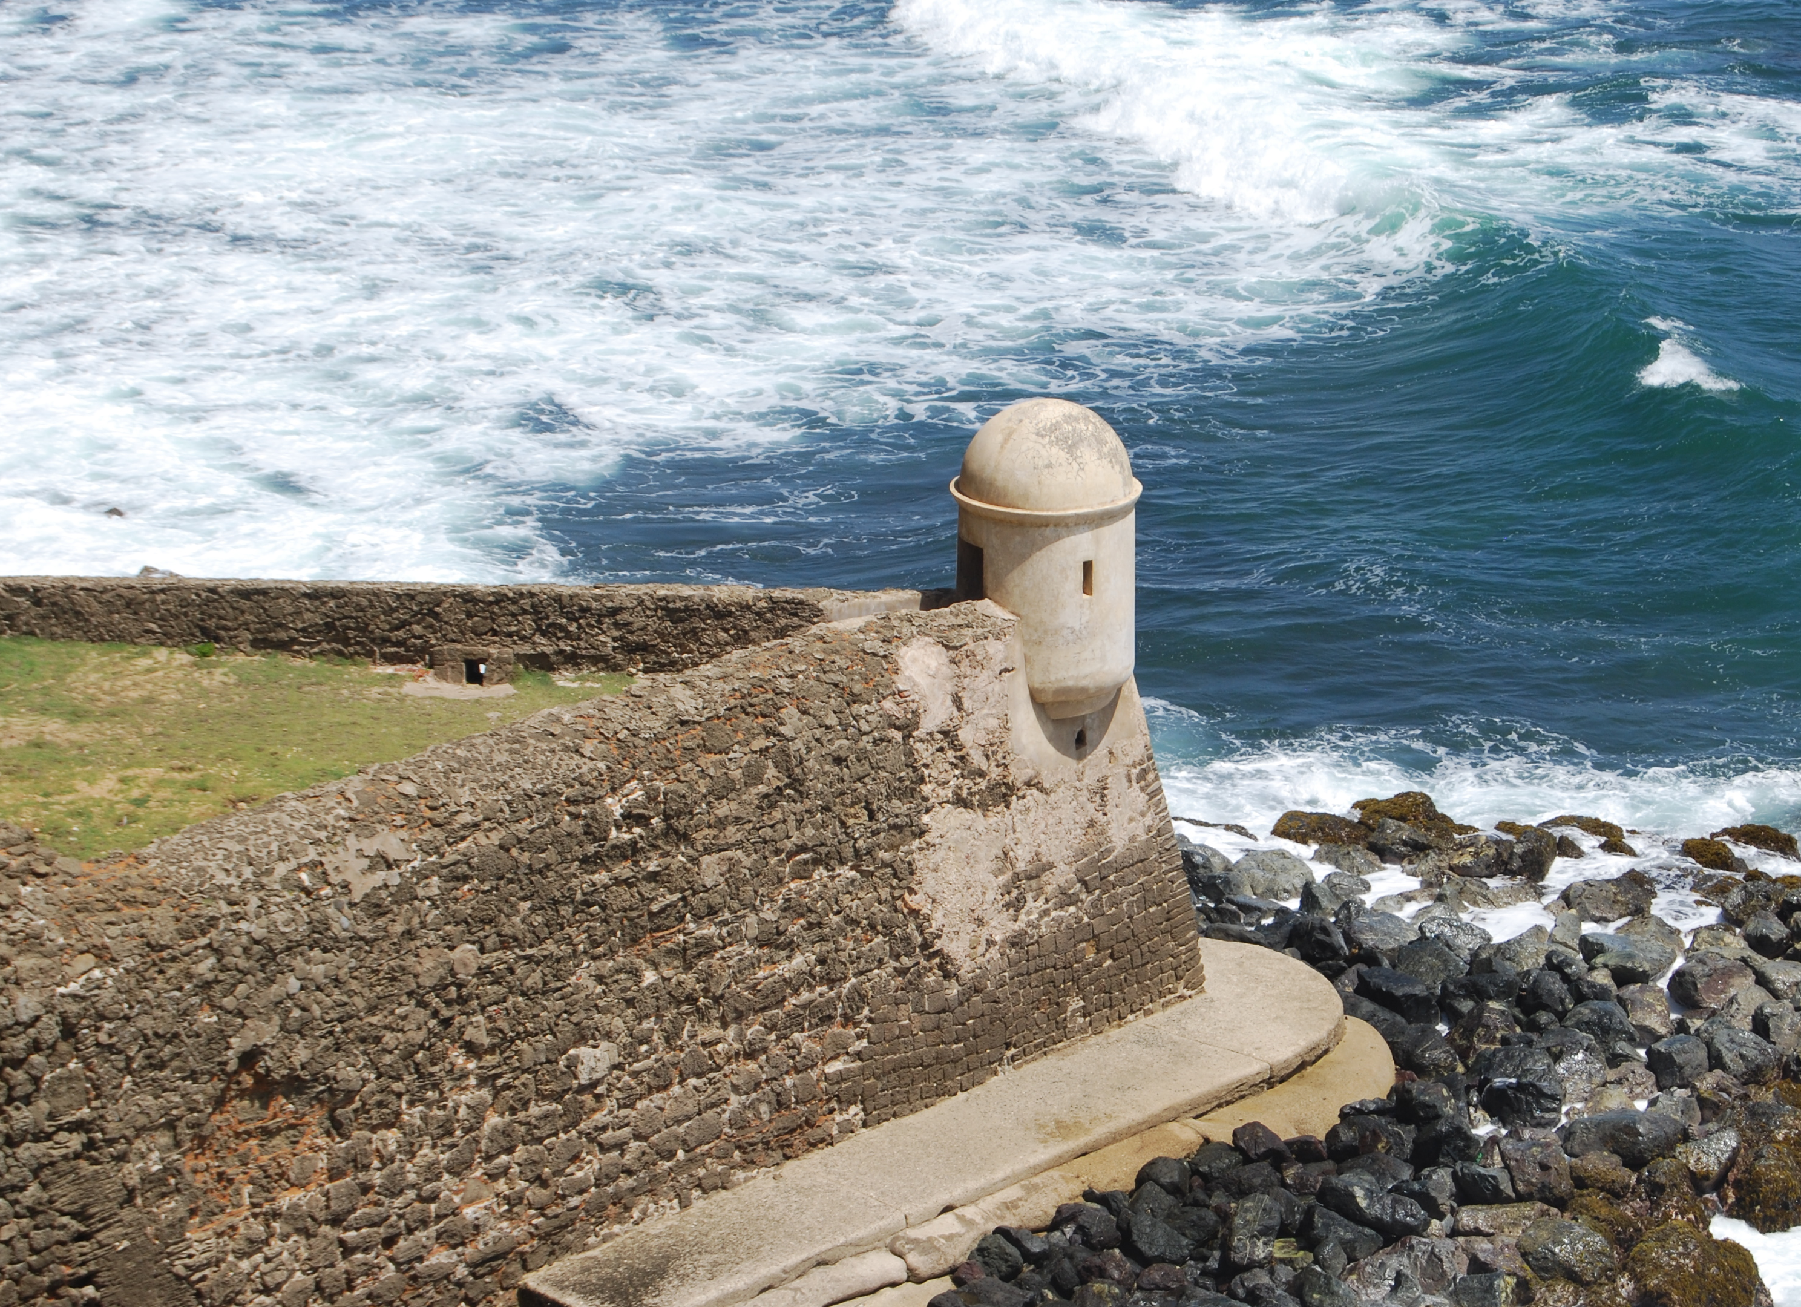
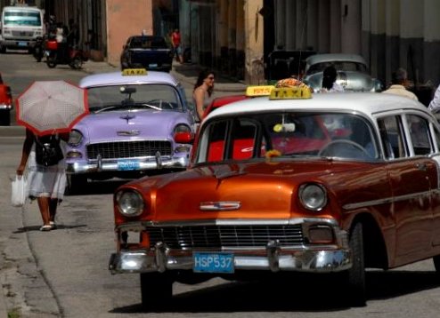
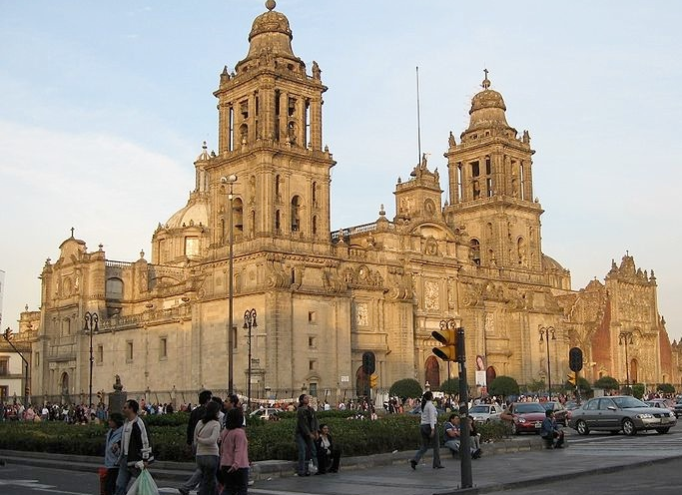
1
2
Bahamas
Puerto Rico
A | CUBA
B | MEXICO
C | BAHAMAS
D | PUERTO RICO
Cuba
Mexico
3
4

Slide 2
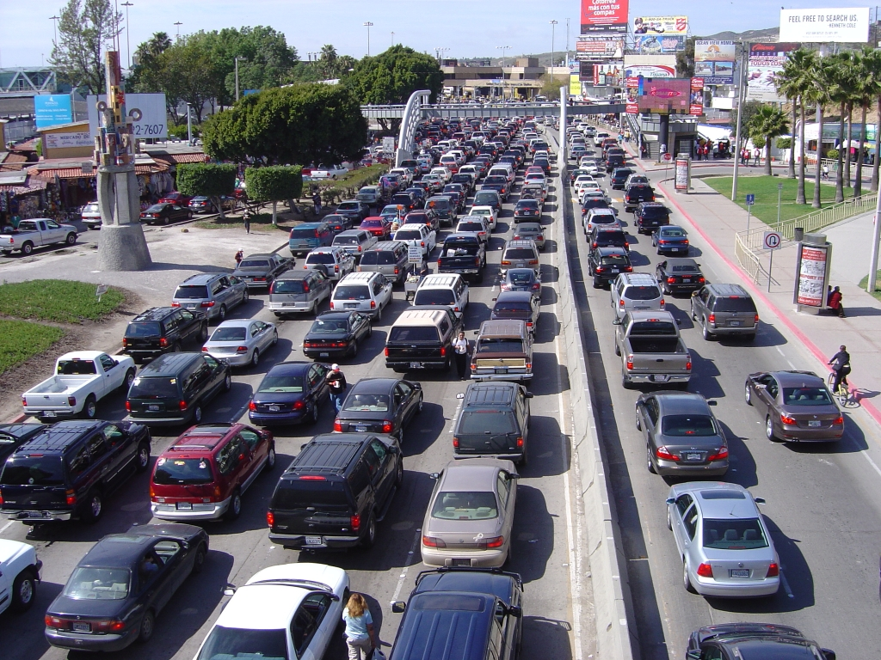
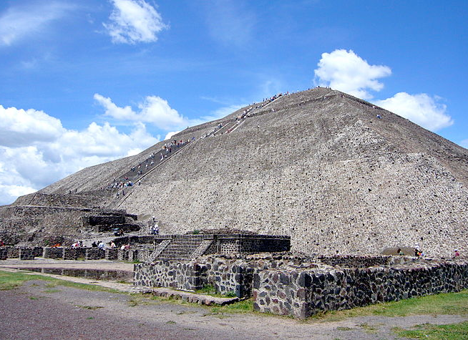
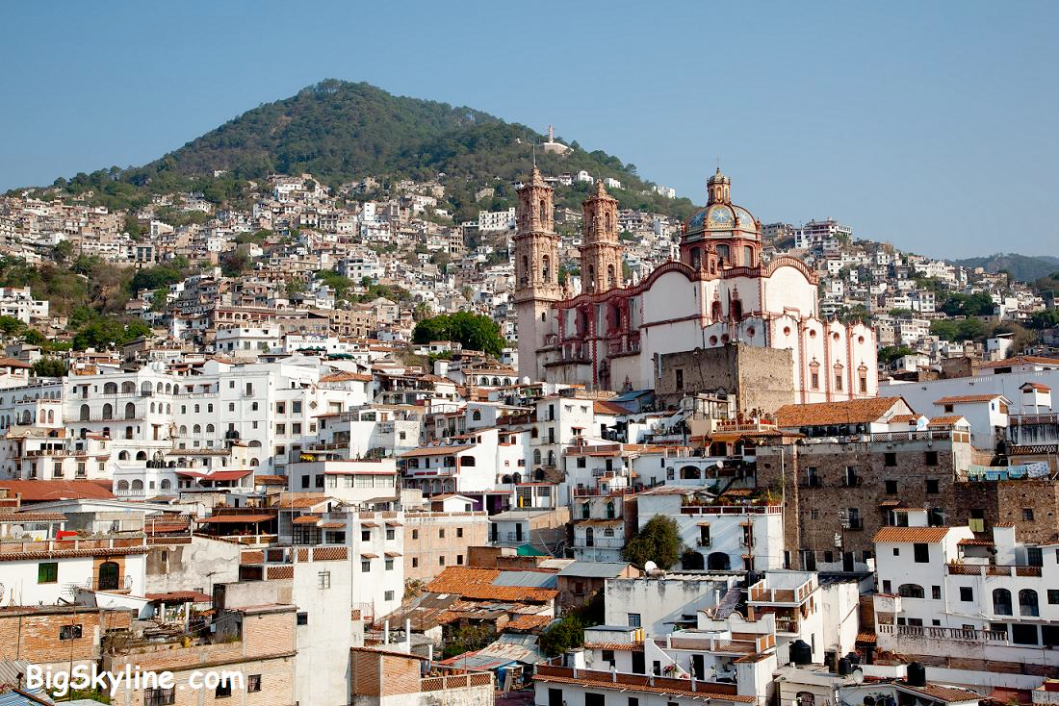
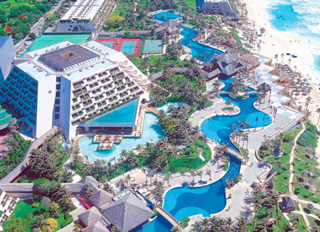
1
2
Tijuana
Mexico City
A | MEXICO CITY
B | TIJUANA
C | CANCUN
D | TAXCO
Taxco
Cancun
3
4

Slide 3
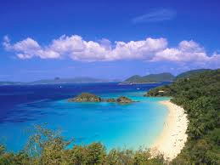
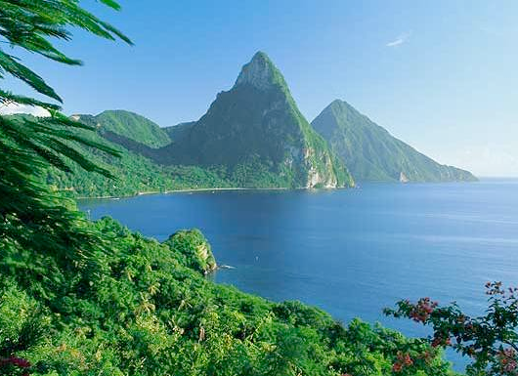
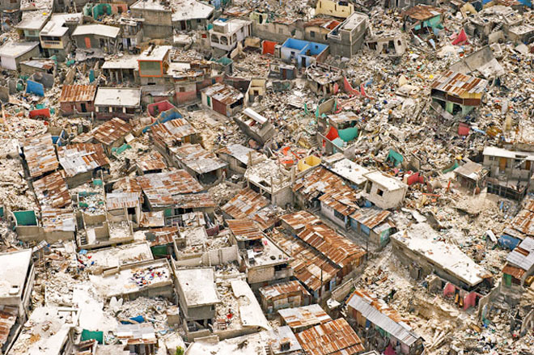
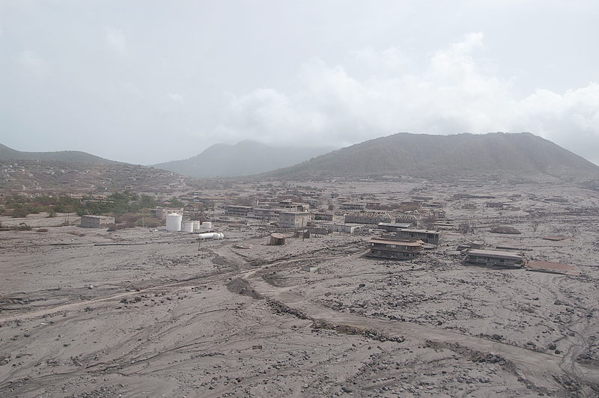
1
2
US Virgin Islands
St. Lucia
A | US VIRGIN ISLANDS
B | ST. LUCIA
C | MONTSERRAT
D | HAITI
Haiti
Montserrat
3
4

Slide 4
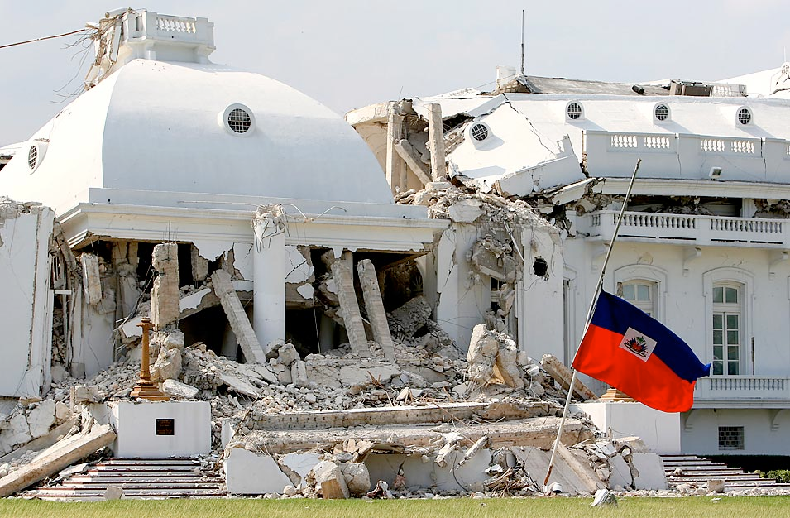

Slide 5
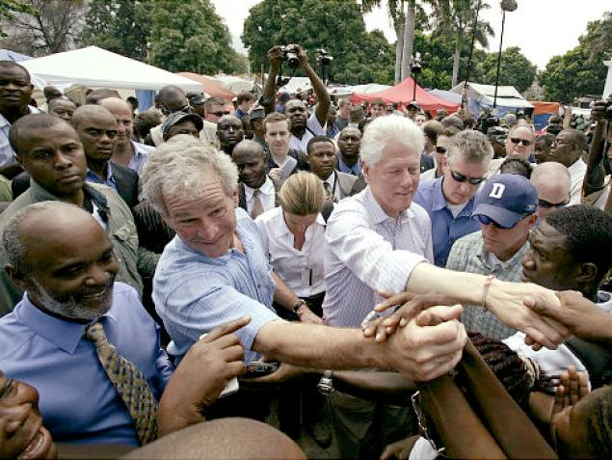

Slide 7
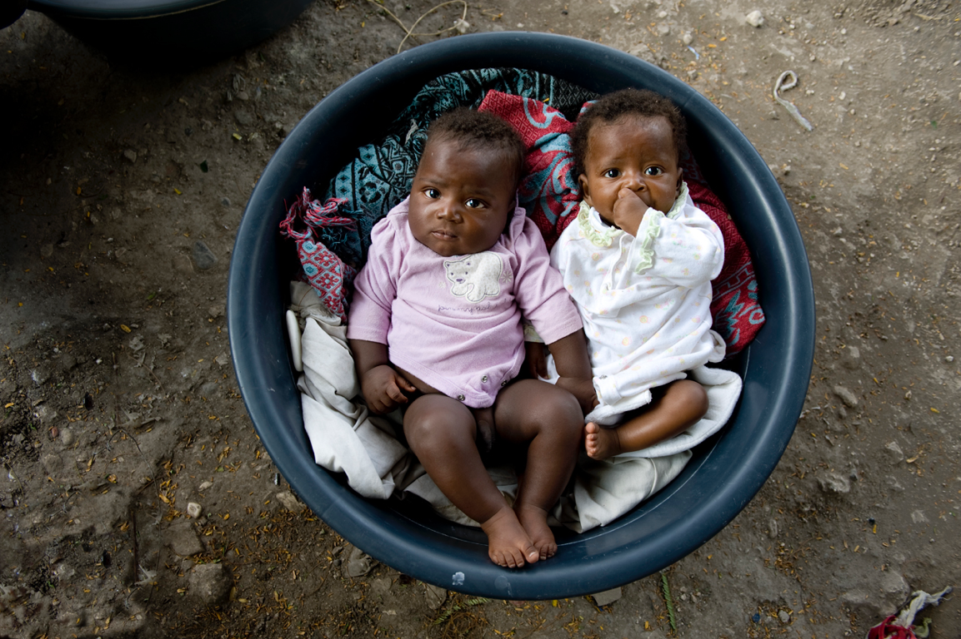

Slide 8
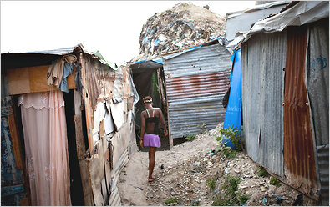

Slide 9
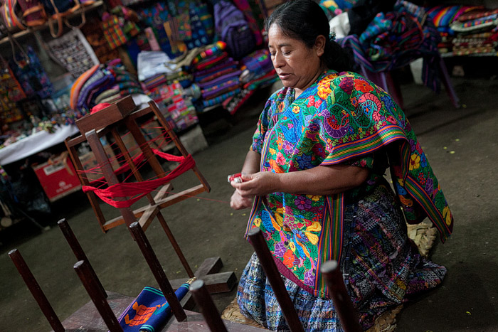
1
2
Mexico
Guatemala
A | Guatemala
B | Mexico
C | Panama
D | Costa Rica
Panama
Costa Rica
3
4

Slide 10
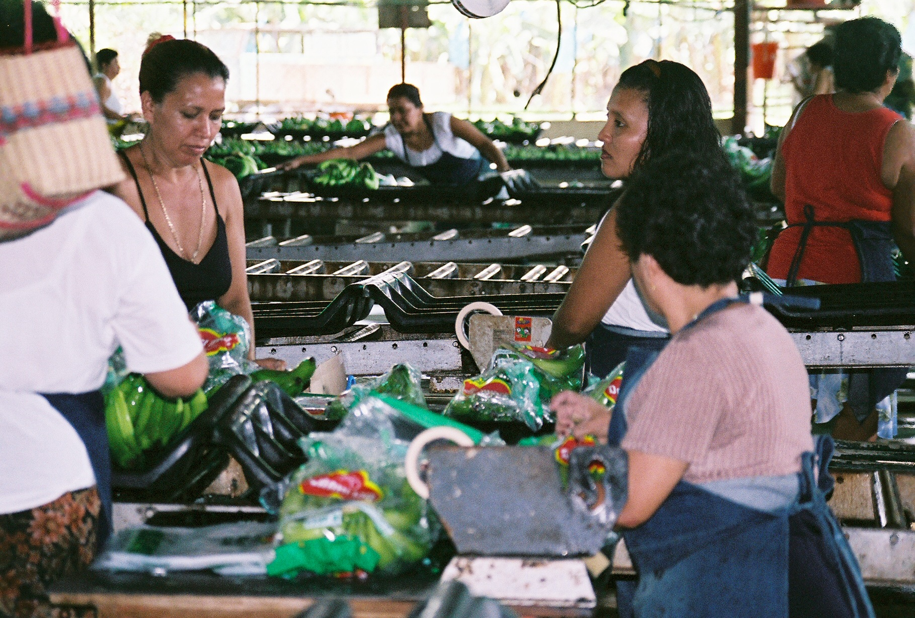
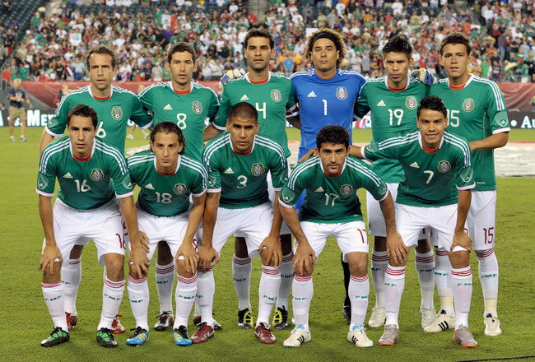
1
2
Guatemala
Costa Rica
A | Guatemala
B | Mexico
C | Panama
D | Costa Rica
Panama
Mexico
3
4

Slide 11
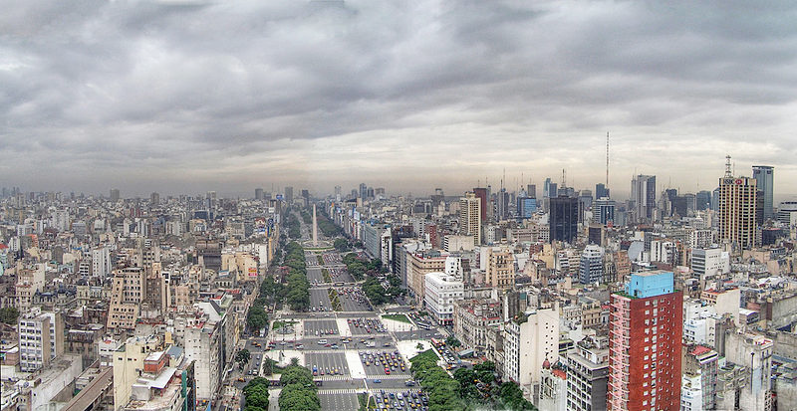
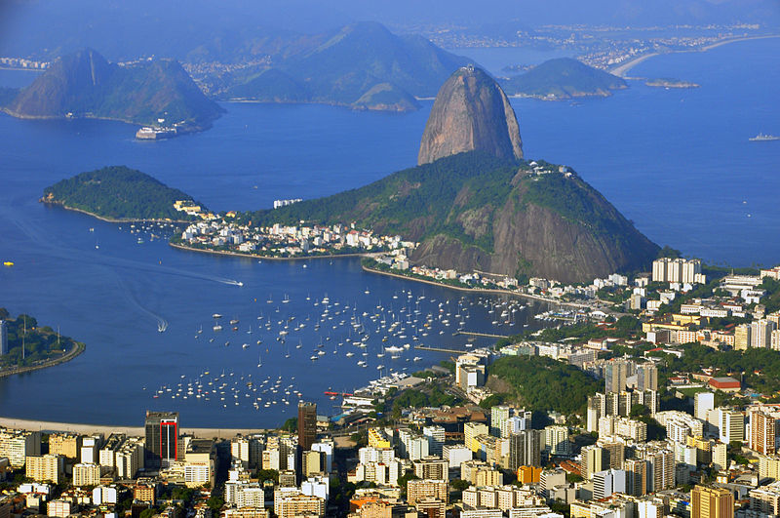
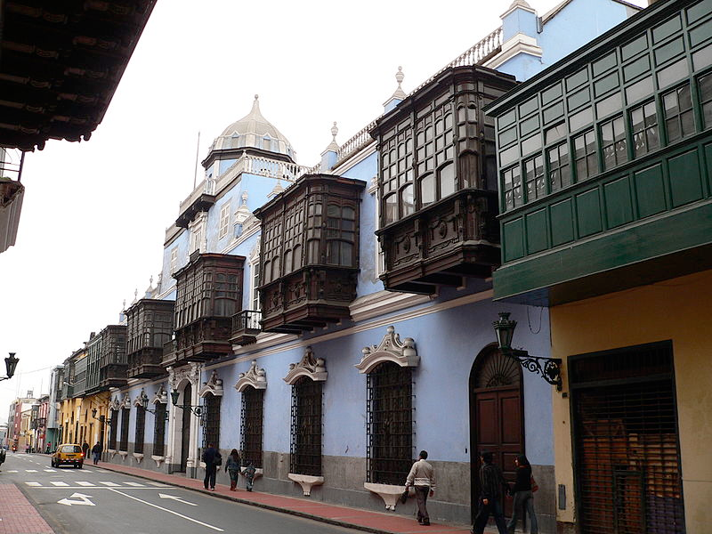
1
2
Buenos Aires
Rio
A | Lima
B | Rio de Janeiro
C | Sao Paulo
D | Buenos Aires
Lima
Sao Paulo
3
4

Slide 16
1
2
Quetzal - Guatemala
U.S. Dollar - Panama
A | Guatemala
B | Panama
C | Belize
D | Costa Rica
Dollar - Belize
Colones - Costa Rica
3
4

Slide 21
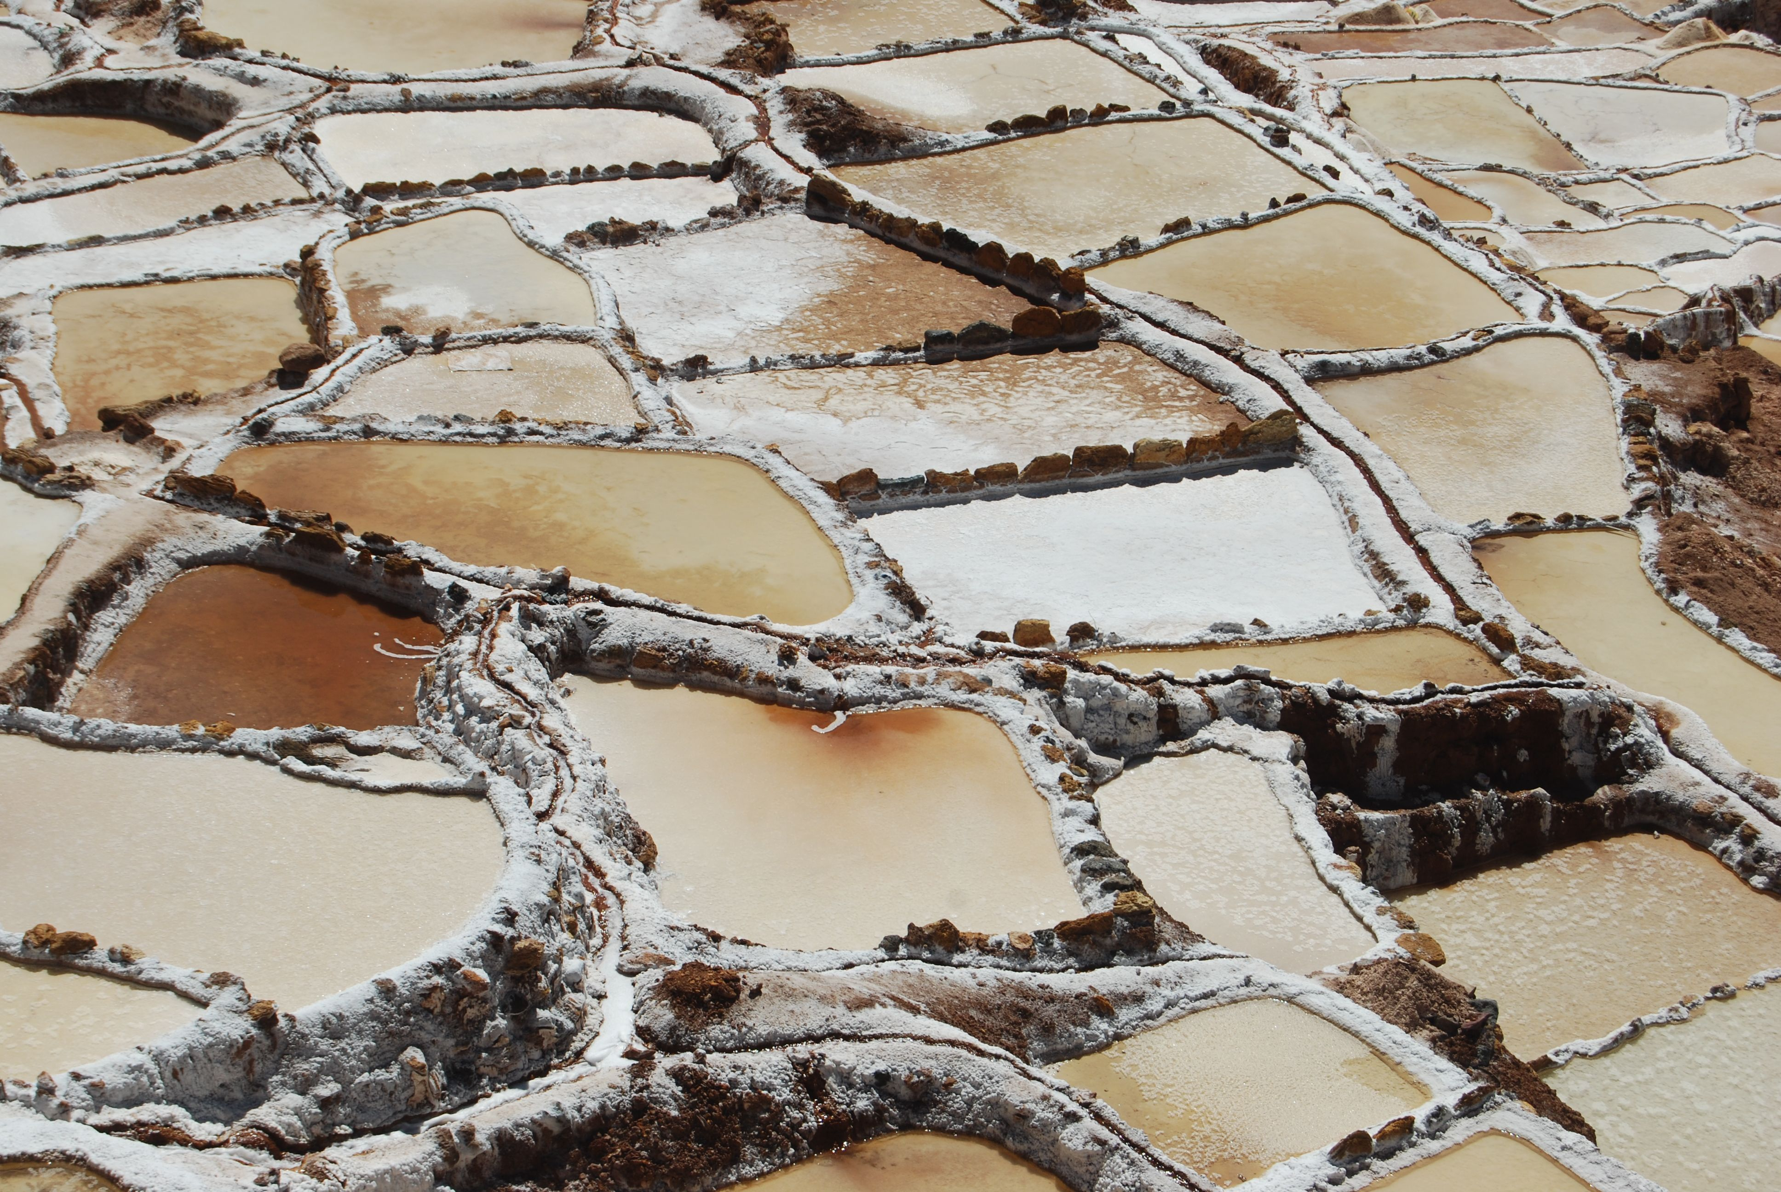
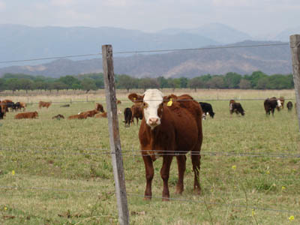
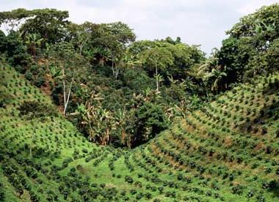
1
2
Peru
Chile
A | Chile
B | Peru
C | Colombia
D | Argentina
Argentina
Colombia
3
4

Slide 22
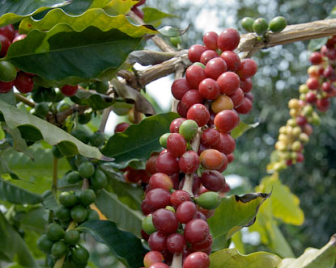

Slide 23
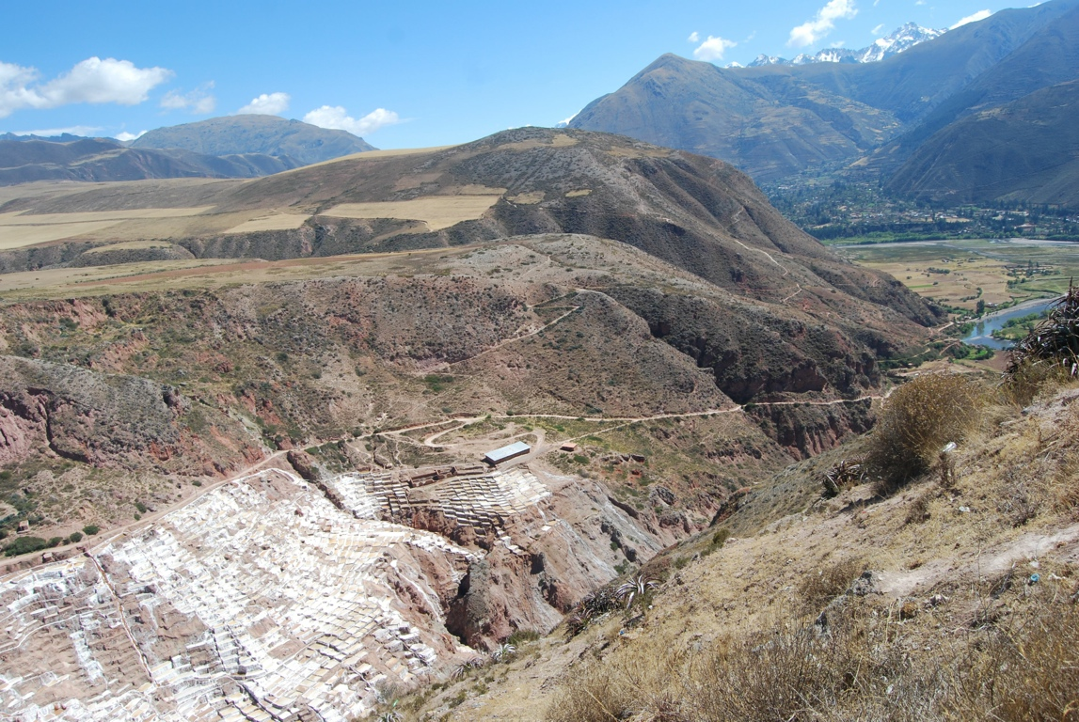

Slide 24
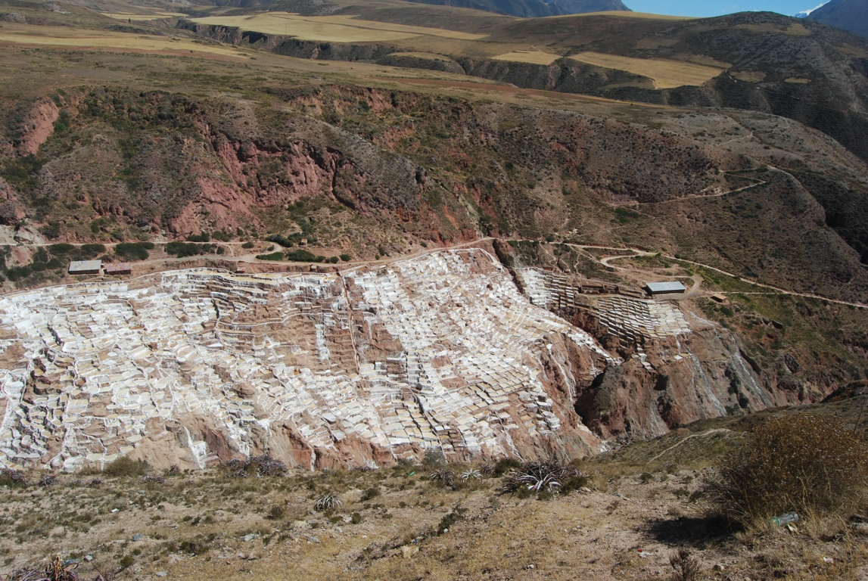

Slide 25
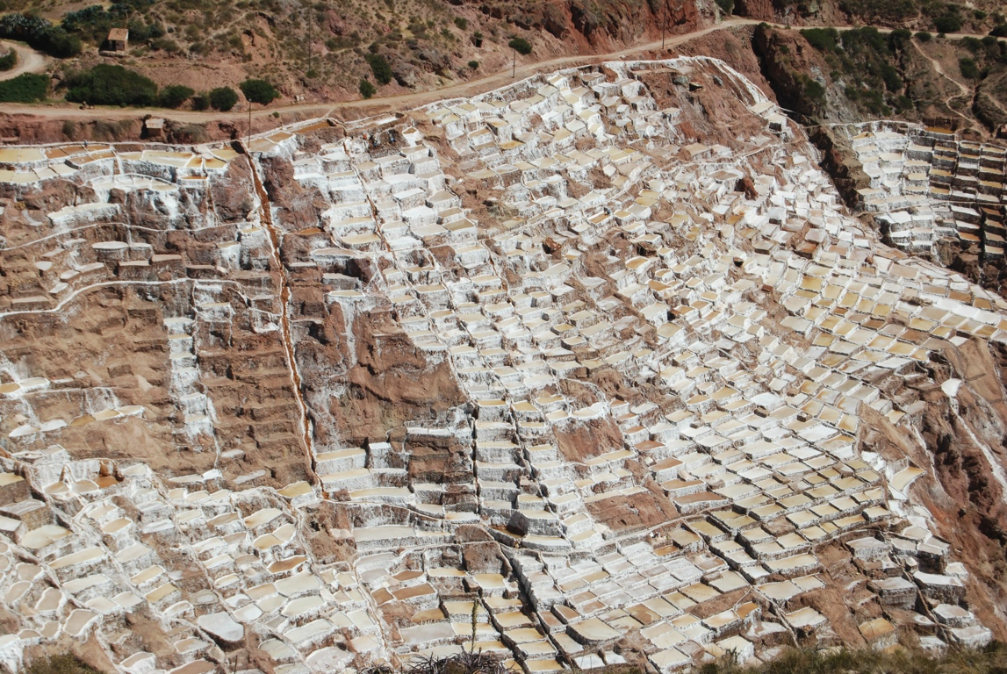

Slide 27
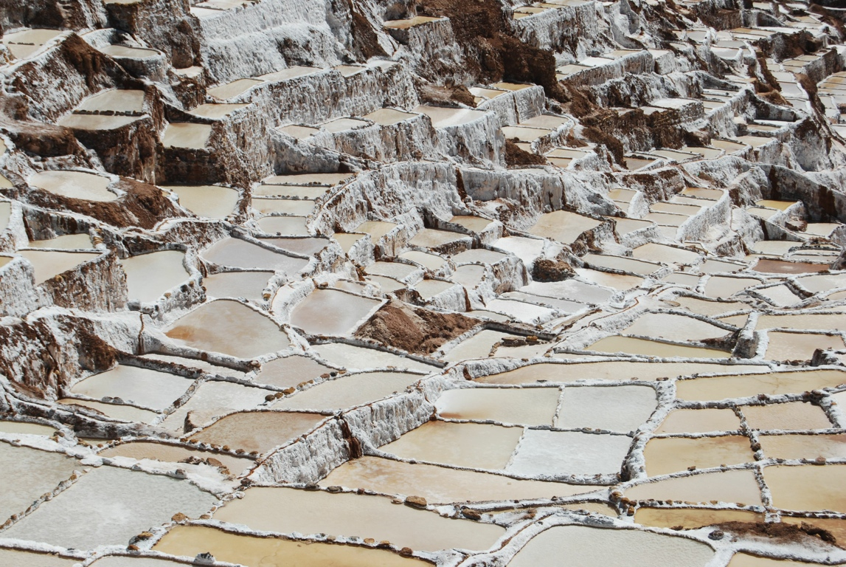

Slide 28
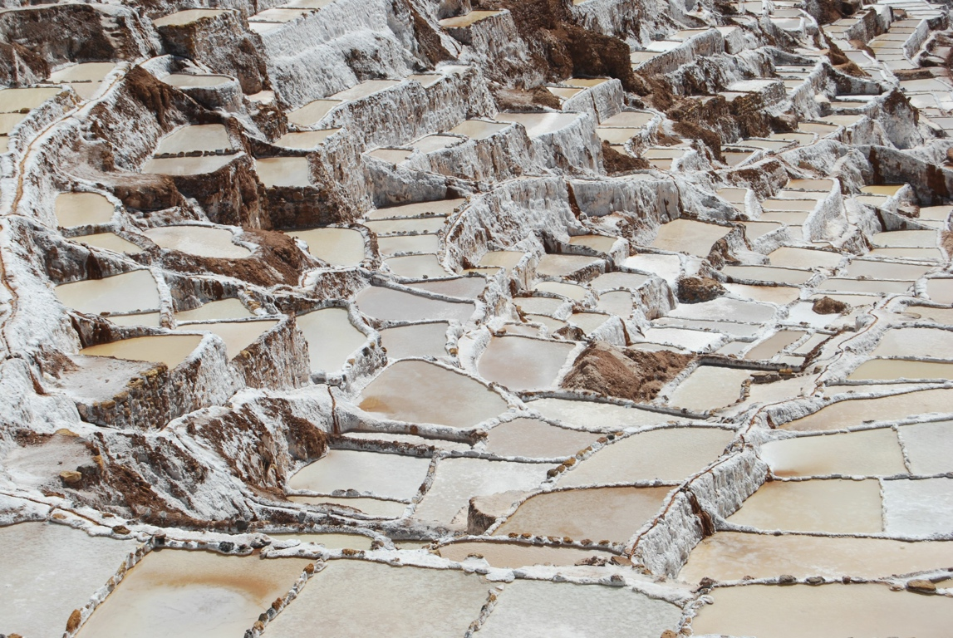

Slide 29
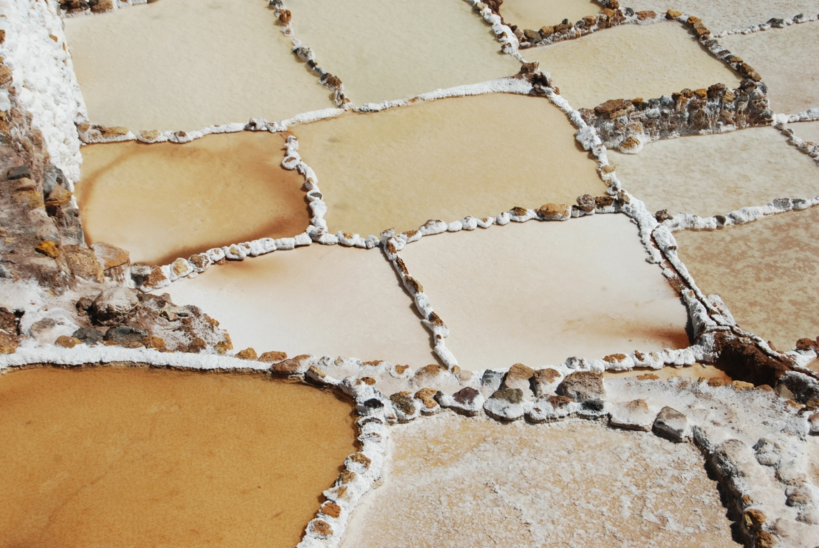

Slide 30
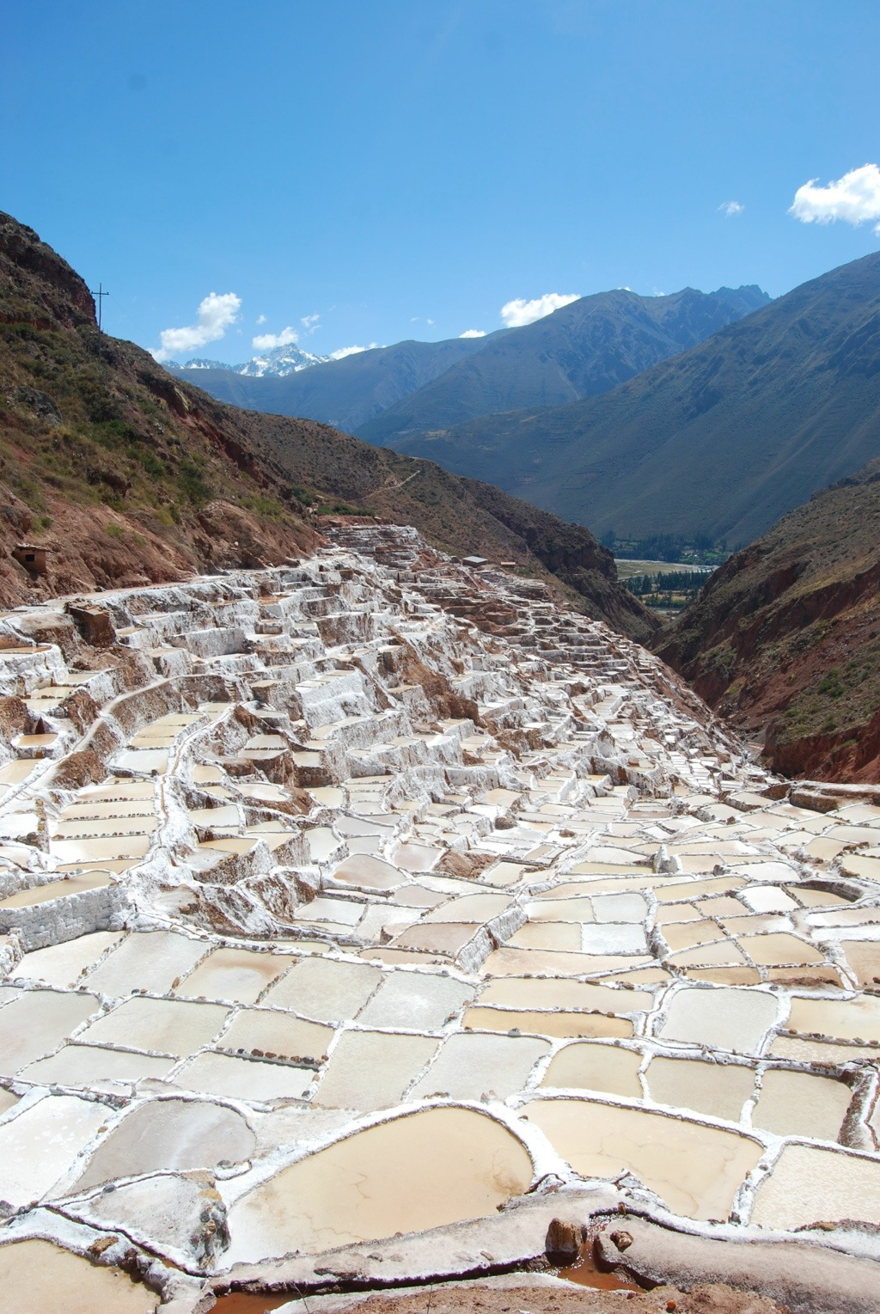

Slide 31
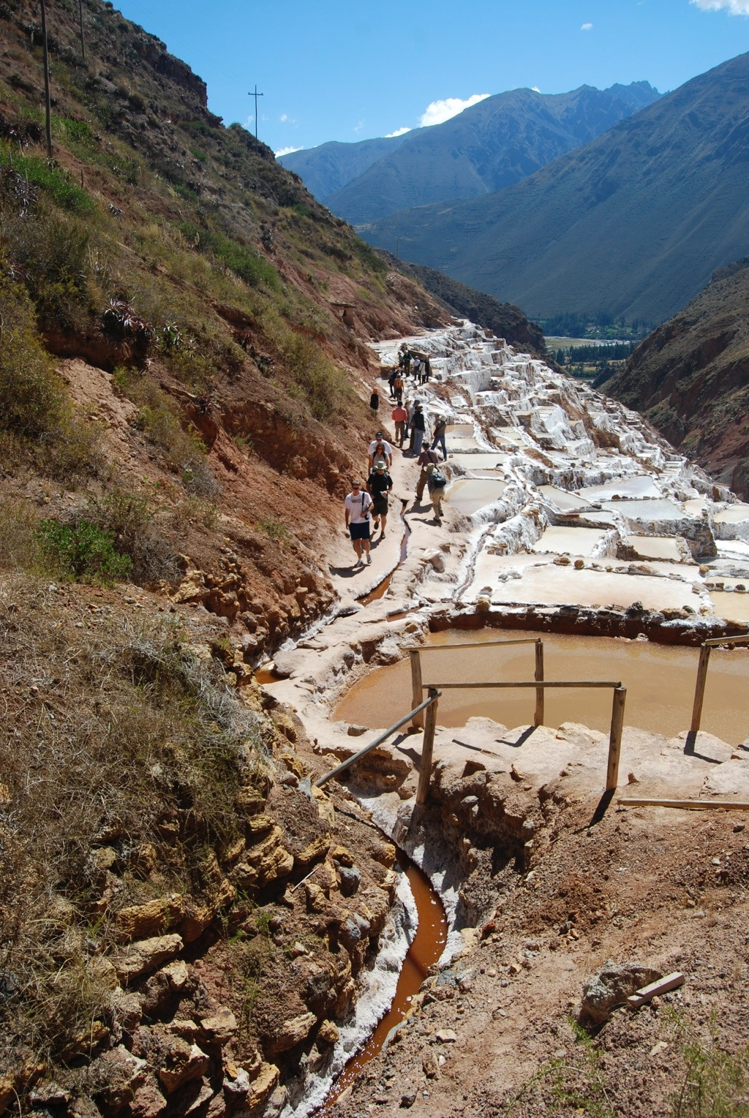

Slide 32
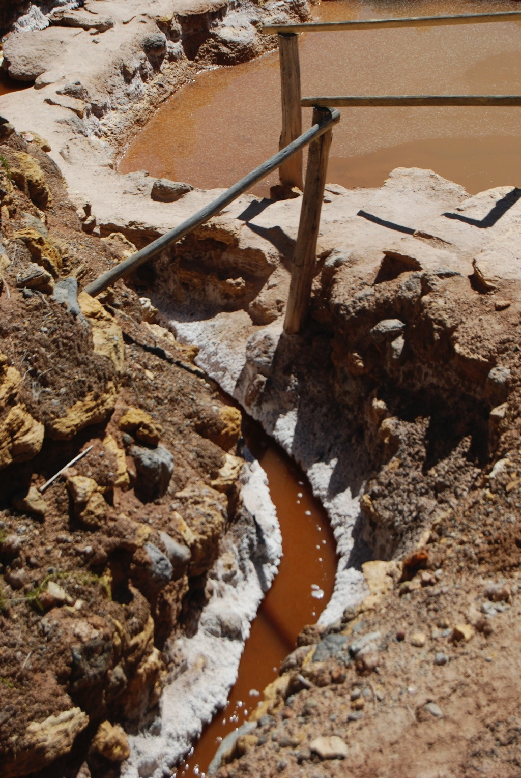

Slide 34
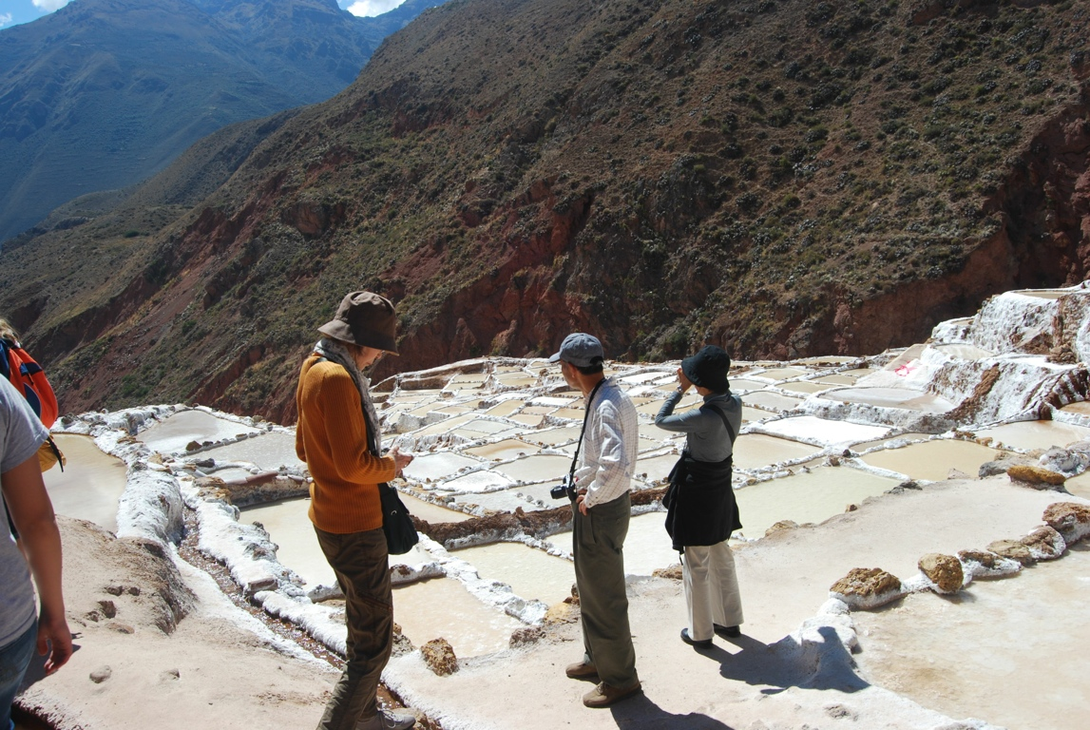

Slide 35
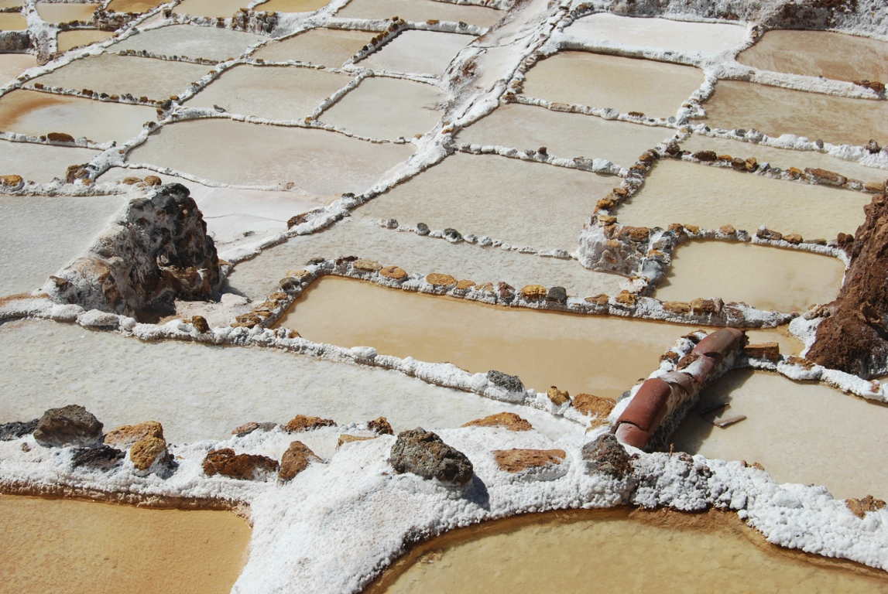

Slide 36
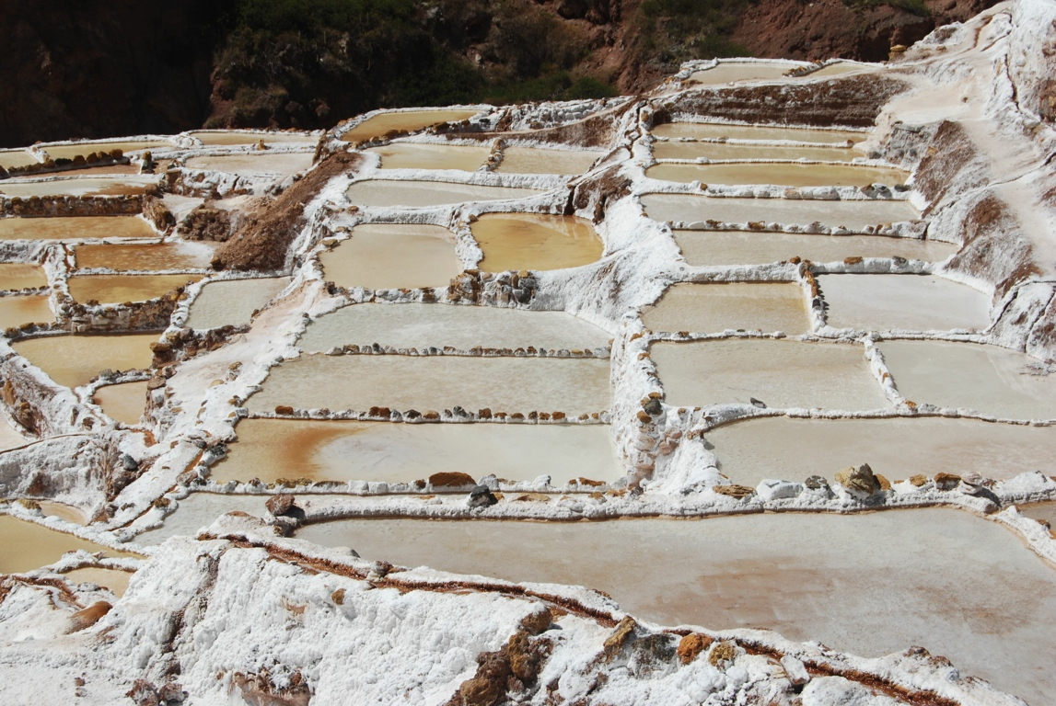

Slide 37
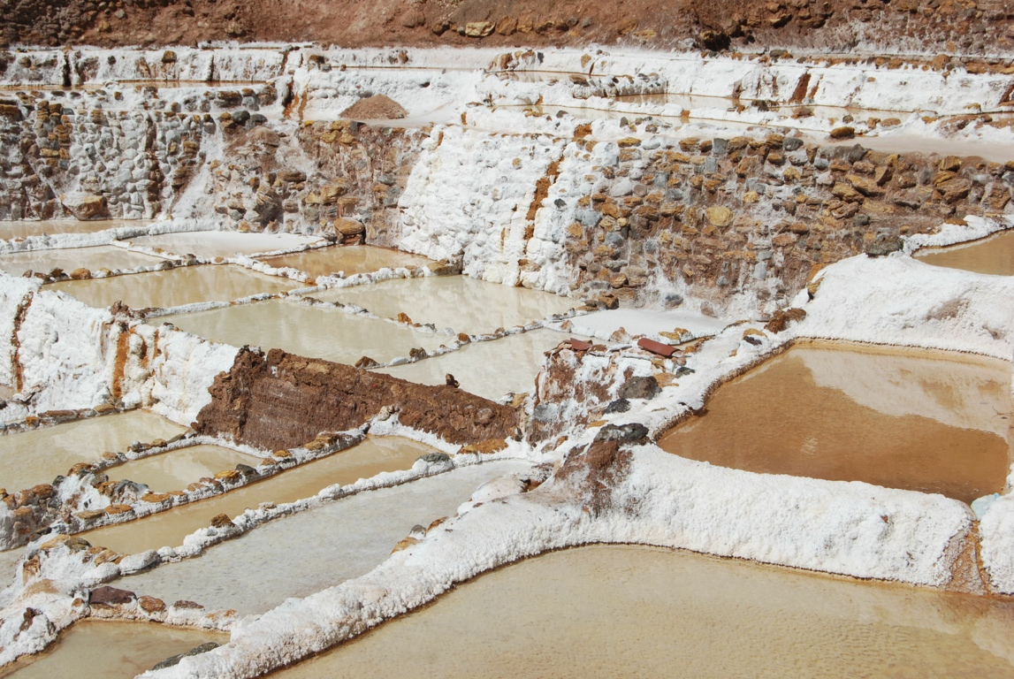

Slide 38
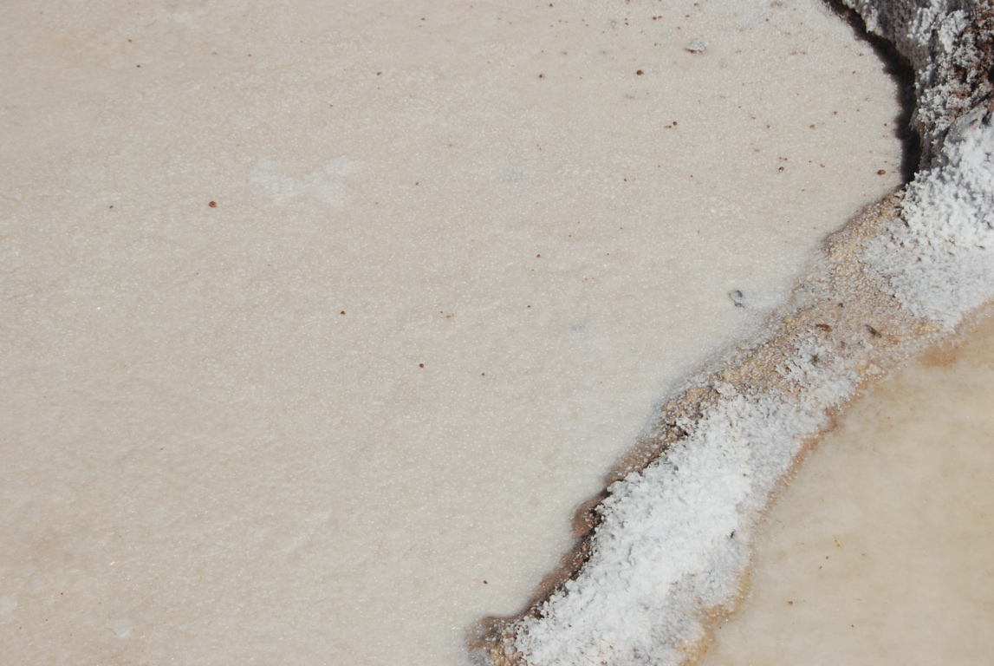

Slide 39
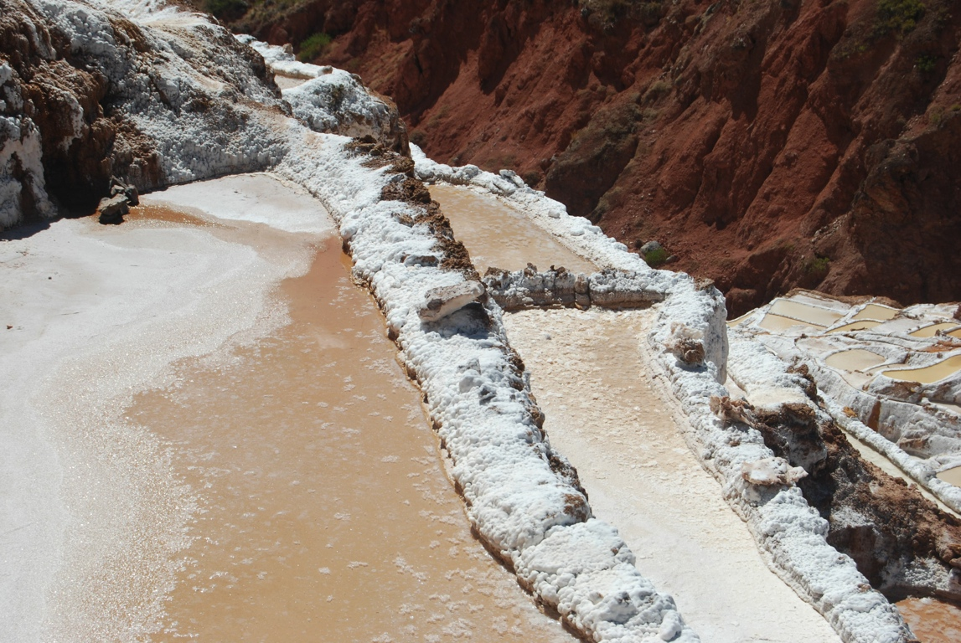

Slide 40
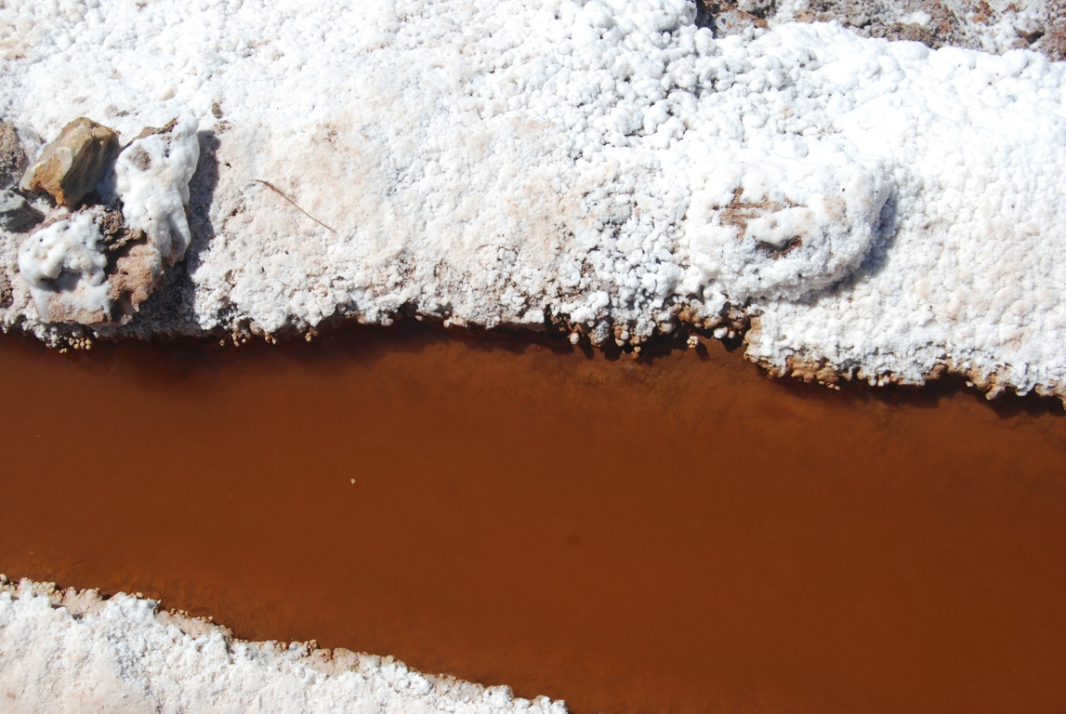

Slide 41
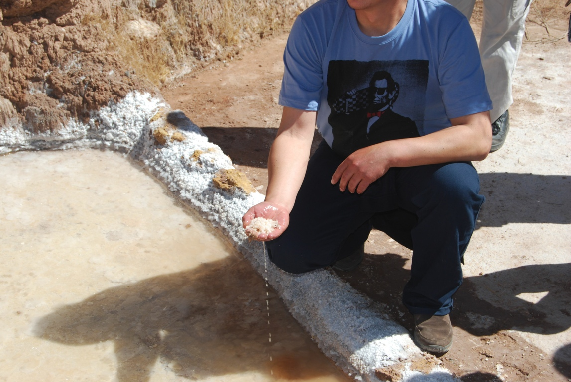

Slide 42
