Slide 1
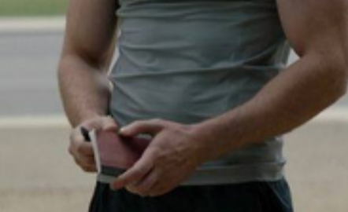
Captain America’s
To Do List
Can you name the country?

Slide 2
Captain America’s
To Do List
1

Slide 3
Captain America’s
To Do List
2

Slide 4
Captain America’s
To Do List
3

Slide 5
Captain America’s
To Do List
4

Slide 6
Captain America’s
To Do List
5

Slide 7
Captain America’s
To Do List
6

Slide 8
Captain America’s
To Do List
7

Slide 9
Captain America’s
To Do List
United States
Canada
1

Slide 10
Captain America’s
To Do List
France
2

Slide 11
Captain America’s
To Do List
South Korea
3

Slide 12
Captain America’s
To Do List
Italy
4

Slide 13
Captain America’s
To Do List
United Kingdom
5

Slide 14
Captain America’s
To Do List
Mexico
6

Slide 15
Captain America’s
To Do List
Russia
7

