Slide 1
Metropolitan Population Pyramids
U.S. History and Geography High School
Tennessee Geographic Alliance
Instructor
Michael Robinson
Houston High School
Germantown, TN

Slide 2
Overview of Lesson
What are population pyramids?
How has the population of the United States changed over time?
Identify cities and zip codes by analyzing their population pyramid.
USA Cities
Shelby County Zip Codes
Knoxville Zip Codes
Nashville Zip Codes

Slide 3
Tennessee Standard
US.107 Using census data and population pyramids, identify and describe the demographic changes in the United States since 1980. (G)

Slide 4
Connections to
Common Core Standards
Recognize and interpret (at different scales) the relationships among patterns and processes.

Slide 6
Population Pyramids at Different Scales...

Slide 7
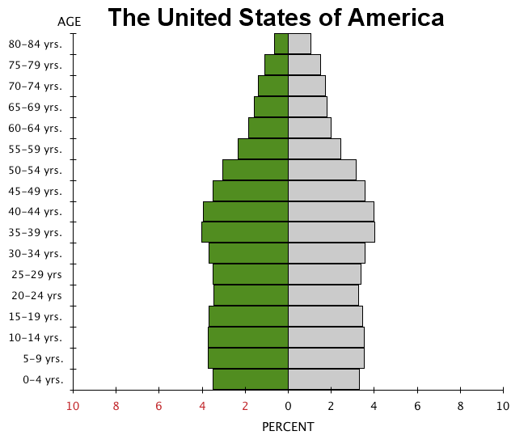
Country

Slide 8
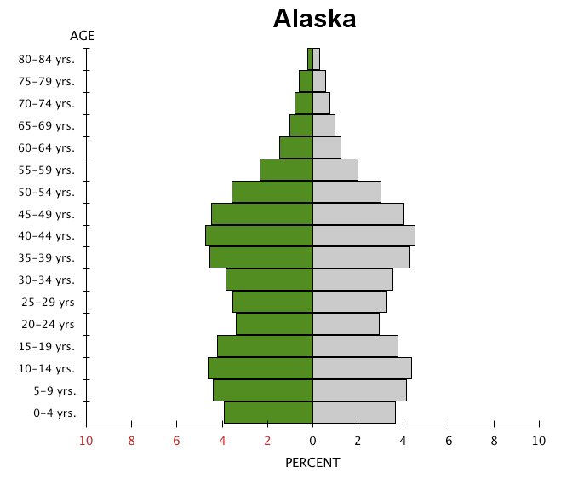
State

Slide 9
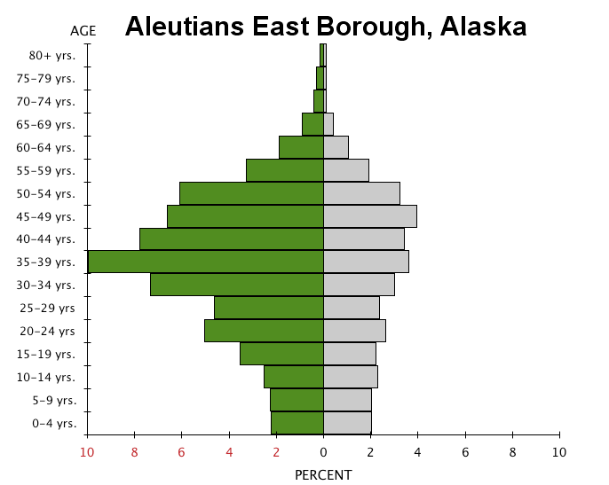
Borough
(county)

Slide 10
http://dsc.discovery.com/fansites/deadliestcatch/deadliestcatch.html

Slide 11
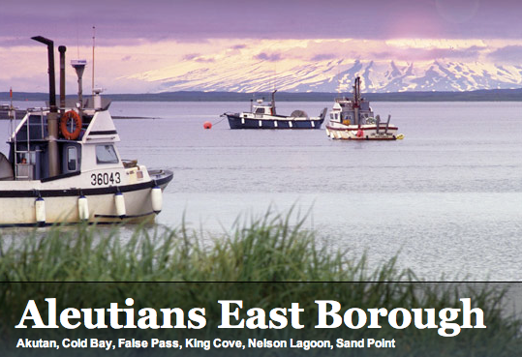
http://www.aleutianseast.org

Slide 12
Group Activity:
Population Pyramids for Different US Cities

Slide 13
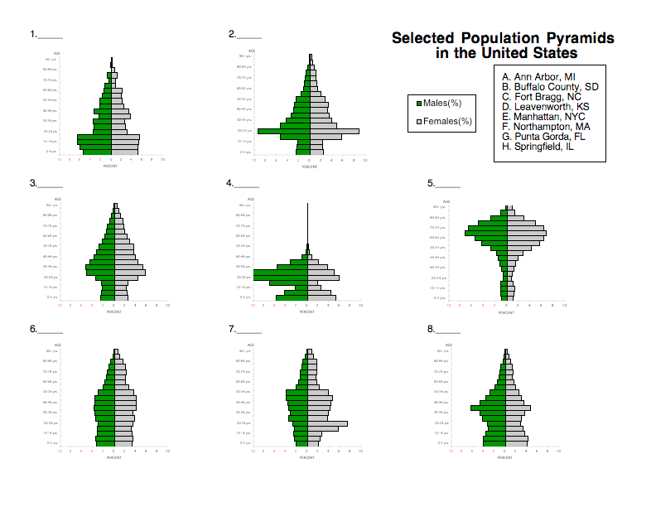

Slide 14
Helpful Hints…
A. Ann Arbor, MI - University of Michigan
B. Buffalo county, SD - Crow Creek Indian Reservation, one of the
poorest counties in the United States
C. Fort Bragg, NC - United States Army Fort
D. Leavenworth, KS - United States Penitentiary
E. Manhattan, NYC - wealthy downtown, few large families
F. Northampton, MA - Smith College, an all girls college
G. Punta Gorda, FL - retirement community
H. Springfield, IL - average American city

Slide 15
B.
Buffalo County, SD
# 1

Slide 16
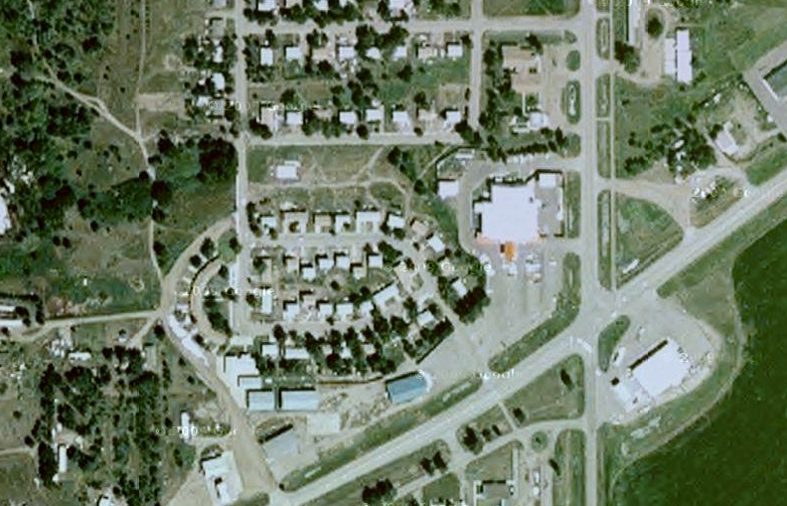
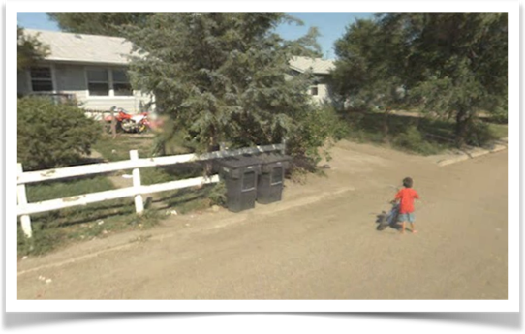

Slide 17
A.
Ann Arbor, MI
# 2

Slide 18
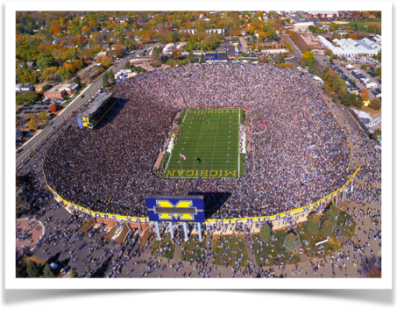

Slide 19
E.
Manhattan Borough,
NYC
# 3

Slide 20
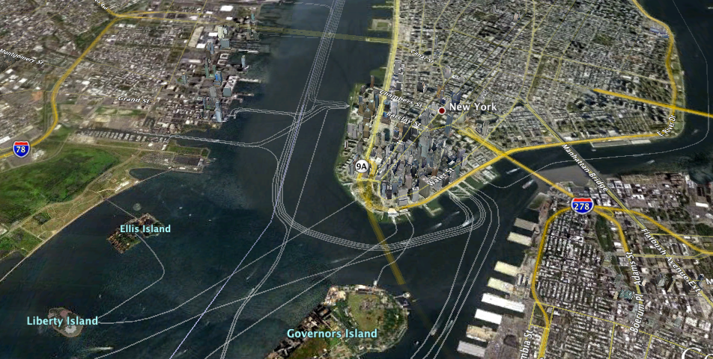
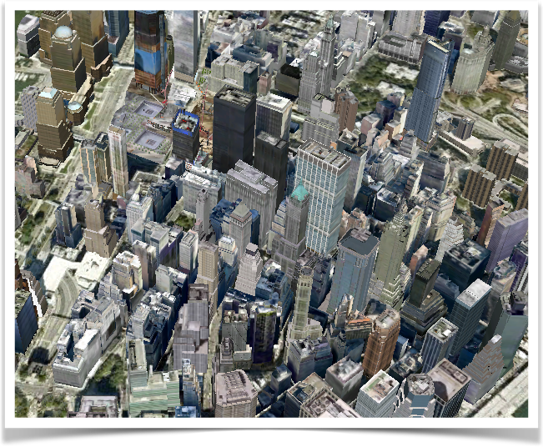

Slide 21
C.
Fort Bragg, NC
# 4

Slide 22
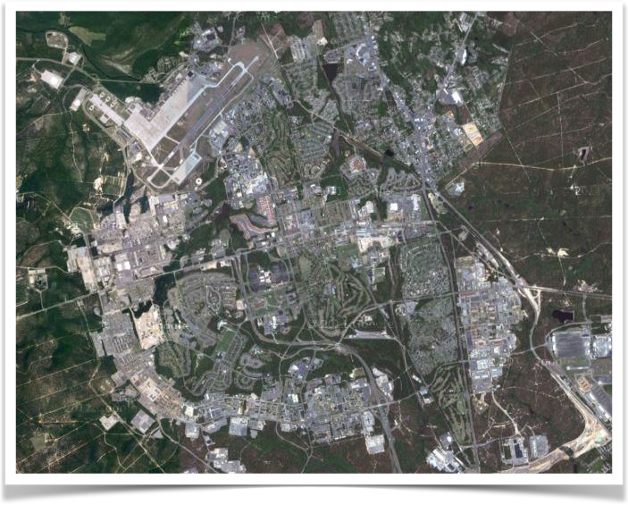

Slide 23
G.
Punta Gorda, FL
# 5

Slide 24
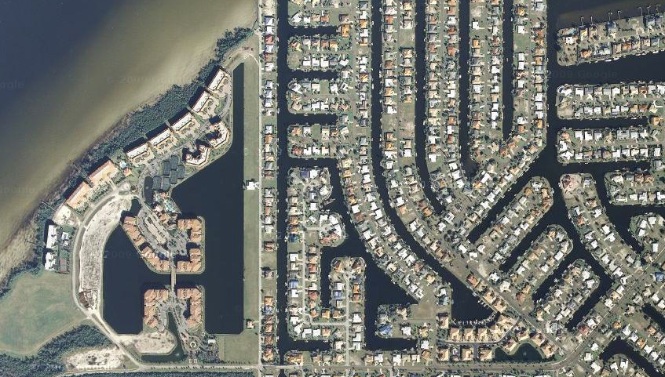
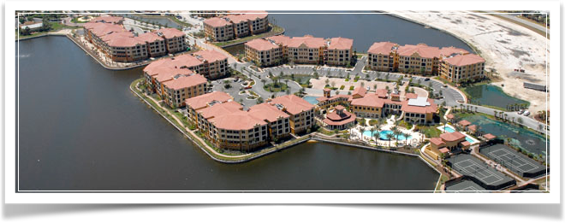

Slide 25
H.
Springfield, IL
# 6

Slide 26
F.
Northampton, MA
# 7

Slide 28
D.
Leavenworth, KS
# 8

Slide 29
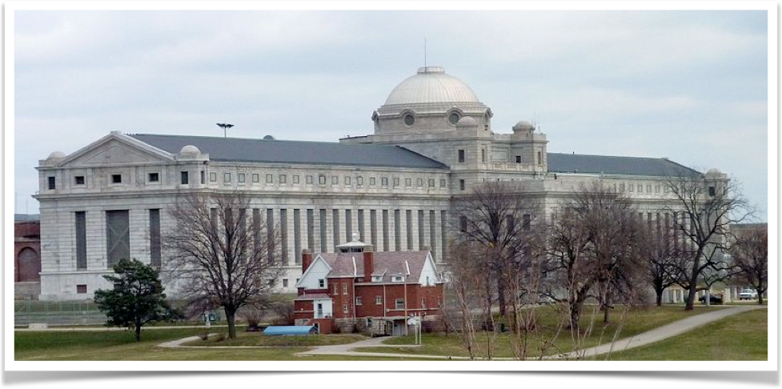

Slide 30
Answers
1. B
2. A
3. E
4. C
5. G
6. H
7. F
8. D

Slide 31
Group Activity:
Population Pyramids for Zip Codes in Shelby Co.

Slide 32
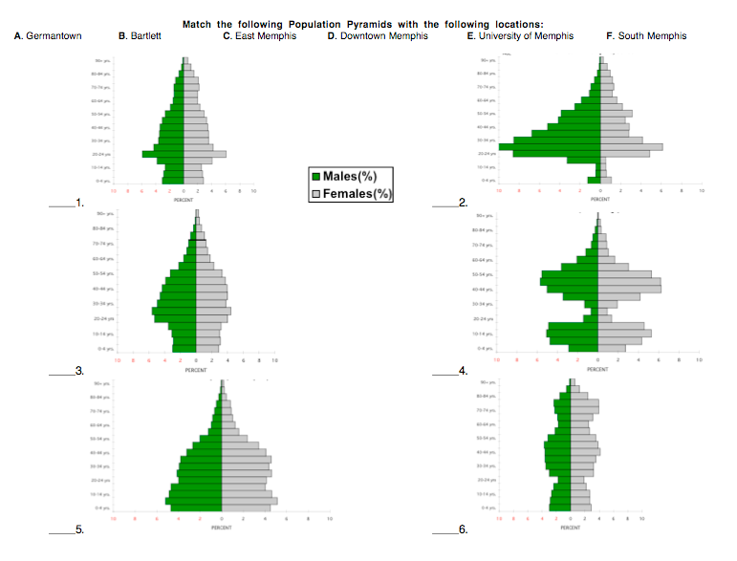

Slide 33
Helpful Hints
Germantown - wealthy suburb
Bartlett- older, mature suburb
East Memphis- wealthy, older, mature area
Downtown Memphis- young professionals
University of Memphis- college age students
South Memphis- poor area

Slide 34
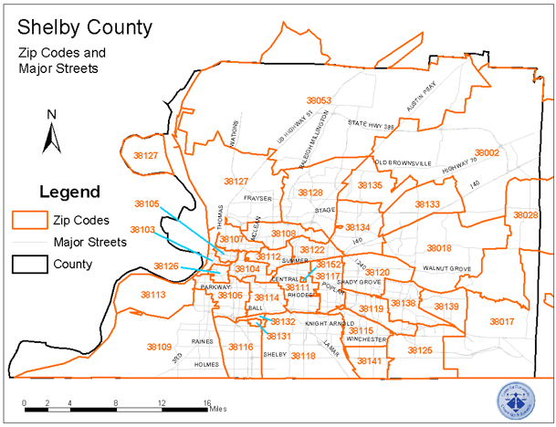
Germantown
Bartlett
East Memphis
Downtown Memphis
University of Memphis
South Memphis
B
D
C
E
A
F

Slide 35
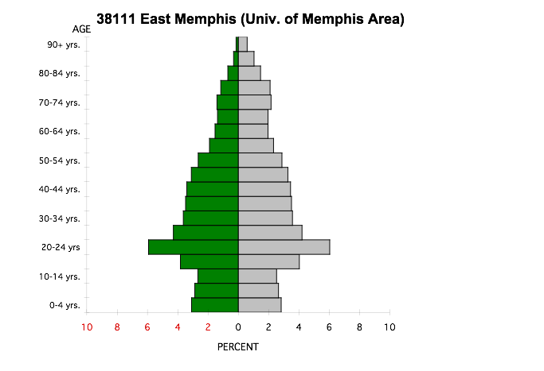
# 1
E

Slide 36
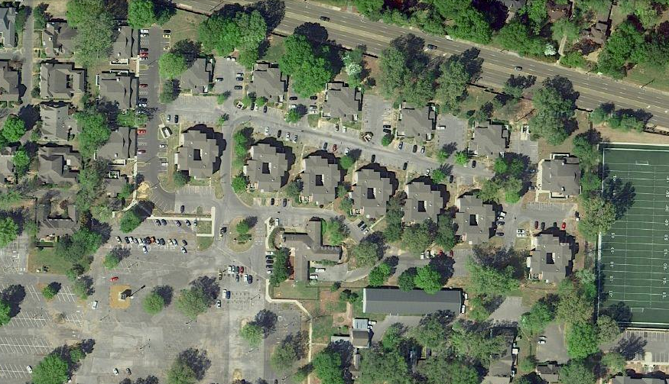

Slide 37
# 2
Downtown Memphis, 38103
D

Slide 38
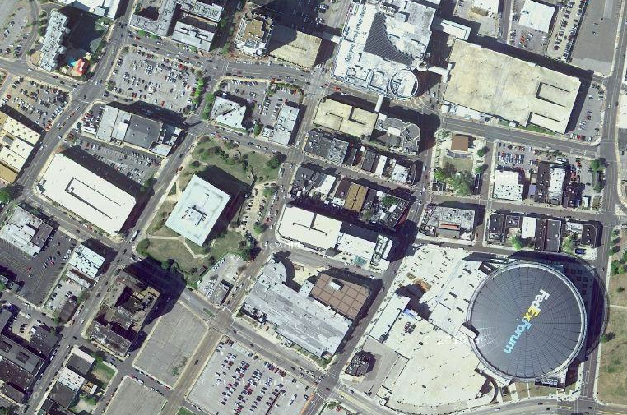

Slide 39
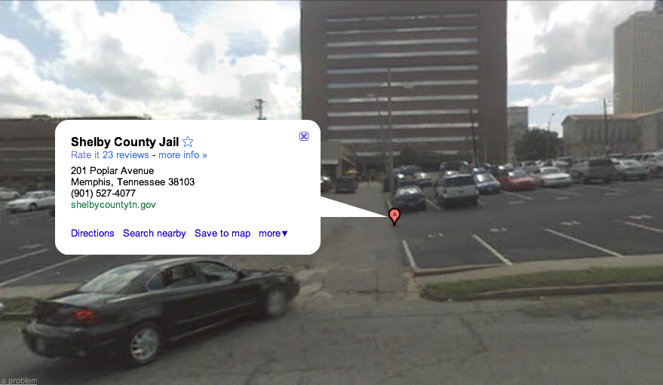

Slide 40
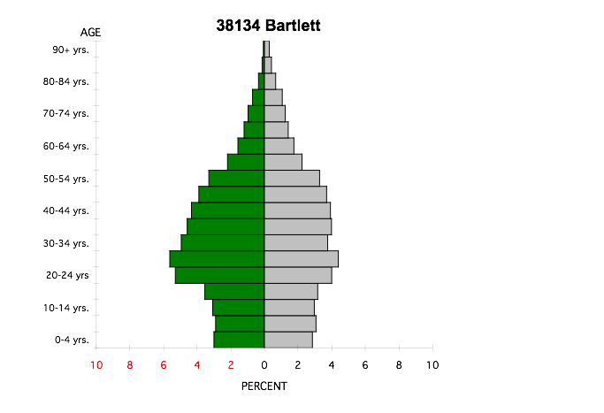
# 3
B

Slide 41
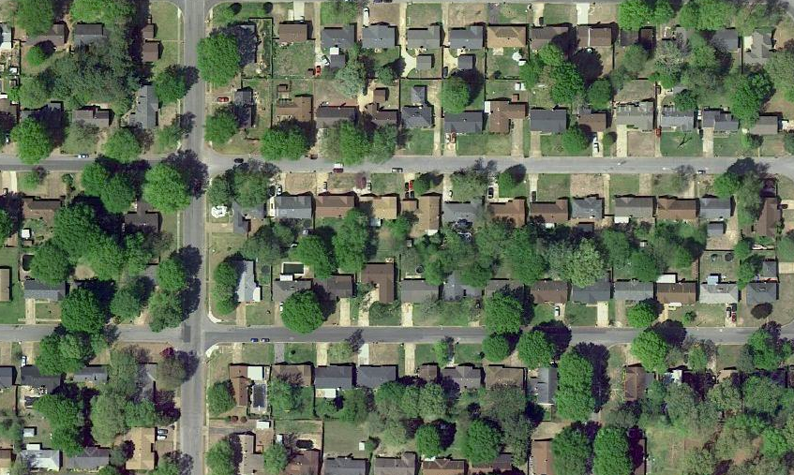

Slide 42
Germantown, 38139
(Houston High)
# 4
A

Slide 43
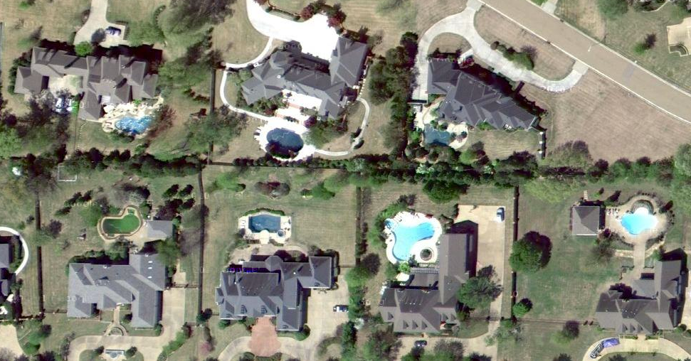

Slide 44
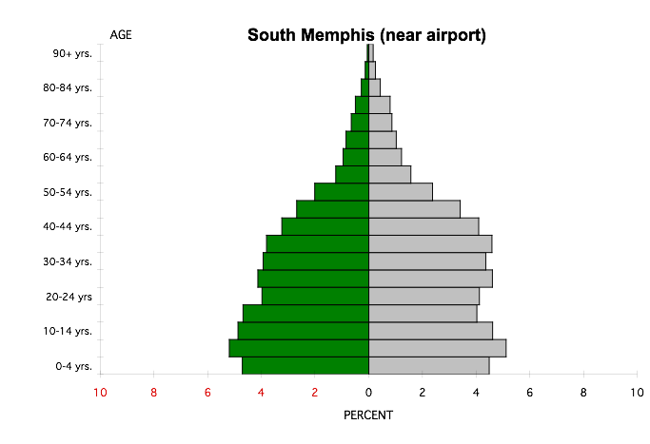
# 5
F

Slide 45
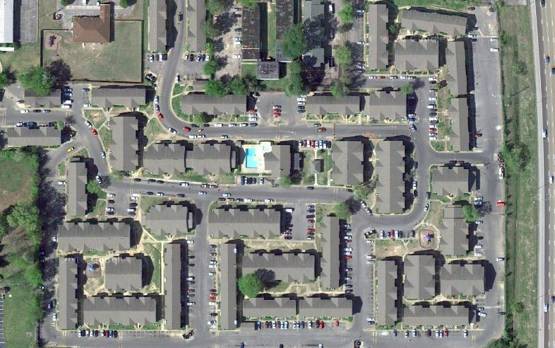

Slide 46
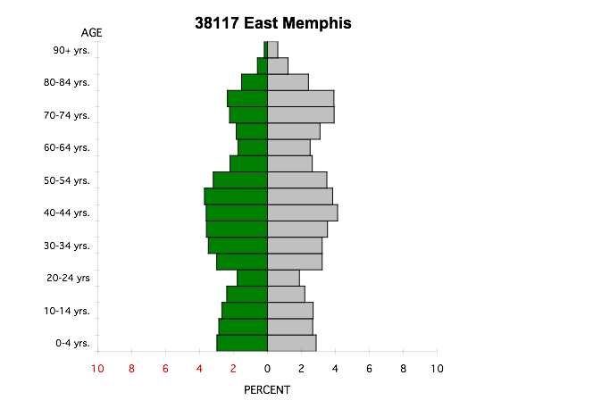
# 6
C

Slide 47
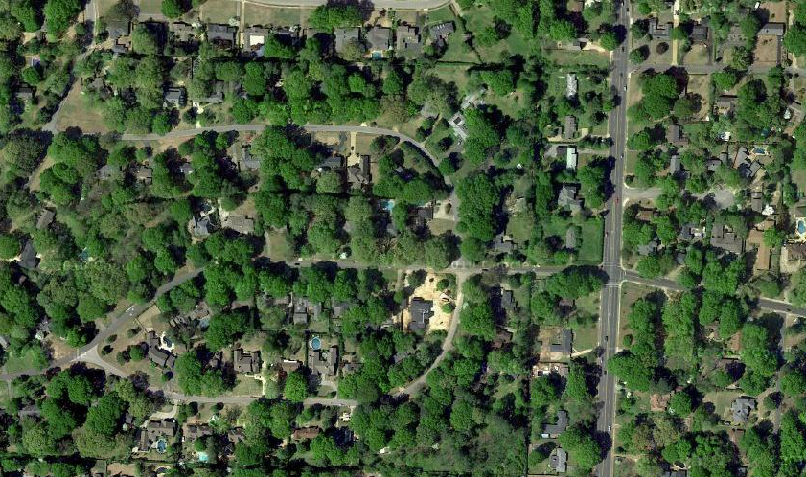

Slide 48
Answers
1. E
2. D
3. B
4. A
5. F
6. C

Slide 49
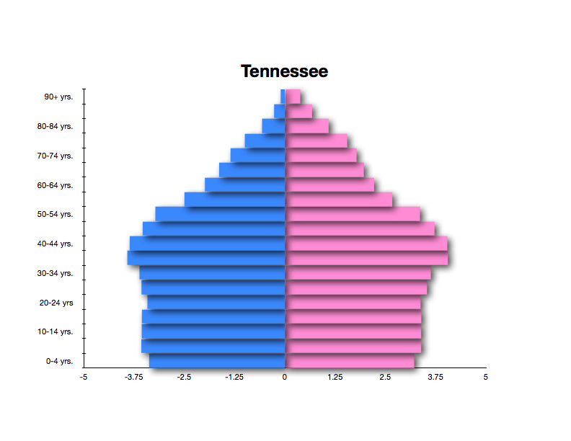

Slide 50
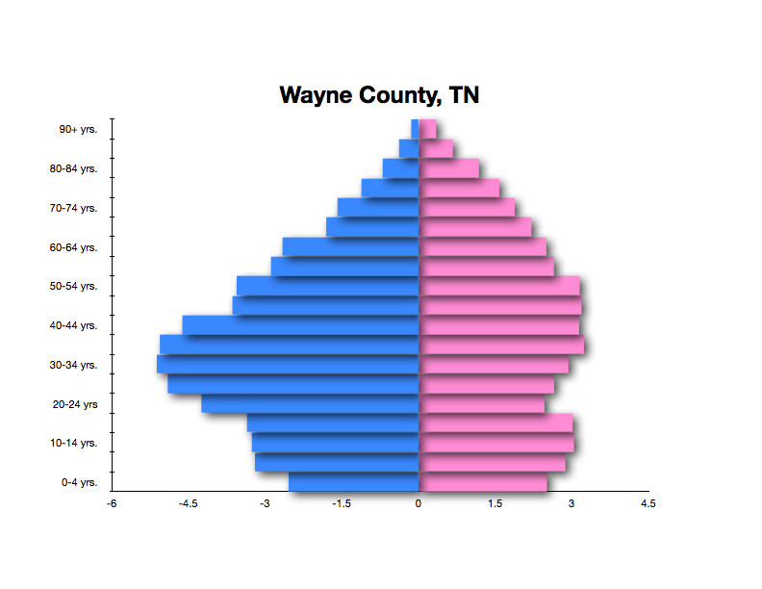

Slide 51
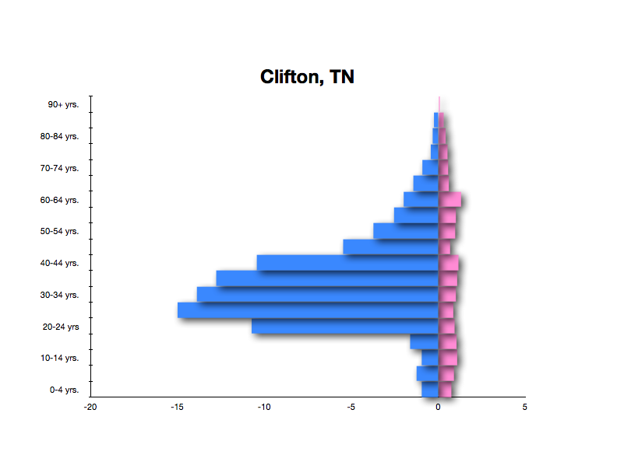

Slide 52
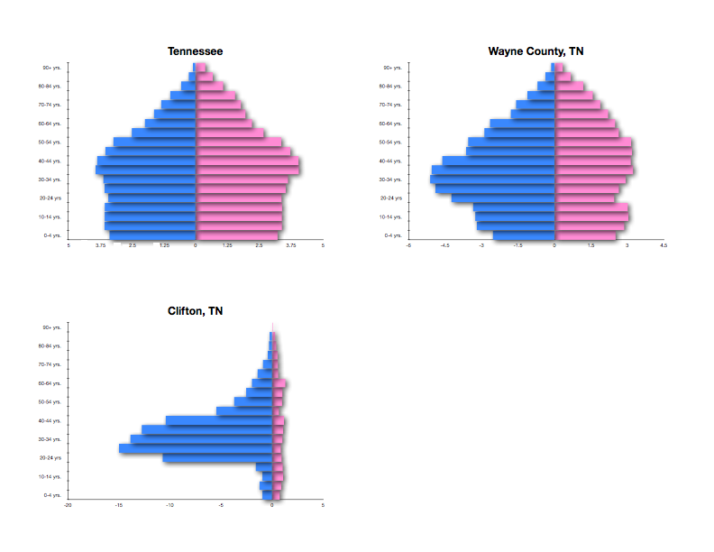
Why so many more men?

Slide 54
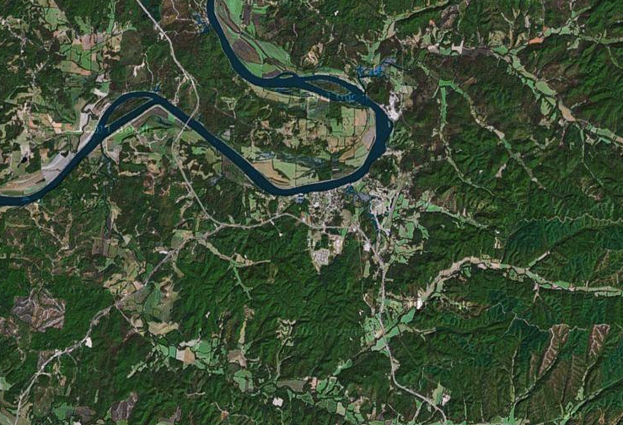

Slide 55
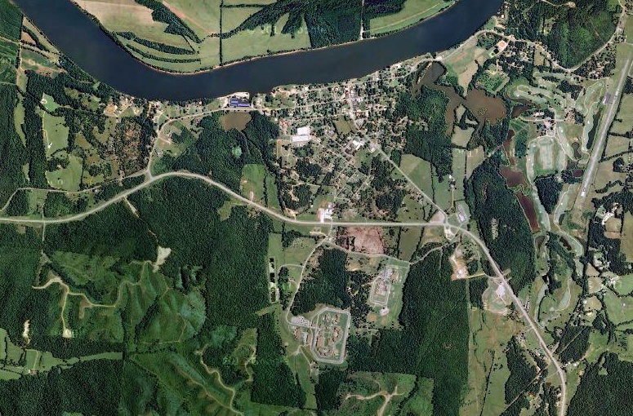

Slide 56
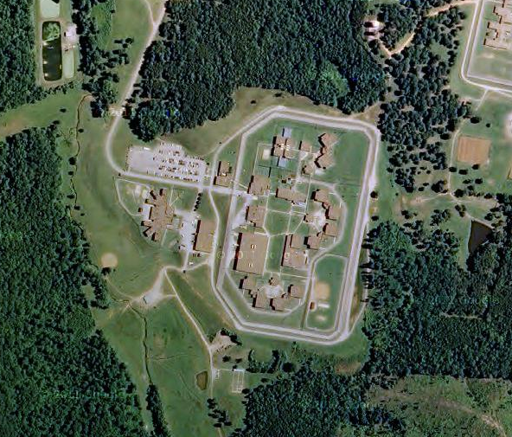

Slide 58
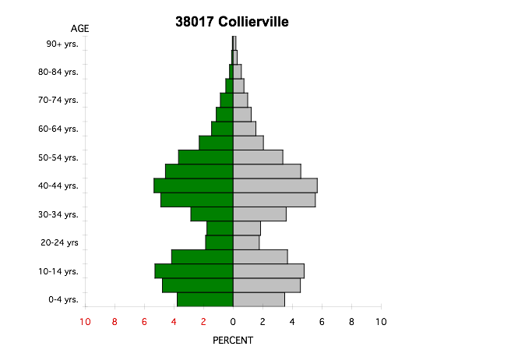
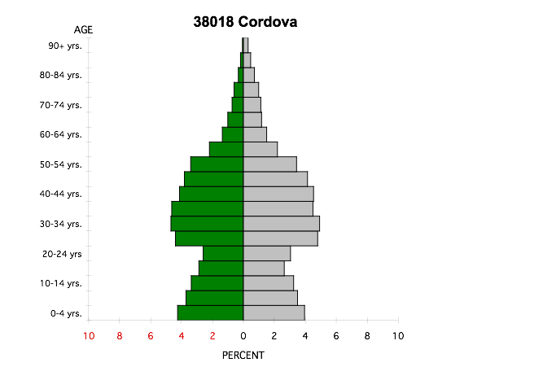
Reflection.... Suburban America
How are the two graphs similar? How are they different? Why the differences?

Slide 59
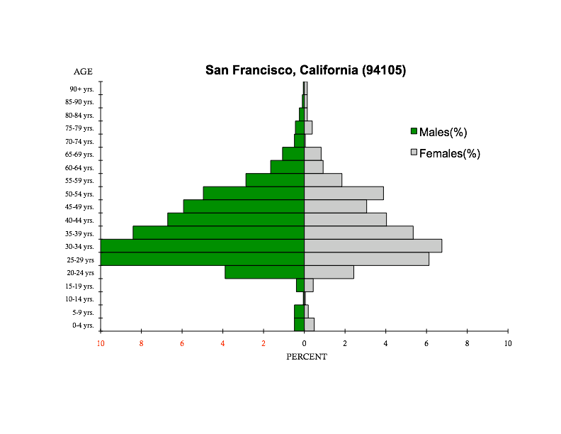
Reflection... What part of San Francisco?
Why so many
people?
Why so few people?

Slide 60
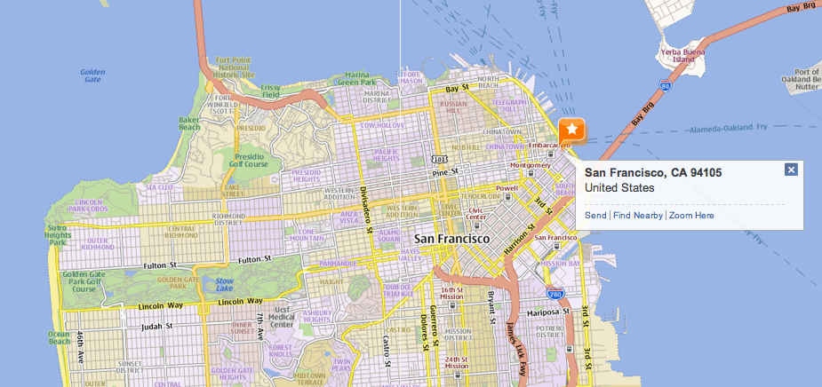
Downtown San Francisco

Slide 61
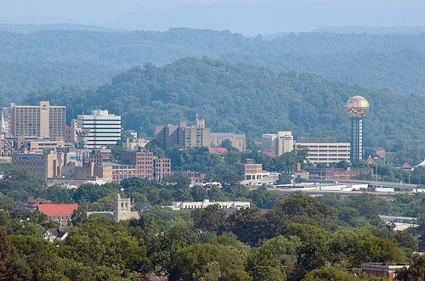
Student Activity
Selected Population Pyramids for Knoxville, TN

Slide 62
Match the Knox County Population Pyramids (1-9) with the correct description and photo (A-I)

Slide 63
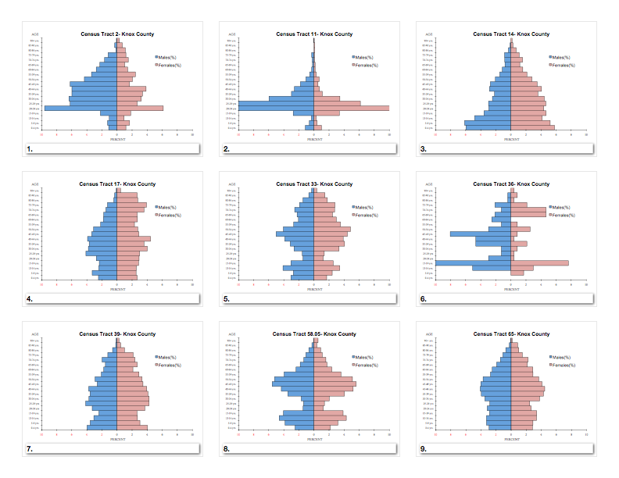

Slide 64
Knox County Population Pyramids
A- Wealthy Suburban Neighborhood
B- Government Housing Low Income Neighborhood
C- Established (older) Wealthier Neighborhood
D- Rural Housing (outskirts of urban area)
E- Established (older) Middle Class Urban Neighborhood
F- Downtown Knoxville Area
G- Health Facility (with low population numbers)
H- Student Housing for the University of Tennessee, Knoxville
I- Middle Income Suburban Neighborhood

Slide 65
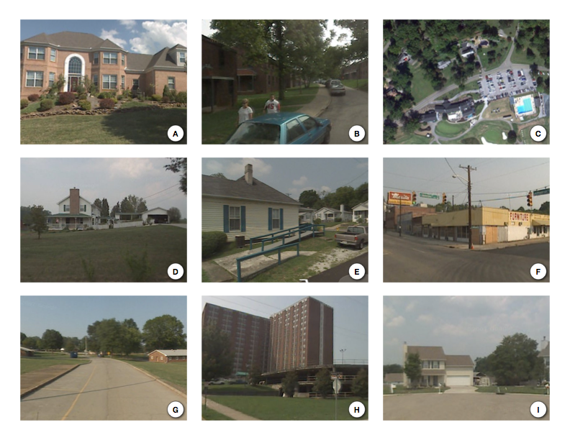

Slide 66
Knox County Tennessee
Selected Census Tracts
65
33
39
17
14
2
11
58.05
36
Central Knoxville
Knox County

Slide 67
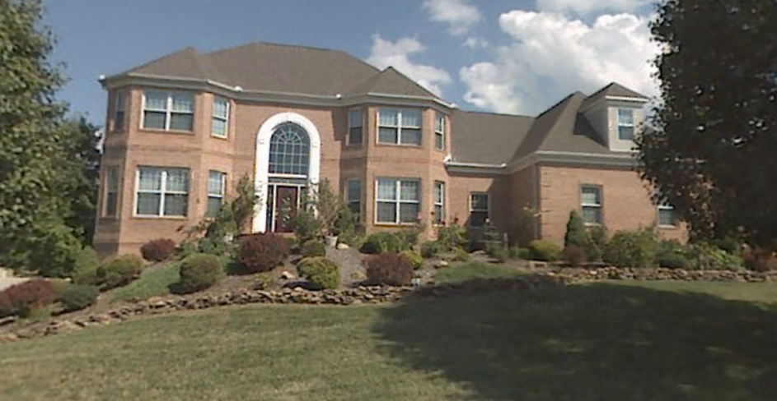
A

Slide 68
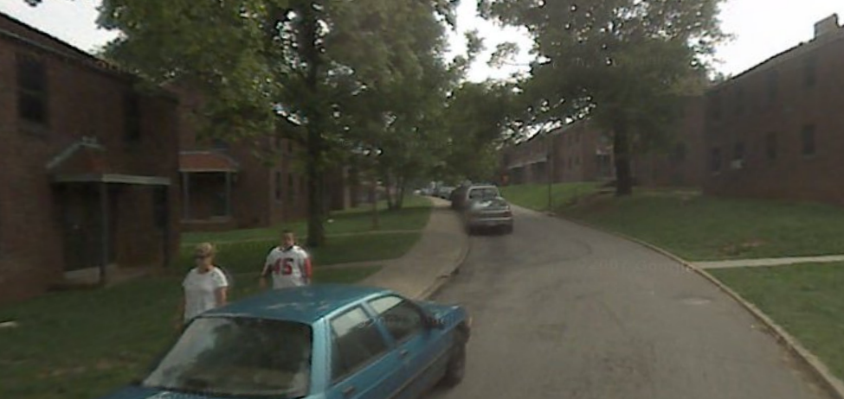
B

Slide 69
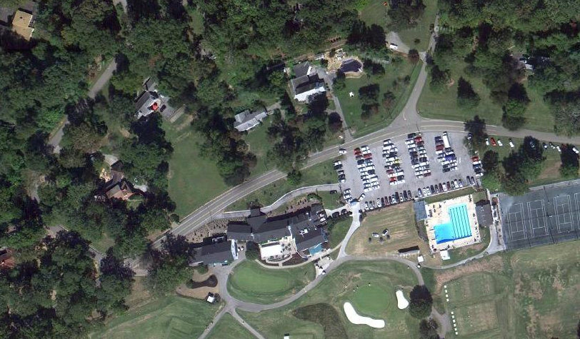
C

Slide 70
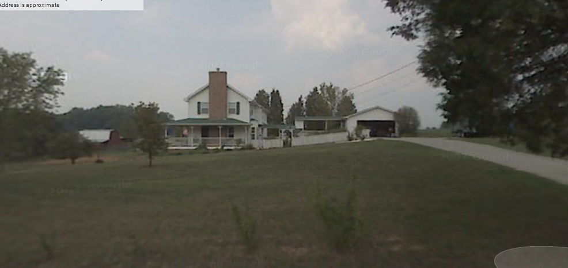
D

Slide 71
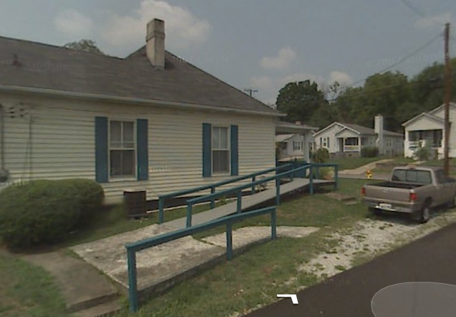
E

Slide 72
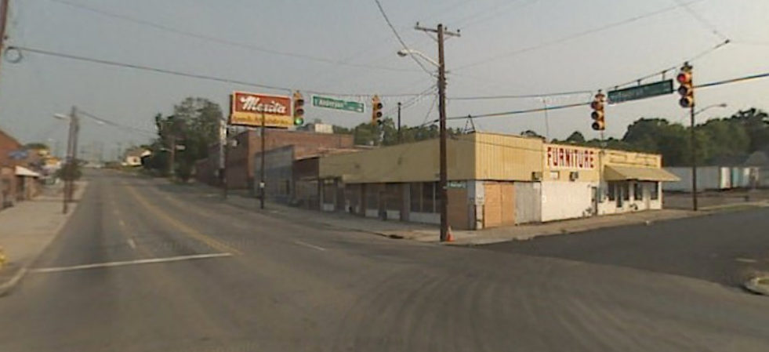
F

Slide 73
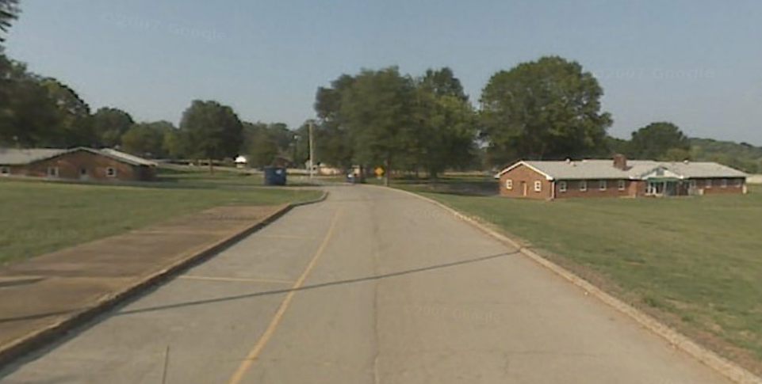
G

Slide 74
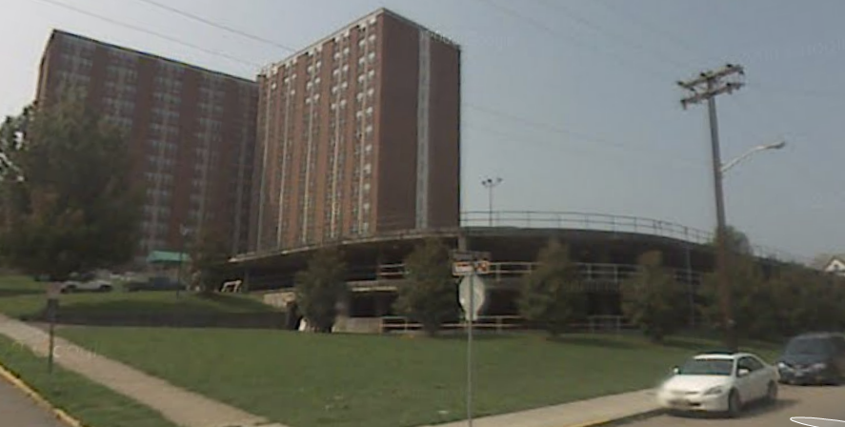
H

Slide 75
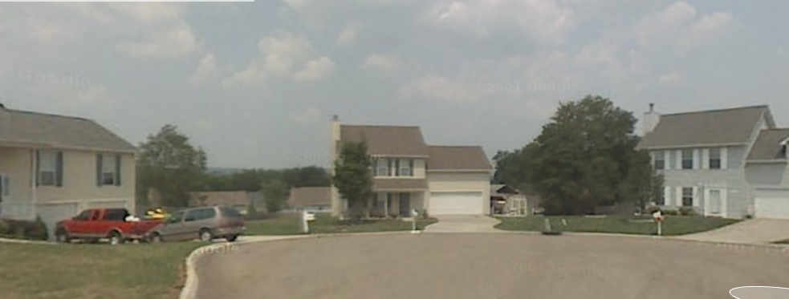
I

Slide 76
Knox County Population Pyramids HINTS
A- very few 18-35 year olds (not a place where many retire)
B- high birth rates and higher than average death rates
C- some children with few between 20-30
D- # of 55 year olds = 5 year olds
E- larger number or elderly
F- very few under the age of 20 (not family orientated)
G- very uneven population distribution
H-vast majority college age
I- like letter A but with more under the age of 5

Slide 77
Answers...

Slide 78
1.
F- Downtown Knoxville Area

Slide 90
2.
H- Student Housing for University

Slide 97
3.
B- Government Housing Low Income Neighborhood

Slide 106
4.
E- Established (older) Middle Class Urban Neighborhood

Slide 116
5.
C- Established (older) Wealthier Neighborhood

Slide 121
6.
G- Health Facility (with low population numbers)

Slide 126
7.
I- Middle Income Suburban Neighborhood

Slide 132
8.
A- Wealthy Suburban Neighborhood

Slide 140
9.
D- Rural Housing (outskirts of urban area)

Slide 147
Knoxville Population Pyramid Answers
F
H
B
E
C
G
I
A
D

Slide 148
Nashville Metropolitan Area
Population Pyramid Activity

Slide 149
SELECTED POPULATION PYRAMIDS IN THE NASHVILLE METROPOLITAN AREA
Directions: Match up each population pyramid with the correct letter on the map.
1
2
3
4
5
6
7
8
9
B
F
H
C
D
G
A
E
I

Slide 151
1._____________________________________________

Slide 152
2._____________________________________________

Slide 153
3._____________________________________________

Slide 154
4._____________________________________________

Slide 155
5._____________________________________________

Slide 156
6._____________________________________________

Slide 157
7._____________________________________________

Slide 158
8._____________________________________________

Slide 159
9._____________________________________________

Slide 161
SELECTED POPULATION PYRAMIDS IN THE NASHVILLE METROPOLITAN AREA
Directions: Match up each population pyramid with the correct letter on the map.
1 |  | B
2 |  | G
3 |  | H
4 |  | D
5 |  | C
6 |  | E
7 |  | A
8 |  | F
9 |  | I
B
F
H
C
D
G
A
E
I

Slide 162
1._____________________________________________

Slide 163
2._____________________________________________

Slide 164
3._____________________________________________

Slide 165
4._____________________________________________

Slide 166
5._____________________________________________

Slide 167
6._____________________________________________

Slide 168
7._____________________________________________

Slide 169
8._____________________________________________

Slide 170
9._____________________________________________

