Slide 1
The Diffusion of Protestantism
7.52 Locate and identify the European regions that remained Catholic and those that became Protestant and how the division affected the distribution of religions in the New World. (C, G, H)

Slide 2
Review from Previous Lesson:
IMPORTANT PEOPLE
LOCATION
Martin Luther
Henry VIII
John Calvin
The Pope
Geneva, Switzerland
Rome, Italy
Wittenburg, Germany
London, England

Slide 3
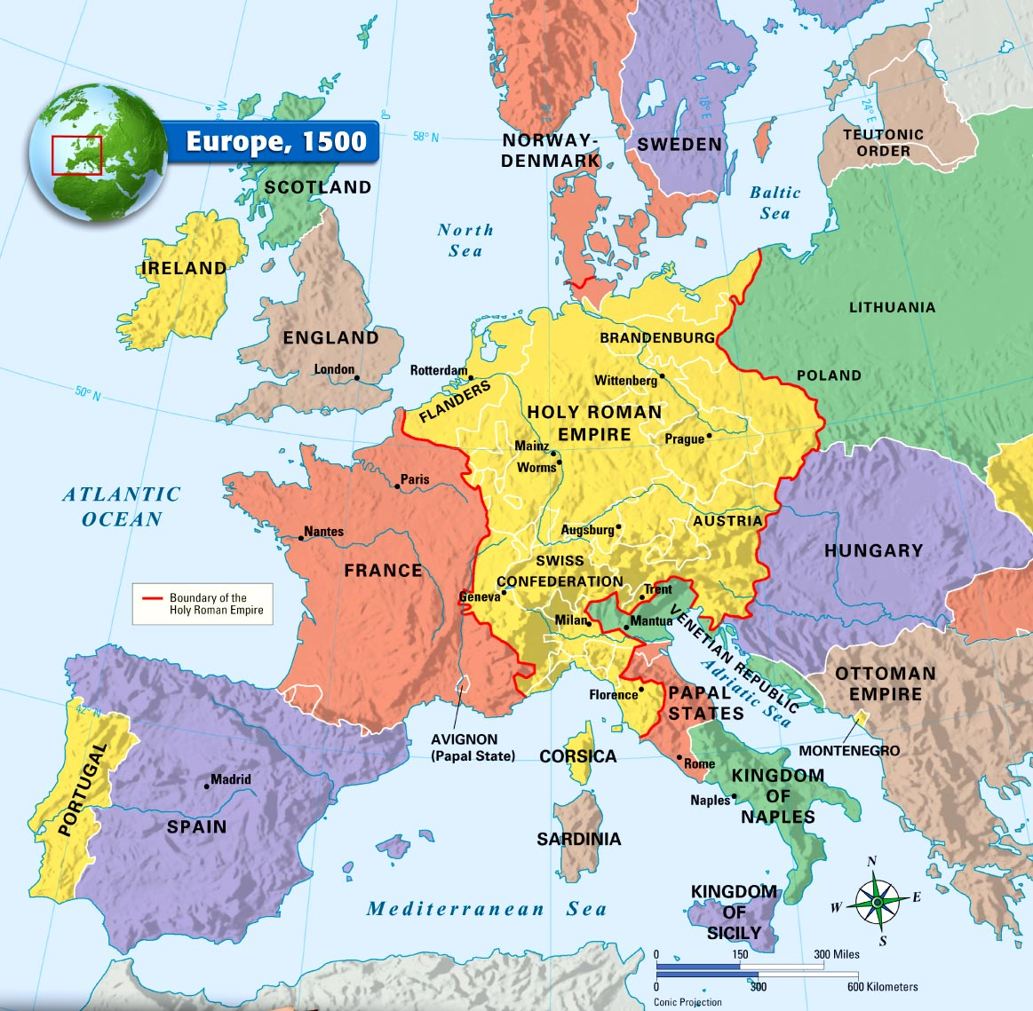

Slide 4
Lesson Procedures
After introducing the Protestant Reformation, have students match the region with the correct religious majority
Divide students in to small groups and give them the handout (see next slide)
Students should use their knowledge of where the reformers are from to draw conclusions
As you review the answer discuss with students how they made their decisions

Slide 5
Name: _________________________________________________________________________ Class Period: _________
LETTER | Dominant Religion | Why do you think so?
A
B
C
D
E
F
G
CHOICES: ROMAN CATHOLIC---ROMAN CATHOLIC WITH PROTESTANT MINORITIES---LUTHERAN---ANGLICAN---MUSLIM---CALVINIST---EASTERN ORTHODOX

Slide 6
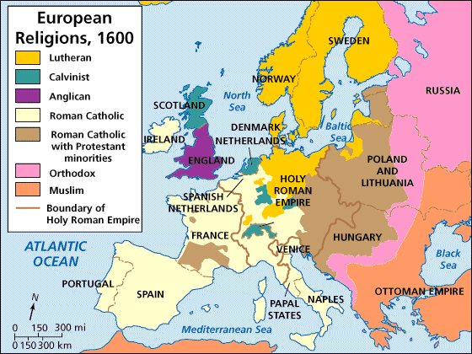
A
F
C
E
B
D
G

Slide 7
A
F
C
E
B
D
G

Slide 8
A
F
C
E
B
D
G

Slide 9
A
F
C
E
B
D
G

Slide 10
A
F
C
E
B
D
G

Slide 11
A
F
C
E
B
D
G

Slide 12
A
F
C
E
B
D
G

Slide 13
A
F
C
E
B
D
G

Slide 14
Name: _________________________________________________________________________ Class Period: _________
LETTER | Dominant Religion | Why do you think so?
A | LUTHERAN | Began in Wittenberg, Germany and spread north
B | CALVINIST | John Calvin established a theocracy in Geneva, Switzerland
C | ANGLICAN | Was started by Henry VIII, King of England, therefore Anglicanism would be prominent in England
D | ROMAN CATHOLIC | The head of the Roman Catholic Church is in Rome, therefore Italy and southern Europe remained Catholic
E | ROMAN CATHOLIC WITH PROTESTANT MINORITIES | Parts of the Holy Roman Empire were torn between growing Protestants and loyal Catholics
F | EASTERN ORTHODOX | Russian Orthodox church and Russia is included
G | MUSLIMS | Ottoman Turks were Muslim, more closely connected with the Middle East
CHOICES: ROMAN CATHOLIC---ROMAN CATHOLIC WITH PROTESTANT MINORITIES---LUTHERAN---ANGLICAN---MUSLIM---CALVINIST---EASTERN ORTHODOX

Slide 15
Answers
A – Lutheran
B – Calvinist
C – Anglican
D – Roman Catholic
E – Roman Catholic with Protestant Minorities
F – Eastern Orthodox
G – Muslim

Slide 16
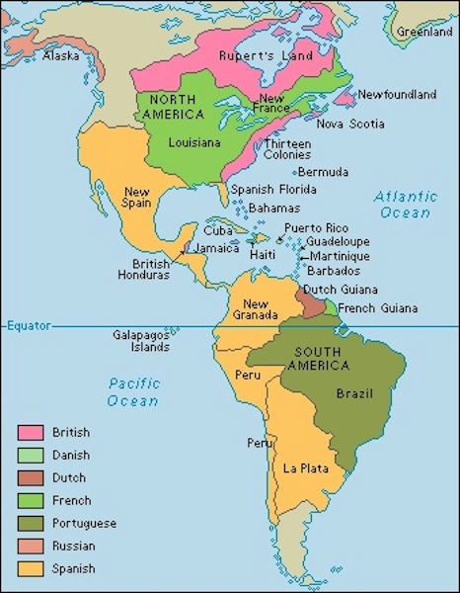
Based on your knowledge of the Protestant Reformation in Europe, predict which areas of the New World will most likely adopt Catholicism and which areas will most likely adopt Protestantism

Slide 17
Sources
Review Map:
http://images.classwell.com/mcd_xhtml_ebooks/2005_world_history/images/mcd_mwh05_0618377115_p35_f1.jpg
Lesson Map taken from: http://go.hrw.com/hrw.nd/gohrw_rls1/pKeywordResults?ST9%20Eur%20Religions%201600
Colonization Map
http://www.transpacificproject.com/index.php/european-exploration-and-colonization/

