Slide 1
The Border and Immigrant Worker Nation
U.S. History and Geography High School
Tennessee Geographic Alliance
Instructor
Michael Robinson
Houston High School
Germantown, TN

Slide 2
Overview of Lesson
How has the border between the United States and Mexico changed since 1821?
Describe the current border between the United States and Mexico.
Discuss the personal stories of people living near the border between the United States and Mexico.
Describe the demographics for Hispanic-Americans.
What types of jobs do foreign-born Americans have, and in which country were they born?

Slide 3
Tennessee Standard
US.9 US.9 Describe the difference between “old” and “new” immigrants and analyze the assimilation process and consequences for the “new” immigrants and their impact on American society.… (C, E, G).

Slide 4
Connections to
Common Core Standards
Characterize and analyze changing interconnections among places and regions.

Slide 5
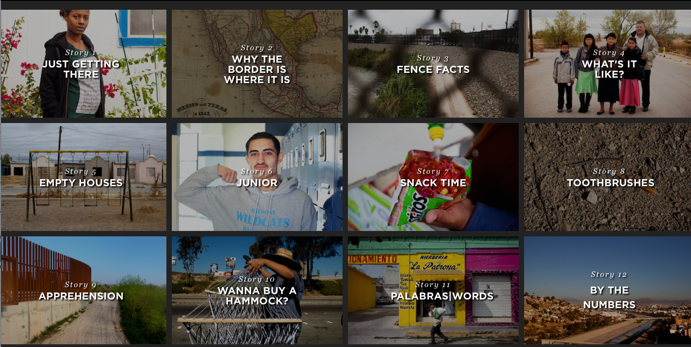
http://apps.npr.org/borderland

Slide 6
How has the border between Mexico and the United States changed over time? What did the border look like in…
1821?
1836?
1948?
1953?

Slide 7
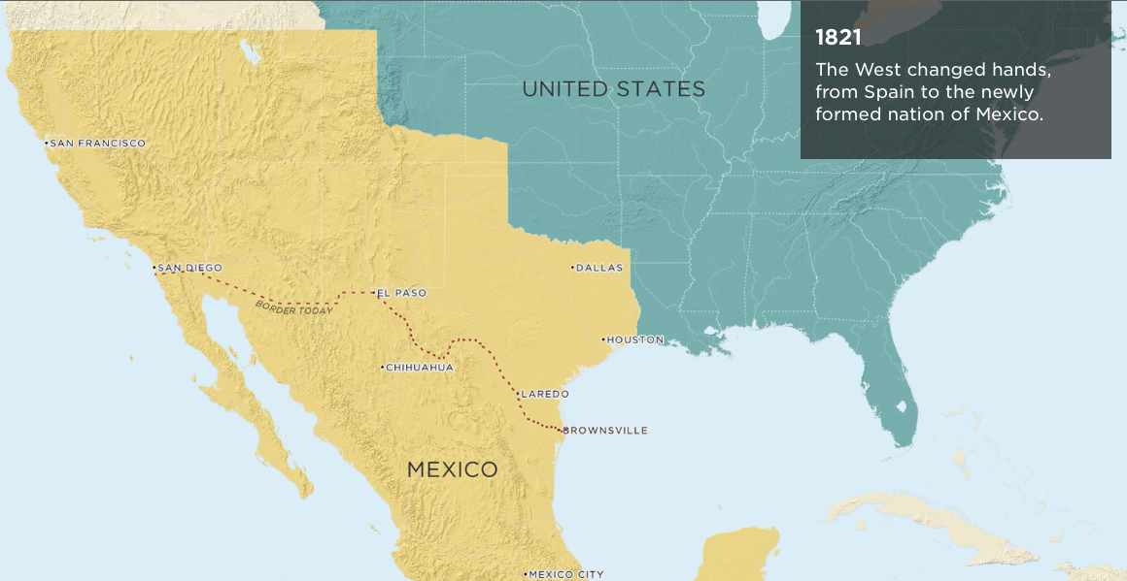
How has the border changed?

Slide 8
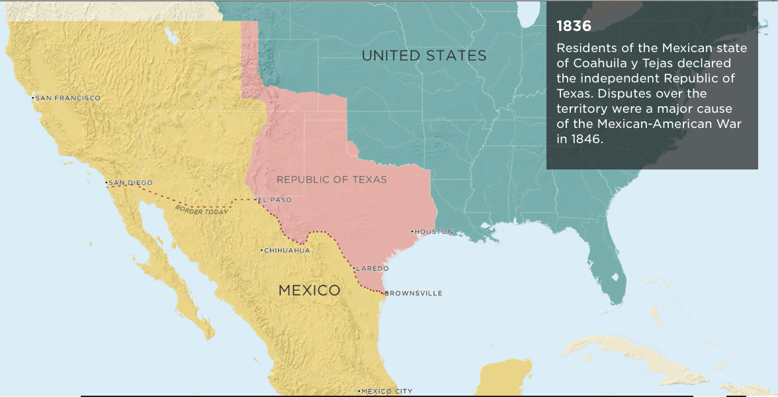
How has the border changed?

Slide 9
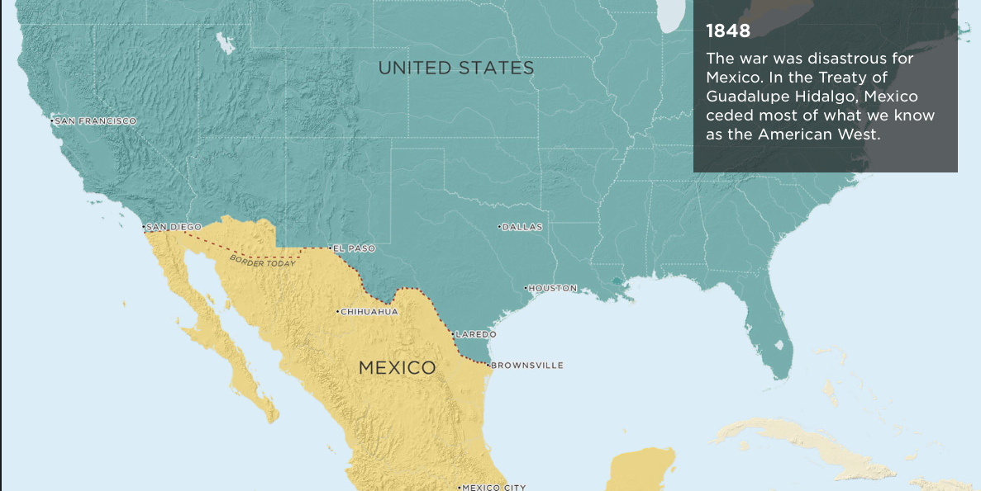
How has the border changed?

Slide 10
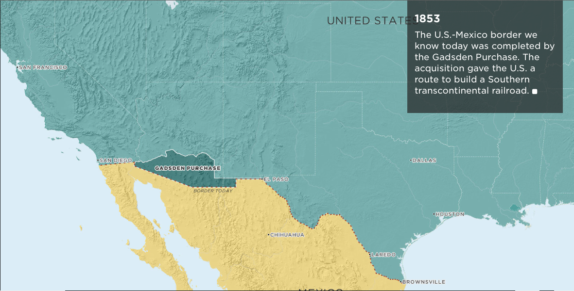
How has the border changed?

Slide 11
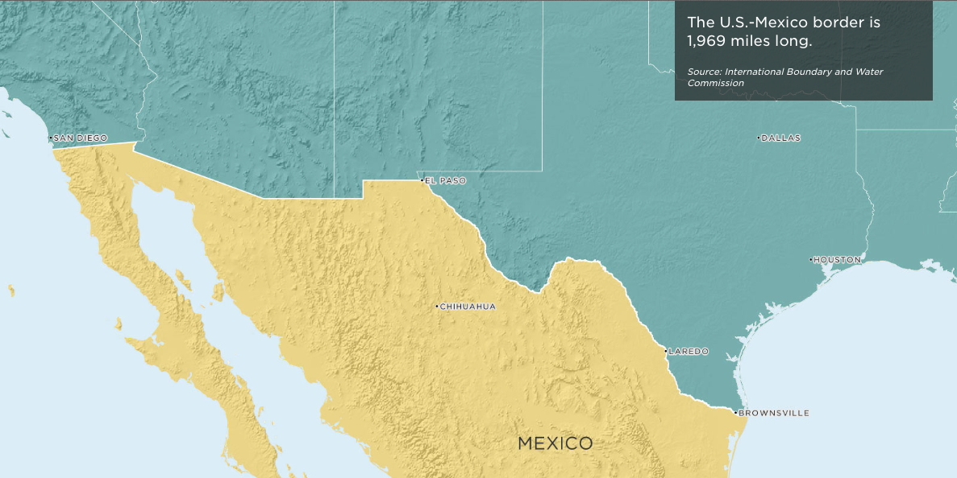
What is the border like today?

Slide 12
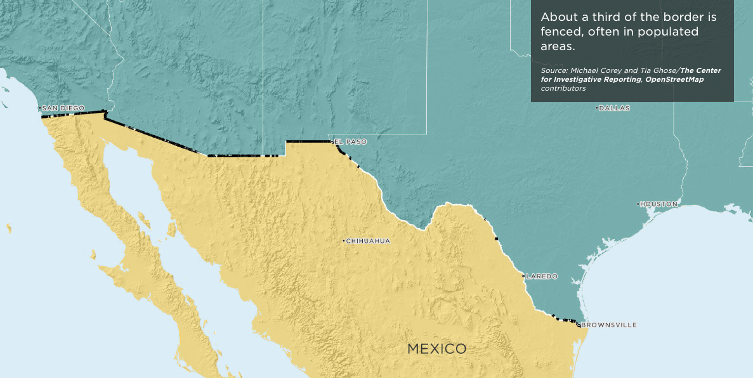
What is the border like today?

Slide 13
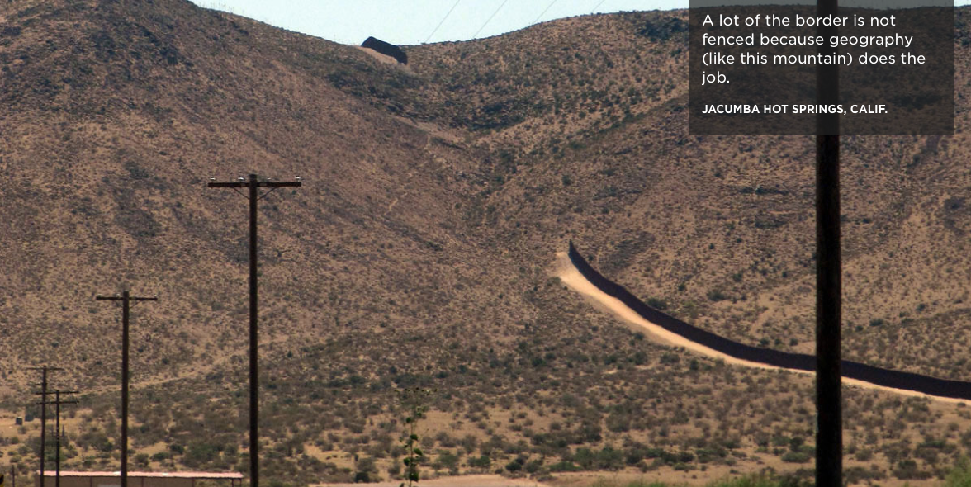
From the following slides describe the border and life for those living near the border…

Slide 15
“This is where dreams turn into nightmares.”
“This is where dreams are turned back.”

Slide 23
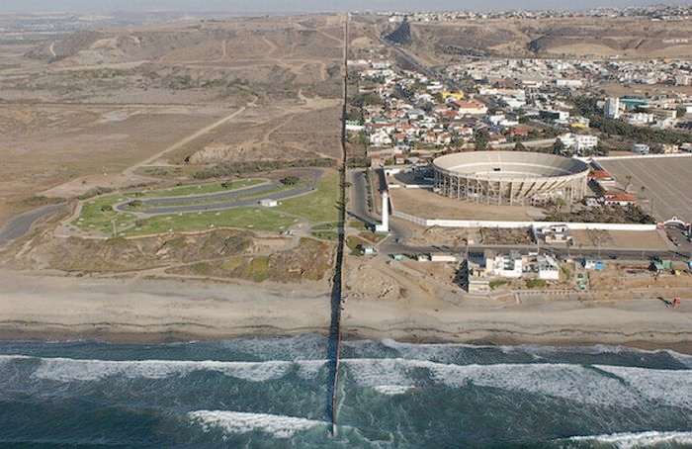

Slide 24
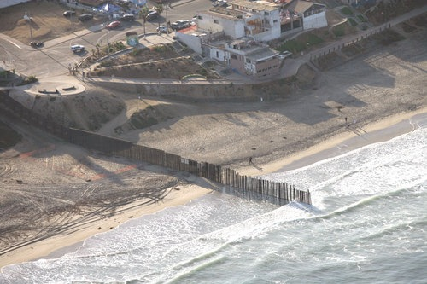
Pacific Ocean - Mexico and USA Border (CA)

Slide 25
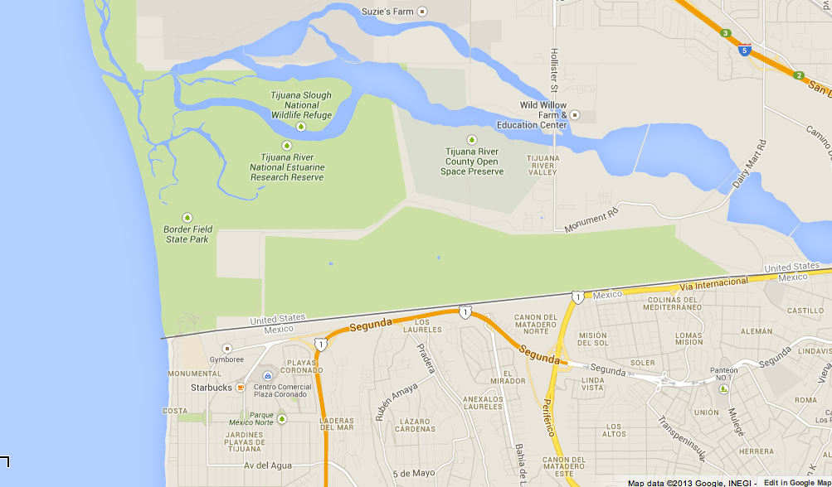

Slide 26
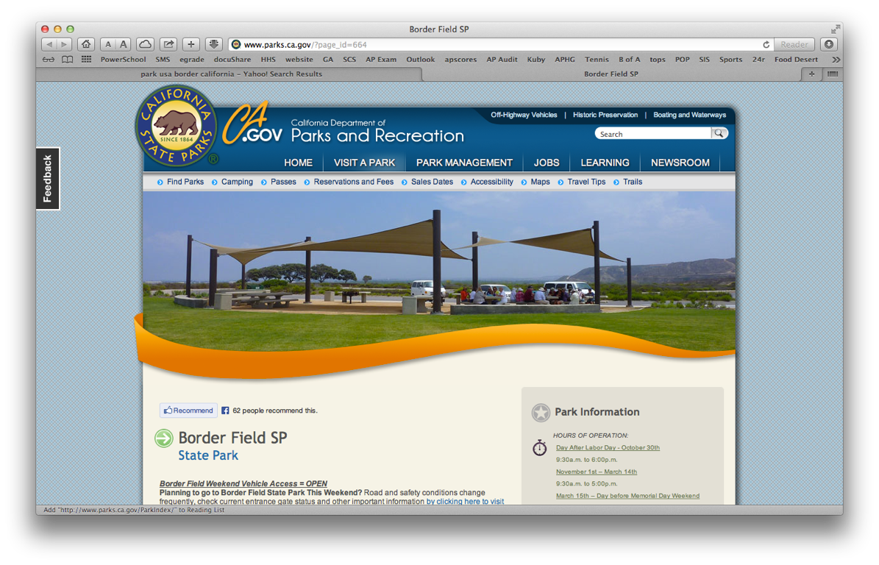

Slide 28
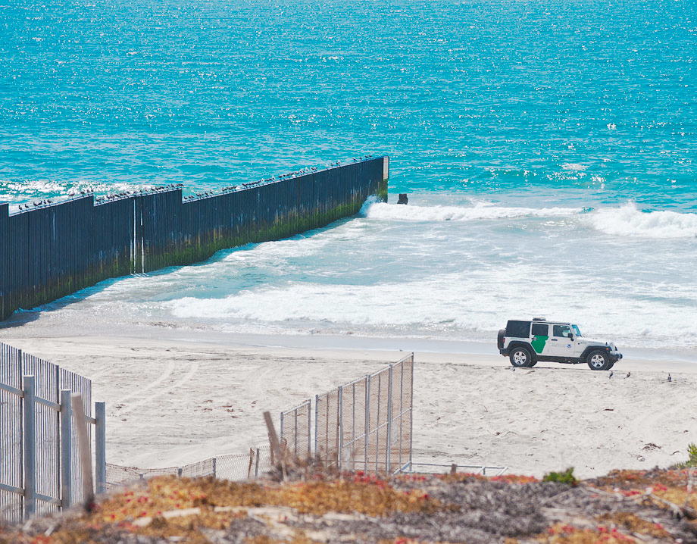

Slide 29
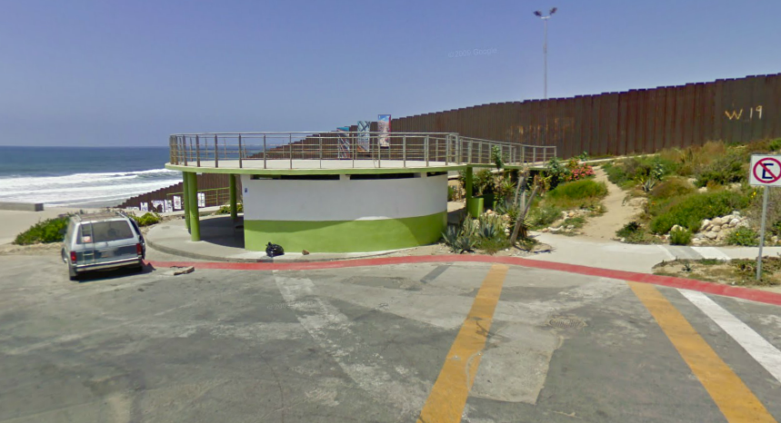

Slide 30
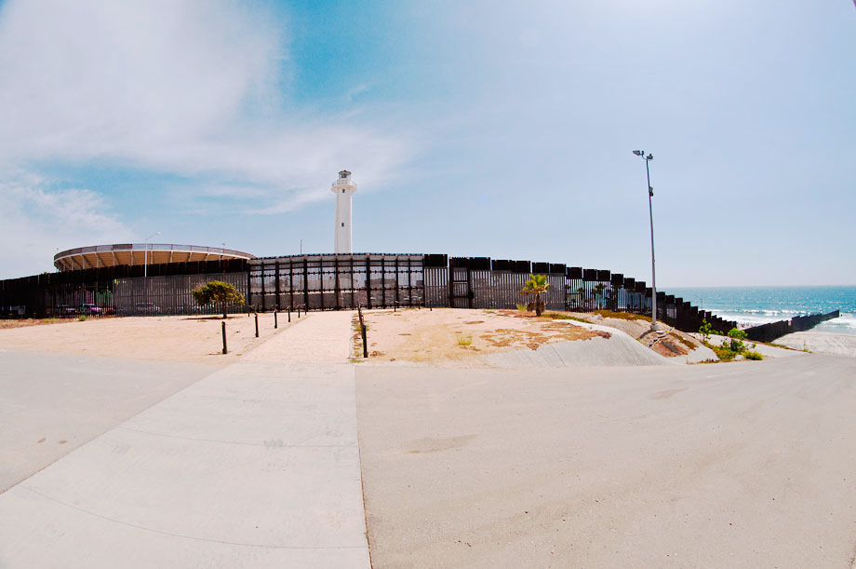

Slide 31
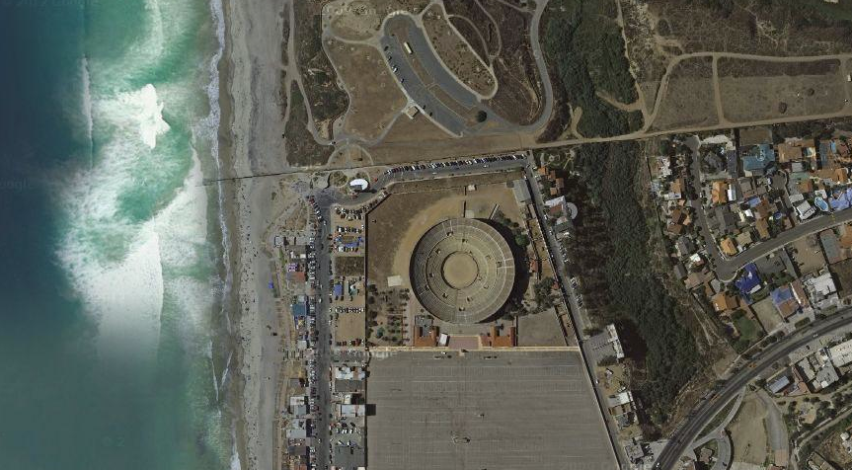

Slide 32
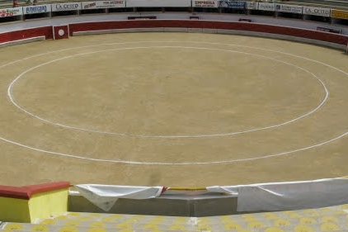
Bullring in Mexico

Slide 33
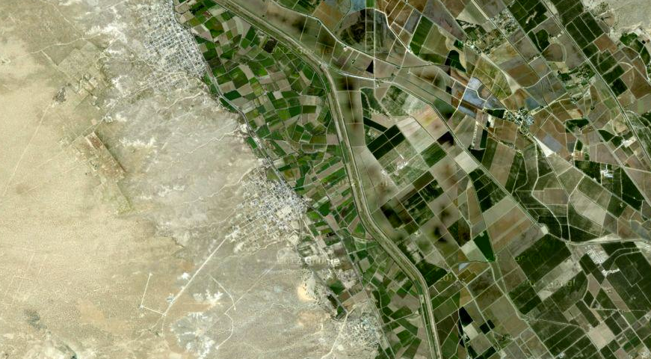

Slide 34
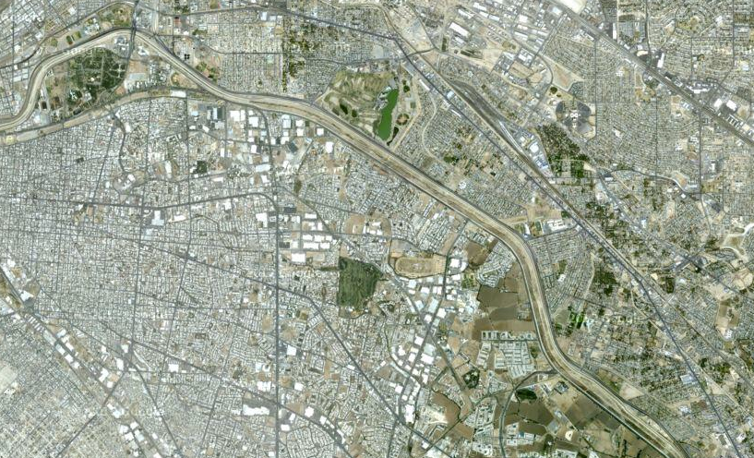

Slide 35
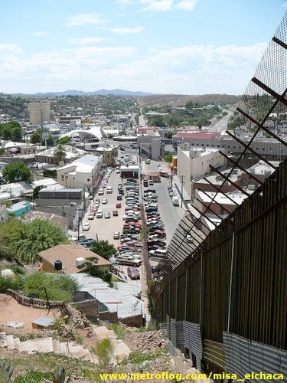
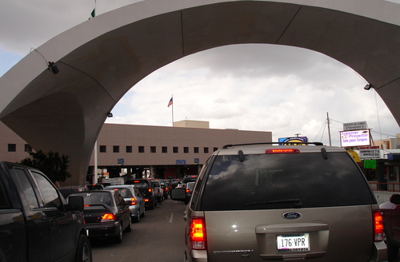
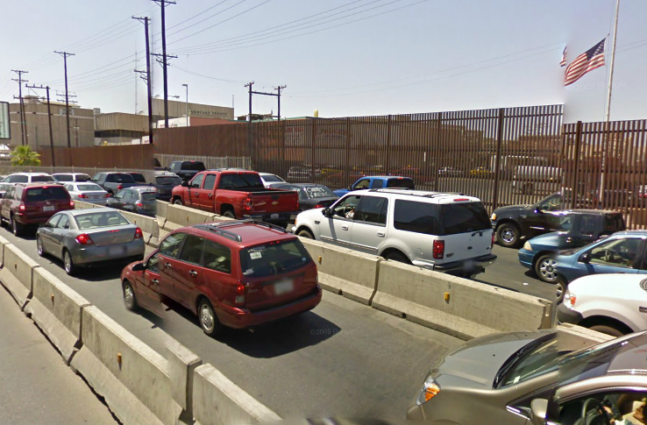
The Border

Slide 36
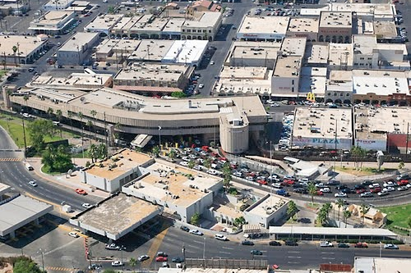
The Border Crossing from Mexico to the USA

Slide 37
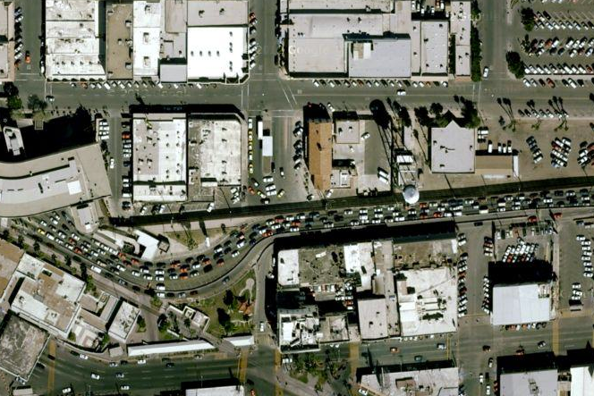
The Border Crossing from Mexico to the USA

Slide 38
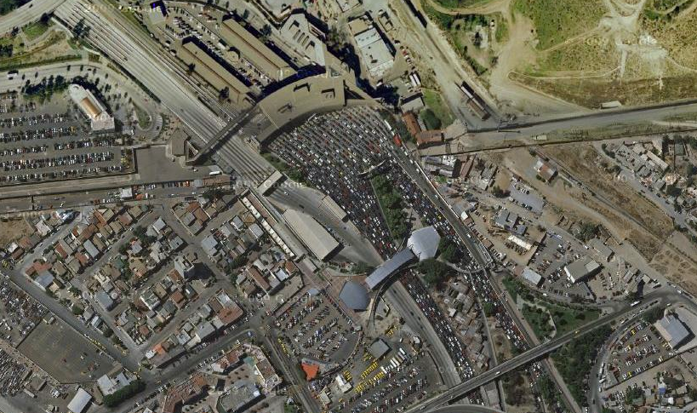
Tijuana, Mexico

Slide 40
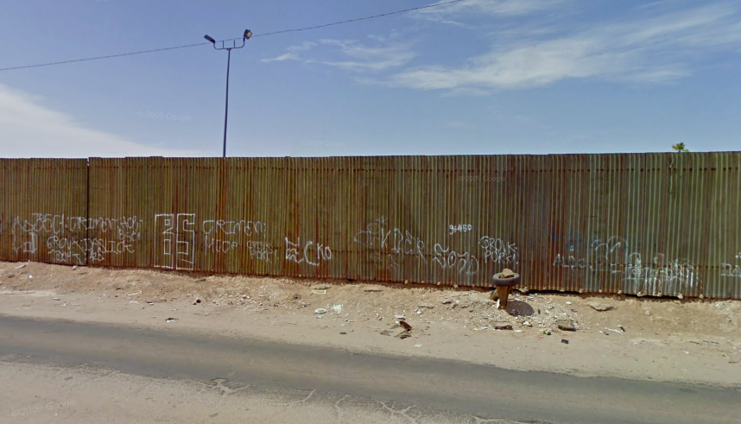

Slide 41
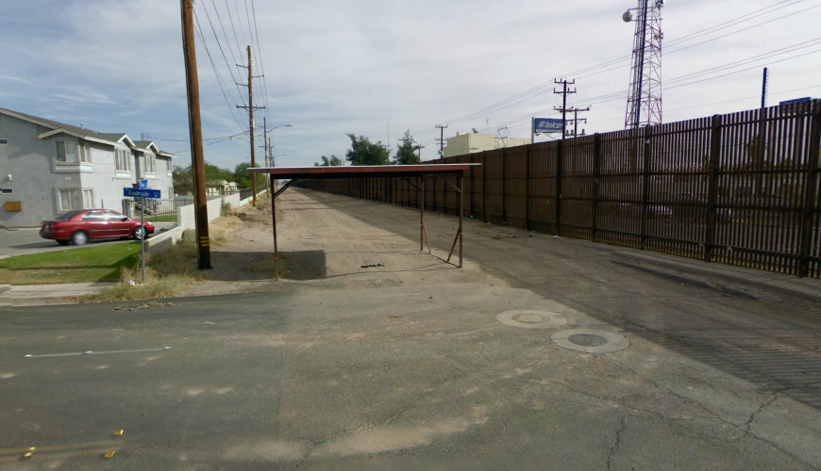

Slide 42
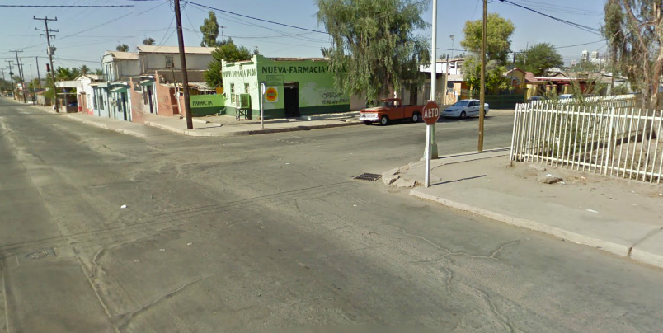

Slide 43
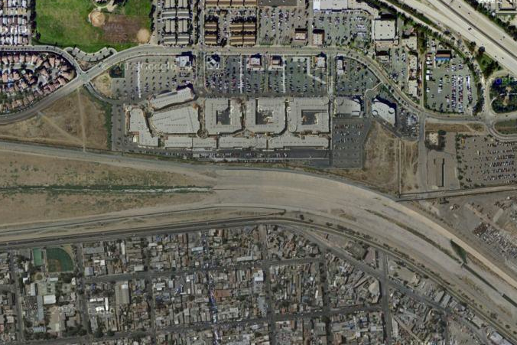
Worlds Apart

Slide 44
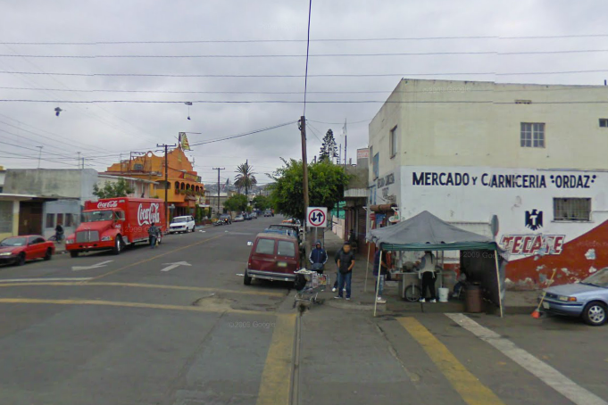
Shopping in Mexico

Slide 45
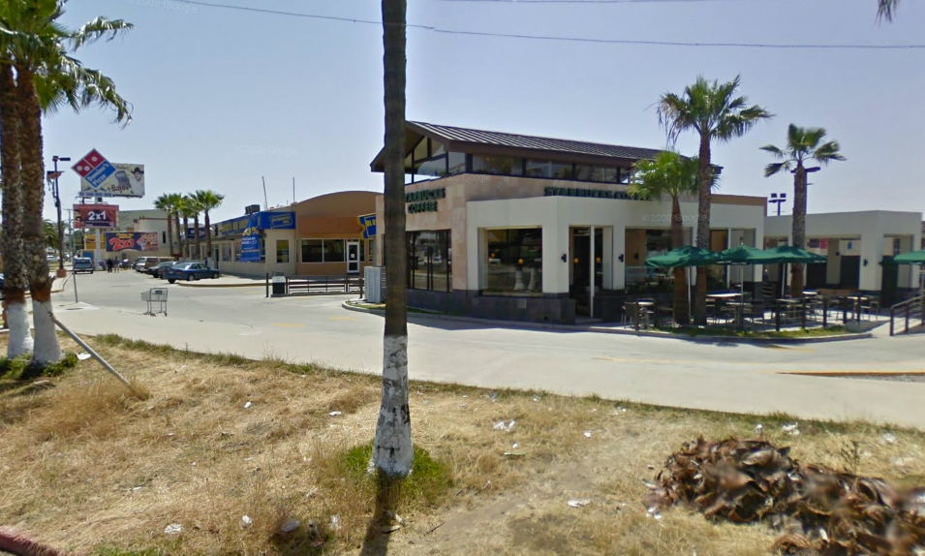

Slide 46
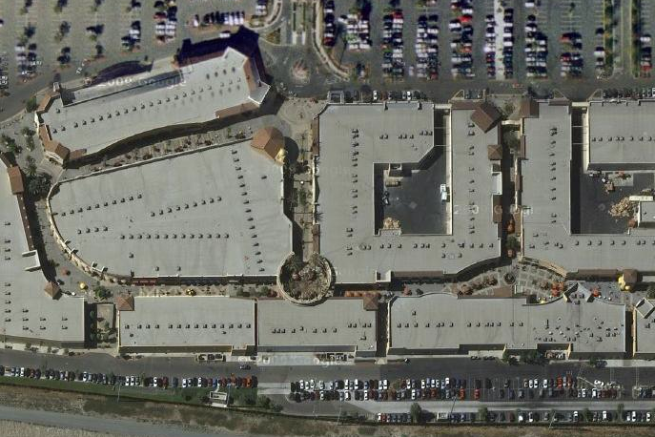
Upscale Shopping Mall

Slide 47
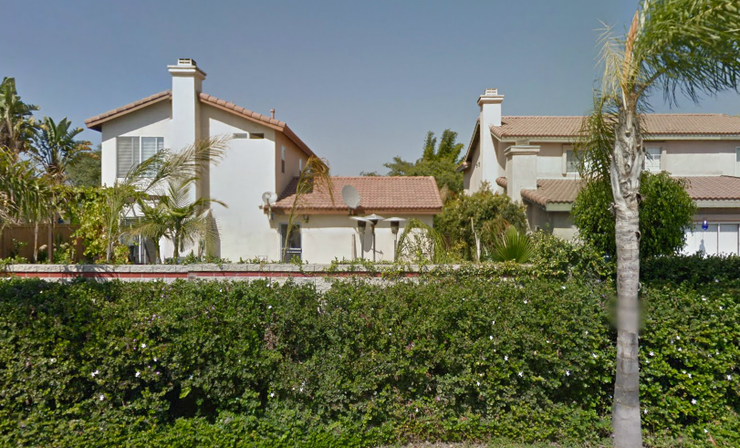

Slide 48
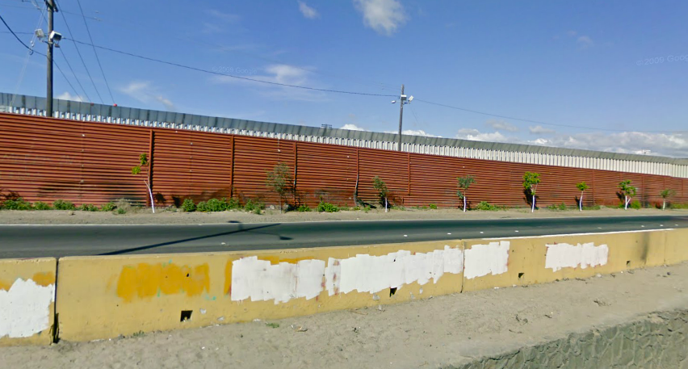

Slide 49
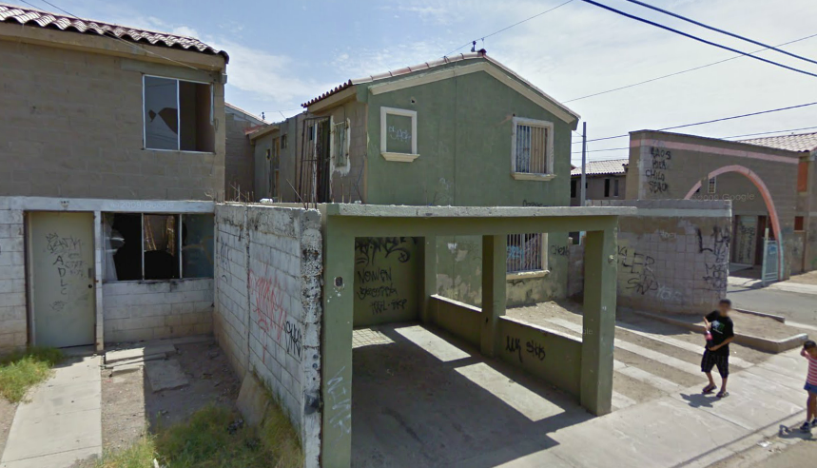

Slide 50
Personal Stories
Brianna Barraza, 15
Yvonne Navarro, 48, and her daughters Yvonne, 16, and Jasmine, 11
Junior Adarano, 17
Saraa Zewedi Yilma, 28

Slide 51
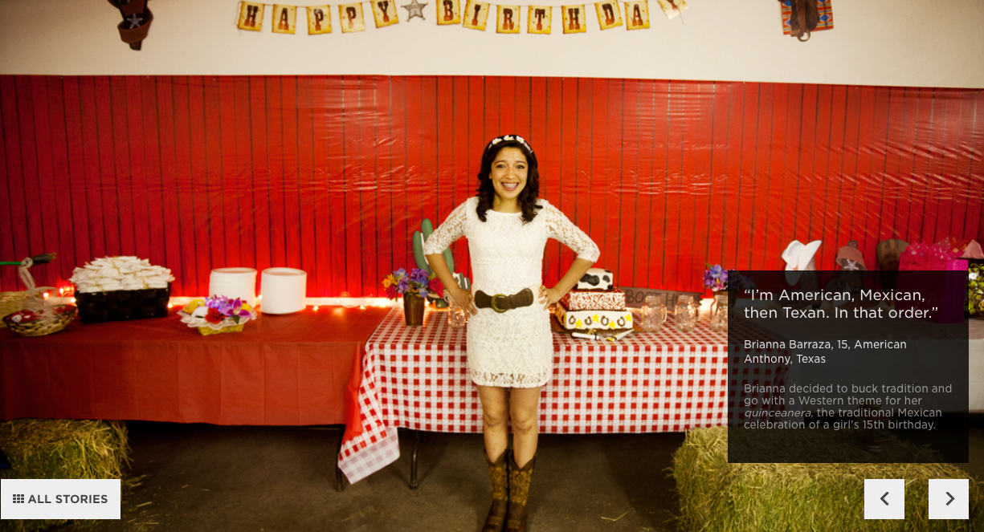

Slide 53
Explain if Junior and his sister are America.
Discuss how Junior sees himself…does he think he is American?
Describe Junior’s life. Why are his parents now with him?

Slide 57
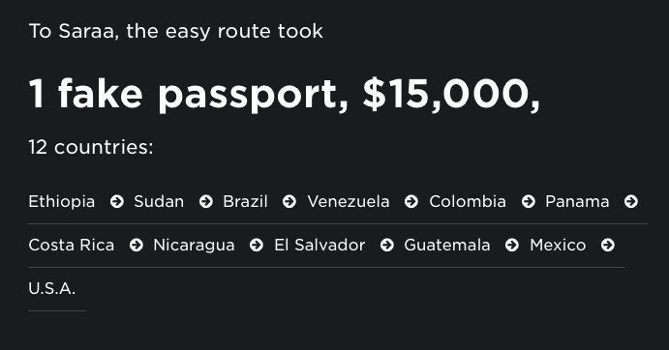

Slide 58
Why did she risk her life and/or freedom to come to America?

Slide 62
Hispanics in America
Questions

Slide 63
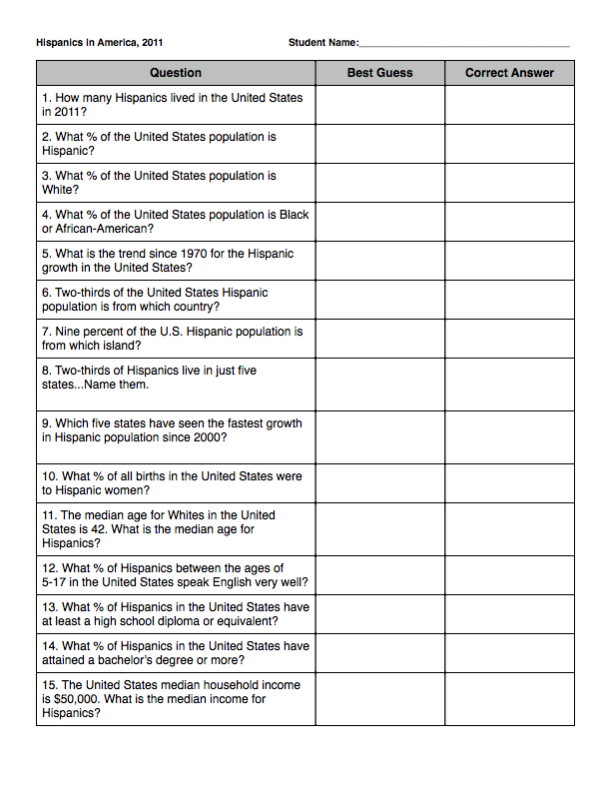

Slide 64
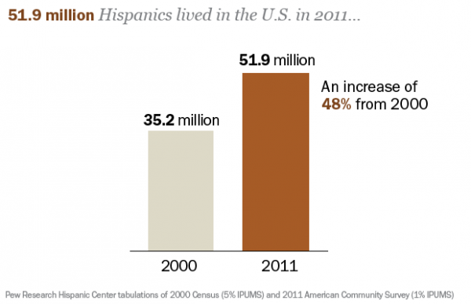
1- ANSWER

Slide 65
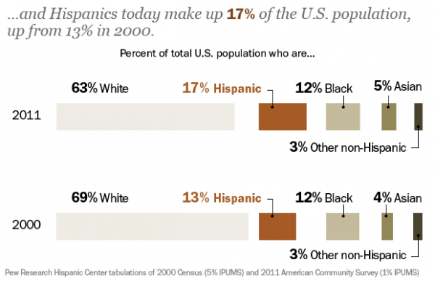
2- ANSWER
3 and 4- ANSWER

Slide 66
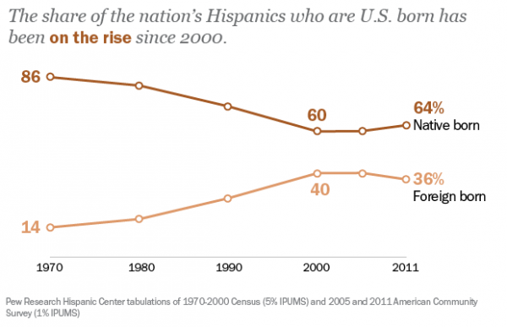
5- ANSWER

Slide 67
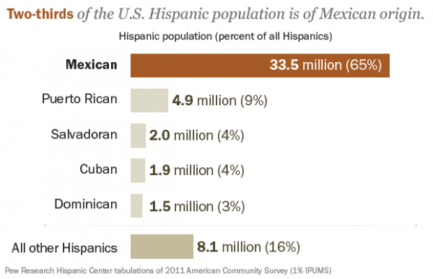
6- ANSWER

Slide 68
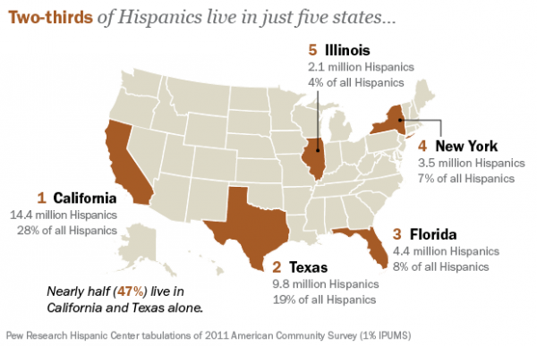
7- ANSWER

Slide 69
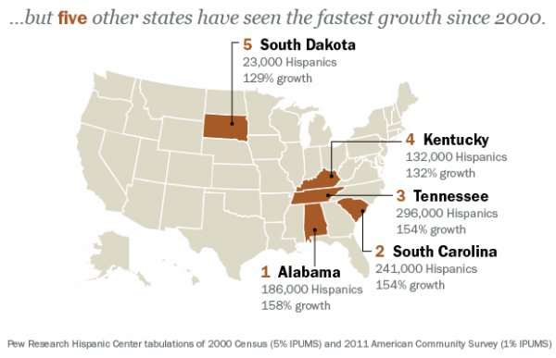
8- ANSWER

Slide 70
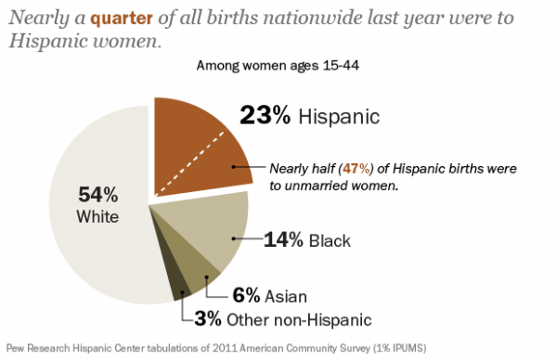
9- ANSWER

Slide 71
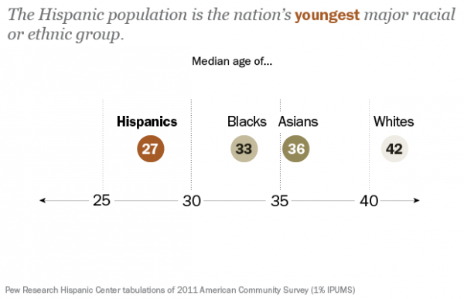
10- ANSWER

Slide 72
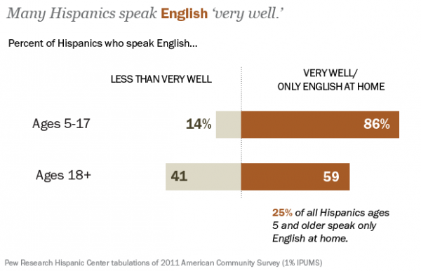
11- ANSWER

Slide 73
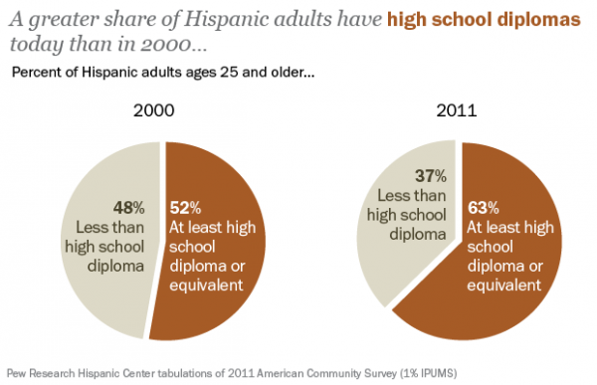
12- ANSWER

Slide 74
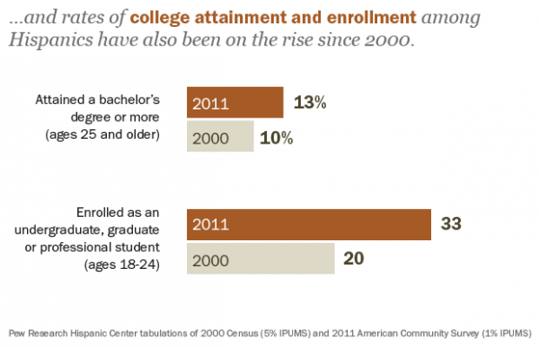
13- ANSWER

Slide 75
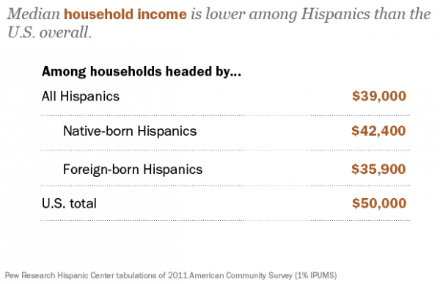
14- ANSWER

Slide 76
15- ANSWER

Slide 77
Question | Correct Answer
1. How many Hispanics live in the United States?
2. What % of the United States population is Hispanic?
3. What % of the United States population is White?
4. What % of the United States population is Black or African-American?
5. What is the trend since 1970 for the Hispanic growth in the United States?
6. Two-thirds of the United States Hispanic population is from which country?
7. Nine percent of the U.S. Hispanic population is from which island?
51.9 million
17%
63%
12%
INCREASING
Mexico
Puerto Rico

Slide 78
Question | Correct Answer
8. Two-thirds of Hispanics live in just five states...Name them.
9. Which five states have seen the fastest growth in Hispanic population since 2000?
10. What % of all births in the United States were to Hispanic women?
11. The median age for Whites in the United States is 42. What is the median age for Hispanics?
12. What % of Hispanics between the ages of 5-17 in the United States speak English very well?
13. What % of Hispanics in the United States have at least a high school diploma or equivalent?
14. What % of Hispanics in the United States have attained a bachelor’s degree or more?
15. The United States median household income is $50,000. What is the median income for Hispanics?
CA-TX-FL-NY-IL
AL-SC-TN-KY-SD
23%
27
86%
63%
13%
$39,000

Slide 79
FOREIGN-BORN WORKERS

Slide 81
Part 1
GROUP WORK
Part 2

Slide 82
CHOICES
Construction Workers
Cooks and other food preparers
Doctors
Farm Laborers
Hairdressers and other grooming services
Scientists and Quantitative Analysts

Slide 83
FOREIGN-BORN...
CHOICES
Construction Workers
Cooks and other food preparers
Doctors
Farm Laborers
Hairdressers and other grooming services
Scientists and Quantitative Analysts
1.

Slide 84
FOREIGN-BORN...
CHOICES
Construction Workers
Cooks and other food preparers
Doctors
Farm Laborers
Hairdressers and other grooming services
Scientists and Quantitative Analysts
2.

Slide 85
FOREIGN-BORN...
CHOICES
Construction Workers
Cooks and other food preparers
Doctors
Farm Laborers
Hairdressers and other grooming services
Scientists and Quantitative Analysts
3.

Slide 86
FOREIGN-BORN...
CHOICES
Construction Workers
Cooks and other food preparers
Doctors
Farm Laborers
Hairdressers and other grooming services
Scientists and Quantitative Analysts
4.

Slide 87
FOREIGN-BORN...
CHOICES
Construction Workers
Cooks and other food preparers
Doctors
Farm Laborers
Hairdressers and other grooming services
Scientists and Quantitative Analysts
5.

Slide 88
FOREIGN-BORN...
CHOICES
Construction Workers
Cooks and other food preparers
Doctors
Farm Laborers
Hairdressers and other grooming services
Scientists and Quantitative Analysts
6.

Slide 89
ANSWERS

Slide 90
FOREIGN-BORN...
CHOICES
Construction Workers
Cooks and other food preparers
Doctors
Farm Laborers
Hairdressers and other grooming services
Scientists and Quantitative Analysts
1.

Slide 91
FOREIGN-BORN...
CHOICES
Construction Workers
Cooks and other food preparers
Doctors
Farm Laborers
Hairdressers and other grooming services
Scientists and Quantitative Analysts
2.

Slide 92
FOREIGN-BORN...
CHOICES
Construction Workers
Cooks and other food preparers
Doctors
Farm Laborers
Hairdressers and other grooming services
Scientists and Quantitative Analysts
3.

Slide 93
FOREIGN-BORN...
CHOICES
Construction Workers
Cooks and other food preparers
Doctors
Farm Laborers
Hairdressers and other grooming services
Scientists and Quantitative Analysts
4.

Slide 94
FOREIGN-BORN...
CHOICES
Construction Workers
Cooks and other food preparers
Doctors
Farm Laborers
Hairdressers and other grooming services
Scientists and Quantitative Analysts
5.

Slide 95
FOREIGN-BORN...
CHOICES
Construction Workers
Cooks and other food preparers
Doctors
Farm Laborers
Hairdressers and other grooming services
Scientists and Quantitative Analysts
6.

Slide 96
Answers
1- Doctors
2- Cooks and other food preparers
3- Hairdressers and other grooming services
4- Construction Workers
5- Scientists and Quantitative Analysts
6- Farm Laborers

Slide 97
CHOICES
Accountants and other Financial Specialists
Computer Software Developers
Drivers and Other Transportation Workers
Gardeners and Groundkeepers
Household Service Staff
Writers, Artists and Entertainers

Slide 98
FOREIGN-BORN...
CHOICES
Accountants and other Financial Specialists
Computer Software Developers
Drivers and Other Transportation Workers
Gardeners and Groundkeepers
Household Service Staff
Writers, Artists and Entertainers
1.

Slide 99
\
FOREIGN-BORN...
CHOICES
Accountants and other Financial Specialists
Computer Software Developers
Drivers and Other Transportation Workers
Gardeners and Groundkeepers
Household Service Staff
Writers, Artists and Entertainers
2.

Slide 100
FOREIGN-BORN...
CHOICES
Accountants and other Financial Specialists
Computer Software Developers
Drivers and Other Transportation Workers
Gardeners and Groundkeepers
Household Service Staff
Writers, Artists and Entertainers
3.

Slide 101
FOREIGN-BORN...
CHOICES
Accountants and other Financial Specialists
Computer Software Developers
Drivers and Other Transportation Workers
Gardeners and Groundkeepers
Household Service Staff
Writers, Artists and Entertainers
4.

Slide 102
FOREIGN-BORN...
CHOICES
Accountants and other Financial Specialists
Computer Software Developers
Drivers and Other Transportation Workers
Gardeners and Groundkeepers
Household Service Staff
Writers, Artists and Entertainers
5.

Slide 103
FOREIGN-BORN...
CHOICES
Accountants and other Financial Specialists
Computer Software Developers
Drivers and Other Transportation Workers
Gardeners and Groundkeepers
Household Service Staff
Writers, Artists and Entertainers
6.

Slide 104
ANSWERS

Slide 105
FOREIGN-BORN...
CHOICES
Accountants and other Financial Specialists
Computer Software Developers
Drivers and Other Transportation Workers
Gardeners and Groundkeepers
Household Service Staff
Writers, Artists and Entertainers
1.

Slide 106
\
FOREIGN-BORN...
CHOICES
Accountants and other Financial Specialists
Computer Software Developers
Drivers and Other Transportation Workers
Gardeners and Groundkeepers
Household Service Staff
Writers, Artists and Entertainers
2.

Slide 107
FOREIGN-BORN...
CHOICES
Accountants and other Financial Specialists
Computer Software Developers
Drivers and Other Transportation Workers
Gardeners and Groundkeepers
Household Service Staff
Writers, Artists and Entertainers
3.

Slide 108
FOREIGN-BORN...
CHOICES
Accountants and other Financial Specialists
Computer Software Developers
Drivers and Other Transportation Workers
Gardeners and Groundkeepers
Household Service Staff
Writers, Artists and Entertainers
4.

Slide 109
FOREIGN-BORN...
CHOICES
Accountants and other Financial Specialists
Computer Software Developers
Drivers and Other Transportation Workers
Gardeners and Groundkeepers
Household Service Staff
Writers, Artists and Entertainers
5.

Slide 110
FOREIGN-BORN...
CHOICES
Accountants and other Financial Specialists
Computer Software Developers
Drivers and Other Transportation Workers
Gardeners and Groundkeepers
Household Service Staff
Writers, Artists and Entertainers
6.

Slide 111
Answers
1- Drivers and Other Transportation Workers
2- Accountants and other Financial Specialists
3- Writers, Artists and Entertainers
4- Computer Software Developers
5- Household Service Staff
6- Gardeners and Groundkeepers

Slide 112
FOREIGN-BORN WORKERS
TOP TEN COUNTRIES

