Slide 1
Social Studies Standards
Third Grade

Slide 2
North America
Third Grade Social Studies Standards

Slide 3
22
Identify major physical features on a map (G, TN):
Rivers – Colorado, Cumberland, Mississippi, Missouri, Ohio, Rio Grande, St. Lawrence, Tennessee
Mountains – Alaska Range, Appalachian, Cascade, Rockies
Bodies of Water – Arctic, Atlantic, Great Lakes, Great Salt Lake, Gulf of Mexico, Hudson Bay, Niagara Falls, Pacific
Deserts – Death Valley, Great Basin
Landforms – Grand Canyon

Slide 7
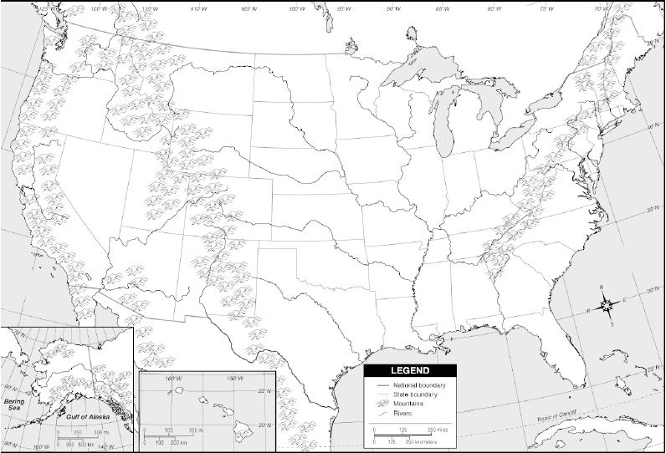
USA Physical Features: Mountains, Rivers, Lakes, Regions

Slide 9
23
Identify examples of scarcity in and around specific regions. (E, G)

Slide 10
For over 125 years, the Colorado Division of Water Resources has been empowered to administer all water rights according to the Appropriation Doctrine (in short, 1st in time, 1st in right). Most of this work is done by Division Offices located in the seven major river basins of the state. These offices employ water commissioners to ensure the priority system is followed, enforcing the decrees and water laws of the State of Colorado. The Colorado Ground Water Law of 1957 established the permitting requirement of ground water wells, and by 1969, surface and ground water rights were administered together.
Whether water is used simply to drink from your household tap or to irrigate hundreds of acres of cropland, everyone in Colorado benefits from the orderly distribution and management of the state’s most precious resource.

Slide 13
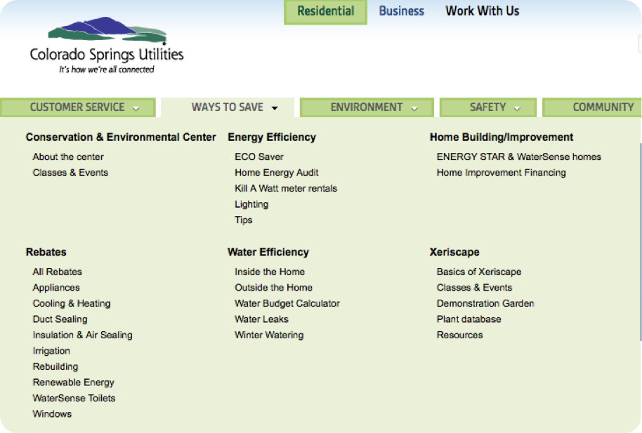
https://www.csu.org/pages/restrictions-r.aspx

Slide 14
• Customers are encouraged to water no more than three days a week during cool periods of the day.
• Avoid applying water or letting water pool on impervious surfaces, such as a patios, streets, parking lots, alleys, sidewalks or driveways.
• Use a positive shut-off nozzle when irrigating landscapes and washing vehicles.
• Be sure to check for water leaks regularly and fix them as soon as possible.
• Restaurants, hotels, cafes, cafeterias or other public places where food is served are encouraged to serve drinking water only upon request.
• You may monitor your water and energy use by logging in to My Account and clicking on My Usage.

Slide 15
the
catfish industry

Slide 16
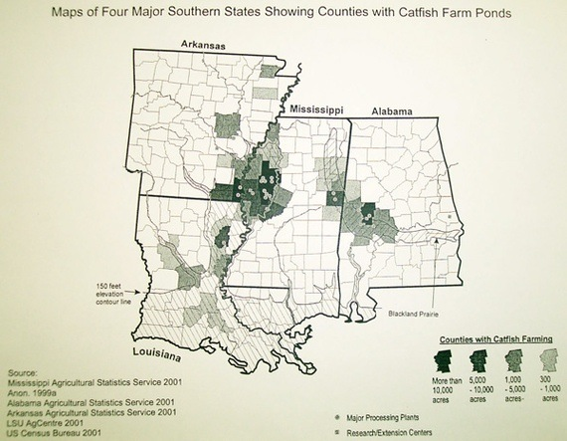

Slide 17
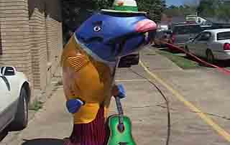
“Bel-zon-a”

Slide 18
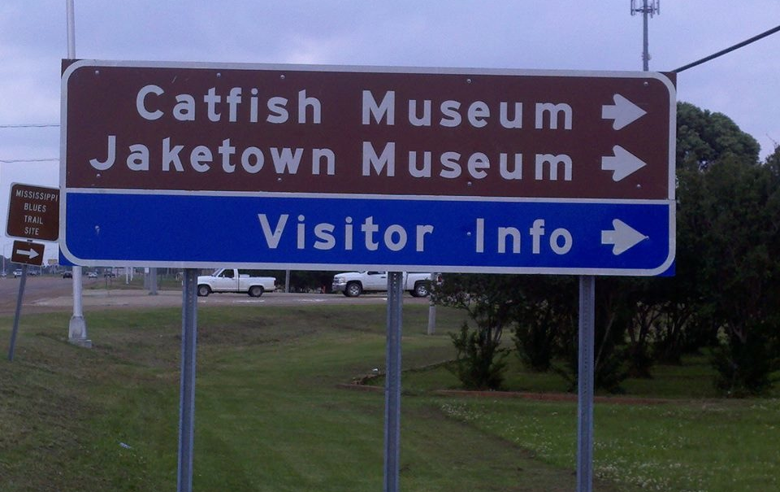

Slide 19
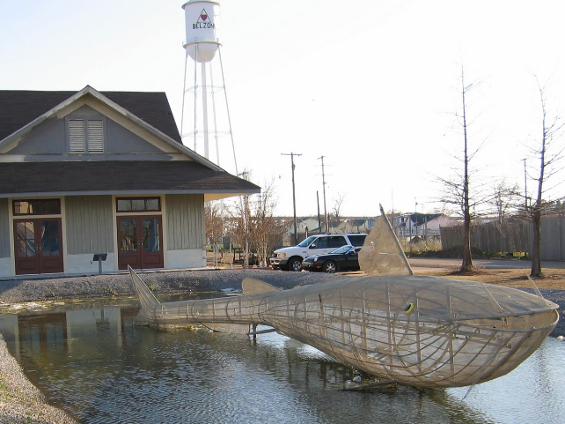

Slide 20
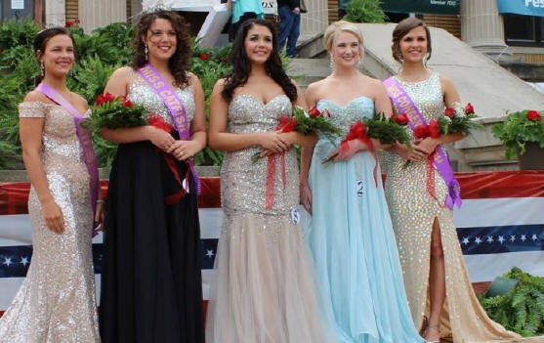
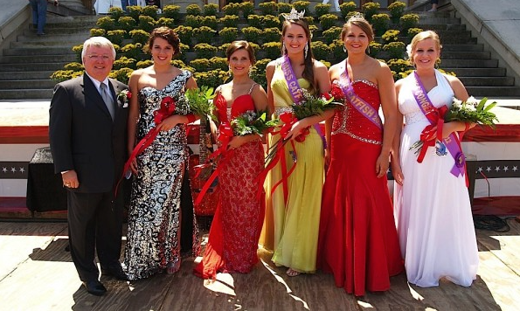

Slide 21
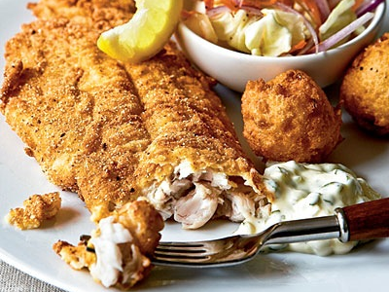

Slide 22
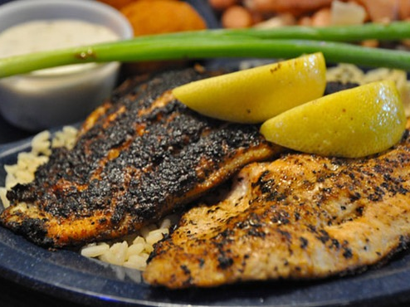

Slide 23
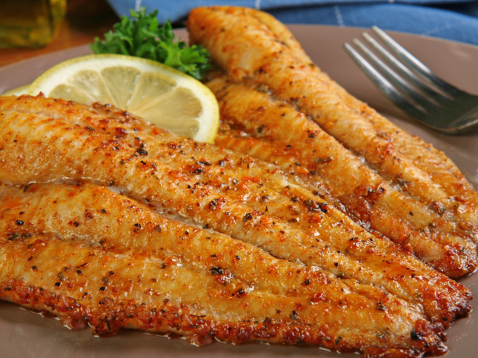

Slide 24
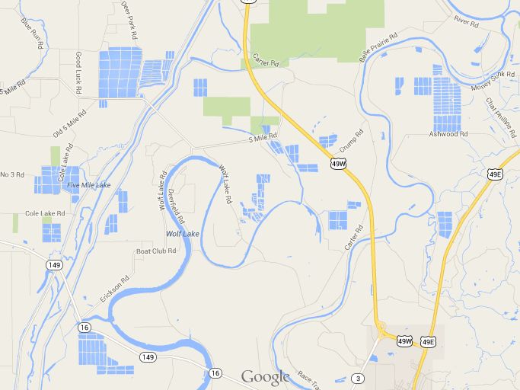

Slide 25
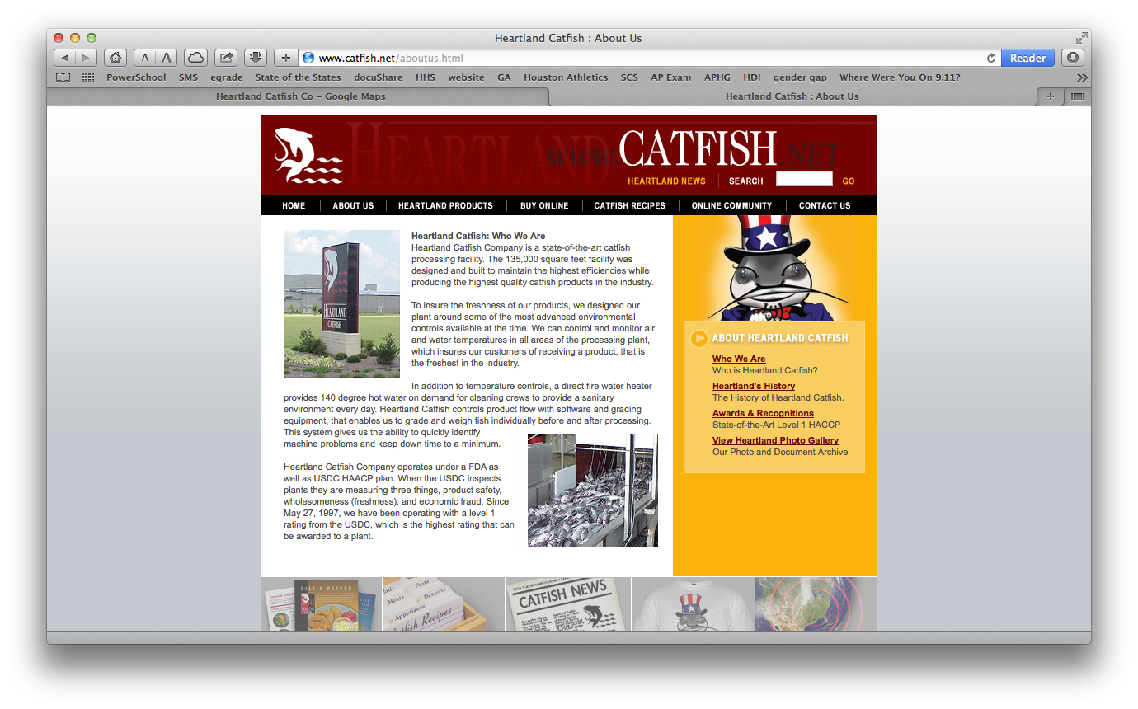

Slide 26
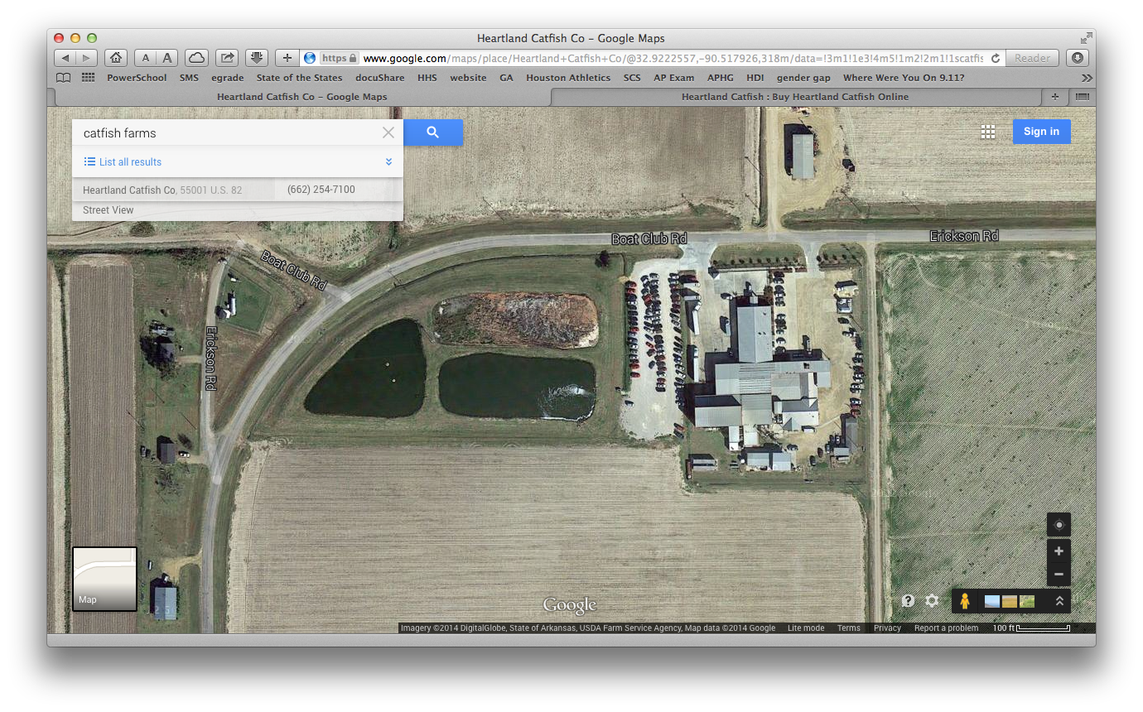

Slide 27
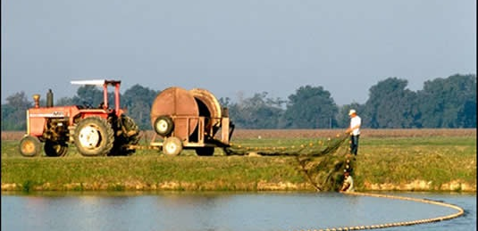
Harvesting catfish
Catfish Industry

Slide 28
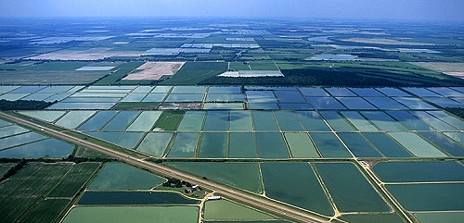
catfish farming
Catfish Industry

Slide 29
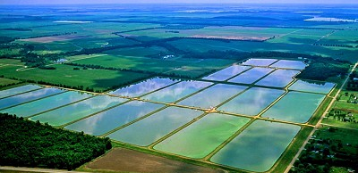
catfish farming
Catfish Industry

Slide 30
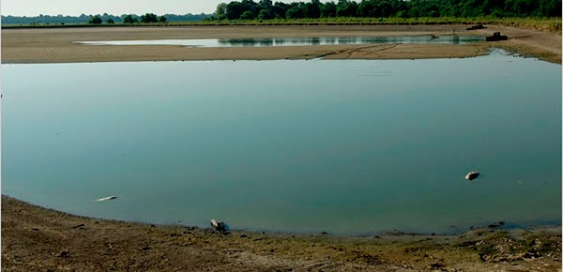
catfish pond
Catfish Industry

Slide 31
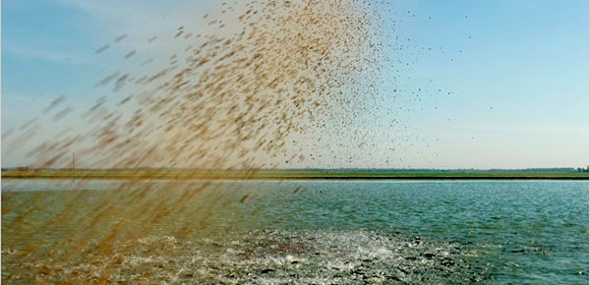
feeding catfish - soy based
Catfish Industry

Slide 33
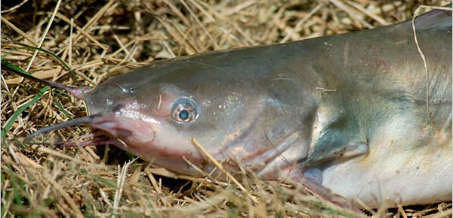
catfish up close
Catfish Industry

Slide 34
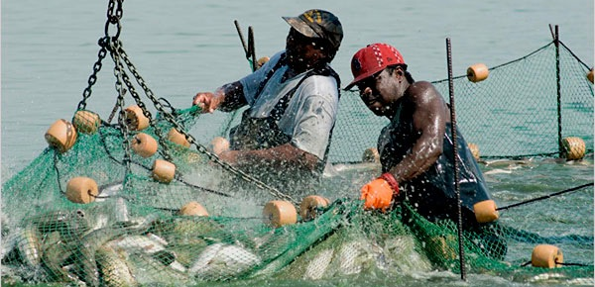
harvesting catfish
Catfish Industry

Slide 35
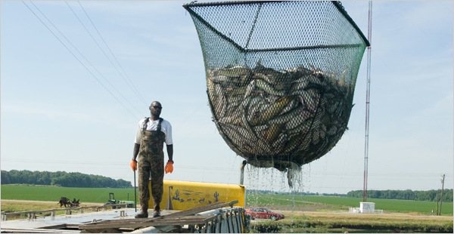
harvesting catfish
Catfish Industry

Slide 37
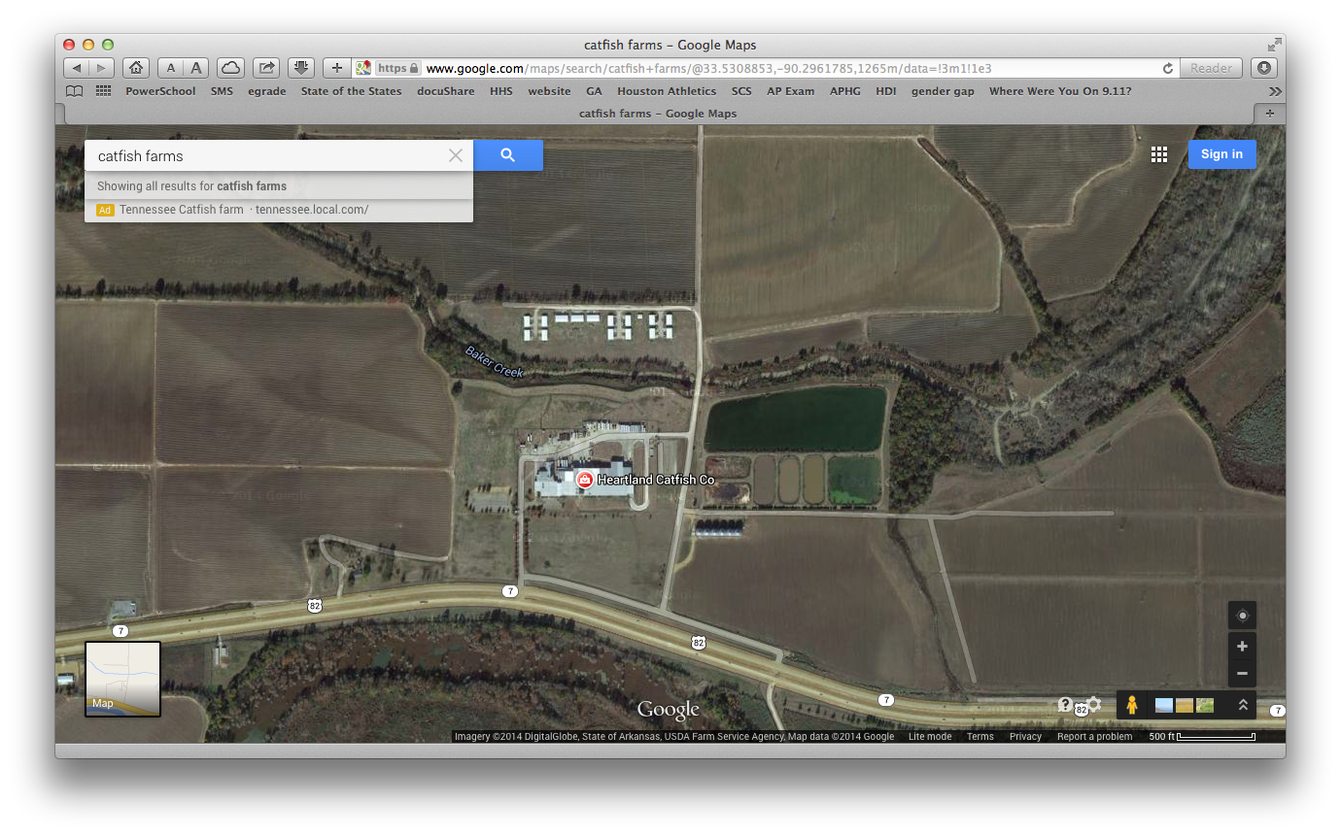

Slide 38
In Mississippi alone, the nation's leading catfish-producing state, catfish acreage has fallen by about 40 percent since it peaked at 113,000 acres in 2002.
The 2011 slowdown led to layoffs at Heartland Catfish processing plants in Mississippi and Alabama in February.

Slide 39
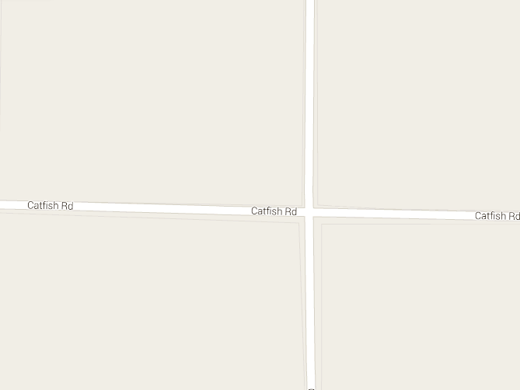

Slide 40
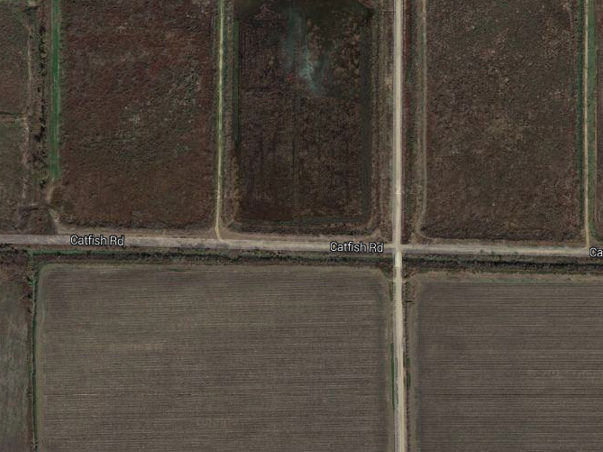

Slide 42
Belzoni still calls itself the catfish capital of the world, but the virtual inland sea of catfish farms between Belzoni and Isola is gone. Where the ponds once stood is now either back in production with other crops or just left to grow up in weeds, like this pond near Isola. It's hard to find a single pond. Dick Stevens, chief executive officer of Consolidated Catfish in Isola says the industry is still producing a quality product and will continue to do so, as a smaller business.

Slide 43
"It's gonna re-invent itself. A lot of changes in production methods, a lot of changes in processing," said Stevens. "Over the long haul I think we are going to have a viable industry, much smaller than we were in the past."
Steve Anderson, executive director of the Catfish Museum in Belzoni, summed up the business this way.
"The catfish industry is having a tough time right now. We are declining in the number of catfish farmers, we have less catfish farms every year, it's going down."

Slide 44
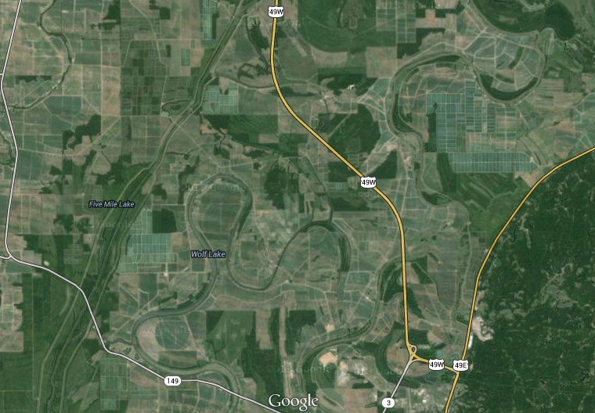

Slide 45
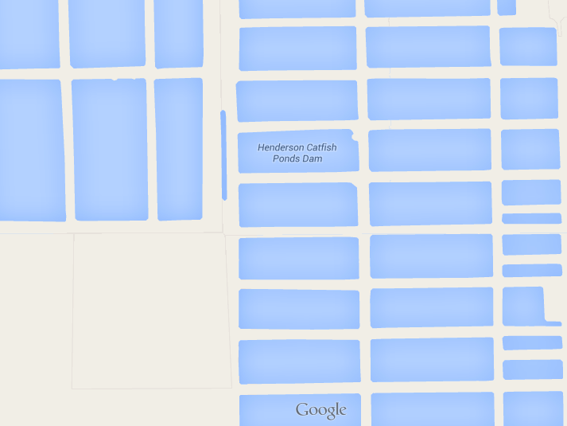

Slide 46
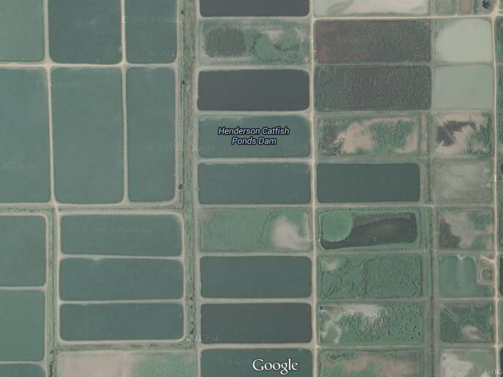

Slide 47
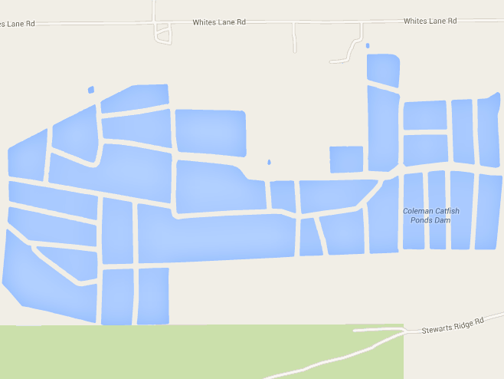

Slide 48
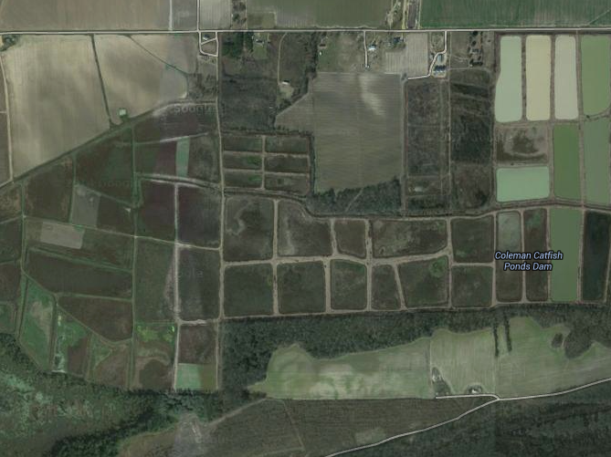

Slide 49
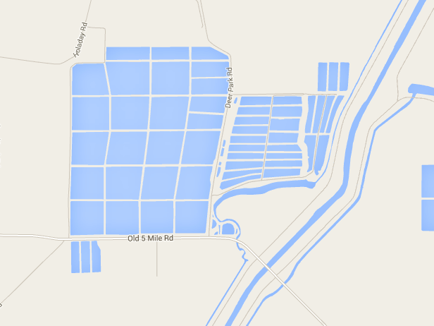

Slide 50
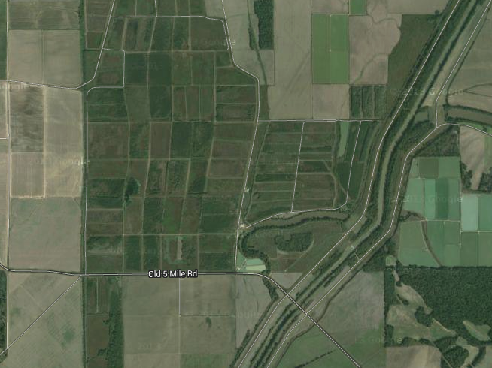

Slide 51
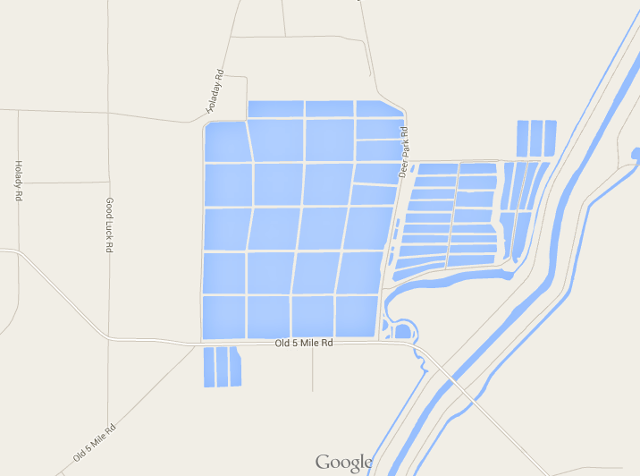

Slide 52
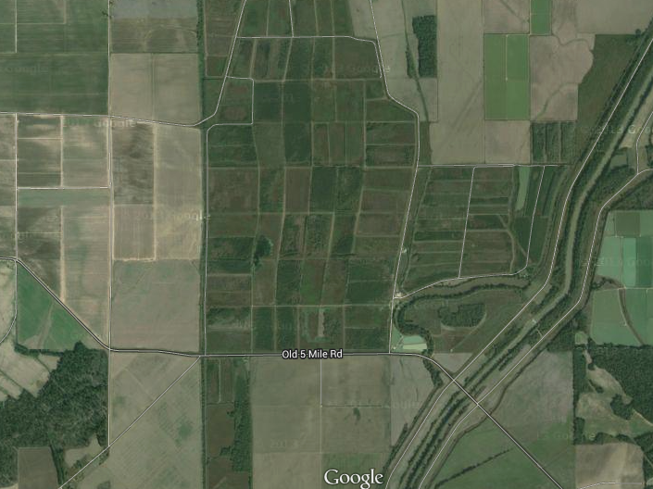

Slide 53
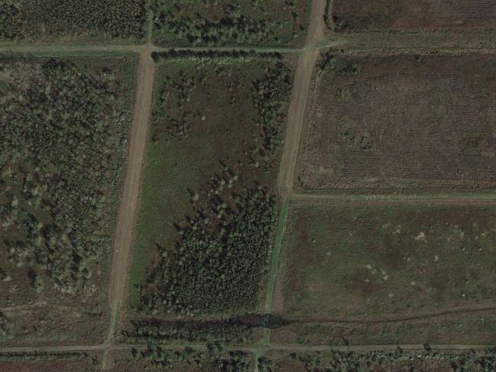

Slide 54
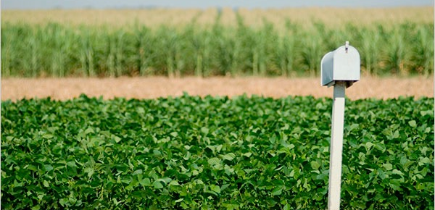
No Longer a catfish farm
Catfish Industry

Slide 55
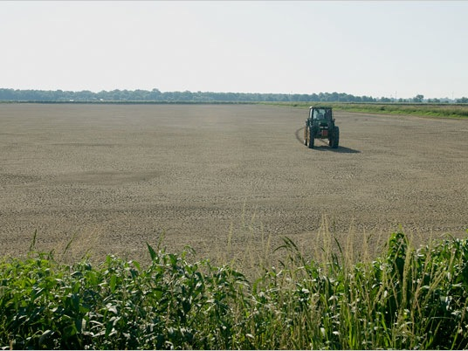

Slide 57
“We've hardly had any rain, and some of our ponds are about 2 feet lower than they should be,” Hogue said. “We dig them deeper than Delta ponds because we have no means of refilling them if it doesn't rain. At this time of year, our ponds are evaporating at the rate of a quarter inch a day, and we've not had rain to fill them back.”

Slide 58
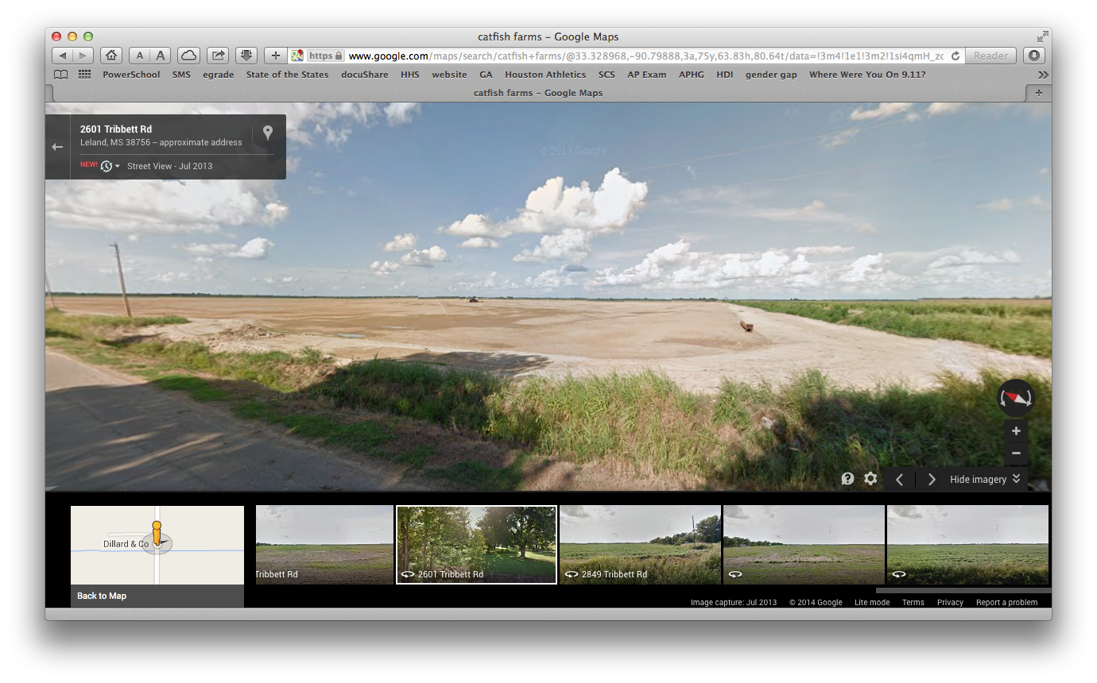

Slide 59
The problem started in (2010), when farmers responded to rising feed prices and stiff competition from Asian imported fish by shifting their resources to more profitable row crops like cotton, soybeans and corn.

Slide 60
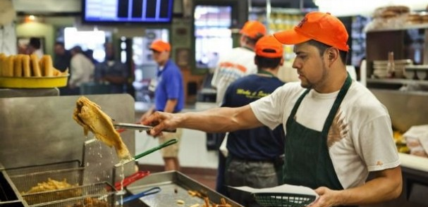
Low supply - high prices
Catfish Industry

Slide 61
McLean said the restaurant is paying 33 percent more for a case of catfish now than it was last year at this time and has, unfortunately, he said, had to pass some of the cost on to customers.
"There was nothing else we could do," McLean said.
But Soul Fish now offers a lower-cost, two-piece catfish fillet
basket that is one fillet smaller than its usual "small order." The new, smaller basket is $9.25.

Slide 62
The county agent in Humphreys County, Preston Aust, says catfish production is down about 60 percent in his county in the last three years.
"I guess when they get to the grocery store and they see catfish at $4.50 a pound, and they look across and they can buy sirloin steak for $5.00 a pound, they are not choosing catfish as often.

Slide 63
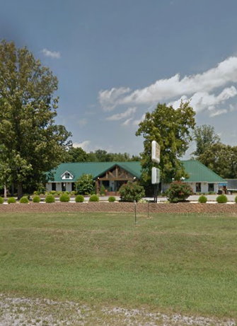
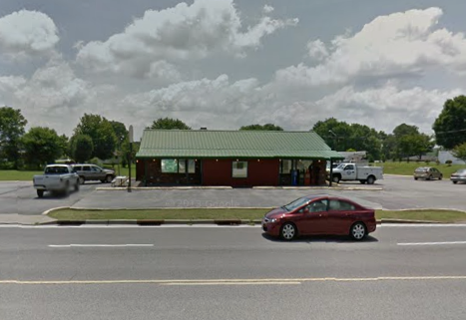
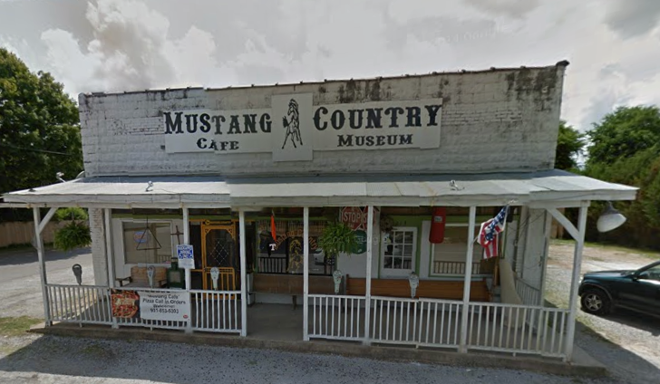
Small Town
Catfish Restaurants

Slide 64
24
Interpret a chart, graph, or resource map of major imports and exports. (E, G)

Slide 70
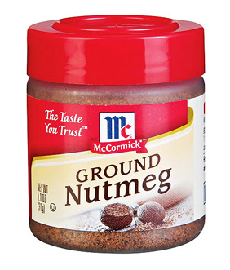

Slide 71
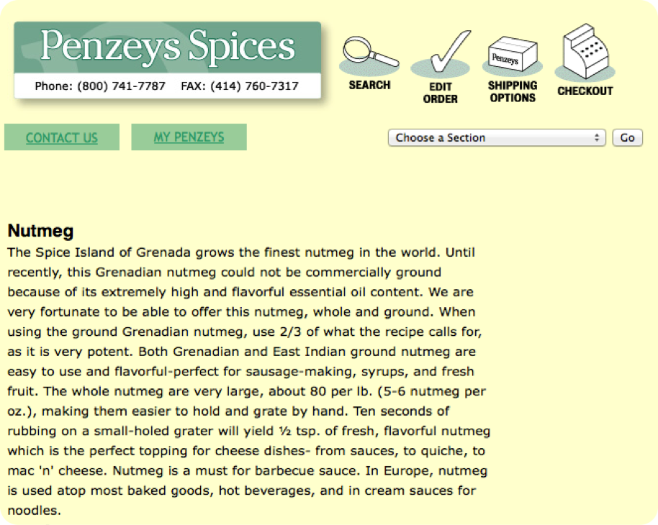

Slide 72
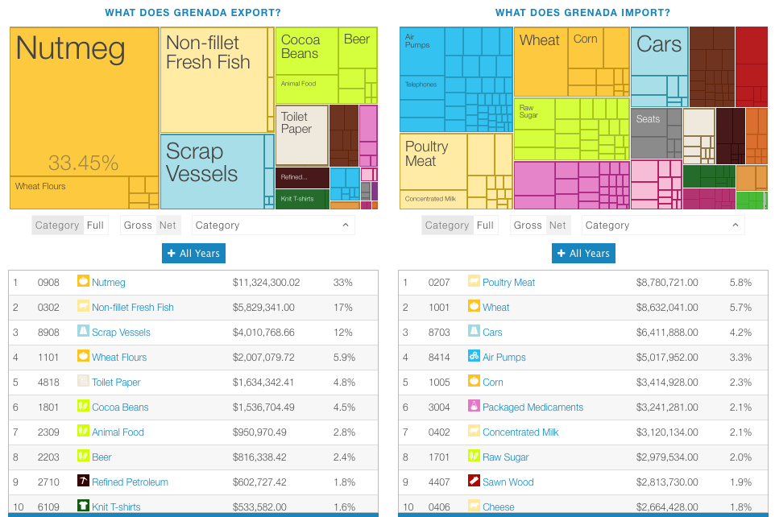
What do you think Grenada needs that it does not make, grow, or produce?

Slide 73
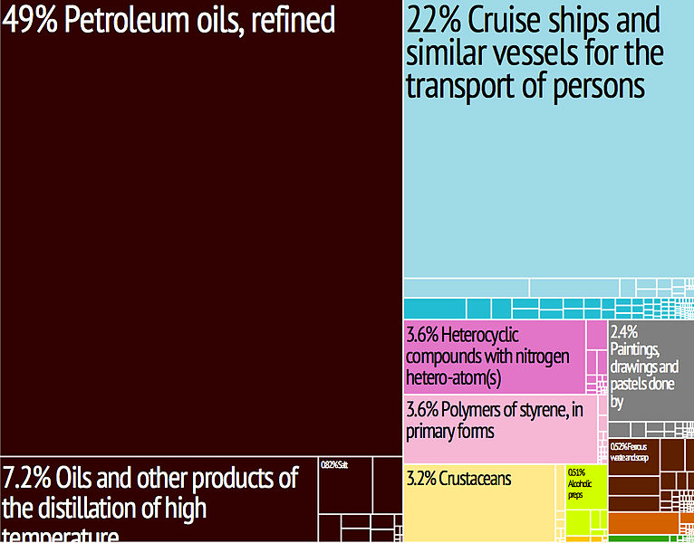

Slide 74
25
Define supply and demand and describe how changes in supply and demand affect prices of specific products. (E)

Slide 77
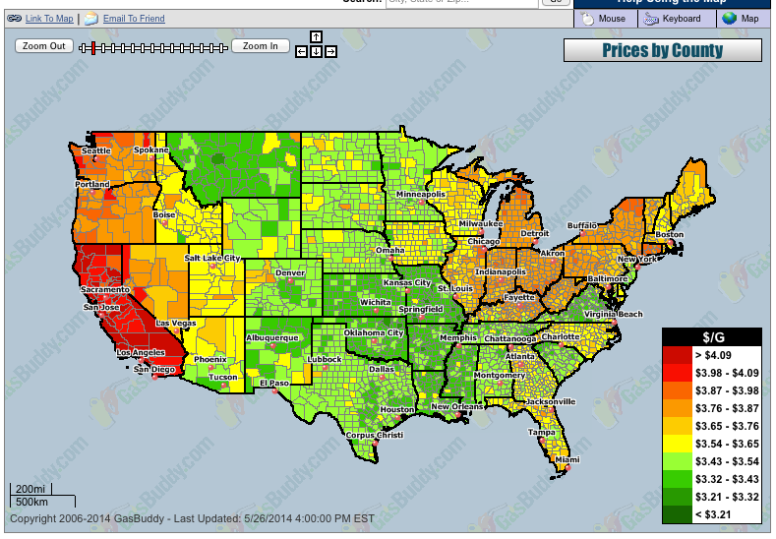
http://www.gasbuddy.com

Slide 78
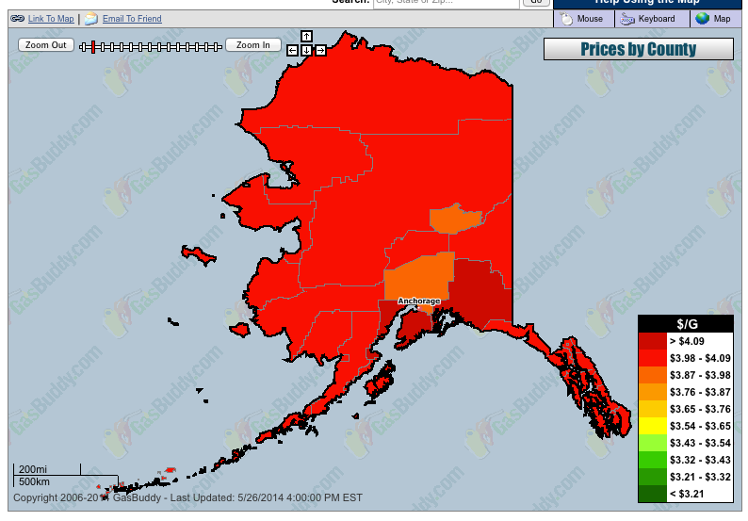

Slide 79
the
catfish industry

Slide 80
feeding catfish - soy based
Catfish Industry

Slide 82
The problem started in (2010), when farmers responded to rising feed prices and stiff competition from Asian imported fish by shifting their resources to more profitable row crops like cotton, soybeans and corn.

Slide 83
Low supply - high prices
Catfish Industry

Slide 84
McLean said the restaurant is paying 33 percent more for a case of catfish now than it was last year at this time and has, unfortunately, he said, had to pass some of the cost on to customers.
"There was nothing else we could do," McLean said.
But Soul Fish now offers a lower-cost, two-piece catfish fillet
basket that is one fillet smaller than its usual "small order." The new, smaller basket is $9.25.

Slide 85
The county agent in Humphreys County, Preston Aust, says catfish production is down about 60 percent in his county in the last three years.
"I guess when they get to the grocery store and they see catfish at $4.50 a pound, and they look across and they can buy sirloin steak for $5.00 a pound, they are not choosing catfish as often.

Slide 86
Small Town
Catfish Restaurants

Slide 87
26
Describe how goods and services are exchanged on local, regional, and international levels including transportation methods and bartering and monetary exchange. (C, E, G, TN)

Slide 88
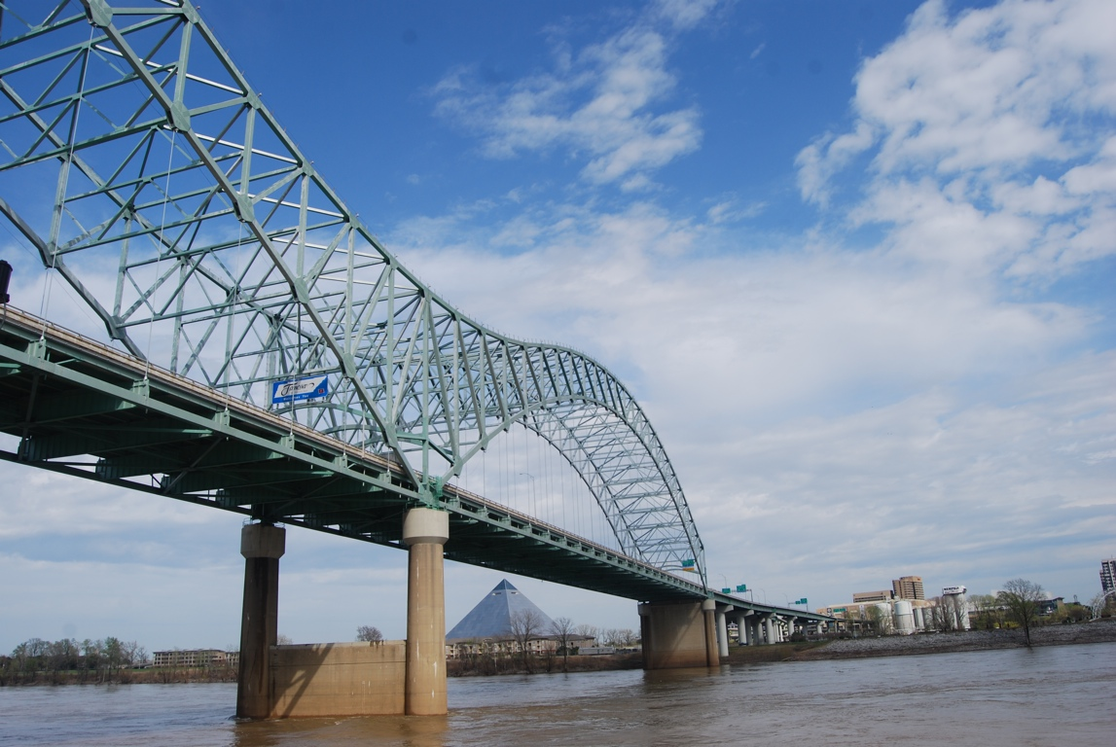
What is the BEST MODE of TRANSPORTATION?

Slide 89
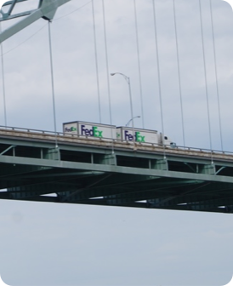
Types of Transportation | A- Airways | B- Highway Carrier | C- Inland Waterway | D- Intermodal Containerization | E- Pipeline | F- Railroad

Slide 96
27
Compare and contrast landforms, climates, population, natural resources, and major cities of the three Grand Divisions of Tennessee. (G, TN)

Slide 101
Memphis, Tennessee
Population Change 2000-2010, U.S. Census Data

Slide 102
Nashville, Tennessee
Population Change 2000-2010, U.S. Census Data

Slide 103
Memphis, TN | Jan | Feb | Mar | Apr | May | Jun | Jul | Aug | Sep | Oct | Nov | Dec
Avg. Temp. Fº | 40° | 44° | 54° | 64° | 71° | 78° | 84° | 81° | 74° | 64° | 54° | 44°
Avg. Precip. in. | 3.7 in | 4.4 in | 5.4 in | 5.5 in | 5.0 in | 3.6 in | 3.8 in | 3.4 in | 3.5 in | 3.0 in | 5.1 in | 5.7 in

Slide 104
http://countrystudies.us/united-states/weather/tennessee

Slide 107
 | Jan | Feb | Mar | Apr | May | Jun | Jul | Aug | Sep | Oct | Nov | Dec
Avg. Temp. Fº
Avg. Precip. in.

Slide 114
Kansas City Royals
Kansas City Royals Play in Kansas City, Missouri not in Kansas City, Kansas.
Baseball Team in the World Series

Slide 119
28
Discuss the structure and purpose of government. (P)

Slide 123
Countries highlighted in blue are designated "electoral democracies" in Freedom House's 2014 survey "Freedom in the World". Freedom House considers democracy in practice, not merely official claims.

Slide 124
29
Compare and contrast the national governments of Canada, Mexico, and the United States. (P)

Slide 125
http://www.mapsofworld.com/thematic-maps/types-of-governments.html

Slide 126
Canada

Slide 127
United States

Slide 128
Mexico

Slide 129
Cuba

Slide 130
Part of Denmark
Greenland

Slide 131
Bahamas

Slide 132
30
Describe the Constitution of the United States and the Tennessee State Constitution in principle and practice. (P, TN)

Slide 134
http://www.archives.gov/exhibits/charters/constitution.html

Slide 135
http://www.archives.gov

Slide 138
National Archives

Slide 139
http://state.tn.us/sos/bluebook/05-06/46-tnconst.pdf

Slide 140
Preamble and Declaration of Rights
Whereas, The people of the territory of the United States south of the river Ohio, having the right of admission into the general government as a member state thereof, consistent with the Constitution of the United States, and the act of cession of the state of North Carolina, recognizing the ordinance for the govern- ment of the territory—of the United States north west of the Ohio River, by their delegates and representatives in convention assembled, did on the sixth day of February, in the year of our Lord one thousand seven hundred and ninety- six, ordain and establish a Constitution, or form of government, and mutually agreed with each other to form themselves into a free and independent state by the name of the state of Tennessee, and,

Slide 146
Five Facts
about North America

Slide 147
1. Includes United States, Canada, Mexico, the Caribbean Islands, and Central America.
2. The main languages are English, French, and Spanish.
3. The main religion is Christianity.
4. The United States is the largest economy in the world.
5. Longest border between a developed (USA) and developing (Mexico) country.

Slide 148
Five Facts
about Middle America

Slide 149
1. Includes Mexico, the Caribbean Islands, and Central America.
2. Caribbean islands depend heavily on tourism.
3. Panama Canal connects the Caribbean Sea to the Pacific Ocean.
4. Produces tropical fruits for sale in the United States, e.g., bananas.
5. Mexico City is the largest city in the Western Hemisphere.

