Slide 1
Social Studies Standards
Third Grade

Slide 2
Geography
Third Grade Social Studies Standards

Slide 3
Content Strand Code - Content Strand - Definition
C- Culture encompasses similarities and differences among people including their beliefs, knowledge, changes, values, and traditions. Students will explore these elements of society to develop an appreciation and respect for the variety of human cultures.
E- Globalization of the economy, the explosion of population growth, technological changes and international competition compel students to understand both personally and globally production, distribution, and consumption of goods and services. Students will examine and analyze economic concepts such as basic needs versus wants, using versus saving money, and policy making versus decision making.
G- Geography enables the students to see, understand and appreciate the web of relationships between people, places, and environments. Students will use the knowledge, skills, and understanding of concepts within the six essential elements of geography: world in spatial terms, places and regions, physical systems, human systems, environment and society, and the uses of geography.
H- History involves people, events, and issues. Students will evaluate evidence to develop comparative and casual analyses, and to interpret primary sources. They will construct sound historical arguments and perspectives on which informed decisions in contemporary life can be based.
P- Government, Civics, and Governance establishes structures of power and authority in order to provide order and stability. Civic efficacy
Politics requires understanding rights and responsibilities, ethical behavior, and the role of citizens within their community, nation, and world.
TN- Tennessee has a unique story and provides a more intimate view of the past in our present lives. As students connect with their own state’s history and geography they will gain a greater perspective of the impact and significance of national history, movements, decisions, and ideas.

Slide 4
1
Process and report information identifying, locating, comparing, and contrasting the major continents and oceans: North America, South America, Europe, Africa, Australia, Asia, Antarctica, Arctic, Atlantic, Indian, Pacific, and Southern using maps, globes, and other technologies.

Slide 5
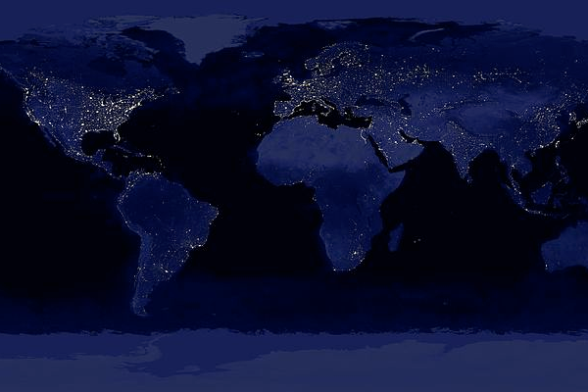
Earth | Population: 7.1 Billion | USA Population: 318 Million *adds 1 person every 13 seconds
 | Males: 50.4% Females: 49.6% | * 1 Birth Every 8 Seconds * 1 Death Every 12 Seconds * 1 International Migrant Every 44 Seconds

Slide 6
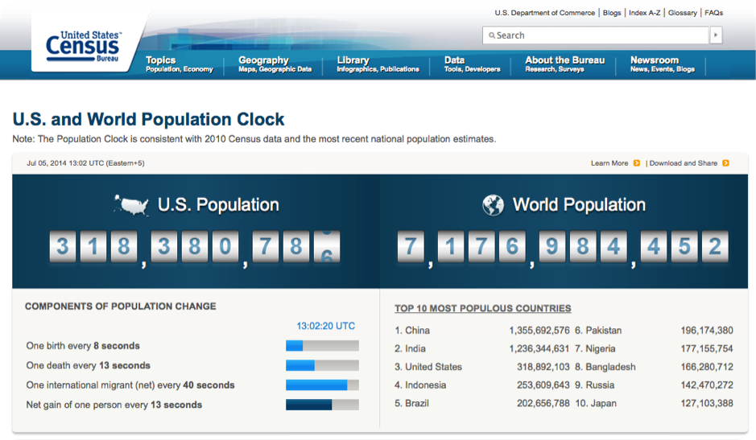
RESOURCE
http://www.census.gov/popclock

Slide 7
RESOURCE

Slide 8
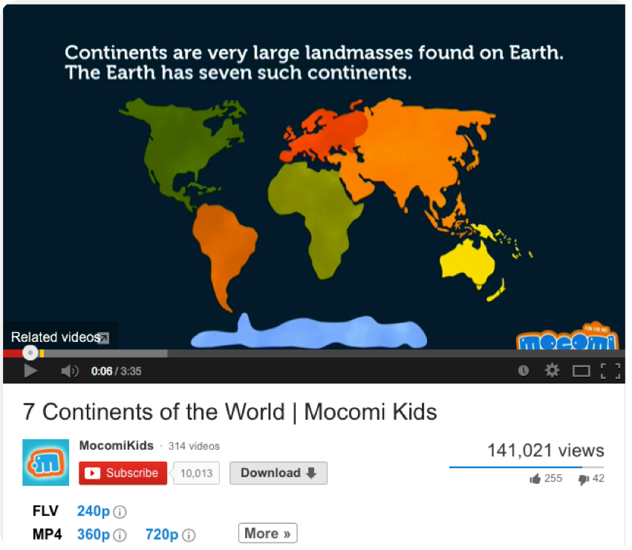

Slide 10
RESOURCE
http://www.eduplace.com/ss/maps

Slide 12
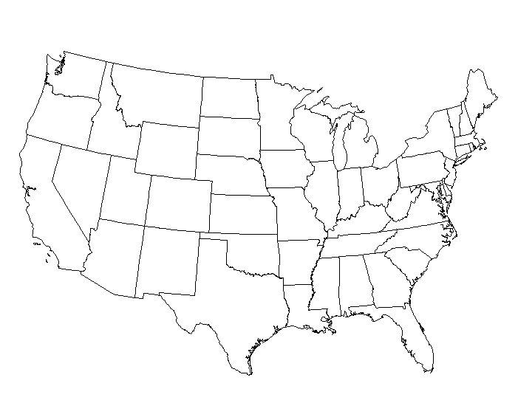

Slide 13
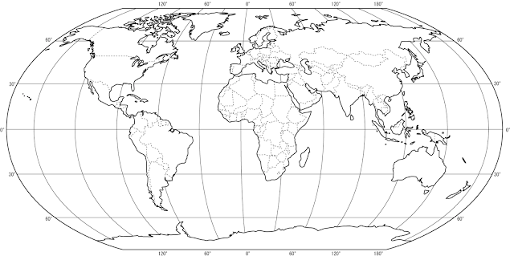

Slide 14
1
4
5
3
2
6
7

Slide 15
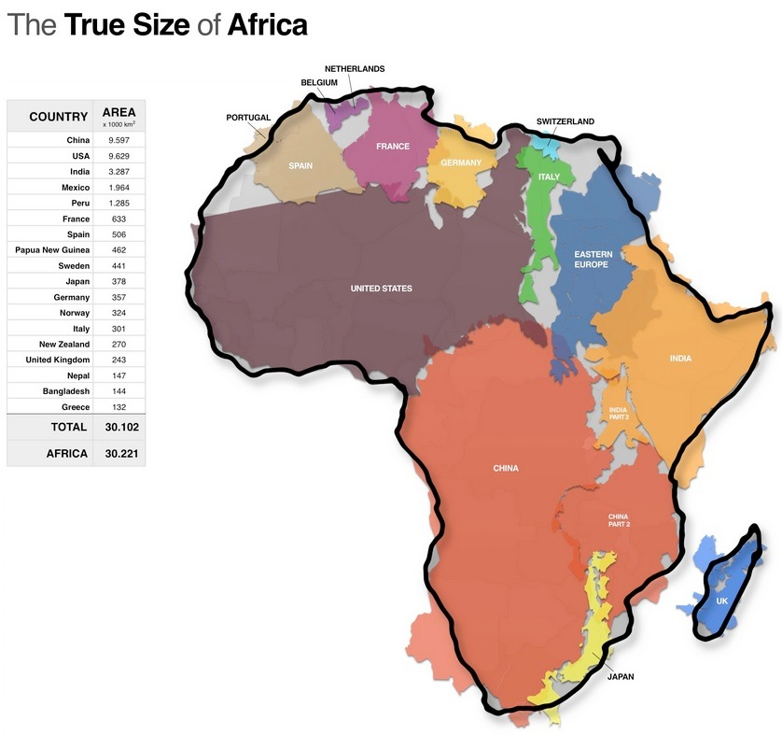

Slide 16
RESOURCE
http://mapfight.appspot.com

Slide 17
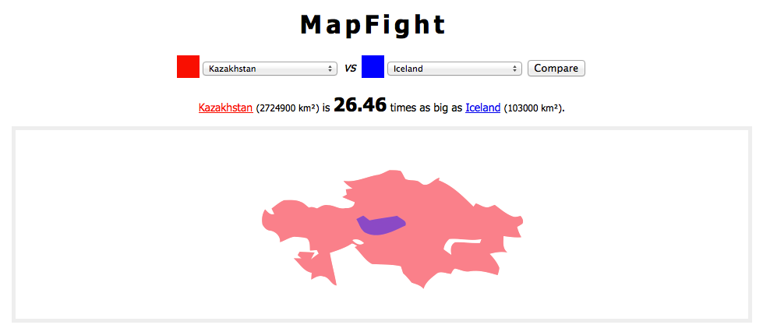

Slide 18
Circle which location is larger in size (area).
1 | United States | Canada
2 | Mexico | Cuba
3 | Australia | Hawaii
4 | Tennessee | California
5 | Florida | United Kingdom

Slide 19
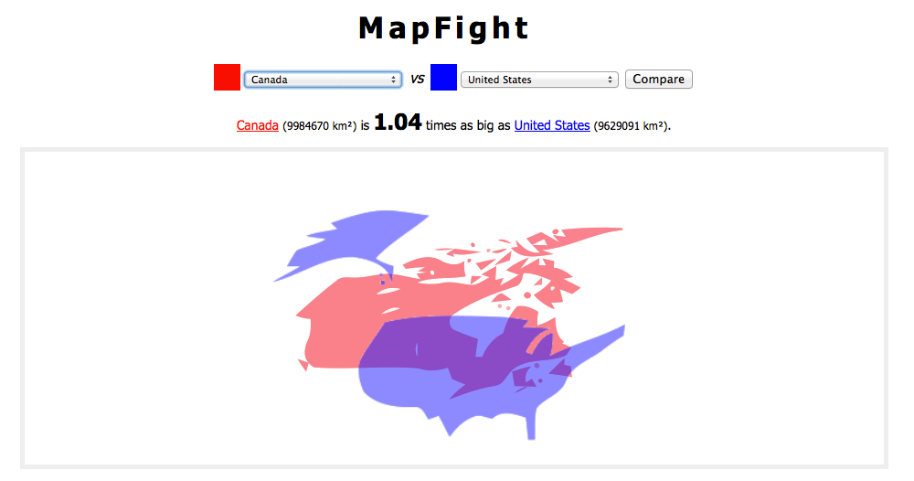
1

Slide 20
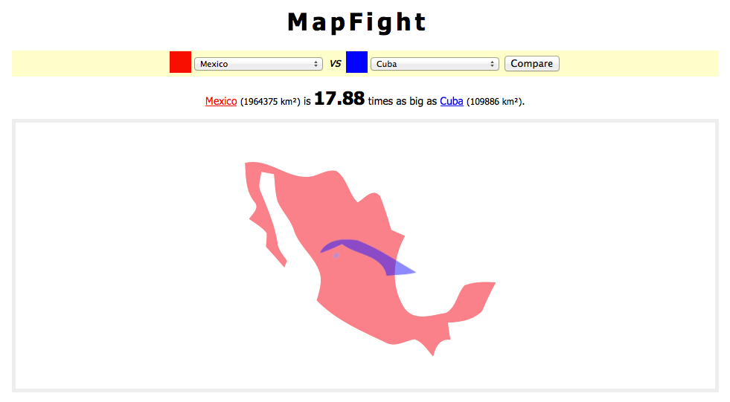
2

Slide 21
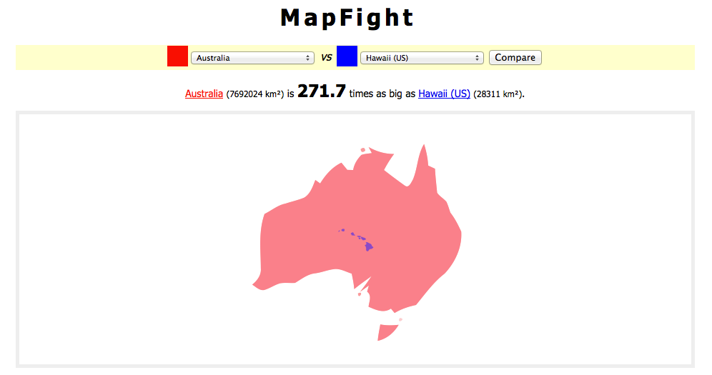
3

Slide 22
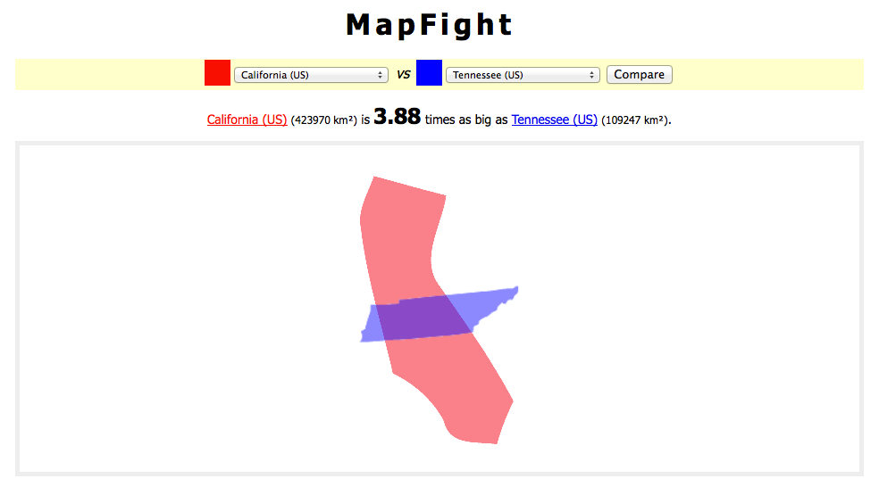
4

Slide 23
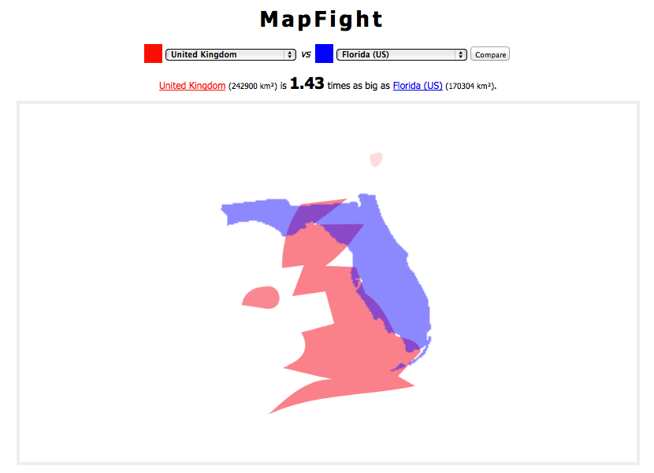
5

Slide 24
Circle which location is larger in size (area).
1 | United States | Canada
2 | Mexico | Cuba
3 | Australia | Hawaii
4 | Tennessee | California
5 | Florida | United Kingdom

Slide 25
2
Interpret maps and globes using common terms, including country, region, mountain, hemisphere, latitude, longitude, north pole, south pole, equator, time zones, elevation, approximate distances in miles, isthmus, and strait.

Slide 26
Latitude (parallels)
Named: equator, tropic of cancer and capricorn, arctic and antarctic circle
Run: east and west
Read: north and south of the equator
0º - 90º
Directions: North and South
Size: smaller as move away from the equator
concentric circles, bulls-eye

Slide 27
Longitude (meridians)
Named: Prime Meridian
24 Time Zones: 15º apart
Run: north and south
Read: east and west of the Prime Meridian
0º - 180º
Directions: North and South
Size: all Great Circles (same size as equator)
meet at the poles; spokes of a wheel

Slide 28
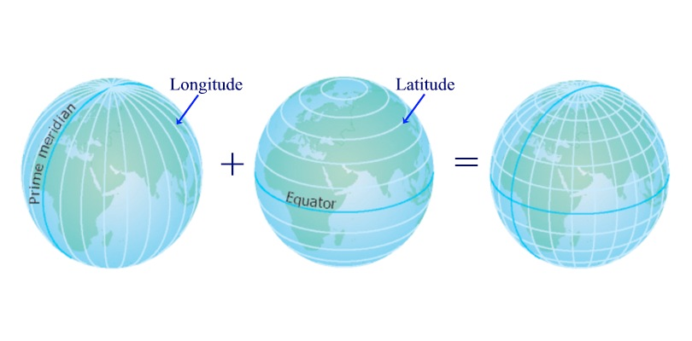

Slide 29
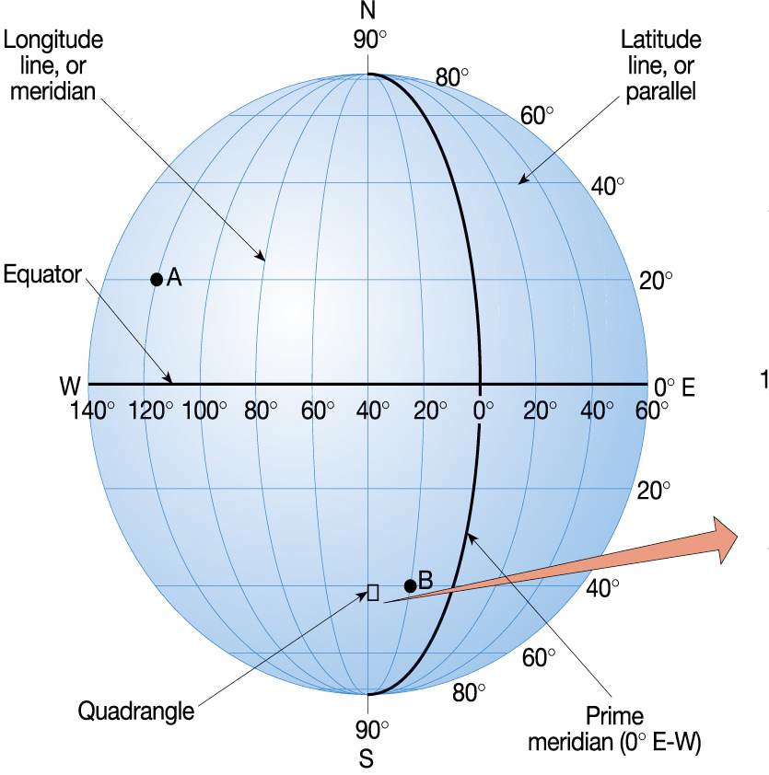

Slide 30
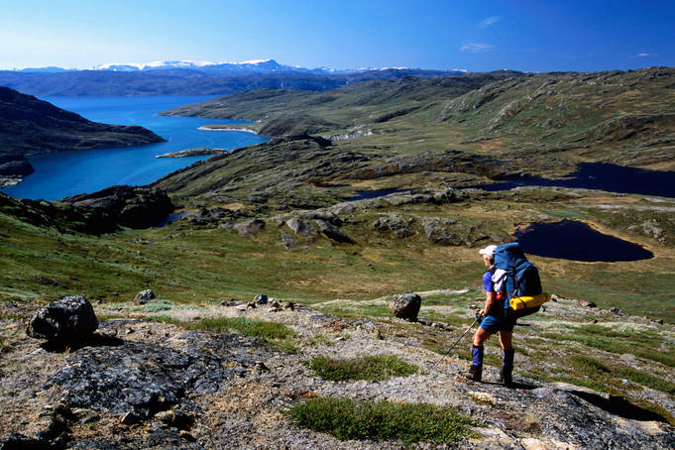
Arctic Circle | 66.5º North | 8 Countries...Name them.
 | Largest city: Murmansk, Russia (307,357) | Norway-Sweden-Finland-Russia-Canada-USA-Greenland (Denmark)-Iceland

Slide 31
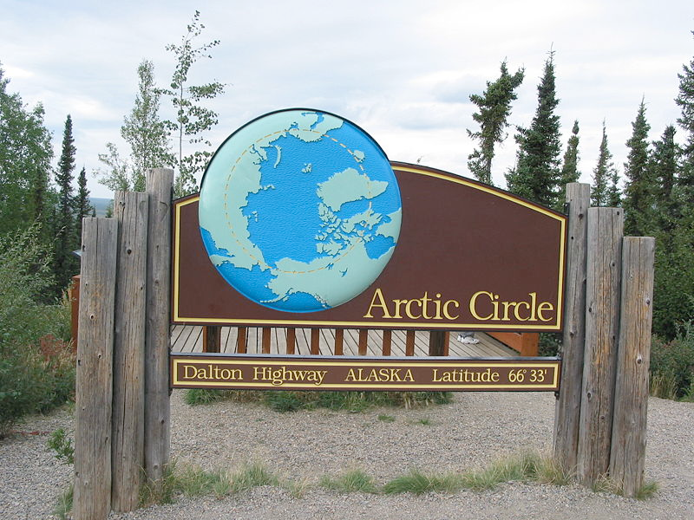

Slide 32
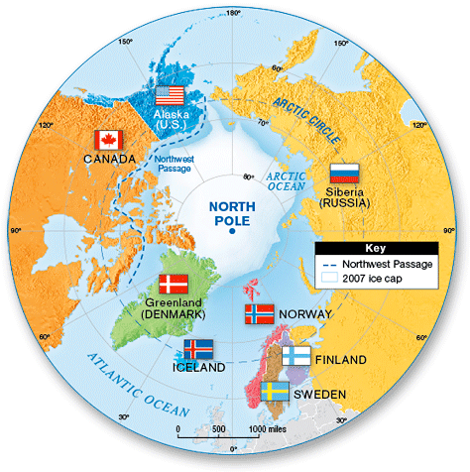

Slide 33
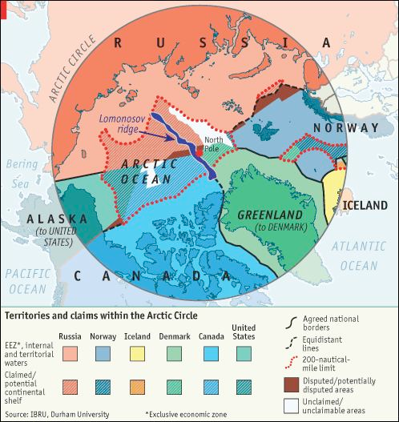

Slide 34
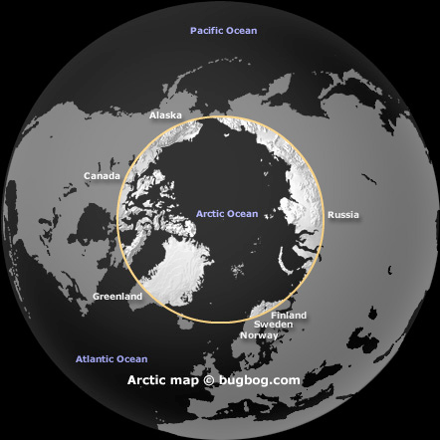

Slide 35
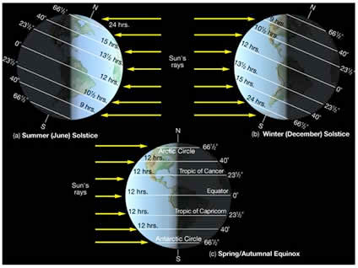

Slide 36
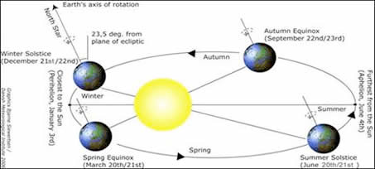

Slide 37
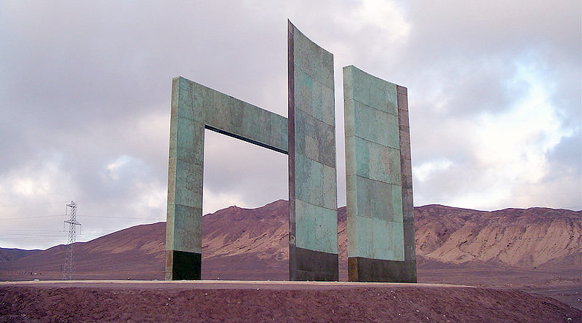

Slide 38
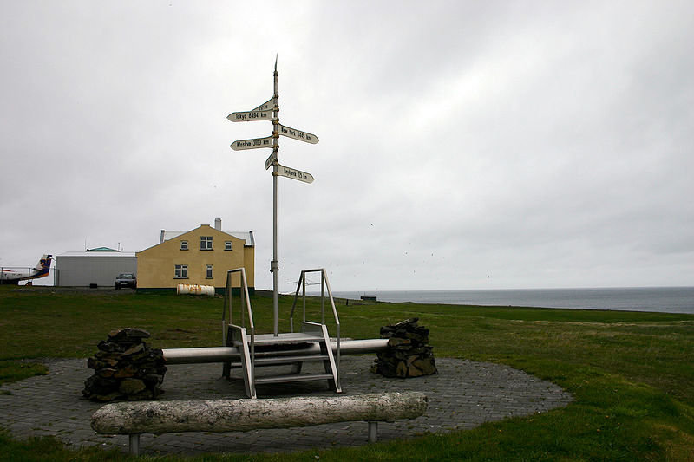

Slide 39
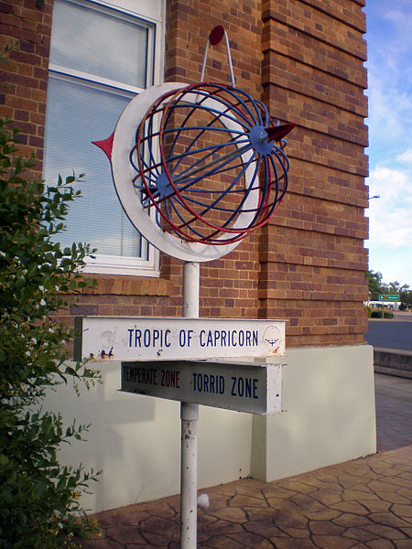

Slide 40
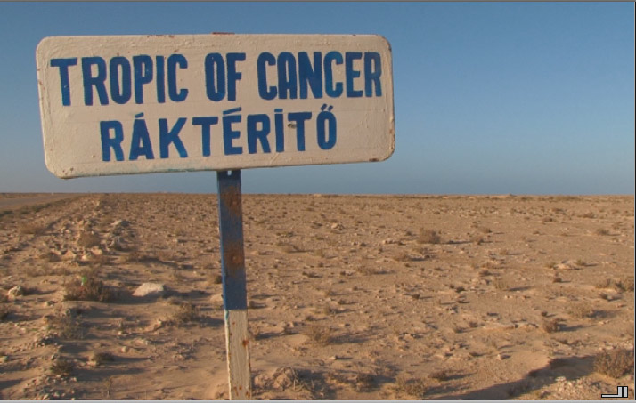

Slide 41
Lines | Latitude | Longitude
Named
Direction
Appearance
Run
Measured From
Degrees

Slide 42
Lines | Latitude | Longitude
Named
Direction
Appearance
Run
Measured From
Degrees
Tropic of Cancer and Capricorn Arctic and Antarctic Circles Equator | Prime Meridian
North South | East West
Concentric Circles Bullseye | Half Great Circles Spokes of a Wheel
East - West | North - South
Equator | Prime Meridian
0 to 90 | 0 to 180

Slide 43
3
Use cardinal directions, map scales, legends, titles, and longitude and latitude to locate major cities and countries in the world.

Slide 44
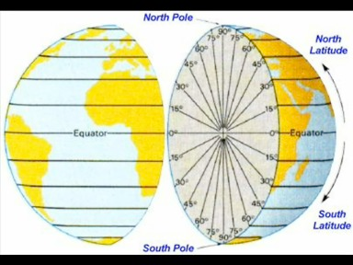

Slide 45
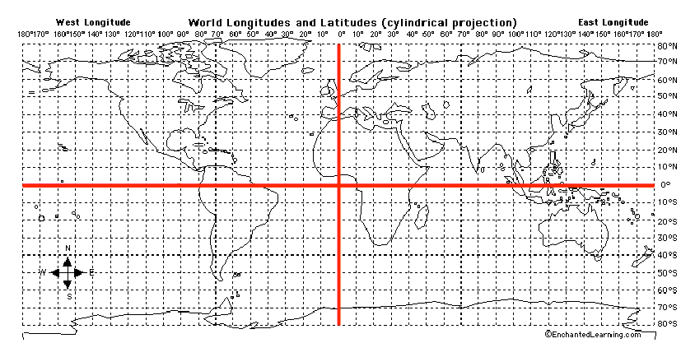

Slide 46
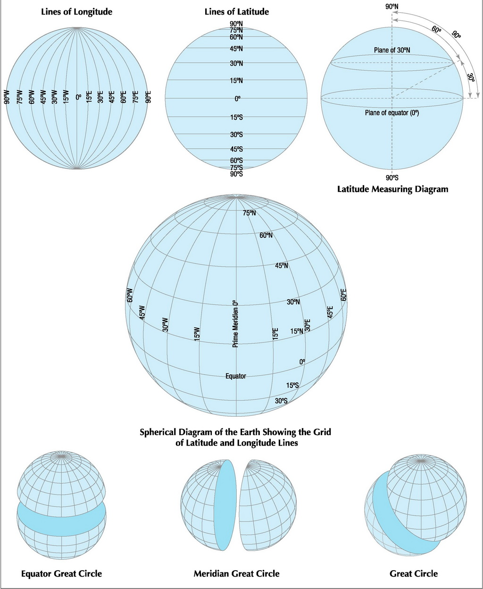
30º

Slide 47
Place the geographic locations in order from the smallest to the largest.
city
continent
country
hemisphere
state
world

Slide 48
continent
country
city
state
hemisphere
world

Slide 49
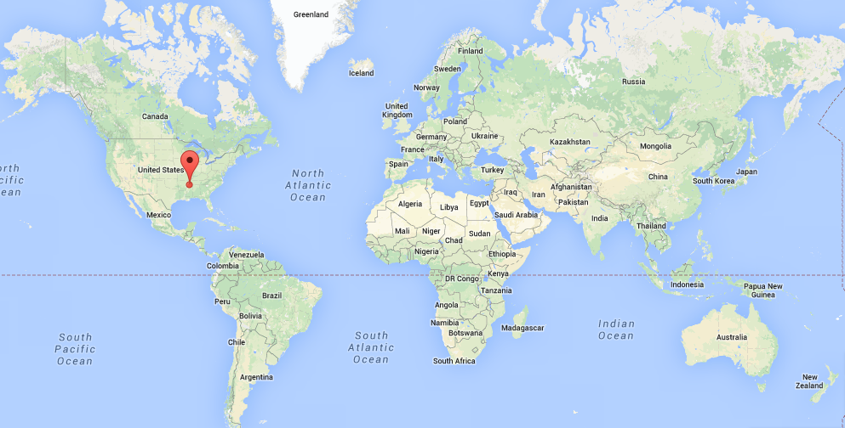
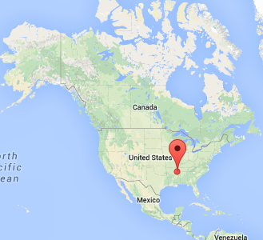
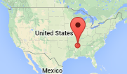

Slide 50
country
continent
city
state
hemisphere
world

Slide 51
4
Examine major physical and political features on globes and maps, including mountains, plains, plateaus, mesas, buttes deserts, deltas, islands, peninsulas, basins, canyons, valleys, bays, streams, gulfs, straits, canals, seas, boundaries, cities, highways, roads, and railroads.

Slide 53
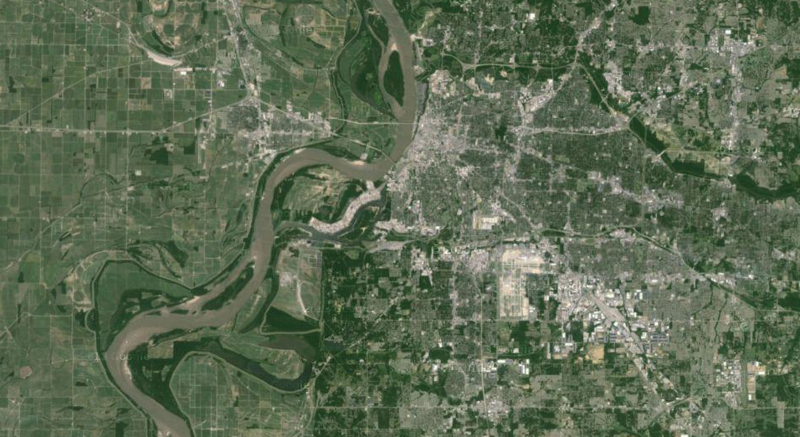
Memphis

Slide 54
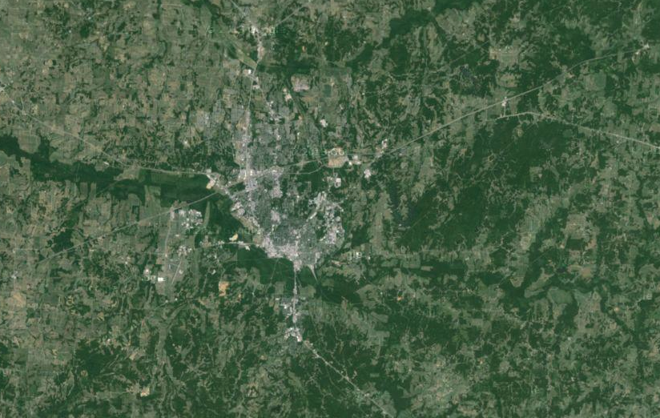
Jackson

Slide 55
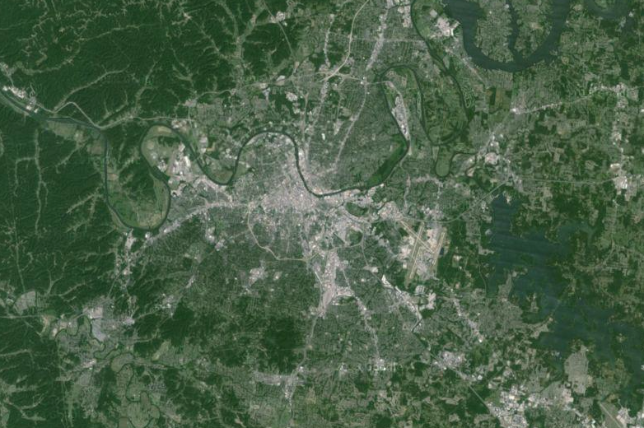
Nashville

Slide 56
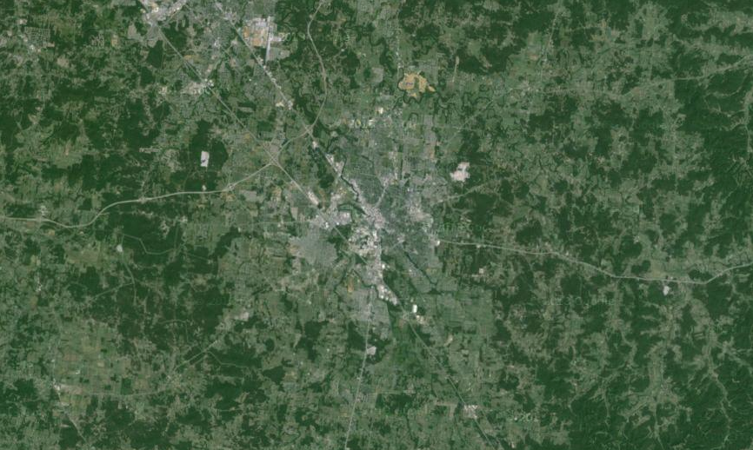
Murfreesboro

Slide 57
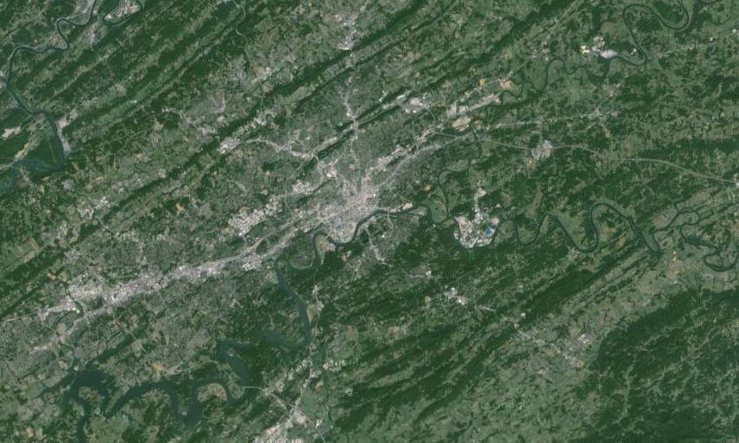
Knoxville

Slide 58
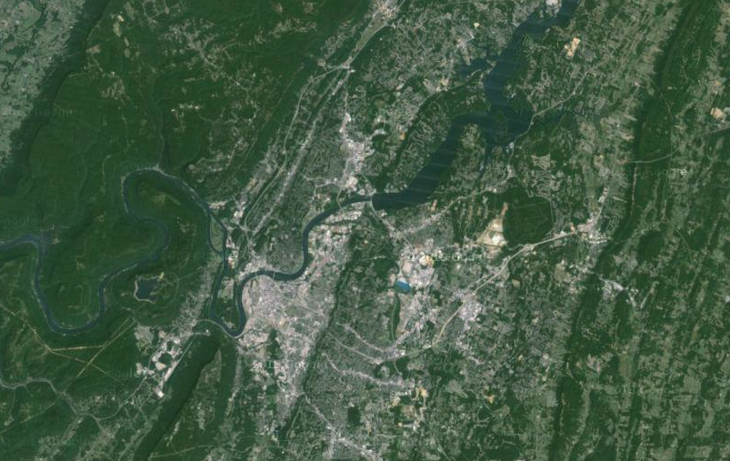
Chattanooga

Slide 59
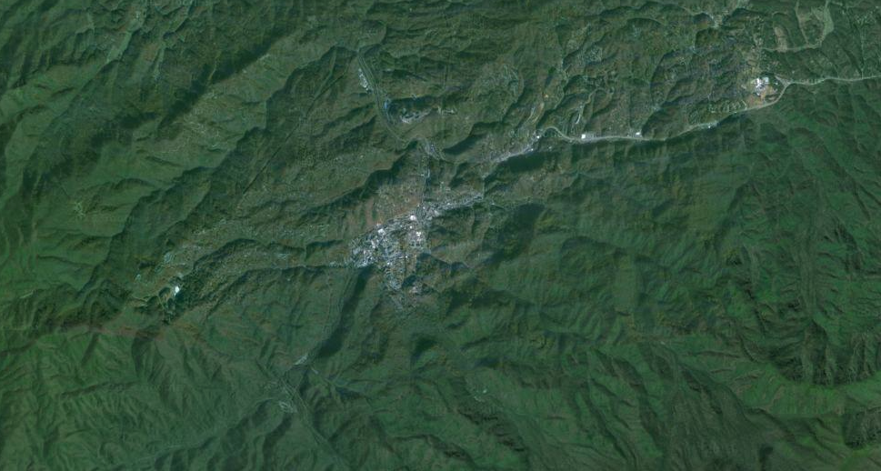
Gatlinburg

Slide 62
5
Explain the difference between relative and absolute location.

Slide 63
Location
Absolute: the specific coordinates (latitude and longitude) for a location, e.g., 35ºN and 75ºW
Relative: the location of a place in relation to another place, e.g., the school is two blocks west of the Walgreens.

Slide 64
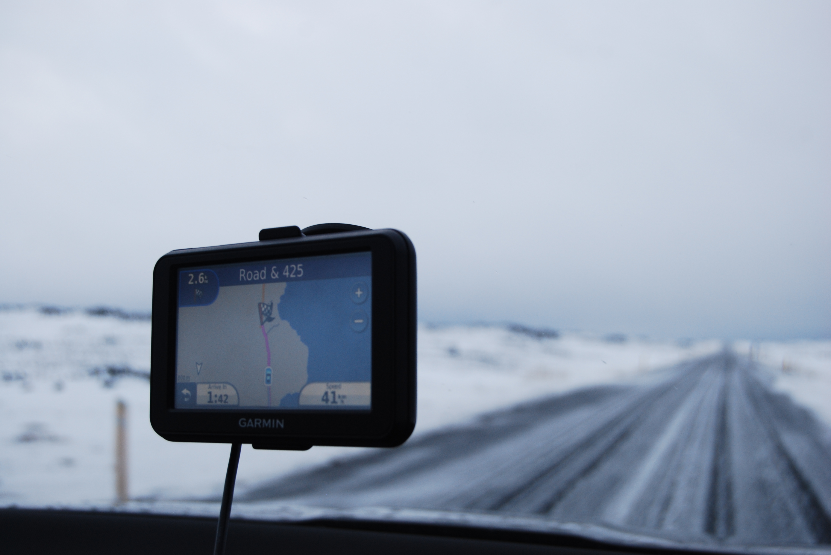

Slide 66
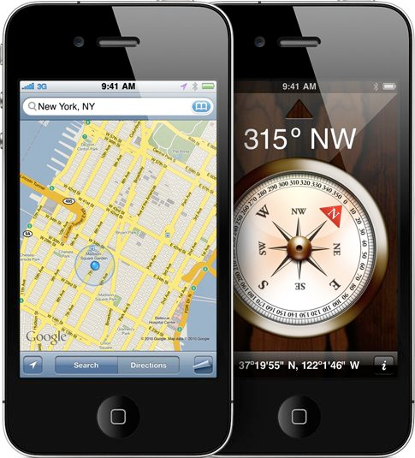

Slide 67
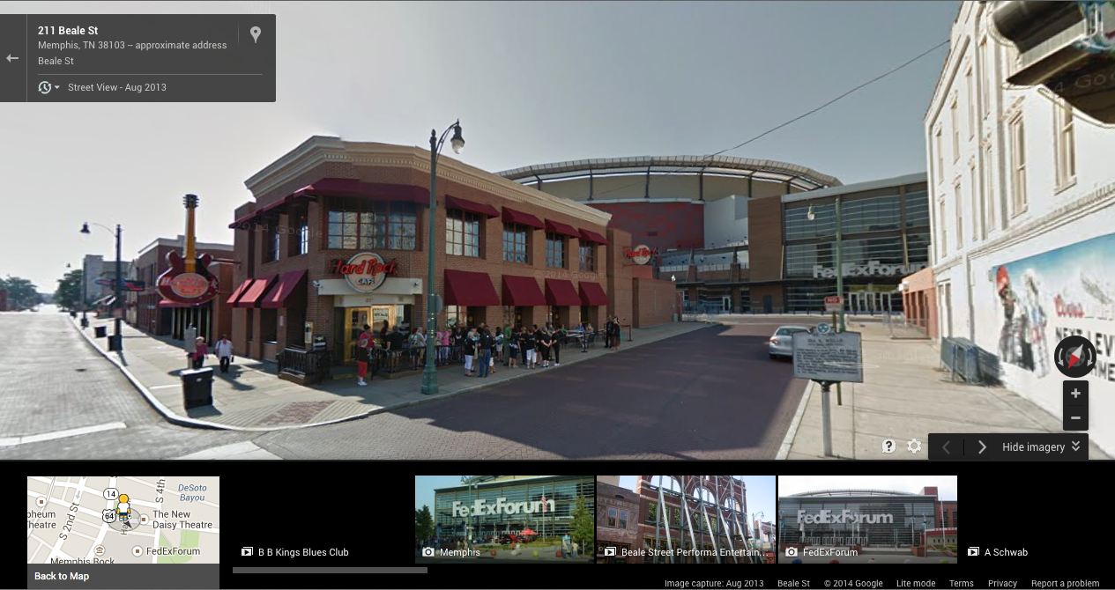
Relative Location
The Hard Rock Cafe is located in front of the FedEx Forum.

Slide 68
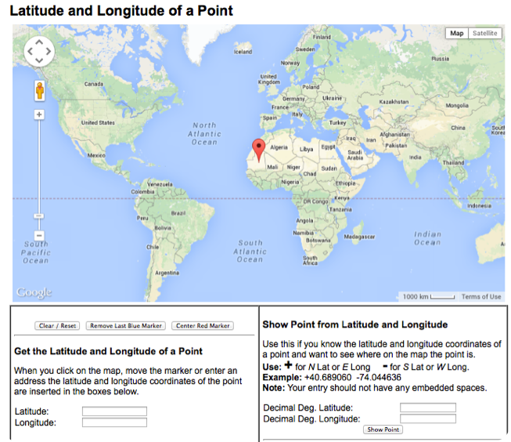
RESOURCE
http://itouchmap.com/latlong.html

Slide 69
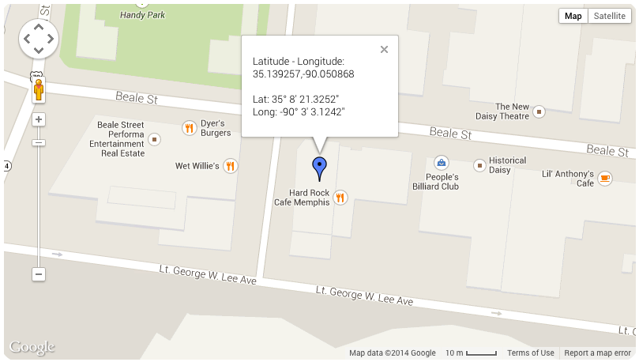
Absolute Location
The Hard Rock Cafe is located
at 35ºN and 90ºW .

Slide 70
The Hard Rock Cafe is located
at 35º NORTH of the Equator and 90º WEST of the Prime Meridian.

Slide 71
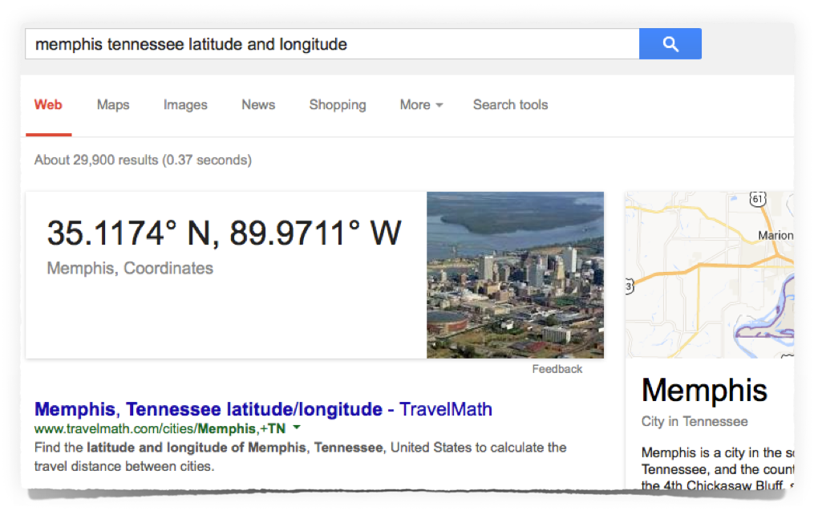

Slide 72
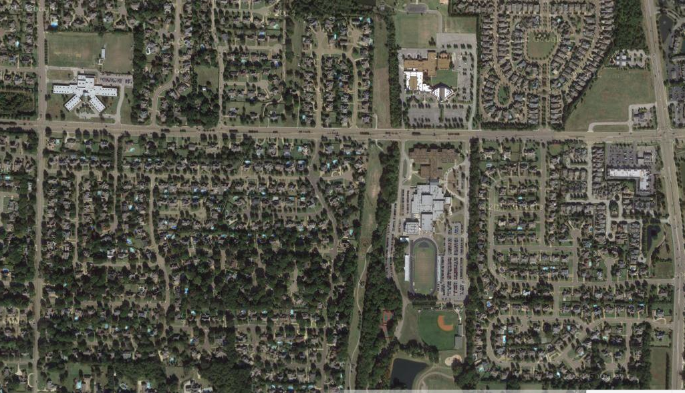
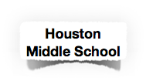
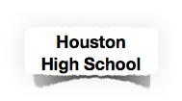
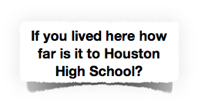
Germantown
Tennessee

Slide 73
Germantown
Tennessee

Slide 74
Germantown
Tennessee

Slide 75
Germantown
Tennessee

Slide 76
Germantown
Tennessee

Slide 79
6
Use different types of maps (political, physical, population, resource, polar projection, and climate) and globe skills to interpret geographic information from a graph or chart.

Slide 80
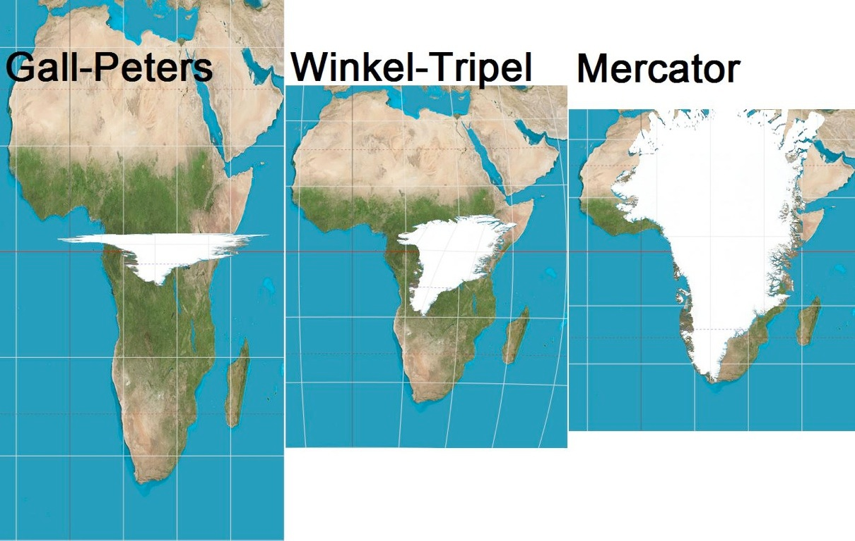
Physical / Cultural:
Misconceptions / Bigger being better.
Map Projections | Round to Flat | Size, Shape, and Distance
 | Shearing, Tearing, and Compression | Relative Location Changes

Slide 81
Map Projections
-projecting the earth onto a flat piece of paper
-classes: conic, cylindrical, planar, oval (false cylindrical)
-tearing, shearing, compression
-distortion increases from the point of contact
-distortions: shape, relative size (area), distance, direction, proximity

Slide 83
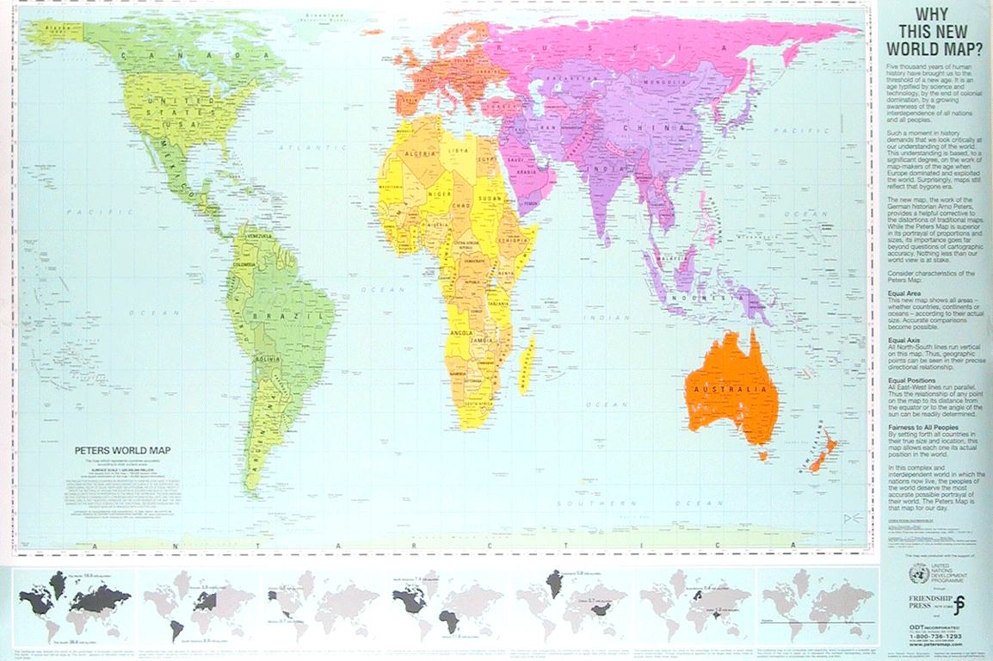

Slide 91
http://www.maphill.com/united-states/maps/physical-map/

Slide 100
7
Explain how specific images contribute to and clarify geographical information
(diagrams, landforms, satellite photos, GPS system, maps, and charts).

Slide 101
RESOURCE

Slide 104
Glaciers
a huge mass of ice which moves slowly over land.
Two Types of Glaciers
1. Sheet (Continental): covering very large areas of land, form broad domes of ice.
Greenland and Antarcrica
2. Alpine: found on mountainsides; move downward through the valley.
Rockies, Alps, Himalayas, Andes

Slide 120
What is meant by a retreating glacier?
Glaciers only move in one direction.
The rate of melting is greater than the forward movement.

